Slide 1
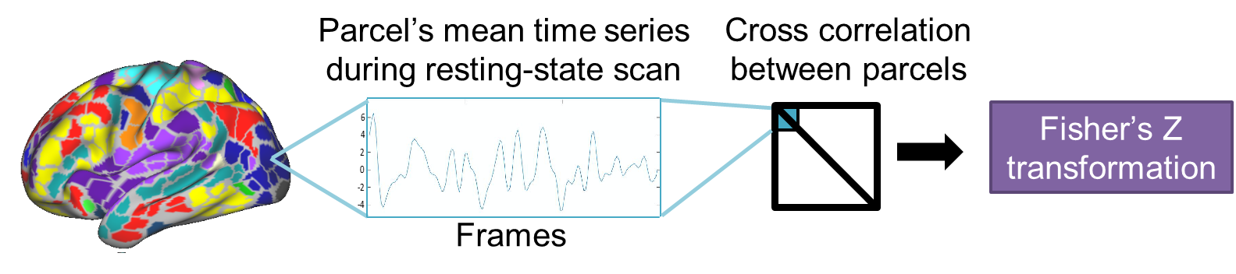

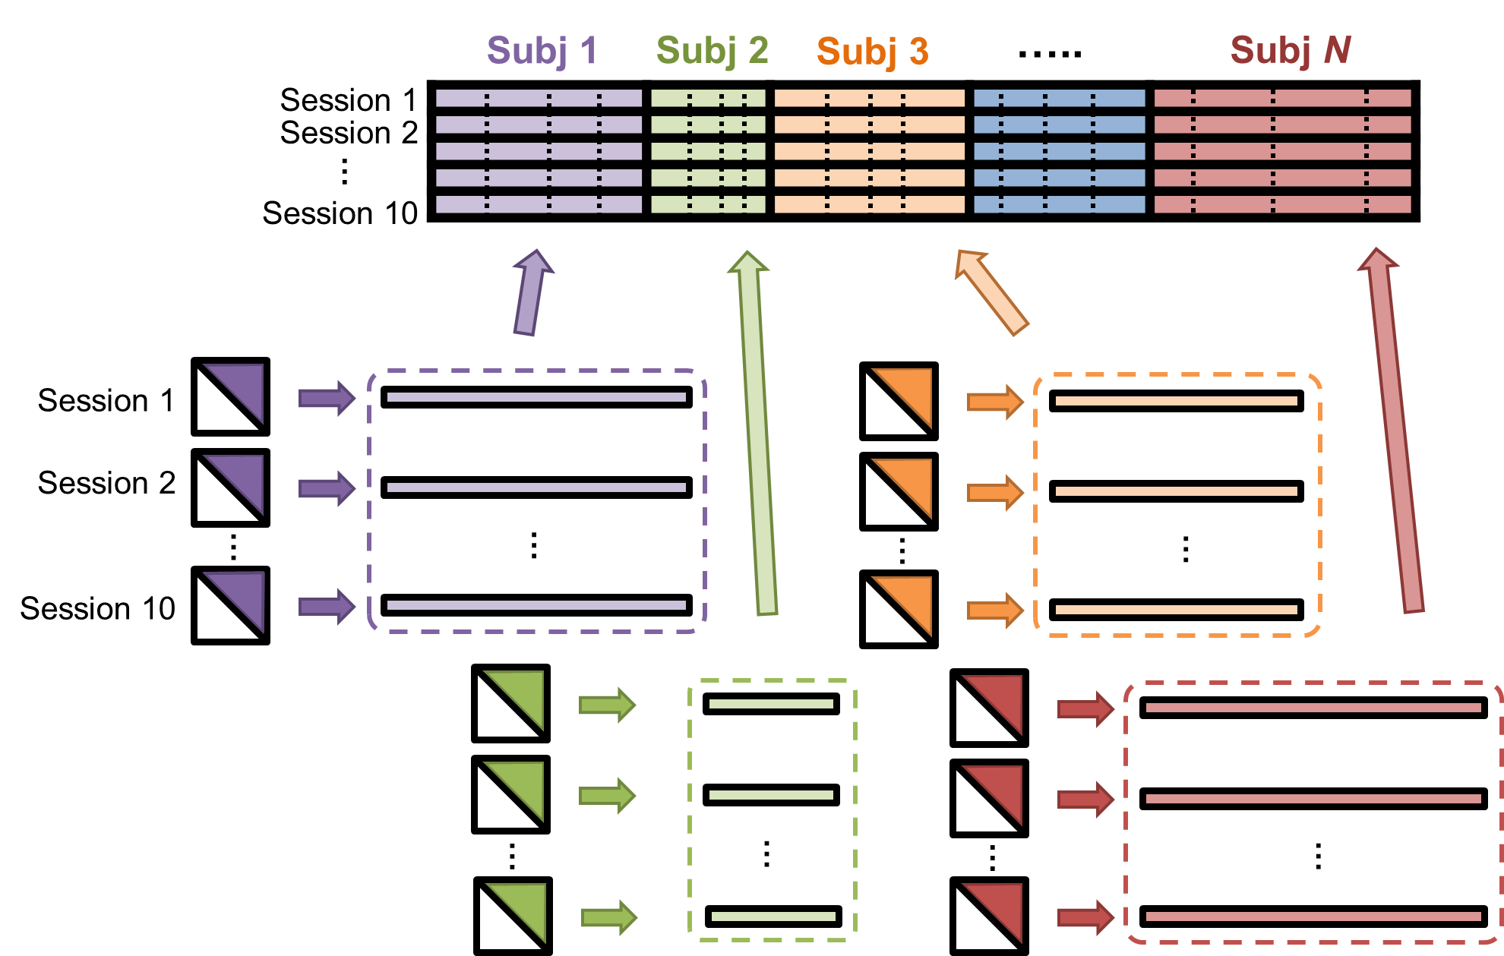
Divide each between/within edge block by its first singular value
Divide each subject block by its subsequently derived first singular value
PCA

Slide 2
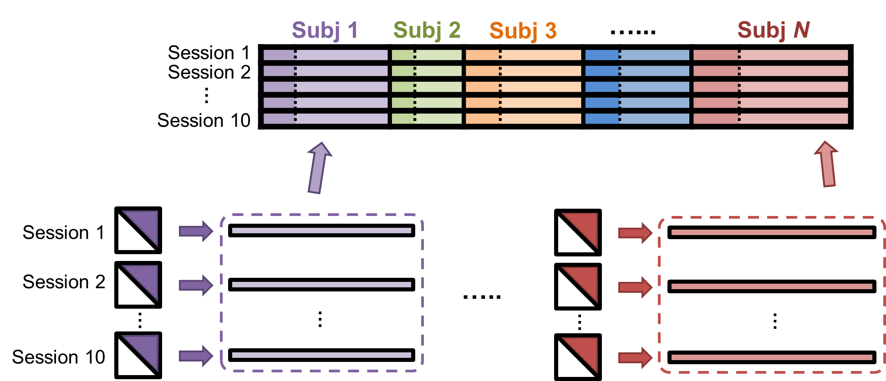
A
Fisher’s Z-transformed
Parcel’s mean time series during resting-state scan
Cross correlation between parcels
B
C
PCA
➗ 𝛿₁
Normalize subject block by its first singular value, and then…
➗ 𝛿’₁
➗ 𝛿’₁
Normalize between/within edge block by its first singular value

