Slide 1
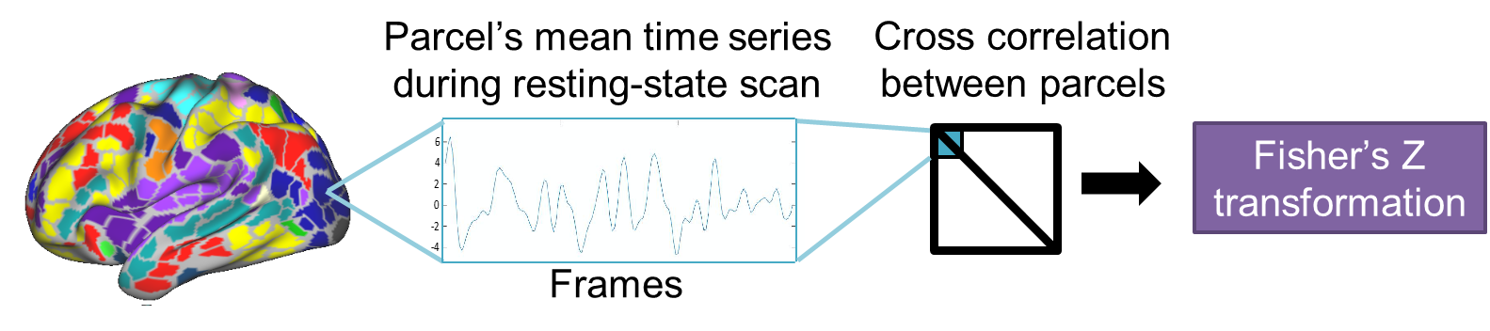
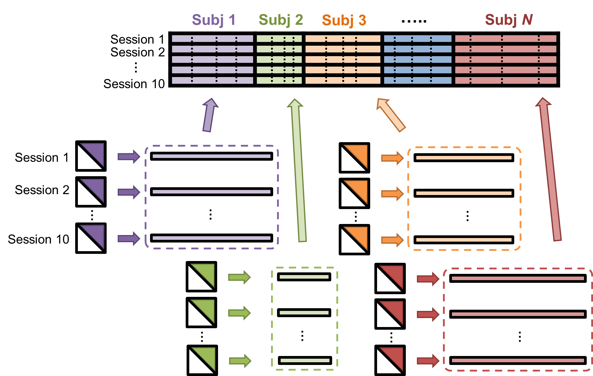
Divide each between/within edge block by its first singular value
Divide each subject block by its subsequently derived first singular value
PCA

