Slide 1
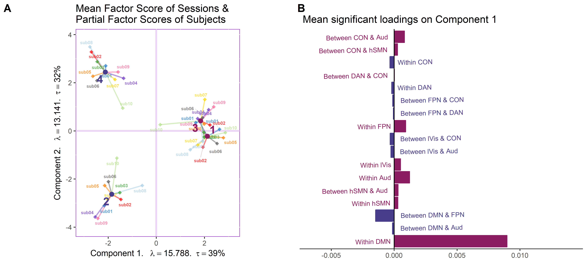
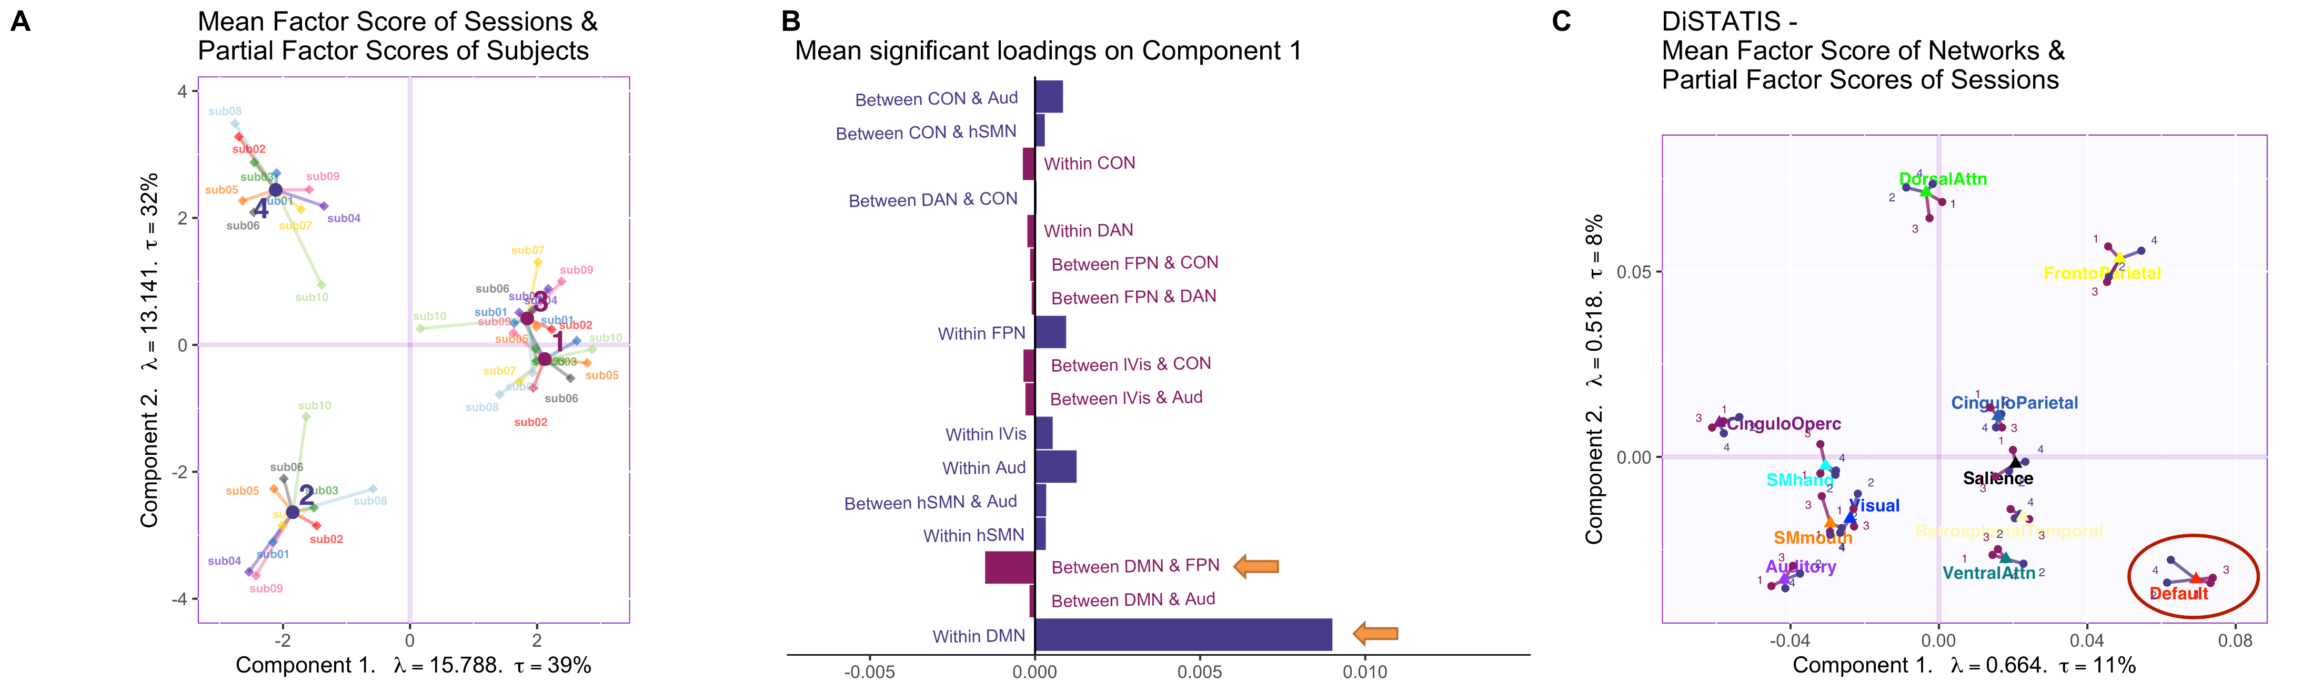
Fig. 2 – HMFA detects the simulated session effect and identifies the types of edges simulated. (A) The biplot shows the row factor scores from the hierarchical multiple factor analysis (HMFA). The first component distinguishes the simulated (blue dots; Sessions 2 and 4) and non-simulated (purple dots; Sessions 1 and 3) sessions. The small diamond dots that extend from each factor score are the partial factor scores which represent how each session is viewed from the perspectives of different tables (i.e., different participants). (B) The barplot indicates the mean loadings of all edges that significantly contribute to the first component and drive the session effect. The orange arrows point towards the simulated edges (i.e., the functional connectivity within the default mode network (DMN) as well as the functional connectivity between the DMN and the fronto-parietal network (FPN)). (C) A comparison analysis was conducted using DiSTATIS with the parcellation based on a shared template, and this biplot shows the mean factor scores of all networks from DiSTATIS (colored triangle dots). The four round dots that extend from each network factor score are the partial factor scores which represent how each network is viewed from the perspectives of different sessions. Only the partial factor scores of the DMN distinguish the simulated (blue dots) and the non-simulated (purple dots) sessions.

