Slide 1
RestingInPCA

Slide 2
Goals of the project
To analyze resting-state data and allow different participants to have different numbers of regions/network
Keep individual difference
Analyze resting state data in a local, instead of an atlas, space

Slide 3
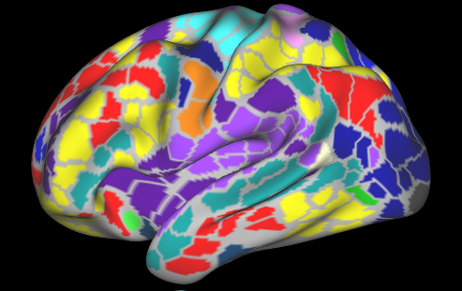
Extracting correlation matrices from data
Parcel’s mean time series during resting-state scan
Cross correlation between parcels
Frames

Slide 4
Other options to analyze resting-state data
Seed-based or ICA analysis comparing the spatial spread of sub-networks or their mean connectivity
Network properties of entire network or sub-networks (e.g., modularity, centrality)
The number of sub-networks (i.e., functional systems) means lots of comparisons have to be made if someone is exploring which sub-network is driving the differences between subjects/sessions.
Existing multivariate methods require the matrices across subjects to be the same dimension (e.g., DISTATIS).
Recent work in resting-state analysis have started deriving subject-specific parcellations, resulting in different matrix dimensions across subjects.

Slide 5
Simattack stuff
If we have space we can add it in?

Slide 6
Solution
Instead of analyzing the correlation matrix, we reshape the upper triangle of this square matrix into a vector and stack the vectors corresponding to different correlation matrix that we want to analyze together
Subj 1
…….
Subj 1
…….

Slide 7
Solution
Instead of analyzing the correlation matrix, we reshape the upper triangle of this square matrix into a vector and stack the vectors corresponding to different correlation matrix that we want to analyze together
Subj 1
Subj 2
…….
Subj 2
…….

Slide 8
Solution
Instead of analyzing the correlation matrix, we reshape the upper triangle of this square matrix into a vector and stack the vectors corresponding to different correlation matrix that we want to analyze together
Subj 1
Subj 2
…...
Subj N
…….
Subj N
…….

Slide 9
Solution
Instead of analyzing the correlation matrix, we reshape the upper triangle of this square matrix into a vector and stack the vectors corresponding to different correlation matrix that we want to analyze together
SVD

Slide 10
Question
What do we to before the SVD?
SVD
?

Slide 11
All possible steps
Double-centering correlation matrices
Centering each vector before stacking them
Normalizing each vector before stacking them
Center the columns
Normalizing the columns (SS =1)
MFA-normalize by subjects
MFA-normalize by edges of networks
Hierarchical MFA-normalize by networks then by subjects

Slide 12
All possible steps
Double-centering correlation matrices
Centering each vector before stacking them
Normalizing each vector before stacking them
Center the columns
Normalizing the columns (SS =1)
MFA-normalize by subjects
MFA-normalize by networks
Hierarchical MFA-normalize by networks then by subjects
Use STATIS (in addition to MFA) for the last three options

Slide 13
Our thoughts
We should make these steps optional based on the main research question of each project.

Slide 14
Other questions/notes
How do we know if these results are giving us something that is really meaningful?
Use common networks to generate the component space and project the rare networks as supplementary elements

Slide 15
Notes for correlation matrix
The correlations are Fisher’s Z-transformed
All negative correlations are removed

