Slide 1
AI-safety communication skills
Make careful AI-safety communication the easy default.
comm-ai-safety turns technical sources into fast, reviewable public communication—then keeps human approval and source fidelity as publication gates.

Slide 2
Portable skills make careful communication easier to repeat.
Bring your own harness
Use the AI or agent harness you already trust.
The package brings a repeatable communication workflow with it.
Package the judgment
Workflows, principles, references, and templates travel together.
Move faster with gates
Draft early; verify evidence and get human approval before publication.
Keep one evidence spine
Public, press, and audit outputs share the same claim boundaries.
2

Slide 3
The failure happens when evidence crosses audiences.
Technical result
A result is bounded by model, task, prompting, baseline, uncertainty, and caveats.
Public artifact
A release, post, visual, or demo must stay clear, useful, and faithful under compression.
Avoidable distortion
Capability becomes propensity; a model-only score becomes misuse uplift or deployment evidence; a demo becomes a misleading proxy.
source
translation
reader belief
3

Slide 4
A useful draft comes early; publication checks stay strict.
1. Frame and draft
Name one audience and goal. Lead with one takeaway, up to two supporting claims, and a visible working-draft label.
2. Verify and approve
Check every load-bearing claim against primary sources. Then a responsible human approves the core evidence map.
3. Test and audit
Use reader teach-back, rapid checks during drafting, and a full, proportionate audit before publication.
working draft
verified evidence
publication decision
4

Slide 5
Three skills share one evidence-preserving handoff.
comm-public
Fast explainers, FAQs, social copy, visuals, and safer demo briefs for one named audience.
Audience copy stays separate from evidence and workflow notes.
comm-press
Working releases, briefs, pitches, and journalist FAQs with independent context, quote approval, and rights checks.
comm-audit
Rapid core-claim checks during drafting; full publication or corpus audits when risk and reuse justify them.
One enforceable rule
Drafts can arrive early. “Audited,” “final,” and “publishable” wait for human approval and resolved material findings.
5

Slide 6
Future plan
Expand to new audiences with human experts.
Next: add dedicated skills for policymakers and grantors; co-design and test them with human experts in communication, policy, funding, accessibility, and safety.

Slide 7
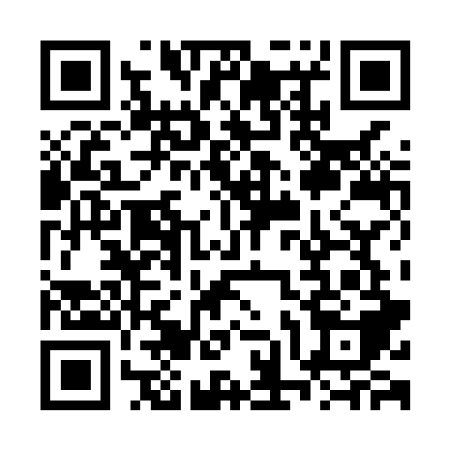
Ready to use
Install the skills. Start with the worked demo. Make a public claim easier to verify.
mychiffonn/comm-ai-safety
Fast draft, proportionate audit
Worked demo included

