Slide 1
The UF DataStory Initiative

Slide 2
Agenda
Why do we need a new approach to data education?
What is a DataStory and the DataStory Method of Instruction?
How will we know if the DataStory Learning Experience is effective?

Slide 3
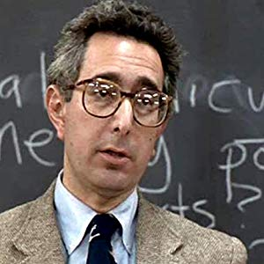
Packaging of the Content

Slide 4

Inadequate Technical Foundation

