Slide 1
The UF DataStory Initiative

Slide 2
Agenda
A note of appreciation to our sponsors…
Why do we need a new approach to data education?
What is a DataStory and the DataStory method of instruction?
How will we determine if this new approach works?

Slide 3
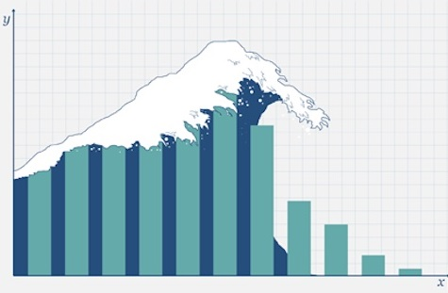
Our students face a data deluge…

Slide 4
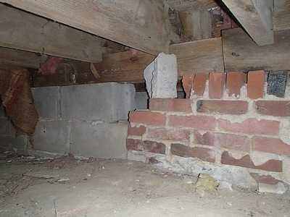
…but what does their foundation look like?

Slide 5

And, how are we teaching them?

Slide 6
So what is a DataStory?
What do you get when you cross a group of comic book characters with a dataset, basic statistics, and open-science tools? You get a data story.
A data story – as its name suggests – is narrative about a data set with the primary objective of educating even as it engages the student in a journey through its narrative arc.

Slide 7


Current Production Schedule

Slide 8
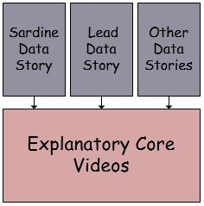
The Explanatory Core

