Slide 1
The UF DataStory Initiative

Slide 2
Agenda
Why do we need a new approach to data education?
What is a DataStory and the DataStory method of instruction?
How will we determine if this new approach works?

Slide 3

The Data Deluge

Slide 4
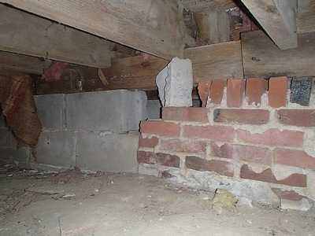
Foundation Issues

Slide 5

Pedagogical Issues

Slide 6
What is a DataStory?
What do you get when you cross a group of comic book characters with a dataset, basic statistics, and open-science tools? You get a data story. A data story – as its name suggests – is narrative about a data set with the primary objective of educating even as it engages the student by way of a story arc or narrative.

Slide 7
