Slide 1

The Unique Value Proposition
Notes:
The UVP is the starting point…

Slide 2
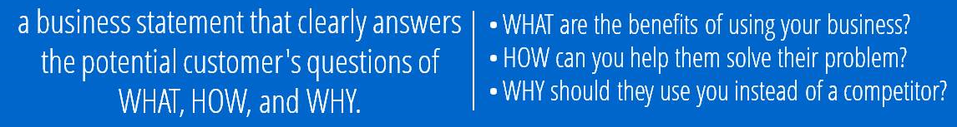
The Unique Value Proposition
Notes:
A unique value proposition (UVP) is a clear (concise) statement that describes the benefit you offer, how you solve your client’s needs and what distinguishes you from the competition.

Slide 3


Notes:
Each of us is a brand. Marston, then, is a family of brands. Obviously, our individual brands ought to support and magnify the library’s overarching brand. But that’s hard to do if the library lacks a clearly defined brand.
Think of the library as a professional service firm – a law firm. What matters to a PSF? Billable hours…

Slide 4
I instruct scientists (both aspiring and experienced) in the art of creating research systems that then enable them to tell amazing data stories. In each educational activity, I seek to model data science best-practices to achieve enduring reproducibility.
Key points:
I’m about integration, designing research systems that are greater than the sum of their parts.
I’m about reusability, reproducibility, data storytelling, and data science best practices.
Notes:
Every word in my UVP is important. Defining one’s value is HARD.
So what are the steps to arriving at a UVP?

Slide 5

Define your Market
Notes:
Also known as segmentation…
Focus on a single segment of the market. For example, my focus is PI’s and undergraduates.
LISTEN, LISTEN... Identify the problem / pain. Do a thorough job defining/understanding the problem.
Identify niches where there’s no competition.
Resist the urge to build before understanding. (Field of Dreams)

Slide 6

Identify your Expertise

Slide 7

Check Alignment
Notes:
Alignment happens at two levels.
1. Your UVP ought to align with what the university deems important. So what does UF value?
2. Only accept client’s whose problem aligns with your UVP.
3. Decide where you want to play ball and where you want to lead – sometimes an organization needs to align to your values.

Slide 8
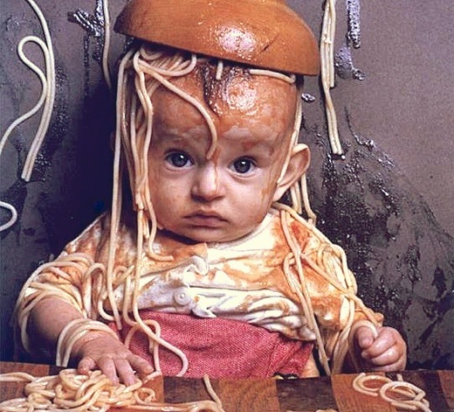
Define Value (First)
Everything Else (Second)
Notes:
Many organizations start with the channel – the medium through which they communicate. Everybody’s doing social media, we need to be doing something too!

Slide 9
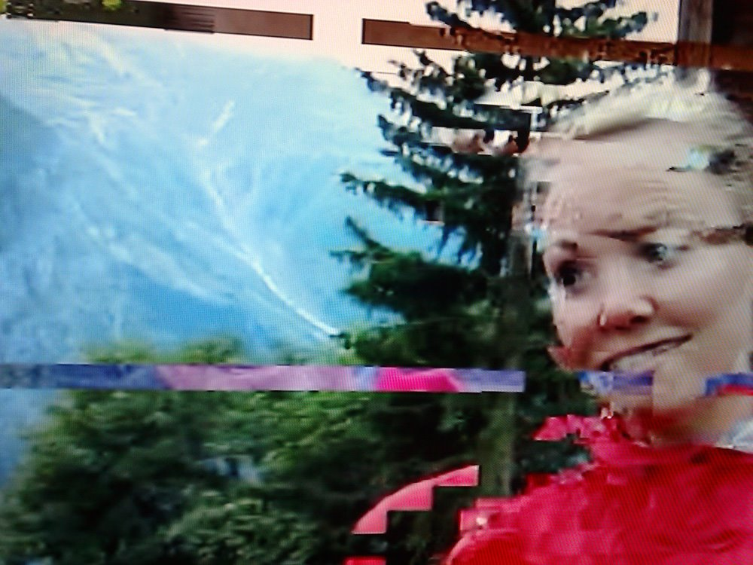
Message or Noise?
Notes:
If you flip the order -- as presented in the previous slide -- your chances of developing clear, high-impact messages drops dramatically. You become nothing more than noise in the competitive landscape.

Slide 10
Questions?

