Slide 1
The DataStory Initiative
Rethinking Data Education in the Precision Health Sciences

Slide 2



Note of Appreciation to our Sponsors

Slide 3
Agenda
Why do we need a new approach to data education?
What is a DataStory and the DataStory method of instruction?
Briefly discuss initial research objectives.

Slide 4
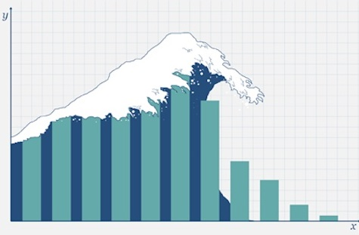
Our students face a data deluge…

Slide 5
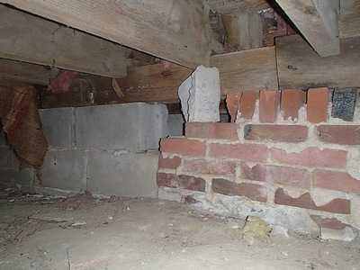
…but their technical foundation often looks like this.

Slide 6

And, our teaching methods aren’t much better.

Slide 7
So what is a DataStory?
What do you get when you cross a group of comic book characters with a dataset, basic statistics, and open-science tools? You get a data story.
A data story – as its name suggests – is narrative about a data set with the primary objective of educating even as it engages the student in a journey through its narrative arc.

Slide 8
The Data Story Characters

Slide 9


Data Stories Slated for Production

Slide 10
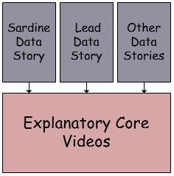
The Explanatory Core

Slide 11
Initial Research Objectives
Our initial research will assess the pedagogical effectiveness of Data Stories, specifically their ability to:
Arouse Emotion
Motivate
Engage

Slide 12


