Slide 1
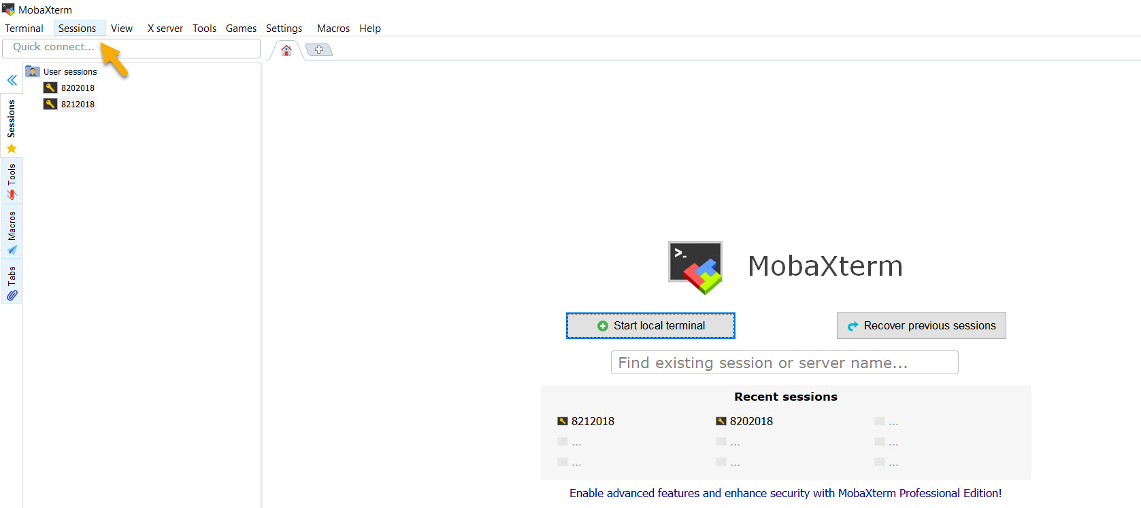
Click on “sessions” drop down

Slide 2
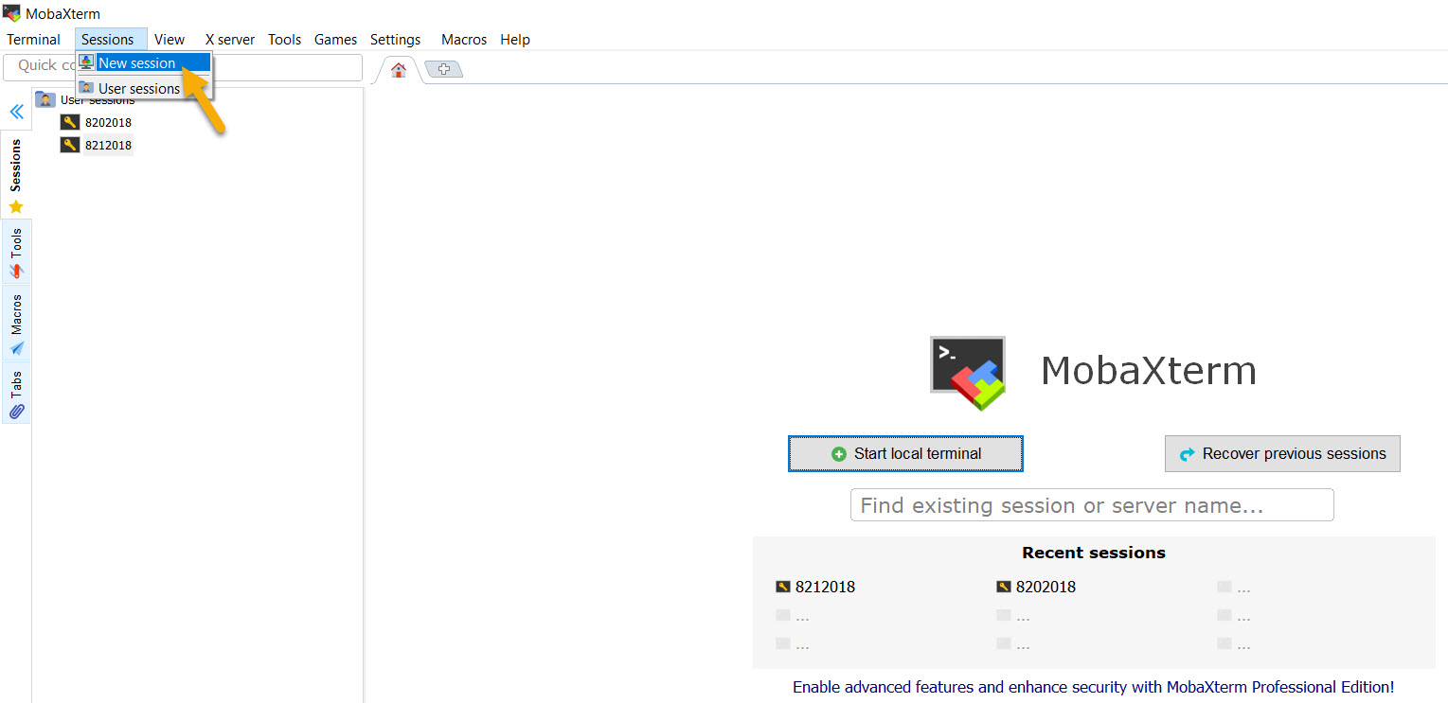
Select “new session”

Slide 3
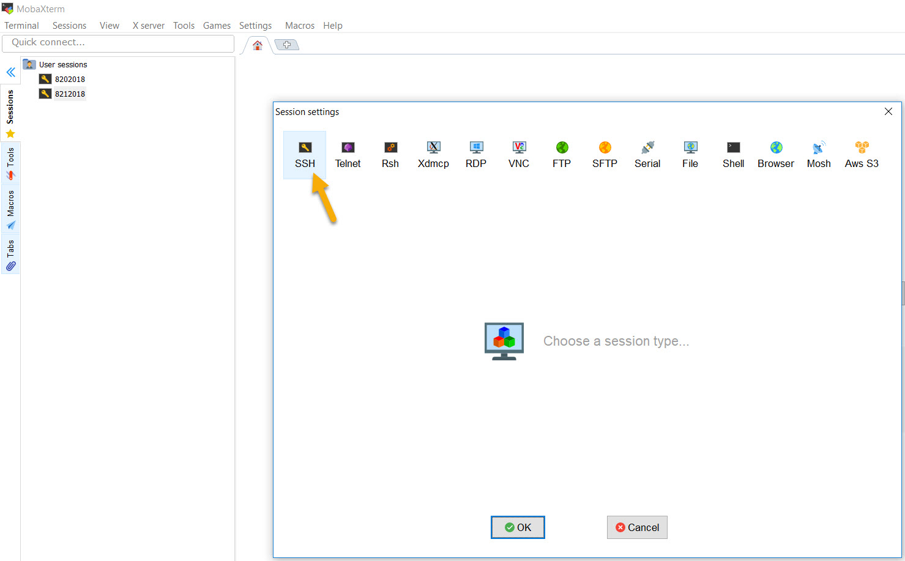
Select SSH

Slide 4
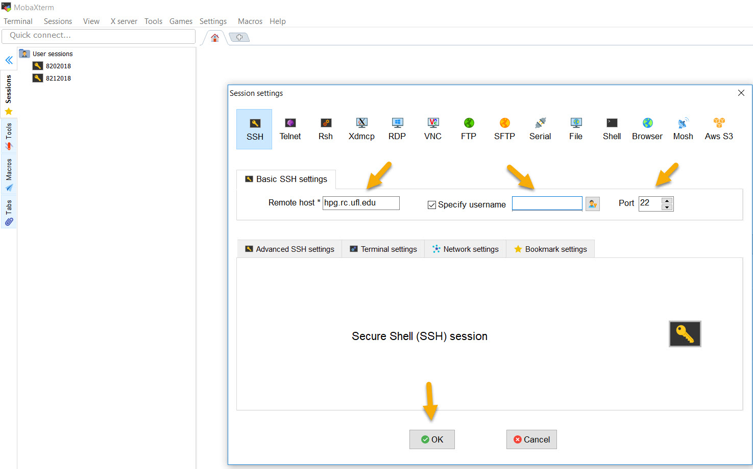
In the remote host box enter “hpg.rc.ufl.edu”
Check the specify username box and enter your Gatorlink ID
Click OK and you will prompted to enter your Gatorlink password
Be sure to keep the port as ‘22’

