Slide 1


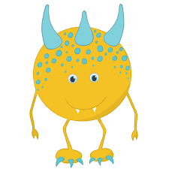

SQL & Research Systems
Taming the Complexity Monsters

Slide 2
Why SQL & Relational Databases?
Notes:
I’m going to start this short presentation by asking a simple question. Why should we even consider SQL and relational database systems? Isn’t this a dated (30+ year old) technology, developed in the 1970’s?
Obviously – on small projects – you may not need to consider a relational database and SQL as you can store all of your data in a single .csv or Excel file. But sometimes the number of datasets increases and/or the volume of data -- once a trickle -- now becomes a raging river. When this happens, you need tools (SQL & RDBMS) to tame the Complexity Monster.
Okay -- I get it. Many of you have never met the Complexity Monster. Or maybe you still view him as a cute and cuddly creature – easily tamed and mastered. Maybe like the image here on the screen. But trust me, complexity can quickly go from cute to ugly, and the information provided in this session will be useful when you encounter this beast. Because when things do get ugly, you’re going to need a research SYSTEM.

Slide 3

Scale, Complexity, and Systems
Notes:
Now when a research project is small, you can move directly from data to analysis. You can begin writing R or Python code right away. Of course, this assumes that your dataset is simple and unrelated to any other data. But as things become more complex, you must shift your focus. Now the task is to design a research system that supports a specific line of inquiry.
Instead of discussing the system, we usually start with the tools. We learn about each of the tools in isolation. A system perspective, on the other hand, helps you see how the tools work together. My goal here is to put the pieces together so you see the bigger picture.
As pictured here, a simple system is much different from a complex one. So what are the basic elements of a research system?

Slide 4
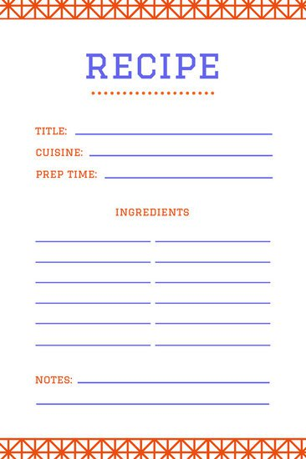
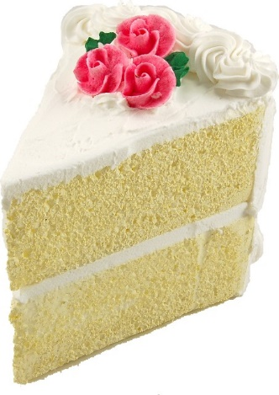
The Cake Metaphor
Icing / Tools
Cake / Data
Recipe / Version Control
Notes:
In response to that last question, I offer you the cake metaphor. Let’s take a quick look at each component…
Version control allows you to safely modify and enhance the cake’s recipe – the code and design documents that define the ingredients in your research cake. The cake is the data and RDBMS that allows you to manage it. The icing is the analytical tools (R, Python, Tableau, Shell Scripts) used to visualize and understand your data.
Best practice suggests that you keep your data separate from the analysis.

Slide 5
The Design Process: A Recipe for Success
Version Control
Requirements
Logical Model
Physical Model
Workflows
App Prototype
Development
Notes:
With our cake metaphor in mind, let’s look briefly at the relational design process. The requirements gathering part of this process creates design documents that then become a part of your research system recipe. The SQL Ecology lesson mentions design in passing, but this is IMPORTANT, particularly for larger systems. Indeed, I’m presently taking a client (Bill Pine) through this process.

Slide 6

Why the Design Process is Important
Notes:
So why bother with a formal design process?
Well – like concrete – code cures quickly, making modifications expensive after it has set. Keep in mind that it is always cheaper and easier to fix a flaw at the design stage rather than after the system has been partially or fully developed. All that to say, you need to understand the problem before developing a solution.
Dr. Clay Shepherd – one of my mentors – used to say, “The first to code is always the last to finish…” This is true because refactoring code (busting up the concrete after it has set) is difficult and time consuming.

Slide 7
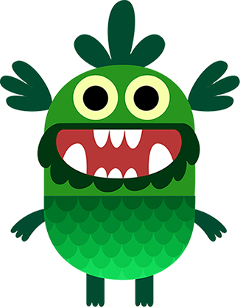
Summary
When you encounter the “Complexity Monster”…
System before Analysis
A system (cake) is more than the sum of its ingredients
Data before Tools
Employ a RDBMS when you have multiple related datasets
Scrub data once and store (Scrub & Store)
Design before Code
Understand the problem first
Implement and follow a design process

Slide 8
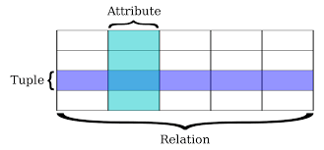
Relational Database Definition
(Field / Column)
(Record)
(Entity / Table)
Notes:
A relational database stores data in relations made up of records with fields. In this picture, I provide both the formal mathematical terminology as well as the colloquial terms.
The relations are usually represented as tables; each record is usually shown as a row, and the fields as columns. In most cases, each record will have a unique identifier, called a key, which is stored as one of its fields. Records may also contain keys that refer to records in other tables, which enables us to combine information from two or more sources.

Slide 9
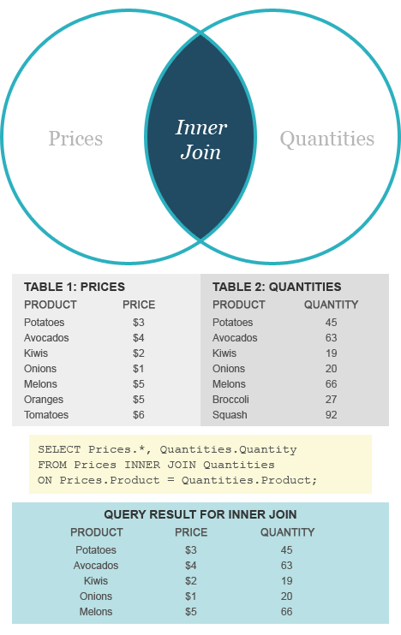
http://www.diffen.com/difference/Inner_Join_vs_Outer_Join

Slide 10
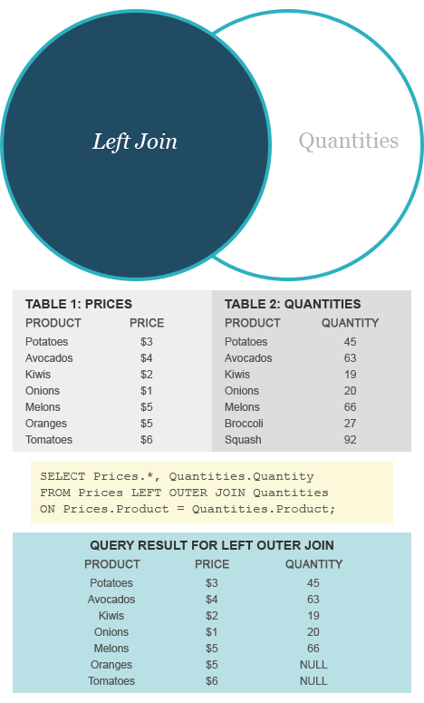
http://www.diffen.com/difference/Inner_Join_vs_Outer_Join

Slide 11
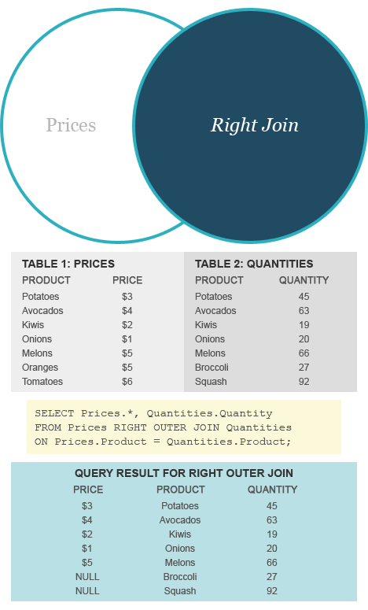
http://www.diffen.com/difference/Inner_Join_vs_Outer_Join

Slide 12
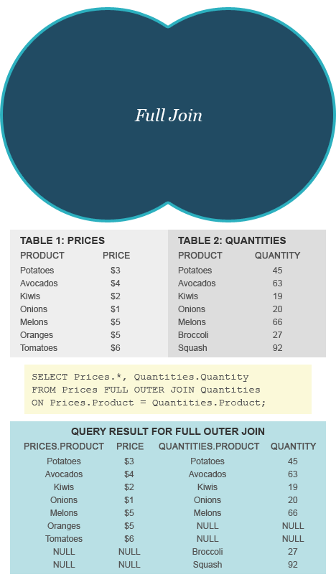
http://www.diffen.com/difference/Inner_Join_vs_Outer_Join

