Slide 1

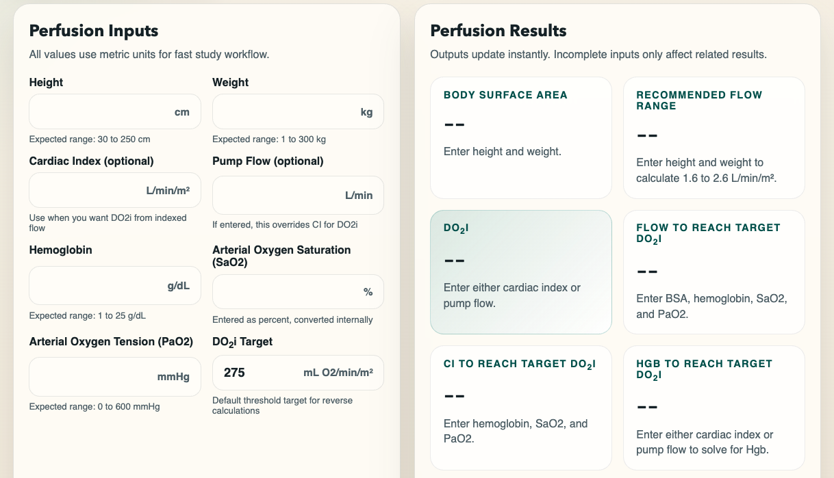
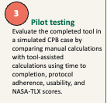
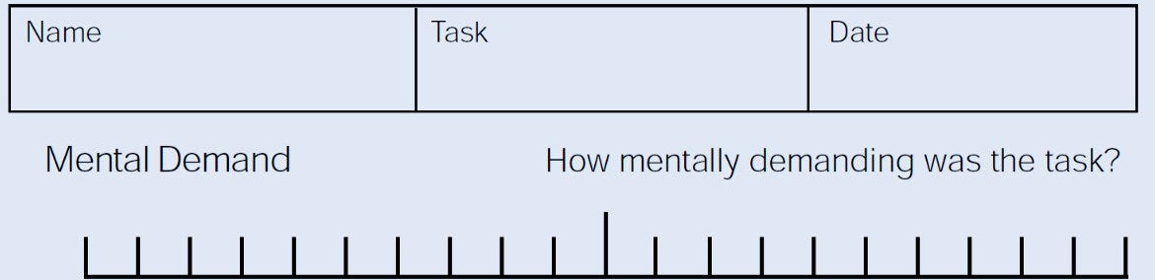
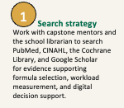
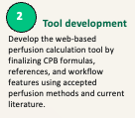
Development and Evaluation of a Web-Based CPB Perfusion Tool for Education and Simulation
Sydney Lias
Emory University - CVP 587
Clinical Problem / Opportunity
Project Design / Methods
Clinical Problem
Cardiopulmonary bypass requires rapid patient-specific calculations while perfusionists monitor circuit function, oxygen delivery, hemodilution, anticoagulation, and team workflow.
Opportunity
Perfusion students often rely on manual or separate calculators during simulation, which can increase cognitive workload and interrupt learning flow.
Goal
Develop a mobile-friendly web-based CPB Perfusion Tool that integrates perfusion, prime planning, and anticoagulation support into one educational workflow.
Conclusion
Design: Evidence-based practice / quality improvement project using a mixed methods evaluation.
Final product: Static web-based CPB tool with perfusion calculator, prime planner, and anticoagulation support modules.
Participants: Perfusion students, instructors, preceptors, and practicing perfusionists when available.
Data collection: Accuracy checklist, task completion time, System Usability Scale, NASA-TLX or brief workload rating, confidence rating, and open-ended feedback.
Timeline: July-November 2026; recruitment and testing occur after IRB/program approval.
The proposed CPB Perfusion Tool addresses an important educational opportunity in cardiovascular perfusion practice. By integrating common CPB calculations into one mobile-friendly workflow, the tool may improve calculation consistency, reduce learner cognitive burden, and strengthen confidence during simulation.
This educational tool does not replace institutional protocols or clinical judgment.
Limitations / Mitigation
Introduction & Background
Limits: educational-only use, institutional protocol variation, formula error risk, small sample size, and mobile usability constraints.
Mitigation: clear disclaimers, visible assumptions, referenced formulas, stakeholder review, testing, and iterative feedback.
CPB is a high-acuity workflow requiring accurate calculations for BSA, pump flow, DO2i, prime dilution, hematocrit, heparin, and protamine.
Perfusion tools have evolved from paper calculations and manual records to electronic perfusion records, simulation systems, online calculators, and emerging decision-support tools.
Similar calculators exist, but many are isolated, commercial, or documentation-focused rather than student-centered, mobile-friendly workflow tools.
Knowledge gap: Limited evidence exists on integrated web-based CPB calculation tools designed specifically for perfusion education and simulation.
Selected References
American Society of ExtraCorporeal Technology. (2023). AmSECT standards and guidelines for perfusion practice.
Babar, Z. U. D., Max, S. A., Martina, B. G., Rosalia, R. A., Peek, J. J., van Dijk, A., Sadeghi, A. H., & Mahtab, E. A. F. (2023). Virtual reality simulation as a training tool for perfusionists in extracorporeal circulation. JTCVS Techniques, 21, 135-148. https://doi.org/10.1016/j.xjtc.2023.06.004
Gao, P., Liu, J., Zhang, P., Bai, L., Jin, Y., & Li, Y. (2023). Goal-directed perfusion for reducing acute kidney injury in cardiac surgery: A systematic review and meta-analysis. Perfusion, 38(3), 591-599. https://doi.org/10.1177/02676591211073783
Hyzy, M., Bond, R., Mulvenna, M., Bai, L., Dix, A., Leigh, S., & Hunt, S. (2022). System Usability Scale benchmarking for digital health apps. JMIR mHealth and uHealth, 10(8), e37290. https://doi.org/10.2196/37290
Mukaida, H., Matsushita, S., Yamamoto, T., Minami, Y., Sato, G., Asai, T., & Amano, A. (2023). Oxygen delivery-guided perfusion for the prevention of acute kidney injury. The Journal of Thoracic and Cardiovascular Surgery, 165(2), 750-760.e5. https://doi.org/10.1016/j.jtcvs.2021.03.032
Ranucci, M., Johnson, I., Willcox, T., et al. (2018). Goal-directed perfusion to reduce acute kidney injury. The Journal of Thoracic and Cardiovascular Surgery, 156(5), 1918-1927.e2. https://doi.org/10.1016/j.jtcvs.2018.04.045
Said, S., Gozdzik, M., Roche, T. R., Braun, J., Rossler, J., Kaserer, A., Spahn, D. R., Nothiger, C. B., & Tscholl, D. W. (2020). Validation of the Raw NASA-TLX questionnaire. Journal of Medical Internet Research, 22(9), e19472. https://doi.org/10.2196/19472
Searles, B. E., Riley, J. B., Darling, E. M., & Wiles, J. R. (2024). Simulated cardiopulmonary bypass. Advances in Simulation, 9, Article 1. https://doi.org/10.1186/s41077-023-00269-w
Shore-Lesserson, L., Baker, R. A., Ferraris, V. A., et al. (2018). Clinical practice guidelines: Anticoagulation during cardiopulmonary bypass. The Annals of Thoracic Surgery, 105(2), 650-662. https://doi.org/10.1016/j.athoracsur.2017.09.061
Tibi, P., McClure, R. S., Huang, J., et al. (2021). STS/SCA/AmSECT/SABM update to the clinical practice guidelines on patient blood management. The Annals of Thoracic Surgery, 112(3), 981-1004. https://doi.org/10.1016/j.athoracsur.2021.03.033
Synthesis of Literature
Key themes from the literature:
Standardization and safety: AmSECT and STS/SCA/AmSECT guidelines support transparent assumptions, protocol awareness, and anticoagulation safety.
Goal-directed perfusion: RCTs and meta-analyses support the clinical importance of oxygen delivery, flow, hemoglobin, and AKI-risk education.
Simulation education: CPB and extracorporeal simulation studies support technology-enhanced learning before patient care.
Usability and workload: SUS and NASA-TLX literature support measuring usability, cognitive load, and learner experience.
PICOT / Research Question
In perfusion students participating in CPB education or simulation, does use of a web-based CPB Perfusion Tool improve calculation accuracy, workflow efficiency, usability, cognitive workload, and learner confidence compared with manual calculation methods?
Appraisal of Literature
Strengths: Evidence includes RCTs, systematic review/meta-analysis, professional guidelines, simulation validation studies, and usability/workload measurement research.
Weaknesses: Much of the evidence is not specific to web-based perfusion calculators. Several studies focus on clinical outcomes, simulation models, or general digital health usability rather than this exact intervention.
Implication: Local usability testing and stakeholder review are needed before broader educational adoption.

