Slide 1
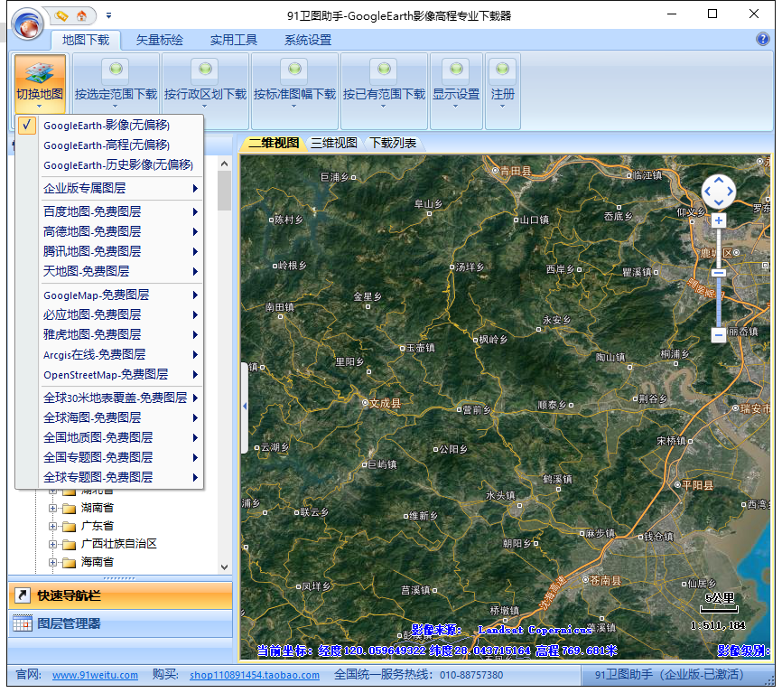
EFLA proto Layout
① 选定影像来源。
② 选定需要预测的类型：单要素 - 全要素。
③ 预测并显示结果。
RESTful API
后端
前端
Fingerprint generate and match
API
POST - img
Param - target class
Command - Predict
Fetch result asynchronously
Result：JSON
Model DB management
Model DB
Adaptive Train/Predict
IPM
building
water
green land
road
Sample DB
Sample DB management
Predict computing
Tools / service

Slide 2
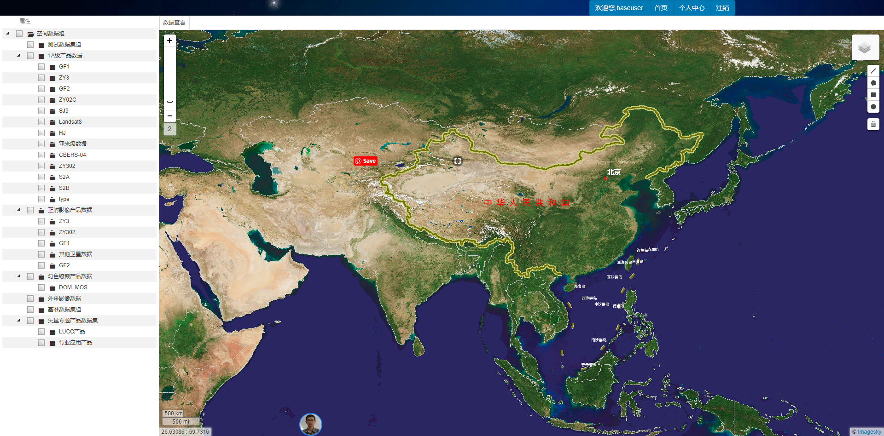
EFLA UI
Predict
Edit
Submit
Run

