Slide 1
Detecting Phishing Websites based on SVM and Decision Tree
Yiqiao Li

Slide 2
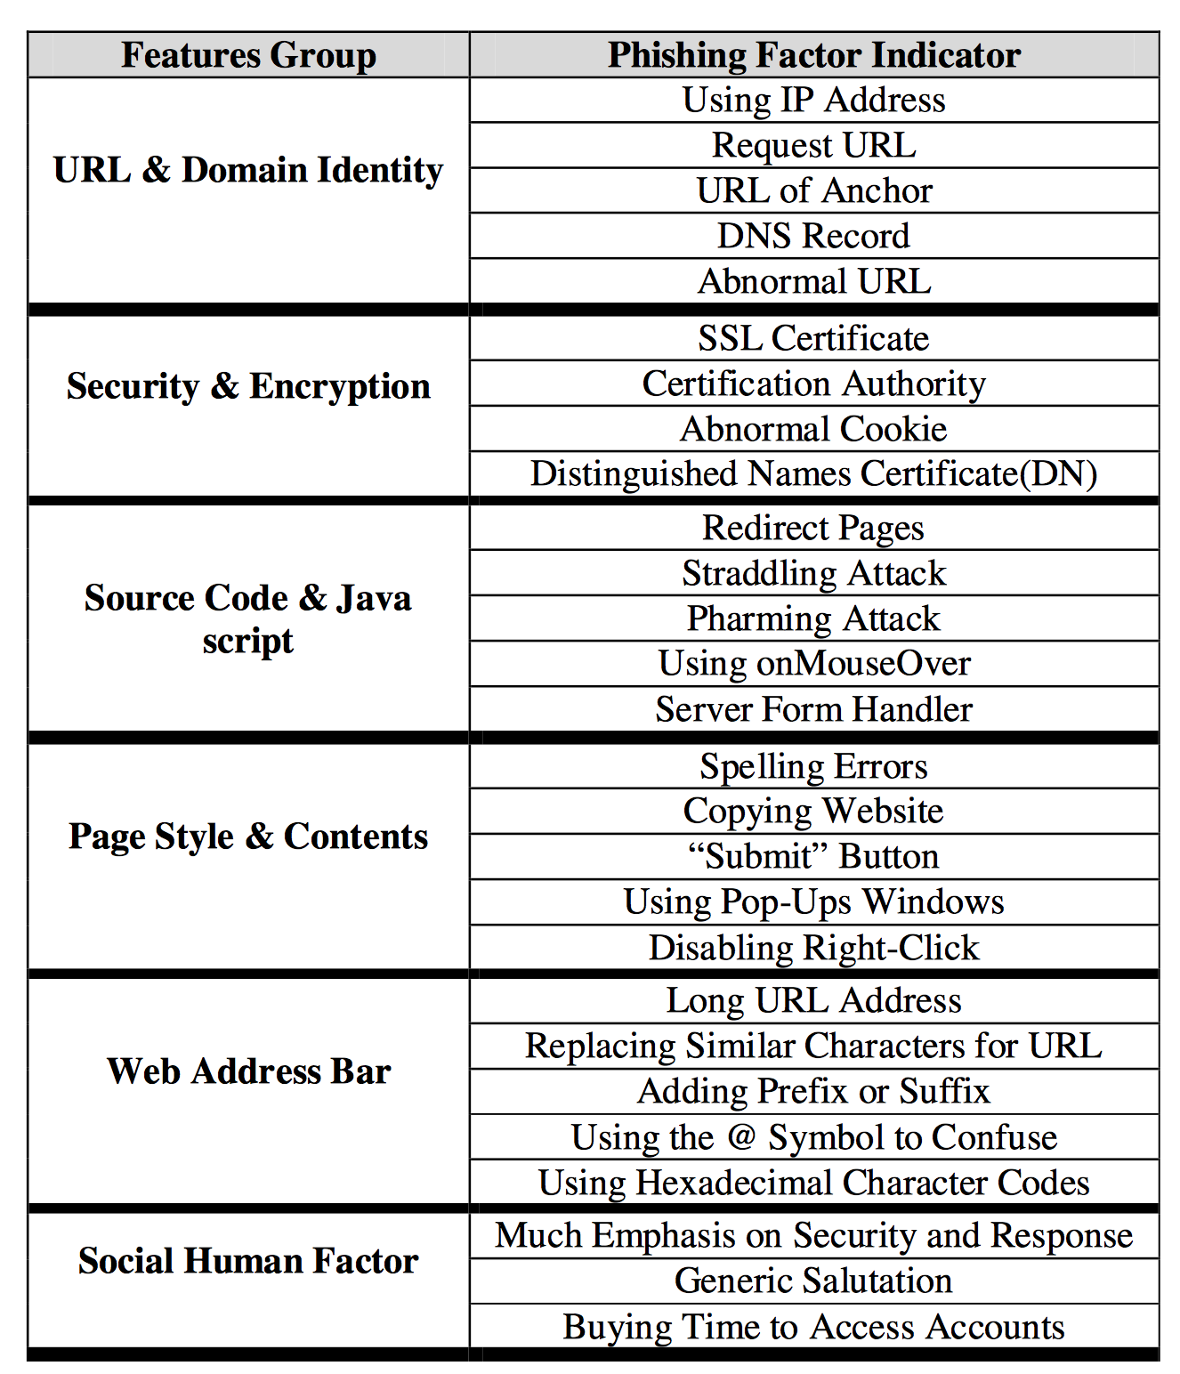
data
Features | 9
SFH | {1,-1,0}
popUpWindow | {-1,0,1}
SSLfinal_State | {1,-1,0}
Request_URL | {-1,0,1}
URL_of_Anchor | {-1,0,1}
web_traffic | {1,0,-1}
URL_Length | {1,-1,0}
age_of_domain | {1,-1}
having_IP_Address | {0,1}
Result | {0,1,-1}
1353 different websites
702 phishing URLs
103 suspicious URLs
548 legitimate

Slide 3
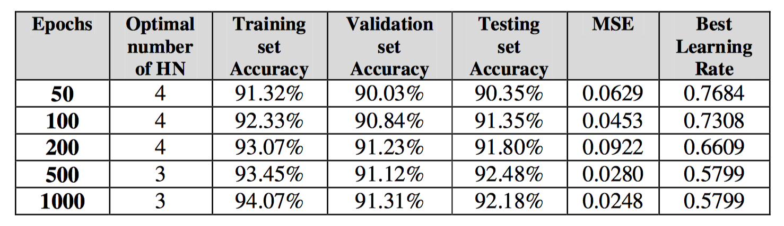
previous work
Phishing Websites based on Self-Structuring Neural Network
based on Artificial Neural Network
Self-structuring
Adaptable
Accuracy

Slide 4
Support vector machine
SVM
Use GridSearch to find optimal kernel and parameters
Linear kernel
RBF kernel
Ploynomial kernel
Use PCA reduce dimension to visualize the data

Slide 5
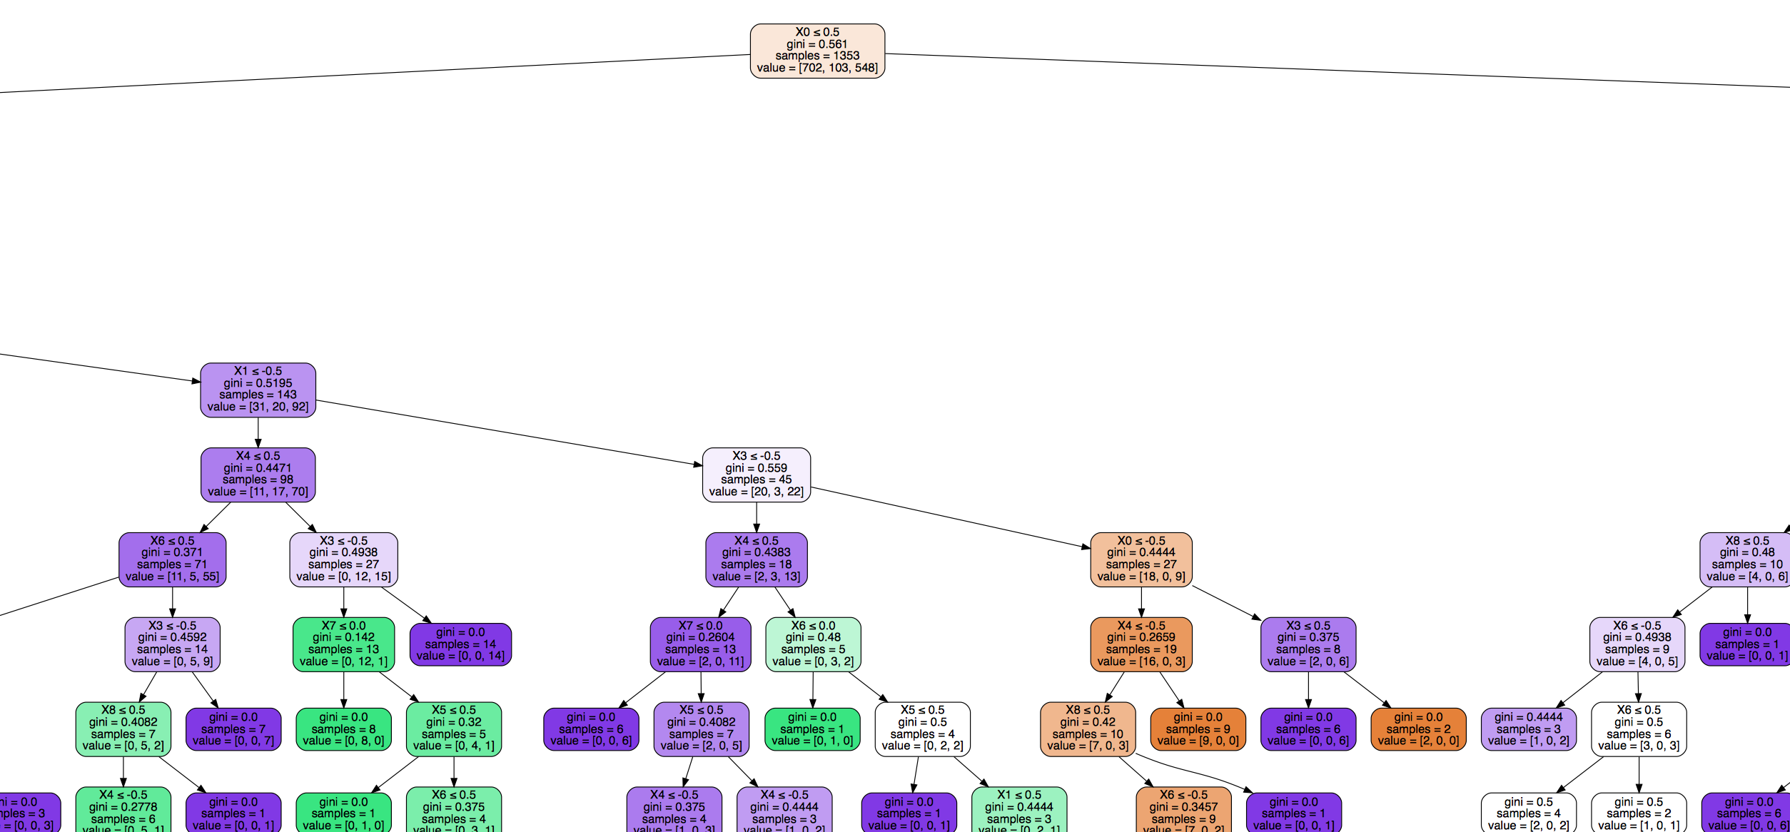
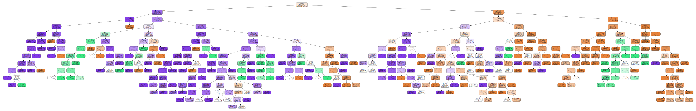
Decision Tree
Decision Tree
Learning decision rules
Trees can be visualized
C4.5
SFH - XSS

Slide 6
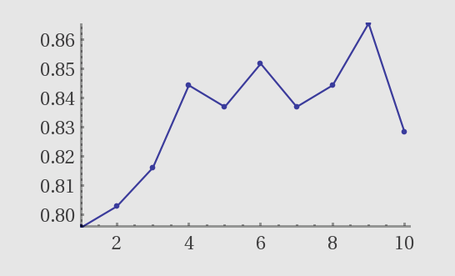
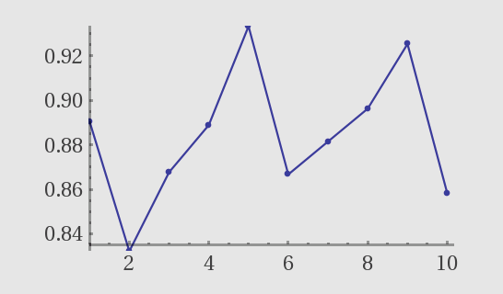
Results
10-Fold Cross Validation
SVM
Accuracy: 0.83 (+/- 0.04)
Decision Tree
Accuracy: 0.88 (+/- 0.06)

Slide 7
conclusions and future directions
The algorithms prove their ability to solve this classification problem
Find optimal model by trial and error
Future work
More data
Find significant features, eg. using frequency analysis
Feature engineering
eg. Content based

