Slide 1


S C O R E
System for Courseware Reuse
Prof. Dr. P.C. Lockemann
Dipl.-Inform. Khaldoun Ateyeh
Dr. Birgitta König-Ries
Dipl.-Inform. Michael Klein
Dipl.-Inform Jutta Mülle
Institute for Program Structures and Data Organization
University of Karlsruhe
www.ipd.uni-karlsruhe.de/SCORE
www.vikar.de

Slide 2
Outline
Motivation: Why Courseware Reuse
Goal of SCORE
Our Approach
Atoms, Modules, Courses
Aspects
Module Types
Ontology
Course Development in Detail
SCORE.CourseBuilder
SCORE.Search
SCORE.ModuleBuilder
SCORE.Export
Summary

Slide 3
Motivation
Why do we need to reuse Courseware?
The development of multimedia courseware
is a very difficult and costly process
is an interdisciplinary process
has high requirements on creativity
has to take psychological and ergonomical aspects into consideration
Notes:
Why do we need courseware reuse?
The development of multimedia systems or courseware has particular characteristics that have to be taken into consideration in the development process.
studies shows that more than 200 hours of development time are needed in order to develop the courseware for one hour
Another Important characteristic that distinguishes the development process of multimedia systems from the development process of other software systems is that: the interdisciplinarity of the developers. In the process participate differnet people form different fields such scientist, psychologist, graphic designer, media specialist, domain expert
It also has high requirements on creativity
the consideration of psychological and ergonomical aspects, as well as engineering aspects during the development process

Slide 4
Motivation: Current Situation
Current courseware tends towards a monolithic structure mixing content, structure, and presentation
Current courseware is difficult to:
  extend
  maintain
  update
  reuse
Notes:
In the current situation developed courseware tends to have a monolithic structure-
As a result of that current courseware is difficult to extend, maintain, update and reuse.
Number of hour neede to develop on hour of lerning material

Slide 5
Requirements: Courseware
Modular courseware
Adaptable courseware
  Adaptability to different university types
  Adaptability to students
  Adaptability to educators
  Adaptability to learning form
Support for cooperation
Support for open standards
Effective search and discovery mechanisms
Notes:
For courseware to be reusable it hast to be:
Modular: This will ease reusability by providing small units that encapsulate one content aspect. It is probably easier to reuse such units in more than one context than a big unit covering a whole course
The second important requirement on courseware is: courseware should be adaptable. For example courseware should be adaptable to meet …
To share the high costs, it is desirable that universities and educators can cooperate. On the other hand the fact that the courseware development is an interdisciplinary one requires the need for cooperation support
Any reusable courseware should take metadata standards and standard format into consideration
In order to be able to reuse courseware we must be able to find it.

Slide 6
Outline
Motivation: Why Courseware Reuse
Goal of SCORE
Our Approach
Atoms, Modules, Courses
Aspects
Module Types
Ontology
Course Development in Detail
SCORE.CourseBuilder
SCORE.Search
SCORE.ModuleBuilder
SCORE.Export
Summary

Slide 7
Goal
Raising the quality and reducing the costs of courseware development
Providing support for cooperative development, reuse, and exchange of courseware
Creating adaptable Courseware to meet the requirements of different authors, educators and students

Slide 8
Outline
Motivation: Why Courseware Reuse
Goal of SCORE
Our Approach
Atoms, Modules, Courses
Aspects
Module Types
Ontology
Course Development in Detail
SCORE.CourseBuilder
SCORE.Search
SCORE.ModuleBuilder
SCORE.Export
Summary

Slide 9
Our Approach
To meet our goals we propose to:
Divide courseware into self-contained learning modules
Separate different aspects such as content, structure, and presentation
Create community and domain-specific ontology
Use standardized metadata
Notes:
Our approach is mainly based on:
Dividing Courseware into self-contained learning units that serves as the basis for courseware reuse an exchange
Separating different aspects such as content structure and presentation which are crucial for supporting the adaptability of courseware
To allow the maximum reuse, it is crucial to mark the learning modules with standardized metadata. We put on standardized metadata schemas such as LOM
An ontology is set of concept definitions and its relations (a specification of a conceptualization). building domain specific ontologies will further enhance the reuse of courseware by allowing users to easily discover the learning modules and to understand how different concepts are related together.

Slide 10
Our Approach: Atoms, Modules & Course
The basic building blocks of our solution are learning atoms
Each learning atom contains a specific learning unit, e.g., a definition, an example, a proof
Learning atoms that deal with a semantically closed set of contents form learning modules
a course is composed out of modules and deals with a specific context

Slide 11
Our Approach: Aspects
In order to allow the reusability of learning modules, they have to be adaptable
Beside the adaptability of the content it has to be possible to adapt other aspects such as didactics and presentation
This kind of adaptability can be achieved by treating different aspects separately

Slide 12
Our Approach: Module Types (1)
Thus, technically a learning module has three variations:
Content
Structure
Presentation
Integration
Module
Structural
Module
Presentational
Module
deal mostly with content aspects
add, as their name suggests, structure to integration modules, i.e., they allow to choose learning atoms out of an integration module and to describe the order in which they should be used
add a presentation form to structural modules, e.g. allowing the contents to be viewed online, to be printed, etc.
Notes:
Integration modules deal mostly with content aspects
Structural modules add, as their name suggests, structure to integration modules, that is, they allow to choose learning atoms out of an integration module and to describe the order in which they should be used
Presentation modules add a presentation form to structural modules, e.g. allowing the contents to be viewed online, to be printed etc.

Slide 13
Our Approach: Module Types (2)
Lerning Content
(from
SCORE.Ontology)
Learning
module
mediate
Integration
Modul
Structural
Module
Presentational
Module

Slide 14
Our Approach
Learning Subject
Learning unit
Learning unit
Learning unit
cooperation + content
Group of authors
Integration Module
Integration
Module Type
choice, structure, didactics
Views of single authors
Structural module
Structural module
Structural module
Structural
Module Type
Presentational module
presentation
Presentational module
Presentational
Module Type
Presentational module
Presentational module
Distance learning view
Print view
Face-to-face view
Print view

Slide 15
Our Approach: Metadata
Metadata is used to describe the various aspects of a learning object
Base on the Metadata standard “Learning Object Metadata LOM”

Slide 16
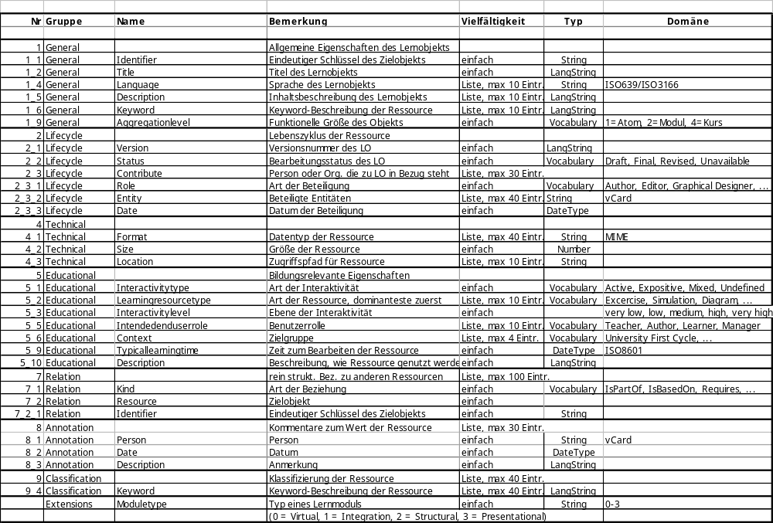
SCORE-Metadata-Standard
General characteristics of the Learning Object
Lifecycle of the Learning Object
Technical Aspects of the Learning Object
Educational Aspects
Structural Relationships to other Learning Objects
Annotation Information
Content Relationship to other Learning Objects in the Ontology
Type of a Learning Module

Slide 17
Our Approach: Ontology
A set of concept definitions and their relationships
A common basis for cooperation and exchange within one community
A browsing space
Notes:
An ontology is set of concept definitions (a specification of a conceptualization). building domain specific ontologies will further enhance the reuse of courseware by allowing users to easily discover the learning modules and to understand who different concepts are related together.

Slide 18
Outline
Motivation: Why Courseware Reuse
Goal of SCORE
Our Approach
Atoms, Modules, Courses
Aspects
Module Types
Ontology
Course Development in Detail
SCORE.CourseBuilder
SCORE.Search
SCORE.ModuleBuilder
SCORE.Export
Summary

Slide 19
Course Development in Detail
In the following, we will present in some detail how our approach can be used to build a course.

Slide 20
Outline: Course Development in Detail
Course Development in Detail
SCORE.CourseBuilder
SCORE.Search
SCORE.ModuleBuilder
SCORE.Export

Slide 21
Course Development
Define a course
structure
Search modules
Assemble montage
Release course
Existing
modules
Suitable
modules
Course with
metadata
ModuleBuilder
Metadata editor
StructuringTool
Search
PresentationGenerator
Export
Uploader

Slide 22
Course Development: CourseBuilder (1)
SCORE.CourseBuilder
Define a course
structure
Search modules
Assemble montage
Release course
Define a course structure
The course structure defines at this stage
a first outline or a concept of the course
It includes the separation of the course into
modules and a specification of each module
This step could also be conducted later
(after the “search modules“ step)
Existing
modules
Suitable
modules
Course with
metadata
ModuleBuilder
Metadata editor
StructuringTool
Search
PresentationGenerator
Export
Uploader

Slide 23
Course Development: CourseBuilder (2)
Course
"if-Clause"
(empty)
Learning Module
Course idea
StructuringTool
Present Tense
Basic Rule
Present Tense
Exceptions
Ontology
Tense
Future
Tense
Future
Present
isPrereq.
isPrereq.
if-Clause
isPartOf
isPartOf
if-Clause
Basic Rule
Exception

Slide 24
Outline: Course Development in Detail
Course Development in Detail
SCORE.CourseBuilder
SCORE.Search
SCORE.ModuleBuilder
SCORE.Export

Slide 25
Course Development: Search
Search modules
for every virtual module search a suitable
module in module repositories (SCORE, ARIADNE,…)
the search could be conducted in form of
queries or browsing an ontology space for
the subject
Define a course
structure
Search modules
Assemble montage
Release course
Existing
modules
Suitable
modules
Course with
metadata
SCORE.Search
Provides a detailed search based on the
SCORE.Metadata. It provides also an ontology
browser.
ModuleBuilder
Metadata editor
StructuringTool
Search
PresentationGenerator
Export
Uploader

Slide 26
Course Development: Search (2)
SCORE.Repository
SCORE.Search
Rule for
to go
Atom
Course
Meta
"if-Clause"
Present Tense
Basic Rule
Integration
Module
Present Tense
Basic Rule
Meta
Present Tense
Exceptions
SCORE.Search
if-Clause
Future
Tense
Meta
Structural
Module
Presentation
Module
if-Clause
Future
Tense
Meta

Slide 27
Outline: Course Development in Detail
Course Development in Detail
SCORE.CourseBuilder
SCORE.Search
SCORE.ModuleBuilder
SCORE.Export

Slide 28
Course Development: ModuleBuilder (1)
Assemble montage
adapt found modules to specific needs
develop unavailable modules
connect modules by adding course specific
(context specific) materials
add and extract metadata for the course
generate a presentation for the course
Define a course
structure
Search modules
Assemble montage
Release course
Existing
modules
Suitable
modules
Course with
metadata
ModuleBuilder
Metadata editor
StructuringTool
Search
PresentationGenerator
Export
SCORE.ModuleBuilder
This tool is used to deal with all aspects of
a module
Uploader

Slide 29
Course Development: ModuleBuilder (2)
SCORE.ModuleBuilder
IM: Present Tense
Basic Rule
Course
Example (XML)
Motivation
(ppt)
"if-Clause"
Present Tense
Basic Rule
needs
Basic Rule
(txt)
Example
(XML)
Present Tense
Exceptions
SCORE.StructureModuleBuilder
Template
Future Tense
Rule
1. Example
2. Example
Exercise
if-Clause
Present Tense
Basic Rule

Slide 30
Course Development: ModuleBuilder (3)
SCORE.ModuleBuilder
Basic Rule
(txt)
Rule
„The verb ends with –s after he/she/it."
Example
(XML)
<exp>He reads the book 'Harry Potter'.</exp>
1. Example
benötigt
Example
(XML)
<exp>It tells the story of a sorcerer</exp>
2. Example
Exercise
none yet
She ___ (to like) the book, too.

Slide 31
Course Development: ModuleBuilder (4)
SCORE.ModuleBuilder
Course
Course
"if-Clause"
"if-Clause"
Present Tense
Basic Rule
Present Tense
Basic Rule
SCORE.ModuleBuilder
Present Tense
Exceptions
Present Tense
Exceptions
Creation of new integration modules
Adding structure to integration modules to form structural modules
semi-automatic conversion of structural modules to presentational modules
Future
Tense
Future
Tense
if-Clause
if-Clause

Slide 32
Outline: Course Development in Detail
Course Development in Detail
SCORE.CourseBuilder
SCORE.Search
SCORE.ModuleBuilder
SCORE.Export

Slide 33
Course Development: Export (1)
SCORE.Export
Release course
upload and publish course
export course
Define a course
structure
Search modules
Assemble montage
Release course
Existing
modules
Suitable
modules
Course with
metadata
ModuleBuilder
Metadata editor
StructuringTool
Search
PresentationGenerator
Export
Uploader

Slide 34
Course Development: Export (2)
SCORE.Export
SCORE.Repository
(TAMINO-XML)
Other
Repository
SCORE.Export
Other
Repositories
Course
"if-clause"
Present Tense
basic rule
Present Tense
Exceptions
Future
Tense
if-clause

Slide 35
Outline
Motivation: Why Courseware Reuse
Goal of SCORE
Our Approach
Atoms, Modules, Courses
Aspects
Module Types
Ontology
Course Development in Detail
SCORE.CourseBuilder
SCORE.Search
SCORE.ModuleBuilder
SCORE.Export
Summary

Slide 36
Summary (1)
Basic Problem:
  Courseware development is extremely costly and time consuming
Desirable:
  Reusable courseware, i.e. create courseware in a way that allows to use parts of it in other contexts, for other audiences and by other educators
  this is prevented by monolithic courses
    that do not separate contents from structure and presentation
    do not identify semantic units of teaching

Slide 37
Summary (2)
Our approach:
  divide contents into smallest semantic units
  combine related units to form modules
  separate different aspects, in particular: contents, structure, presentation
  provide tools to help
    devise a course structure
    find existing materials that cover the topics needed
    structure contents according to individual needs
    adapt material to presentation requirements.

Slide 38
Thank you!
Thank you for your interest!
Additional information can be found at
http://www.ipd.uni-karlsruhe.de/SCORE

