Slide 1

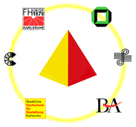

S C O R E
System for Courseware Reuse
Prof. Dr. P.C. Lockemann
Dipl.-Inform. Khaldoun Ateyeh
Dr. Birgitta König-Ries
Dipl.-Inform. Michael Klein
Dipl.-Inform Jutta Mülle
Institute for Program Structures and Data Organization
University of Karlsruhe
www.ipd.uni-karlsruhe.de/SCORE
www.vikar.de
www.uni-karlsruhe.de/~MM-Tag

Slide 2
Motivation
Why do we need to reuse Courseware?
Motivation
Requirements
Approach
Development of multimedia courseware:
difficult and costly process
interdisciplinary process
high requirements on creativity
psychological and ergonomical aspects are important
Course Development
Summary

Slide 3
Motivation: Current Situation
Current courseware:
  often monolithic structure
  mixed content, structure, and presentation
Motivation
Requirements
Approach
Course Development
Summary
Current courseware difficult to...
  extend
  maintain
  update
  reuse

Slide 4
Requirements: Courseware
Modular courseware
Adaptable courseware
  to different university types
  to students
  to educators
  to learning form
Support for cooperation
Support for open standards
Effective search mechanisms
Motivation
Requirements
Approach
Course Development
Summary

Slide 5
Our Approach
Motivation
Our approach:
Divide courseware into self-contained learning modules
Separate different aspects:
content, structure, and presentation
Use standardized Metadata
Create community and domain specific ontology
Requirements
Approach
Course Development
Summary

Slide 6
Our Approach: Atoms, Modules & Course
Motivation
Basic building blocks: learning atoms
Each learning atom contains a learning unit: e.g, a definition, an example, a proof
Learning modules: semantically closed sets of learning atoms
Course: Composition of modules in a specific context
Requirements
Approach
Course Development
Summary

Slide 7
Our Approach: Aspects
Motivation
Which aspects should be adaptable?
Requirements
Approach
Course Development
Content
Structure
Presentation
Summary

Slide 8
Our Approach: Module Types
Technically:
Three variations of learning modules
Motivation
Requirements
Approach
Course Development
Content
Structure
Presentation
Summary
Integration
Module
Structural
Module
Presentational
Module
Notes:
+

Slide 9
Our Approach
Motivation
Requirements
Learning Subject
Approach
Course Development
Learning Module
Learning Module
Learning Module
Summary
cooperation + content
Group of authors
Integration Module
choice, structure, didactics
Views of single authors
Structural module
Structural module
Structural module
Presentational module
presentation
Presentational module
Presentational module
Presentational module
Distance learning view
Print view
Face-to-face view
Print view

Slide 10
Our Approach: Metadata
Motivation
Metadata:
Describe the various aspects of a learning object
Metadata Standards:
Learning Object Metadata (LOM)
Requirements
Approach
Course Development
Summary

Slide 11
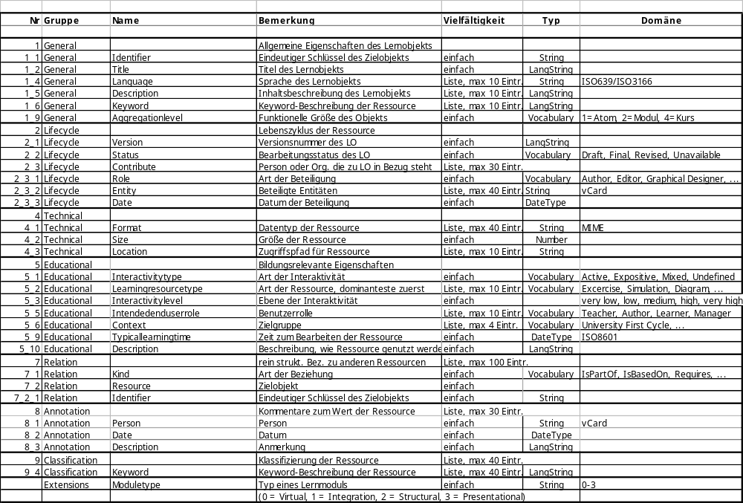
SCORE-Metadata-Standard
General characteristic of the Learning Object
Motivation
Lifecycle of the Learning Object
Requirements
Approach
Course Development
Technical Aspects of the Learning Object
Summary
Educational Aspects
Structural Relationships to other Learning Objects
Annotation Information
Content Relationship to other Learning Objects in the Ontology
Type of a learning Module

Slide 12
Our Approach: Ontology
Motivation
Ontology:
Set of concept definitions and their relationships
Common basis for cooperation and exchange within one community
Browsing space
Requirements
Approach
Course Development
Summary

Slide 13
Course Development: CourseBuilder
Define a course structure
First outline/concept of the course
Separation of course into modules and
specification of each module
Can be conducted later (after search step)
Define a course
structure
Search modules
Assemble course
Release course
Existing
modules
Suitable
modules
Course with
metadata
Ontology Browser
Module Builder
Metadata Editor
Export
Structuring Tool
Search
Presentation Generator
Uploader
Motivation
Requirements
Approach
Course Development
Summary

Slide 14
Course Development: CourseBuilder
Search modules
for every specified module search suitable
module in module repositories
Search: Querying or browsing an ontology space
Define a course
structure
Search modules
Assemble course
Release course
Existing
modules
Suitable
modules
Course with
metadata
Ontology Browser
Module Builder
Metadata Editor
Export
Structuring Tool
Search
Presentation Generator
Uploader
Motivation
Requirements
Approach
Course Development
Summary

Slide 15
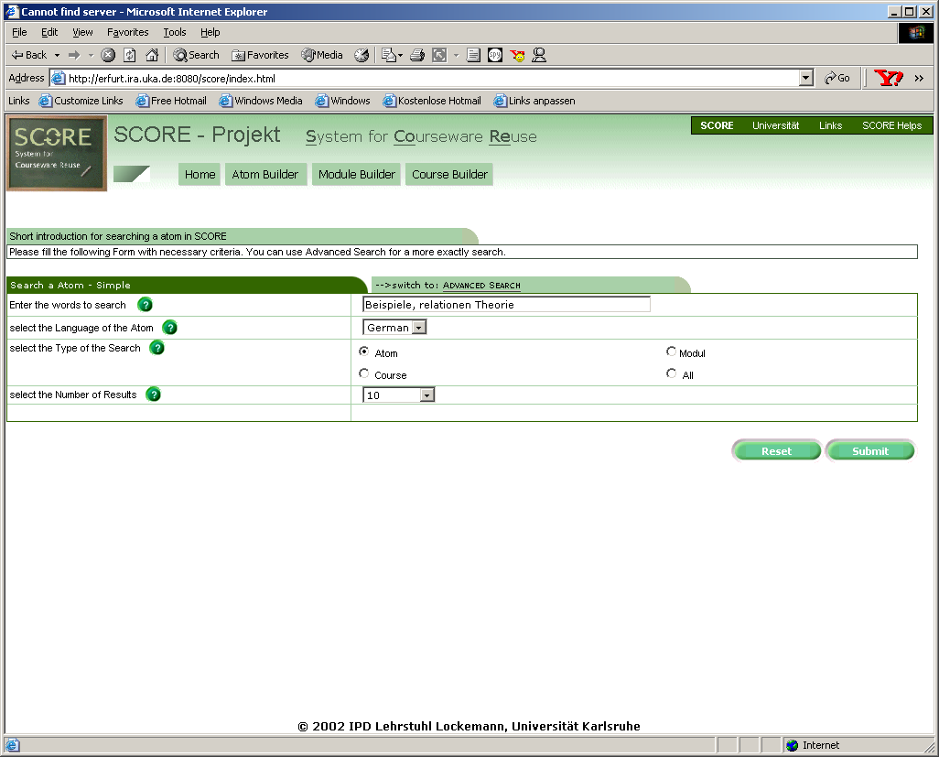
Course Development: Search (1)
Motivation
Requirements
Approach
Course Development
Summary

Slide 16
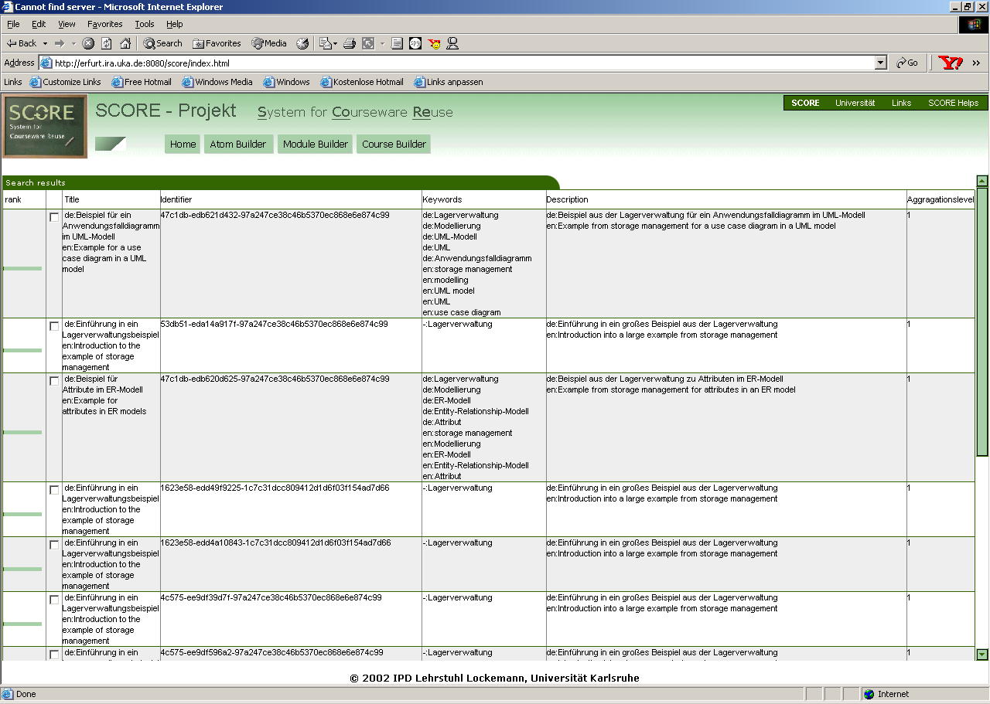
Course Development: Search (2)
Motivation
Requirements
Approach
Course Development
Summary

Slide 17
Course Development: CourseBuilder
Assemble course
Adapt found modules to specific needs
Develop unavailable modules
Connect modules by adding course specific
(context specific) materials
Add metadata for the course
Generate a presentation for the course
Define a course
structure
Search modules
Assemble course
Release course
Existing
modules
Suitable
modules
Course with
metadata
Ontology Browser
Module Builder
Metadata Editor
Export
Structuring Tool
Search
Presentation Generator
Uploader
ModuleBuilder
This tool is used to deal with all aspects of
a module
Motivation
Requirements
Approach
Course Development
Summary

Slide 18
Course Development: CourseBuilder
Release course
upload and publish course
export course
Define a course
structure
Search modules
Assemble course
Release course
Existing
modules
Suitable
modules
Course with
metadata
Ontology Browser
Module Builder
Metadata Editor
Export
Structuring Tool
Search
Presentation Generator
Uploader
Motivation
Requirements
Approach
Course Development
Summary

Slide 19
Summary (1)
Basic Problem:
  Courseware development extremely costly and time consuming
Desirable:
  Reusable courseware, i.e. create courseware in a way that allows to use parts of it in other contexts, for other audiences and by other educators
But:
  prevented by monolithic courses
    that do not separate contents from structure and presentation
    do not identify semantic units of teaching
Motivation
Requirements
Approach
Course Development
Summary

Slide 20
Summary (2)
Motivation
Our approach:
  Divide contents into smallest semantic units
  Combine related units to form modules
  Separate different aspects:
  contents, structure, presentation
  Metadata standards
  Ontology
  Provide Tools to help
    devise a course structure
    find existing materials that cover the topics needed
    structure contents according to individual needs
    adapt material to presentation requirements.
Requirements
Approach
Course Development
Summary

Slide 21
Thank you!
Thank you for your attention!
Additional information can be found at
http://www.ipd.uni-karlsruhe.de/SCORE

