Slide 1
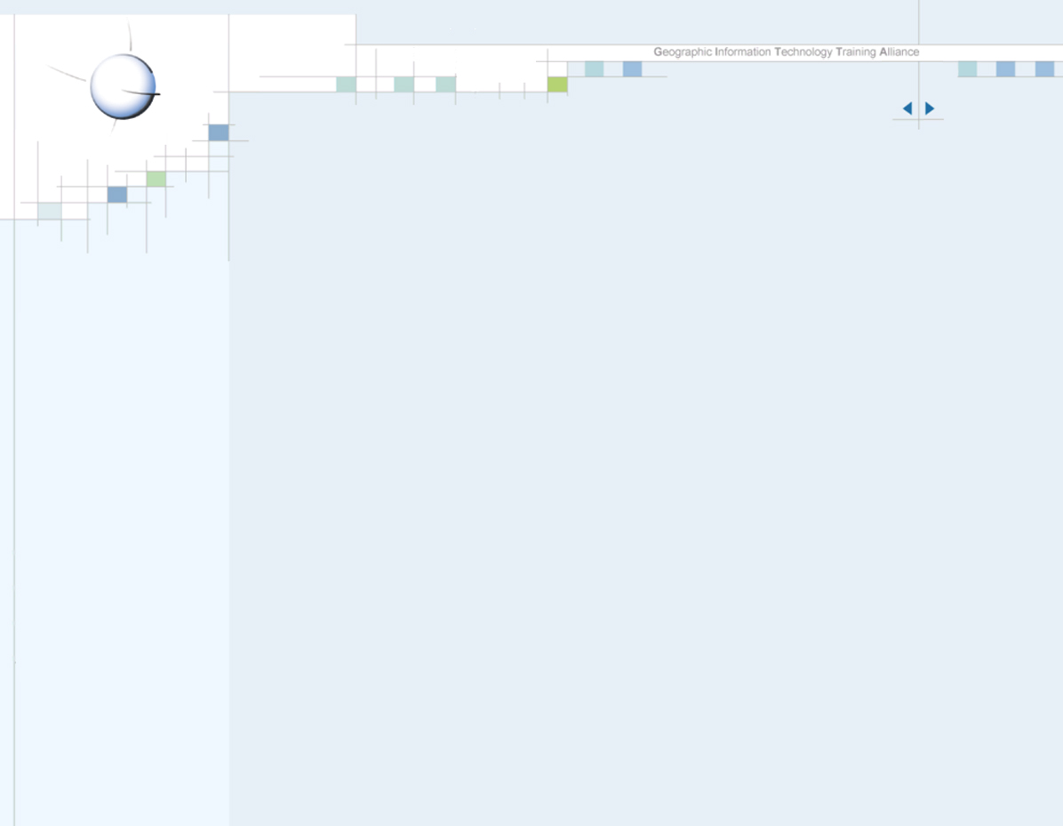
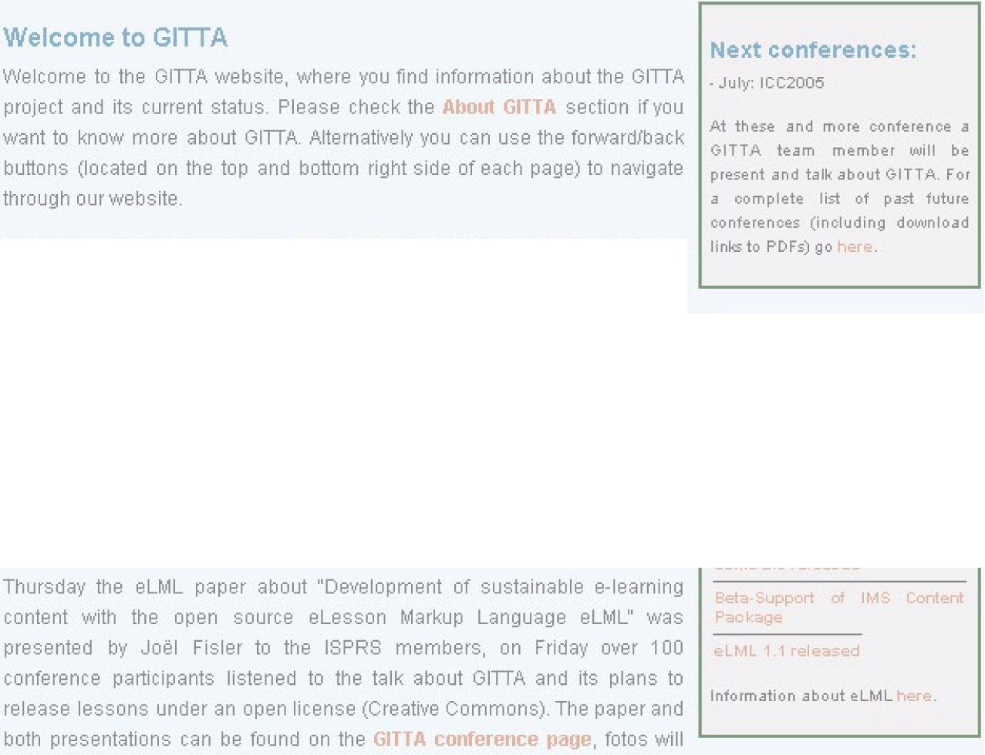
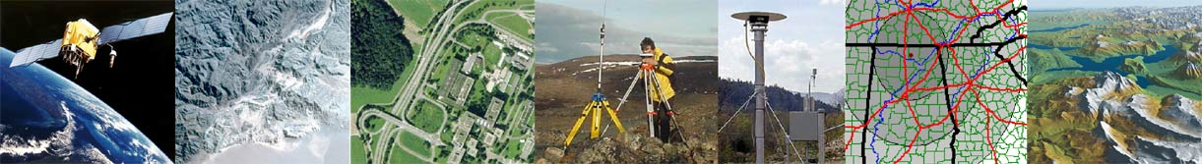

Institute of Cartography ETH Zurich Switzerland M.Werner
E-Learning Materials in
GIS-Technology and Cartography -
Towards an Open-Content Solution
www.gitta.info http://www.karto.ethz.ch
Notes:
Good morning Ladies and Gentlemen,
thank you Mr. xx ( Session Chair ) for the introducing words.
The purpose about this presentation are the ‘E-Learning Materials in GIS Technology and Cartography of the GITTA Project’ that are now on their way towards an open content solution.
Let me shortly explain you the abbreviation G I T T A stands for, for those of you hearing about it the first time. It stands for ‘Geographic Information Technology Training Alliance’.
The project is part of the ‘Swiss Virtual Campus’ where teaching
modules for basic and specialised study programmes for higher
education are created and accessed via the internet.
As time is very limited, I will give you an overview about the content
of this presentation, to make you familiar with the presentation’s
structure.

Slide 2
Institute of Cartography ETH Zurich Switzerland M.Werner
Contents
The GITTA Project & State of Affairs
GITTA’s Improvement Potential
GITTA’s Technical Enhancements
Learning Cartographic Skills with GITTA
www.gitta.info http://www.karto.ethz.ch
Notes:
1. Firstly, I will give a short introduction into GITTA and the development it made from starting the project in 2001 until its estimated end in this constellation in June 2006.
2. Secondly, I will illuminate issues of improvement potential on technical, organisational and content level. Experiences we have made and could be of help for others who are about to start there own e-learning activities and could need some tips.
3. Then, I will come to Gitta’s technical enhancements. This includes a review and comparison of its old and the new technical framework that is and will be done in the e-lesson markup language elml.
With elml a cornerstone is set for heading GITTA for the public., towards open content.
4. Finally I will round the trip trough GITTA by giving you an insight of applying GITTA materials in learning cartographic basics at our University, the Swiss federal Institute of Technology in the Institute of Cartography in Zurich.

Slide 3
Institute of Cartography ETH Zurich Switzerland M.Werner
The GITTA Project
Interactive programmed, multilingual pool of learning materials
Cooperate realisation together with 11 partners
Modular, flexible structure
Covering
Case Studies
Spatial Modeling
Data Presentation
Intermediate
Database Syst.
Spatial Analysis
Data Capture
GI Systems
Basic
Planned to partly substitute ex-cathedra teaching
Multimedia dedication with an obvious surplus value,
instead of conventional teaching methods
www.gitta.info http://www.karto.ethz.ch
Notes:
Gitta is an interactively programmed, IT based and multilingual pool of learning materials. Those can be used for different courses within Geomatic- and Cartographic- or Environmental Studies.
It is a cooperate realisation together with 11 partners, Swisswide.
The GITTA materials have a modular and flexible structure that allows reorganising content blocks with two levels, the basic and intermediate level. Additionally it offers Case Studies that accompany the learning process by applying the learned theory in a practical exercise.
The structure and content Gitta covers, you can see in this figure. ....
Originally it was planned to partly substitute ex-cathedra teaching by GITTA materials. The plan, that has to be always taken into account, was made by different partners, covering various types of higher education, all having individual needs and different level of teaching the subjects, GITTA covers.
The new web technologies allow multimedia dedication in diverse forms. The intention was, to implement it there, where an obvious surplus value can be achieved.

Slide 4
Institute of Cartography ETH Zurich Switzerland M.Werner
GITTA - State of Affairs
GITTA worked problem driven & sustainability oriented
In depth analysis of didactical surrounding
Skeletal structure derived from ECLASS structure for modularity
Realising modularity with XML & open source server architecture
Meeting low-budget restrictions through open source solution
GITTA’s extension: 80% of planned contents realised
Current GITTA scenarios: stand alone use
units or lessons accompanying lectures
blended learning
GITTA Access: via password protected internet page
via LMS
www.gitta.info http://www.karto.ethz.ch
Notes:
The actual state of affairs looks like this:

Slide 5

Institute of Cartography ETH Zurich Switzerland M.Werner
GITTA’s Improvement Potential - Technical Issues
From a deeply nested DTD Structure to an easy to handle
open source E-Lesson Markup Language
No mixture of semantic and representational tags any longer
No need of database anymore
BUT:
Creating homogeneous content and still remaining independent
Creating HTML or PDF’s without additional server software
No XML knowledge needed, CSS and HTML enough to start with
IMS content package and SCORM compatible
Using eLML is for free !!!
www.gitta.info http://www.karto.ethz.ch
Notes:
Sustainability

Slide 6
Institute of Cartography ETH Zurich Switzerland M.Werner
Improvement Potential - Organisational Issues
GITTA materials developed from various Swiss universities &
Uni. of applied sciences with varying curricula and claims
Different types of Universities serve different user groups
with inhomogeneous character
www.gitta.info http://www.karto.ethz.ch

Slide 7

Institute of Cartography ETH Zurich Switzerland M.Werner
Improvement Potential - Content Issues
New demands on teaching personal since method changes
Due to a widely spread group of content creators, content
varies in quality, due to the differing level at the Universities
Too long text phrases for computer-based-learning units
Not taping the full potential that is offered by the variety of
media in teaching
Modular structure offers flexible exchange of teaching materials,
but makes it difficult to built bridges between topics and their
relationship without redundancies.
Sustainability on content side:
Materials are not copyright-conform yet, but have to be
transparent if tending towards open-
content under creative commons licence.
www.gitta.info http://www.karto.ethz.ch

Slide 8
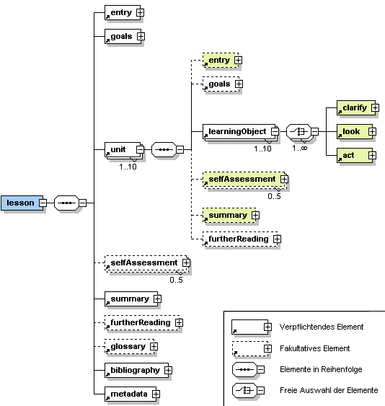
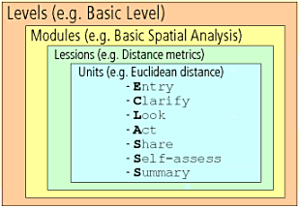
Institute of Cartography ETH Zurich Switzerland M.Werner
GITTA’s Technical Enhancements - eLML
eLML - developed out of GITTA
XML- structure ECLASS
eLML - allows describing e-learning
content, modular on lesson level
eLML - contains learning content &
glossary, bibliography, Metadata = self-containing e-learn. lesson
eLML - is structured by several content elements, e.g. images,
animations, text paragraphs ... & with XML able to separate
content from the presentation
eLML - different authors creating lessons adhering the same
style without to write lengthy style guides
e-LML - content use:
Transform in HTML - stand-alone use on web-server
Transform in HTML - Export of HTML as IMS CP - Import in LMS
www.gitta.info http://www.karto.ethz.ch

Slide 9

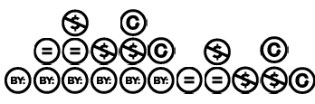
Institute of Cartography ETH Zurich Switzerland M.Werner
GITTA towards Open-Content Materials
Sustainability with open content and open source technique
on
Opening materials (50 lessons & 10 CS) for everyone to use:
ensures broad usage & material's enhancement
GITTA’s License out
of 11 possible ones:
Planed opening of GITTA materials in autumn 2005, depending on:
clarifying copyrights and if needed, adaptations of the content
This means: anyone will be allowed to download and use GITTA
Anyone qualified, will have the possibility to make contributions if:
specialists committee authorises the person
www.gitta.info http://www.karto.ethz.ch

Slide 10
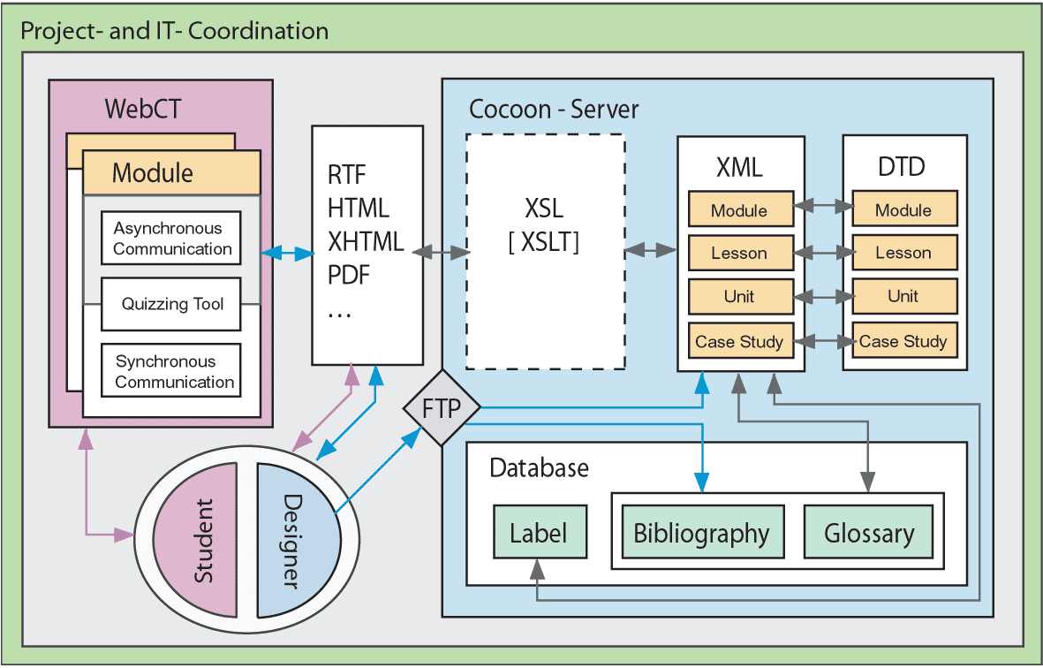
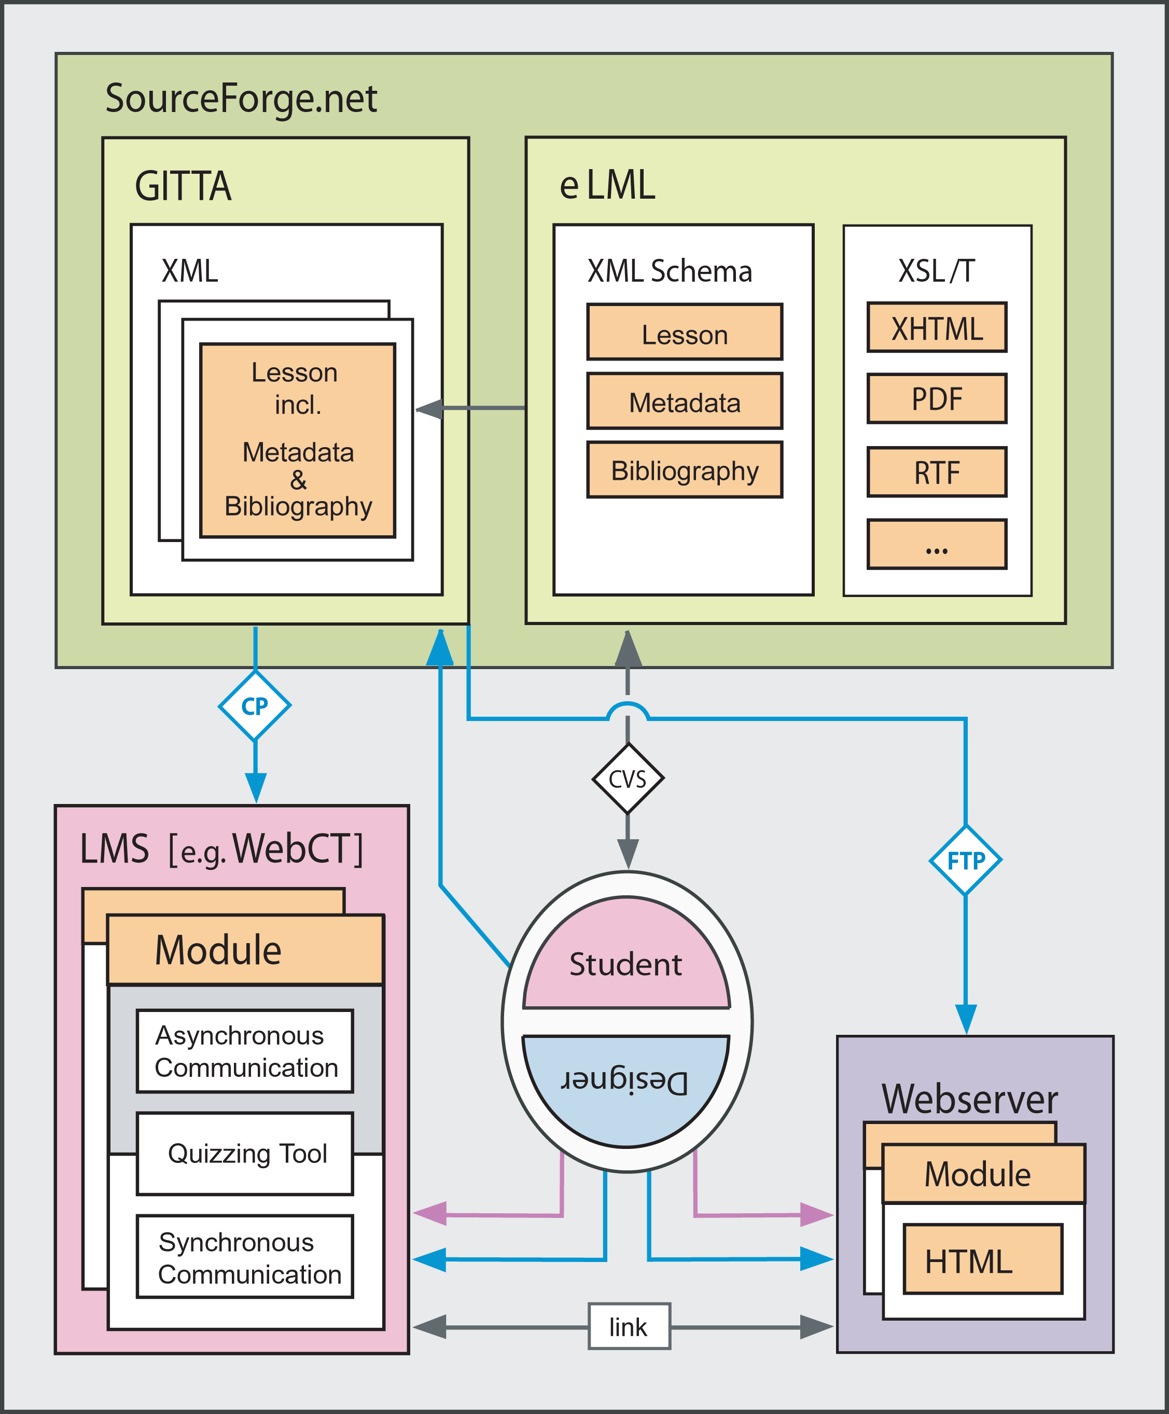
Institute of Cartography ETH Zurich Switzerland M.Werner
GITTA’s Technical Structure
GITTA’s structure in 2003
GITTA’s structure since 2005
www.gitta.info http://www.karto.ethz.ch

Slide 11
Institute of Cartography ETH Zurich Switzerland M.Werner
Learning Cartographic Skills with GITTA
Demonstration ...
www.gitta.info http://www.karto.ethz.ch
Notes:
Übersicht der GITTA Lektionen in offline Webbrowser zeigen:

Slide 12
Institute of Cartography ETH Zurich Switzerland M.Werner
Lessons Learned - A Field Report
Good content creation for e-learning needs a lot of time & effort
Taking one’s time for the concept, enhances the output
Creating content in a way, making the most of new media
New teaching methods changes the way of teaching
The position & requirements of the involved persons change
Work sequences & preparation amount changes
Accompaniment during analysis of learning needs, goals, deve-
lopment and activities up to evaluation stage would be of help
Helping guidelines: writing for e-learning, implementation,
designing illustrations, animations, etc.
www.gitta.info http://www.karto.ethz.ch

Slide 13
Institute of Cartography ETH Zurich Switzerland M.Werner
Many Thanks for Your Attention !
Contact addresses:
Marion Werner
Institute of Cartography - Swiss Federal Institute of Technology
ETH Hoenggerberg - CH-8093 Zurich, Switzerland
werner@karto.baug.ethz.ch
Susanne Bleisch
Department of Geomatic Engineering, Basel University of Applied Sciences
FHBB - CH-4132 Muttenz, Switzerland
s.bleisch@fhbb.ch
Joel Fisler
Department of Geography, University of Zurich
UNIZH - CH-8057 Zurich, Switzerland
fisler@geo.unizh.ch
Subscribe for the GITTA newsletter on www.gitta.info
www.gitta.info http://www.karto.ethz.ch

