Slide 1


Development of sustainable e-learning content with the open source e-Lesson Markup Language
Dipl. natw. Joël Fisler - GITTA Coordinator
ISPRS Workshop 2.6.05
www.elml.ch
Notes:
Flexibilität und Nachhaltigkeit dank XML
Freitag, 5. November 2004
Joël Fisler & Robert Weibel, Uni Zürich

Slide 2
Content
The GITTA Project
The concept behind GITTA
eLML: ECLASS in XML
The eLML content elements
eLML output options
Why use eLML?
Notes:
Flexibilität und Nachhaltigkeit dank XML
Freitag, 5. November 2004
Joël Fisler & Robert Weibel, Uni Zürich

Slide 3
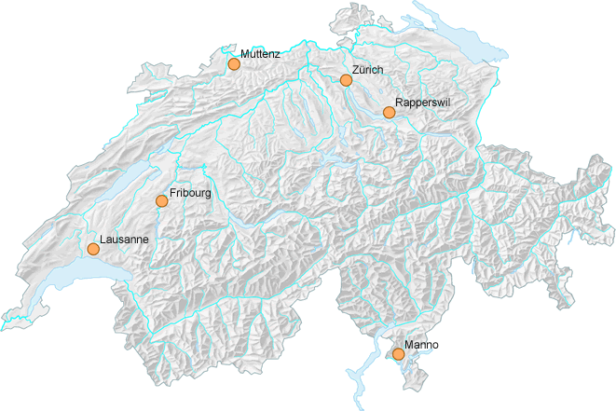
The GITTA Project
GITTA is a modular online course in GIST (Geographic Information Science & Technology)
Consortium of 10 GIST teaching institutes
Institutions cover 75% of Swiss GIS students
Realized 2001-2004, Maintenance 2005-2006
In total 50 lessons and 10 case studies
Notes:
Flexibilität und Nachhaltigkeit dank XML
Freitag, 5. November 2004
Joël Fisler & Robert Weibel, Uni Zürich

Slide 4
The concept behind GITTA
Overview of GITTA‘s didactical guidlines:
Level (e.g. Basic Level)
Basic /Intermed.
Module (e.g. Systems)
Lesson (e.g. What is a GIS?)
Six topics
Unit (e.g. Introduction)
- Entry
- Clarify
- Look
- Act
- Self-assessment
- Summary
One XML file
Based on ECLASS by Gerson (2000)
These didactical guidelines were mapped in XML using XMLSchema
Founded in 2004
Notes:
Flexibilität und Nachhaltigkeit dank XML
Freitag, 5. November 2004
Joël Fisler & Robert Weibel, Uni Zürich

Slide 5
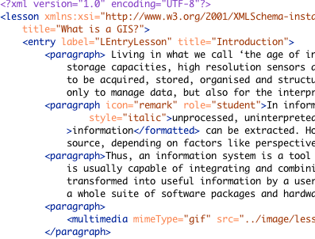
What is XML?
eXtensible Markup Language (unlike HTML that has a fix set of elements that be used)
Strict syntax in comparison to HTML
Based on flat text files and not on binaries
Easy to read for both humans and machines
Project of the World Wide Web Consortium
Started 1998; today a widely used standard
Structure defined using XML Schema
Flexible output formats: HTML, PDF, RTF
Notes:
Flexibilität und Nachhaltigkeit dank XML
Freitag, 5. November 2004
Joël Fisler & Robert Weibel, Uni Zürich

Slide 6
Why use XML?
Content
HTML
PDF, RTF
CP (Content
Packages)
XML lesson files written by authors independently of the layout/presentation
Authors are bound to a strict structure (eLML)
XML
Processor
Via Server (Cocoon)
Via Browser (Firefox)
Via XML Editor (XMLSpy)
Logic
Layout
Databases access using XSP syntax
E.g used for user auth., store metadata etc.
XML files transformed using CSS and XSLT
Different output formats
Designer works autonomous from author
Notes:
Flexibilität und Nachhaltigkeit dank XML
Freitag, 5. November 2004
Joël Fisler & Robert Weibel, Uni Zürich

Slide 7
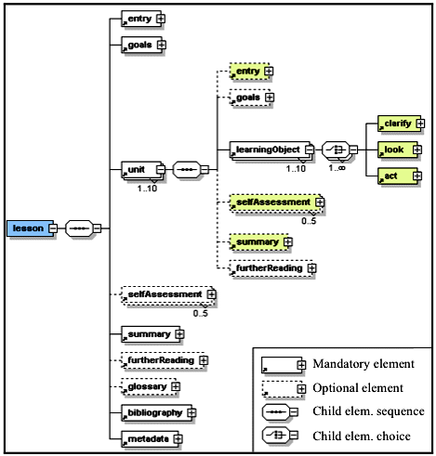
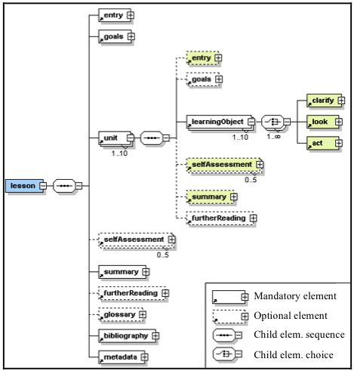
eLML: ECLASS in XML
Lesson starts with entry & goals and ends with a summary (optional in unit)
Self-assessments are optional on both levels
Content stored in learning objects (clarify, look act)
Both glossary and bibliography are validated via the XML schema
Metadata only for tutors
Notes:
Flexibilität und Nachhaltigkeit dank XML
Freitag, 5. November 2004
Joël Fisler & Robert Weibel, Uni Zürich

Slide 8
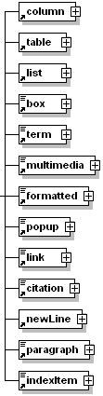

Content elements
In eLML elements can either be represented as a paragraph, inline within a sentence or both.
Paragraph elements: column, table, list, box, popup, paragraph
Inline elements: newLine, formatted and indexItem
Both Paragraph/Inline: term, multimedia, link, citation
Attributes: Alignment, Icon, Title, Glossary/Bibliography reference, Role, Label (for links), Size
Notes:
Flexibilität und Nachhaltigkeit dank XML
Freitag, 5. November 2004
Joël Fisler & Robert Weibel, Uni Zürich

Slide 9
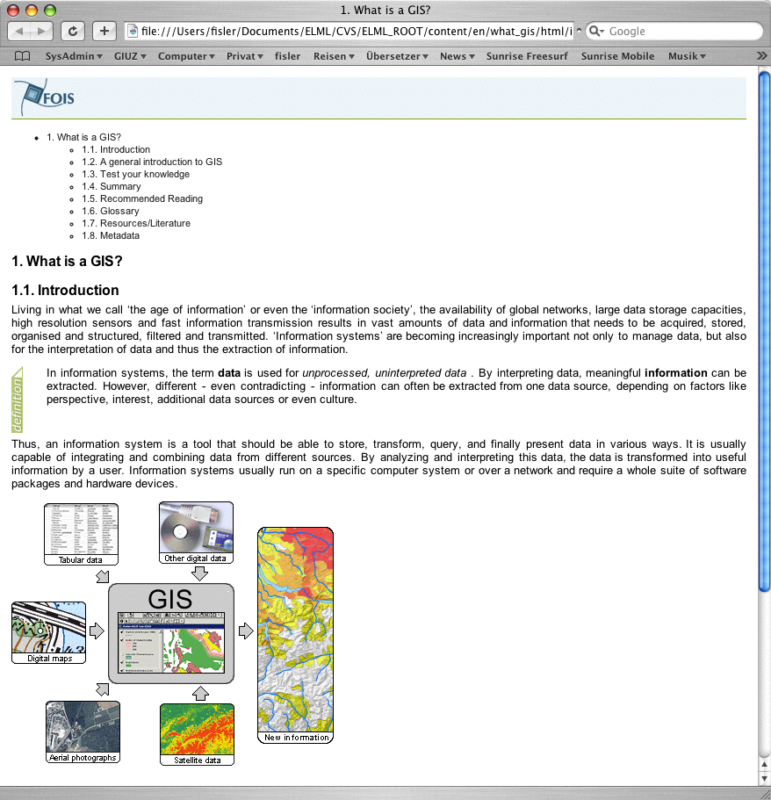
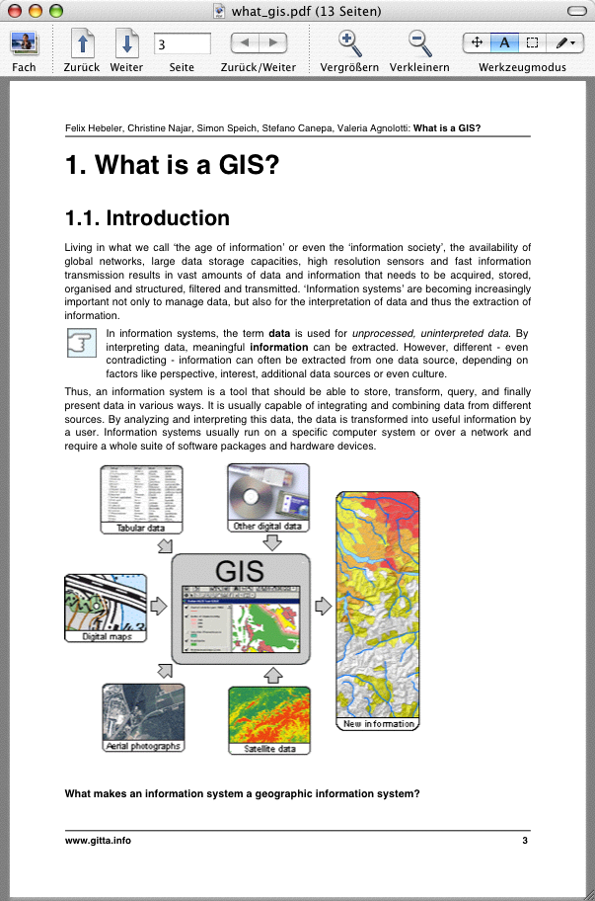
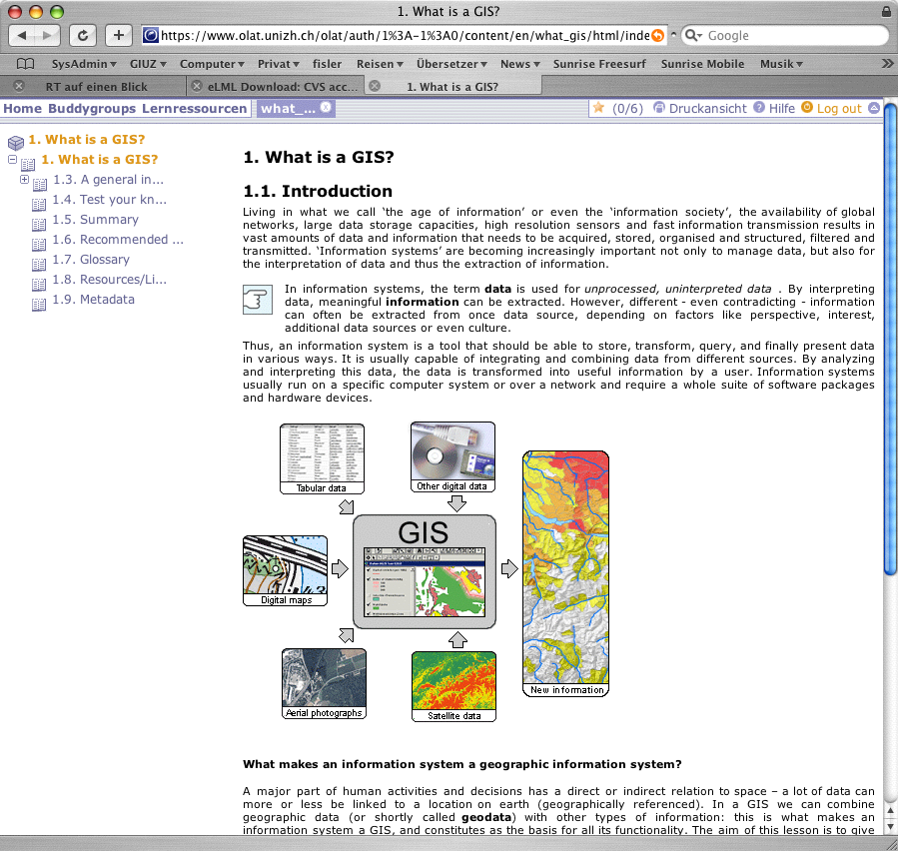
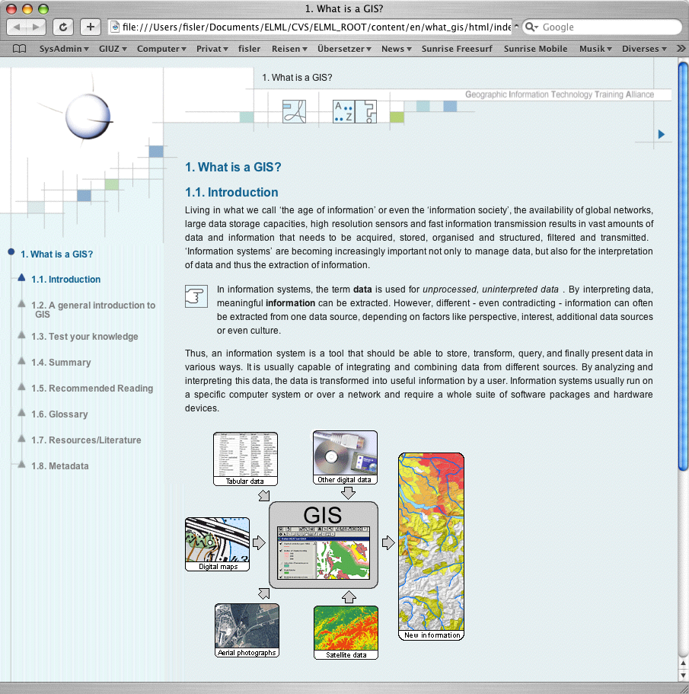
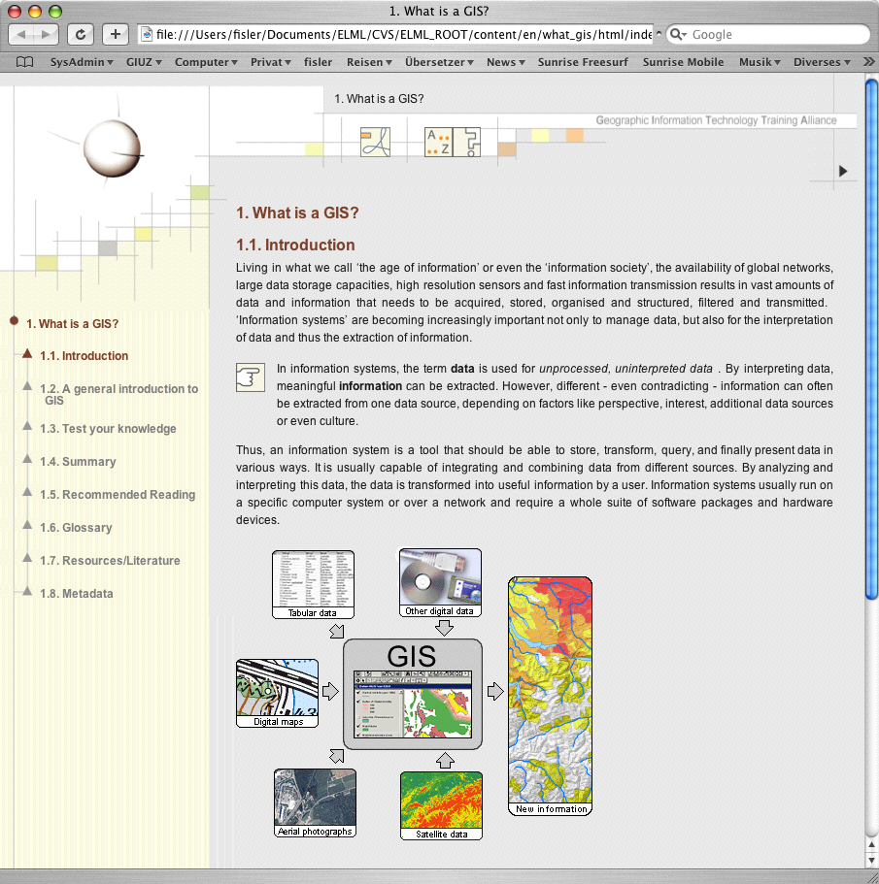
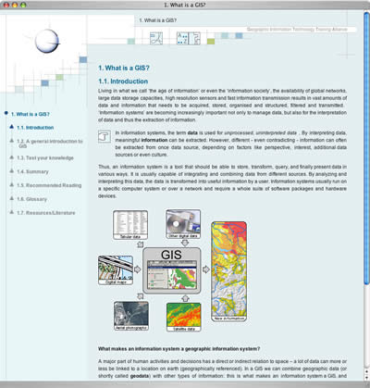
eLML: Output options
XHTML 1.0 with personal layout
No XML knowledge needed (CSS/HTML)
PDF (Formatting Obj.)
IMS Content Package and SCORM supported
Content feeded offline!
Notes:
Flexibilität und Nachhaltigkeit dank XML
Freitag, 5. November 2004
Joël Fisler & Robert Weibel, Uni Zürich

Slide 10
Why use eLML?
Homogeneous content: Using eLML allows structuring e-learning content, generate similarly looking lesson and still remain independent.
Sustainability: eLML is based on XML offering many advantages compared to proprietary formats.
“Real world application”: eLML was developped and tested during the three year GITTA period.
Community: Using eLML means sharing tools and knowledge between other eLML users.
Cost: eLML is open source and therefore free.
Notes:
Flexibilität und Nachhaltigkeit dank XML
Freitag, 5. November 2004
Joël Fisler & Robert Weibel, Uni Zürich

Slide 11

Contact address
Geographisches Institut der Universität Zürich
Winterthurerstrasse 197
8057 Zürich
+41 44 635 5252
http://www.elml.ch
Joël Fisler
fisler@geo.unizh.ch
Tomorrow: Presentation about GITTA at 9 a.m. (DDGI)
For more information subscribe our newsletter on elml.ch!
Notes:
Flexibilität und Nachhaltigkeit dank XML
Freitag, 5. November 2004
Joël Fisler & Robert Weibel, Uni Zürich

Slide 12
