Slide 1


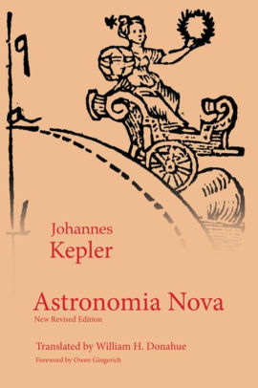
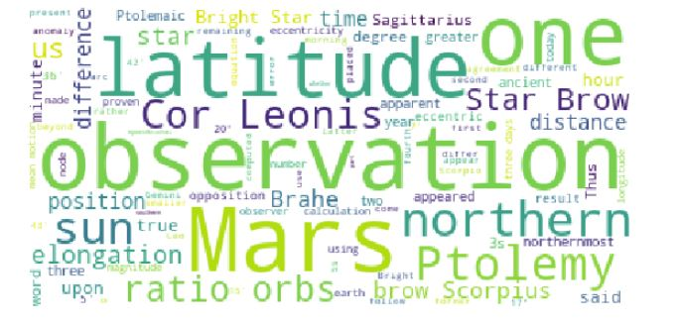
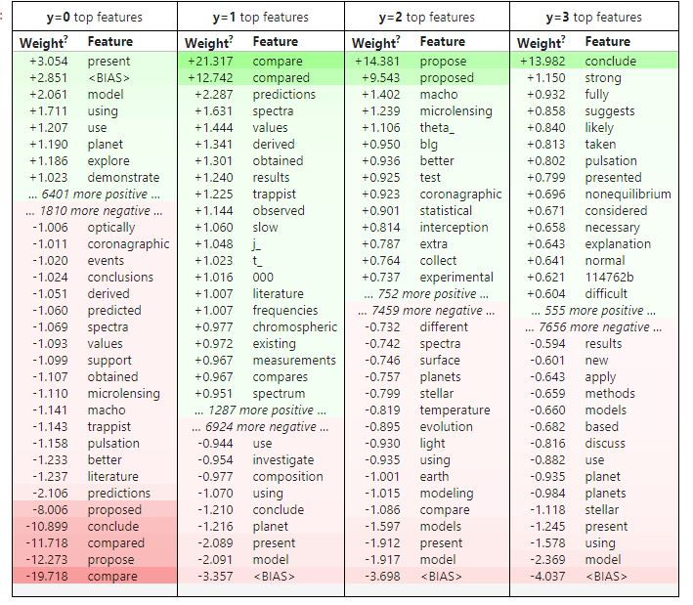
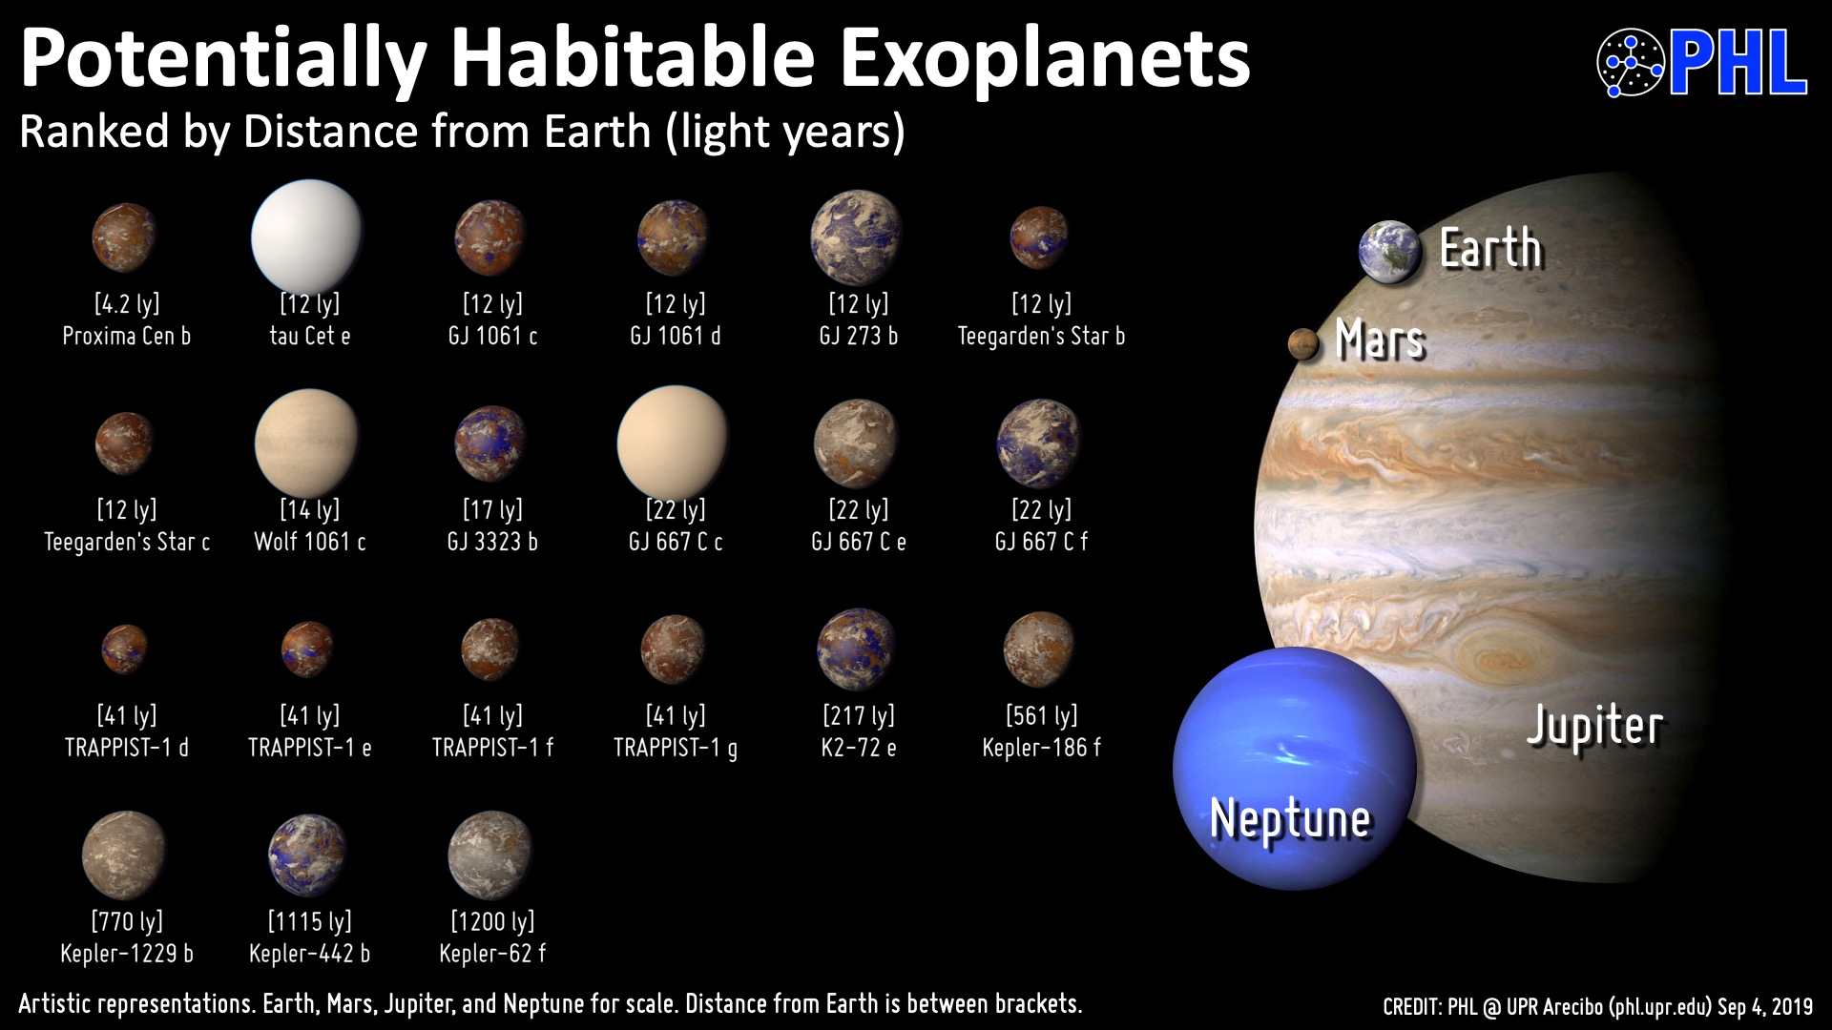
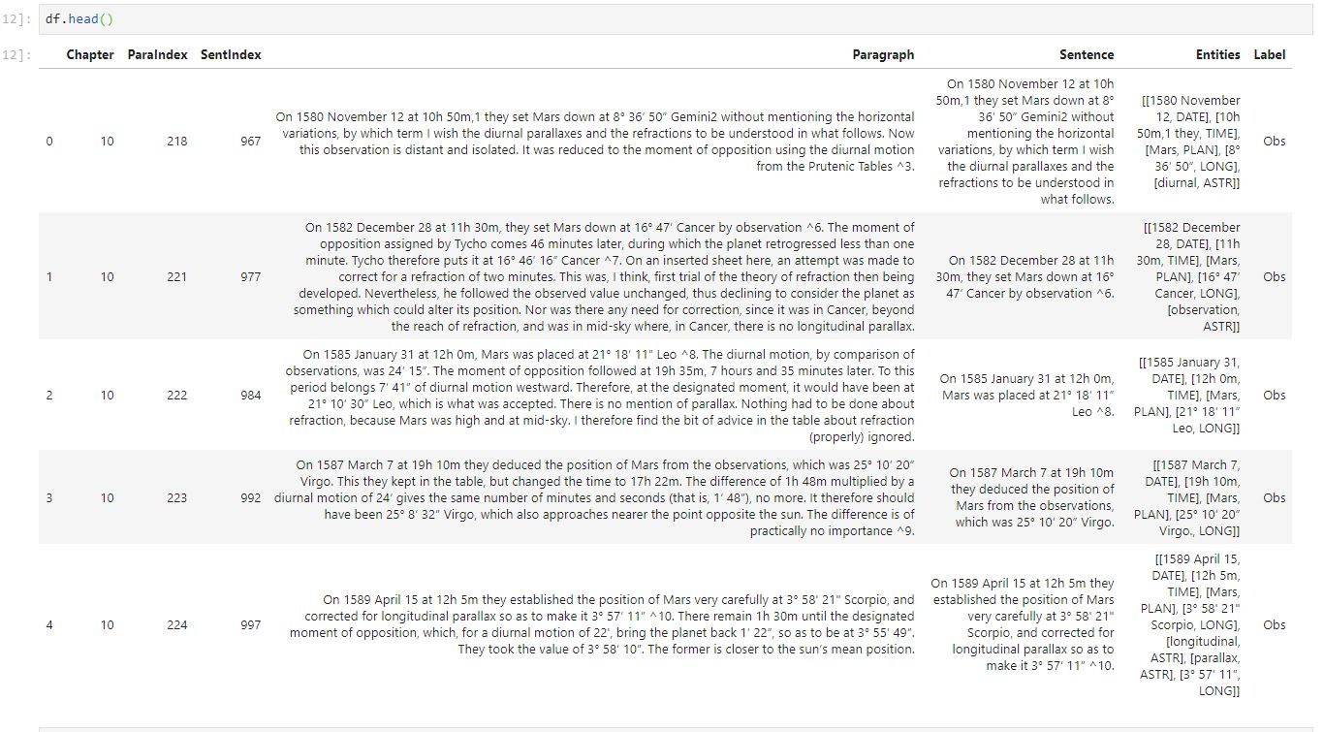
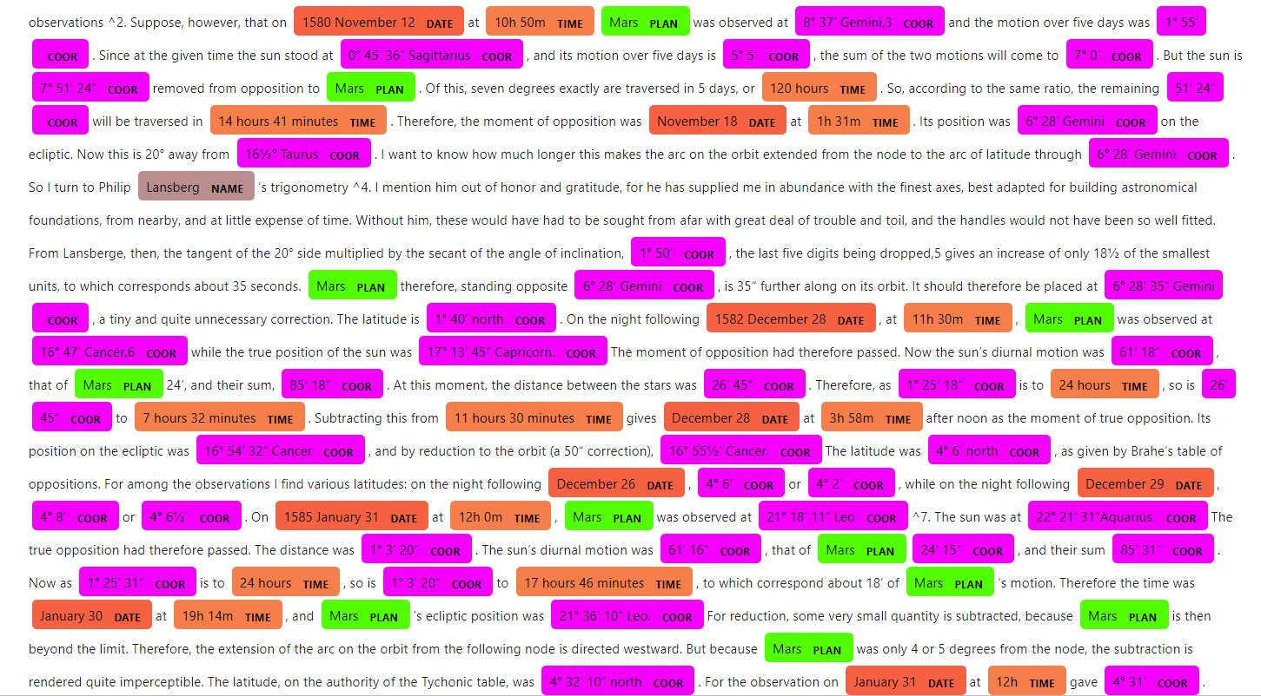
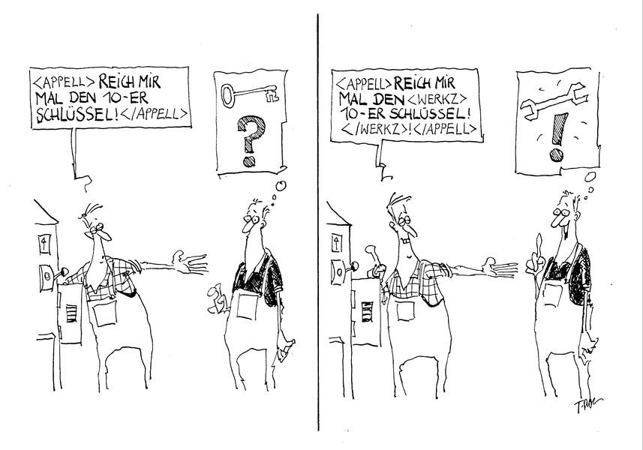
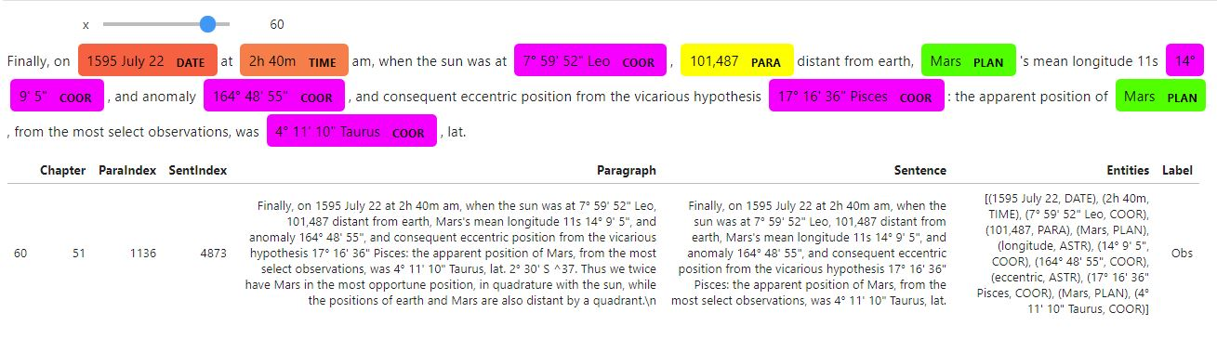
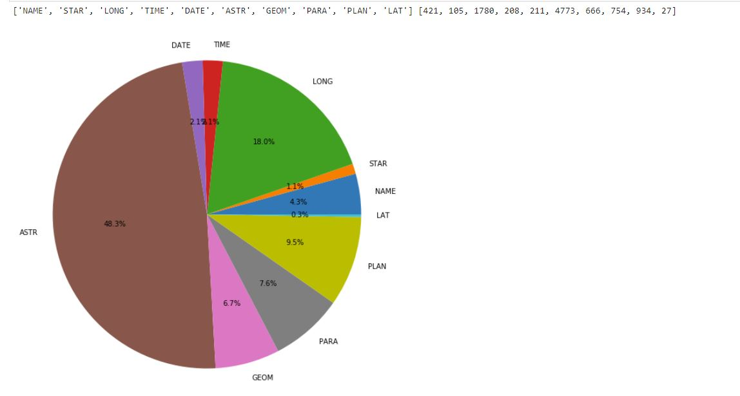
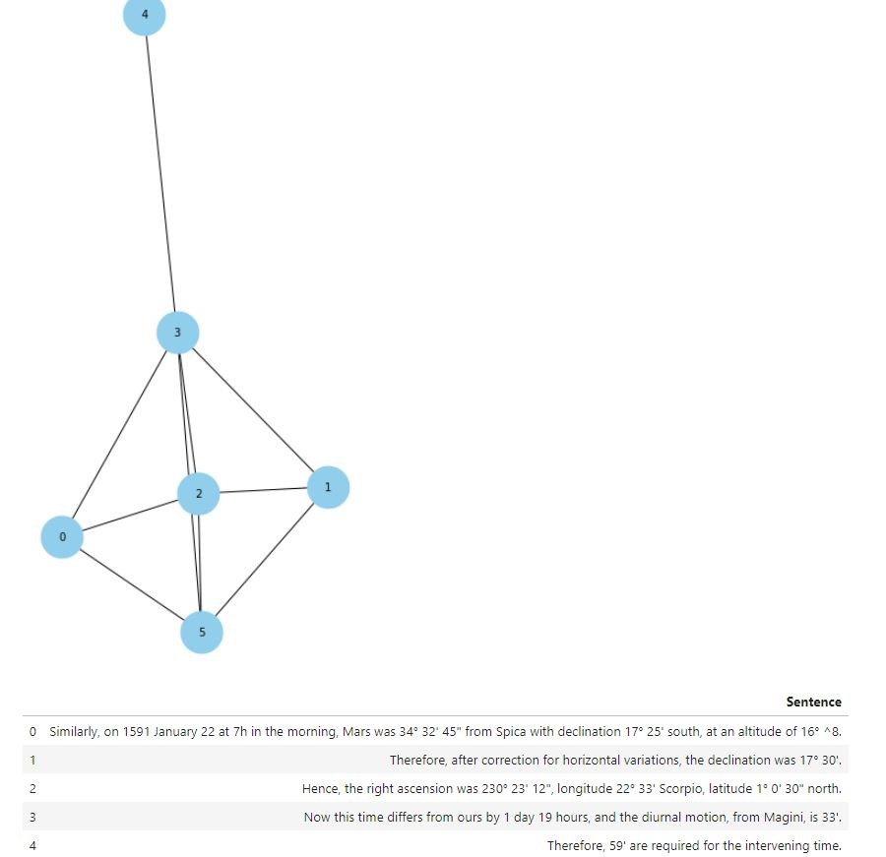

Tackling Semantic :
Semantic Analysis of Text Corpora using AI
HU Berlin
Analysis of Text Corpora
1) Kepler’s book “Astronomia nova” Corpus
-
-
-
2) Exoplanet Publication Corpus [1]
-
-
3) Corona Virus Publication Corpus
-
Structural Corpora
1) Multi Index Dataframe
2) Sentence Structure with Spacy
a) Customized Entities
b) Dependency Parsing
Customized Named Entity Recognition (NER) [2]
Key Idea. Hybrid approach; Pattern based & deep learning to provide NER Model by developing spaCy.
Future Direction: Semantic Objects
Tree structure
Idea. Integrate sentences using xml format to have semantic annotation for extracted observations as a first use case
Explicit Observation Extraction [2]
Key Idea. Extract Semantic from the corpus using customized NER model.
Semantic Relation Extraction
Idea. Extract structure of argumentation components using semantic objects
References
[1] Graßhoff, Gerd; Bier, Sabrina (2019): Database of abstracts in publications on exoplanets from the NASA archive. Zenodo. Dataset. https://doi.org/10.5281/zenodo.3269732
[2] Yeghaneh, Mohammad; https://github.com/myeghaneh
[3] Ribeiro, M. T., Singh, S., & Guestrin, C. (2016, August). " Why should i trust you?" Explaining the predictions of any classifier. In Proceedings of the 22nd ACM SIGKDD international conference on knowledge discovery and data mining (pp. 1135-1144).

