Slide 1


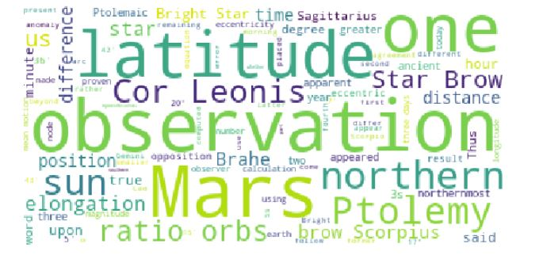
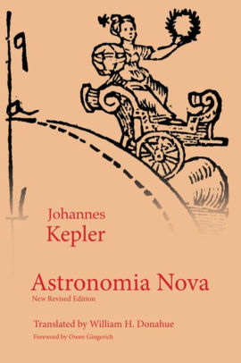
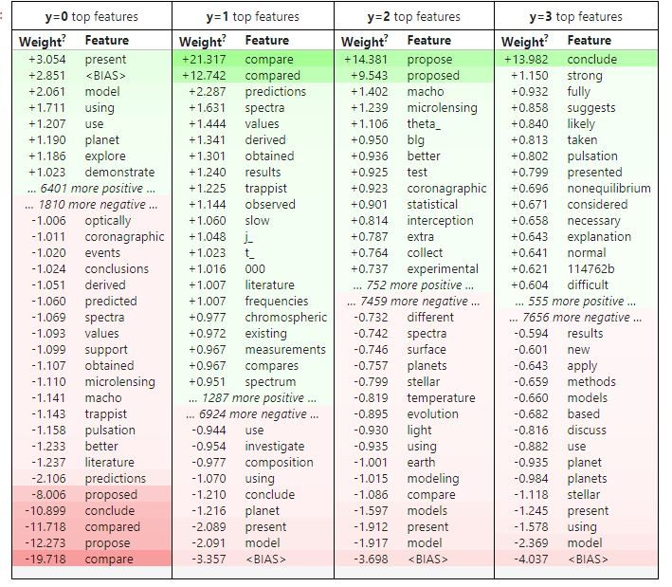
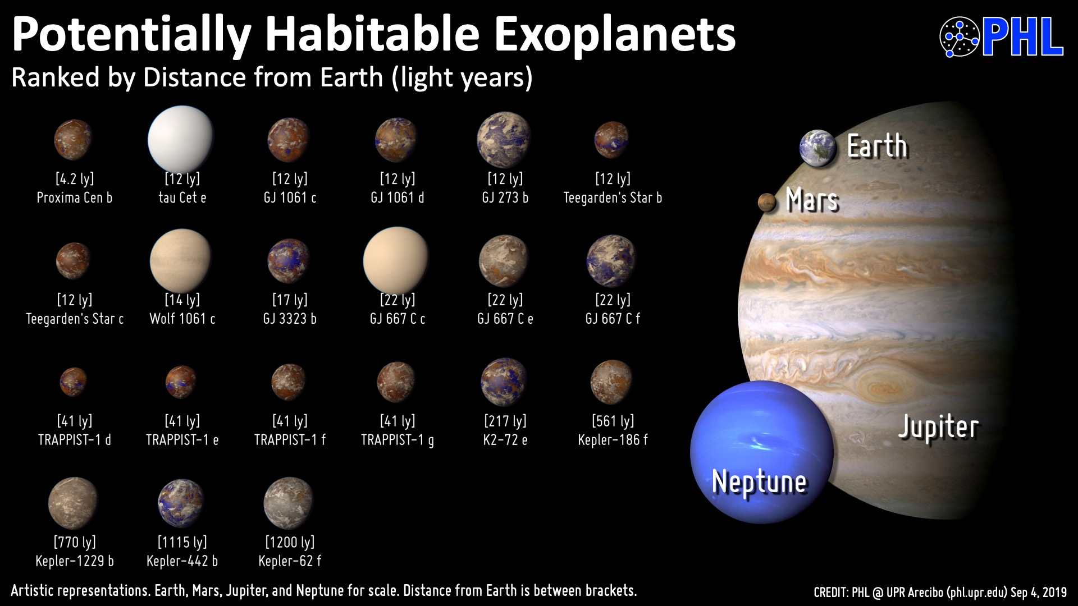
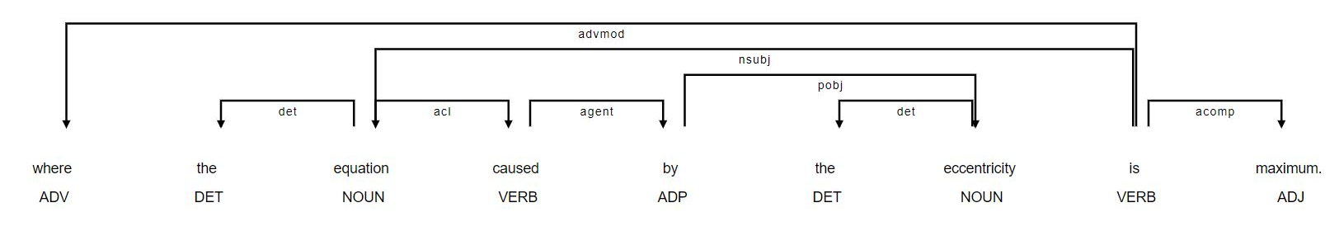
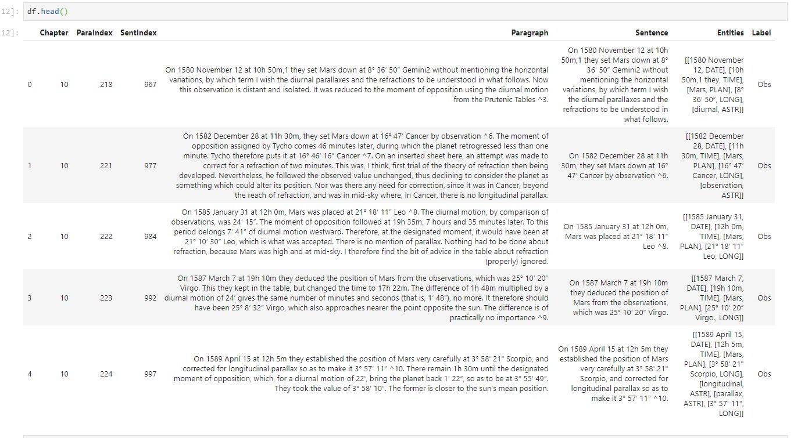
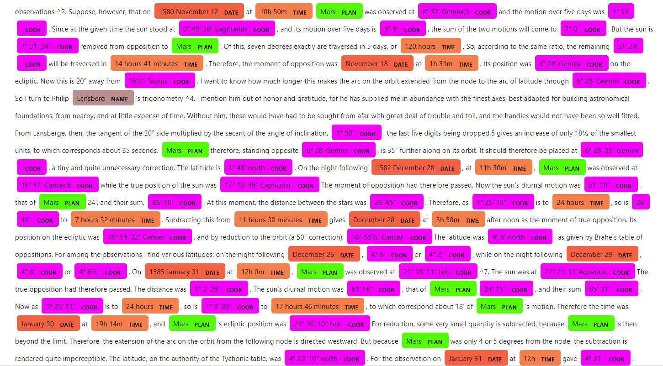
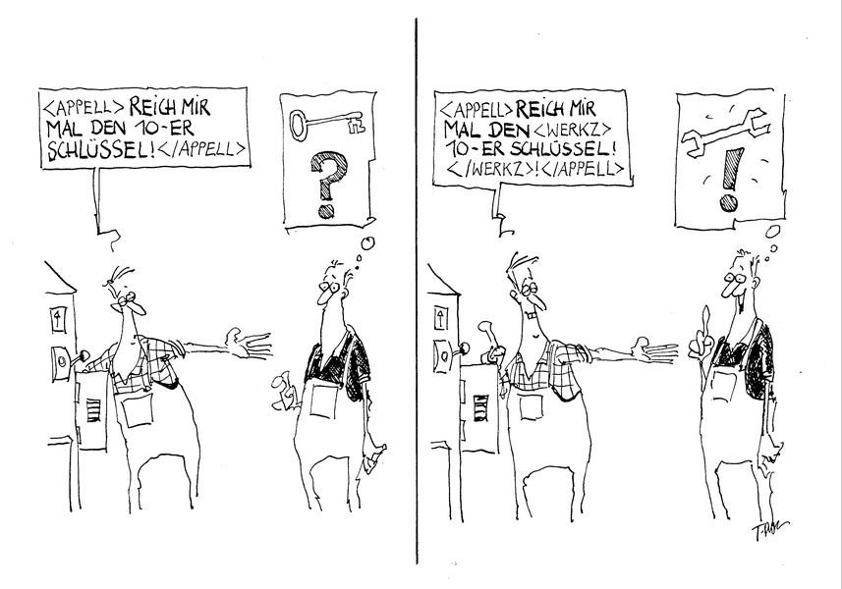
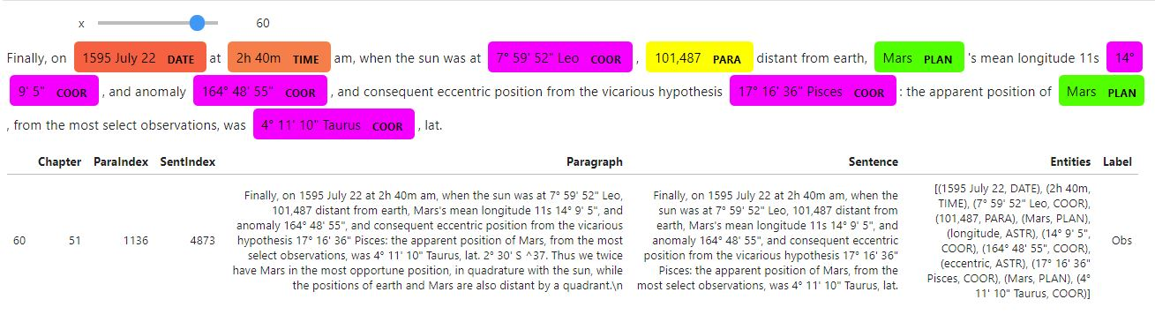
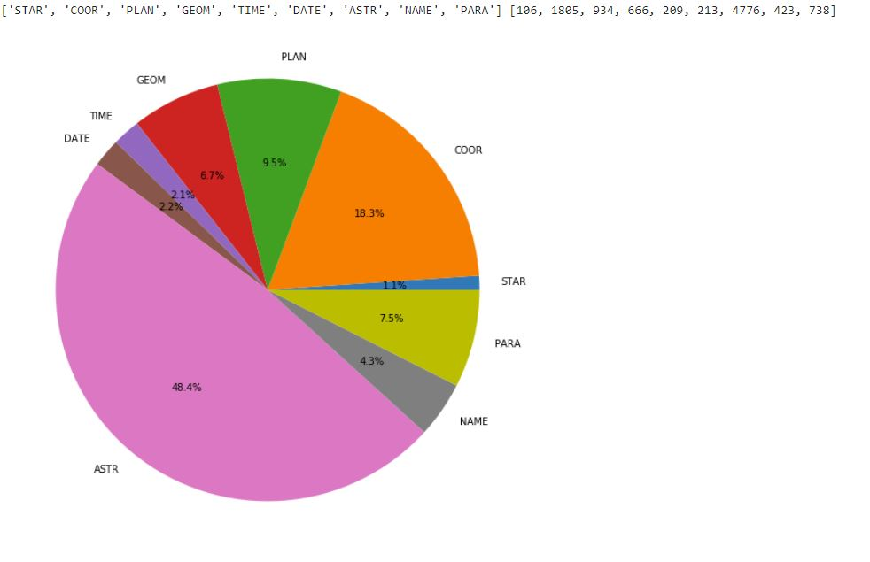
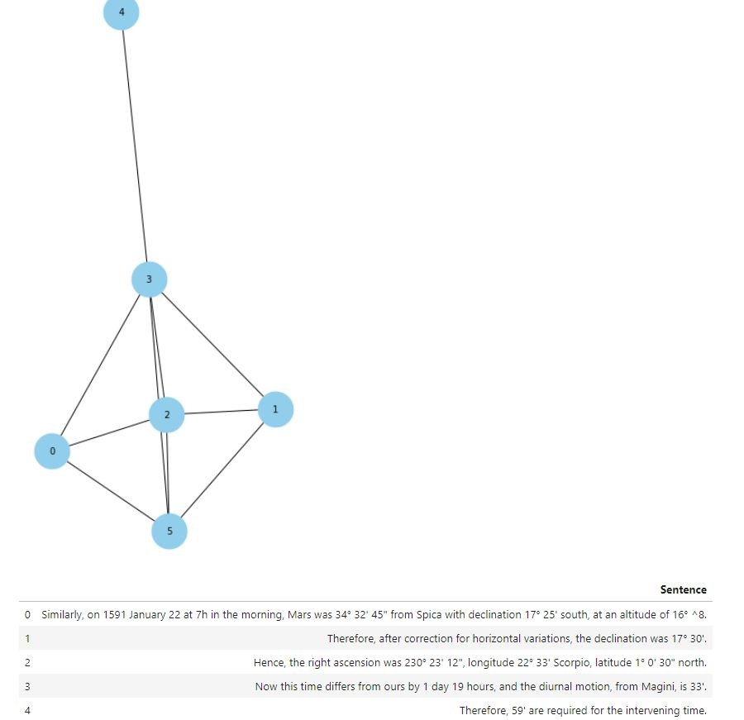

D20.3 Structure of Arguments in Science:
Modelling Kepler’s “Astronomia nova”
Prof. Gerd Graßhoff ( HU Berlin, MPIWG Berlin)
Mohammad Yeghaneh Abkenar (HU Berlin)
Scientific Publications, text corpora
Kepler’s “Astronomia nova” Corpus
- Revolutionary new theory of planetary motion
- Purely geometrical epicyclic models by physical interpretations
→ Aim: Computational model to establish Kepler's arguments!
Exoplanet Publication Corpus [1]
- Scientific articles on recent research on exoplanets 1990-2020
→ Aim: Computational model to extract arguments!
Corona Virus Publication Corpus
- The corpus Analysis of growing publications on the COVID-19
Astronomia nova
The corpora are represented in structural trees representing their textual division.
1) Parts, chapters, paragraphs, sentences, tables, diagrams
2) Sentence Structure with Spacy
a) Customized Entities
b) Dependency Parsing
Customized Named Entity Recognition (NER) [2]
Key Idea. Hybrid approach; Pattern(rule) based & deep learning approach to provide NER model by developing spaCy.
Future Direction: Semantic Objects
Tree structure
Idea. Integrate sentences using xml format to have semantic annotation for extracted observations as a first use case
Explicit Observation Extraction [2]
Key Idea. Extract Observations from the corpus by customized NER model.
Semantic Relation Extraction
Idea. Extract structure of argumentation components using semantic objects
References
[1] Graßhoff, Gerd; Bier, Sabrina (2019): Database of abstracts in publications on exoplanets from the NASA archive. Zenodo. Dataset. https://doi.org/10.5281/zenodo.3269732
[2] Yeghaneh, Mohammad; https://github.com/myeghaneh
[3] Ribeiro, M. T., Singh, S., & Guestrin, C. (2016, August). " Why should i trust you?" Explaining the predictions of any classifier. In Proceedings of the 22nd ACM SIGKDD international conference on knowledge discovery and data mining (pp. 1135-1144).

