Slide 1

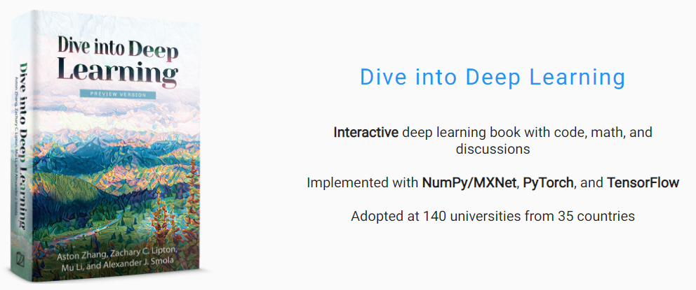
Dive into
Deep Learning
Attention Mechanism
Attention Mechanism / JunHo Yoon
Single RNN disadvantage
Sequence to Sequence
Sequence with Attention
Teacher forcing
Transformer

Slide 2
Dive into
Deep Learning
Single RNN disadvantage
Input
_____________
I
love
you
I love you
_____________
Answer
-->
-->
-->
-->
-->
Output
__________________
나는
사랑해
너를
나는 사랑해 너를
__________________
나는 너를 사랑해
Single RNN disadvantage
Sequence to Sequence
Sequence with Attention
Teacher forcing
Transformer
How are you?
______________
3words
-->
어떻게 지내?
__________________
2 words

Slide 3
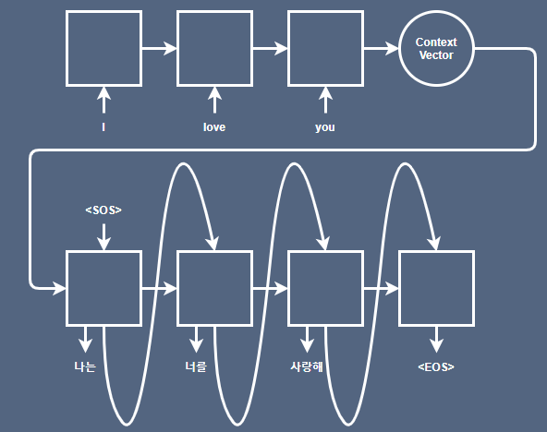
Dive into
Deep Learning
Sequence to Sequence
Encoder
Decoder
Single RNN disadvantage
Sequence to Sequence
Sequence with Attention
Teacher forcing
Transformer

Slide 4
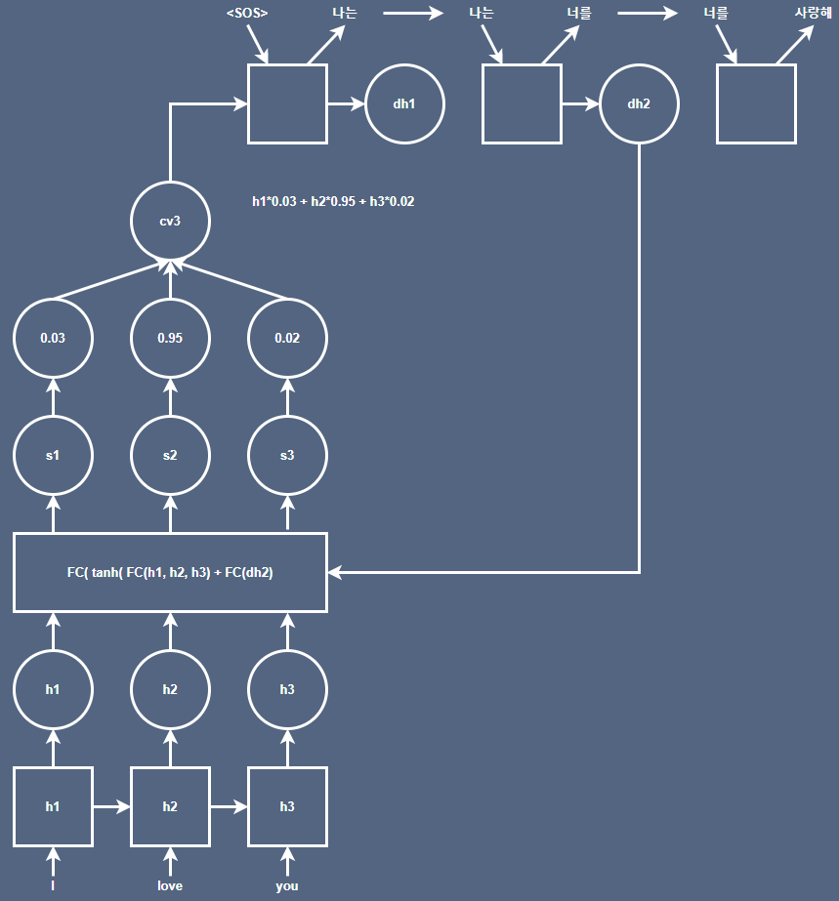
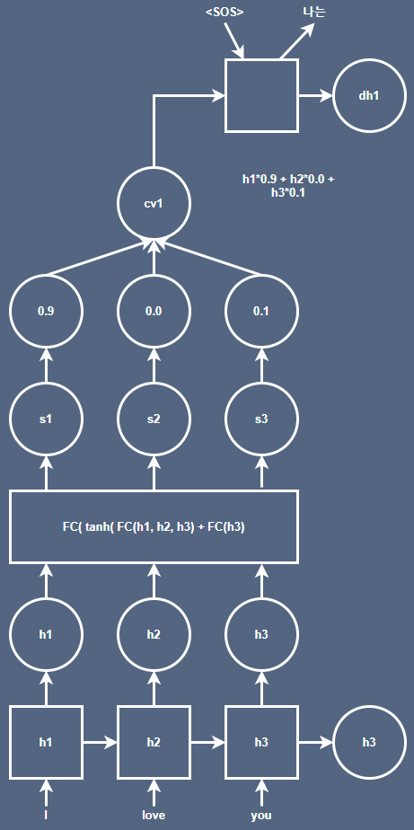

Dive into
Deep Learning
Sequence with Attention
Single RNN disadvantage
Sequence to Sequence
Sequence with Attention
Teacher forcing
Transformer

Slide 5
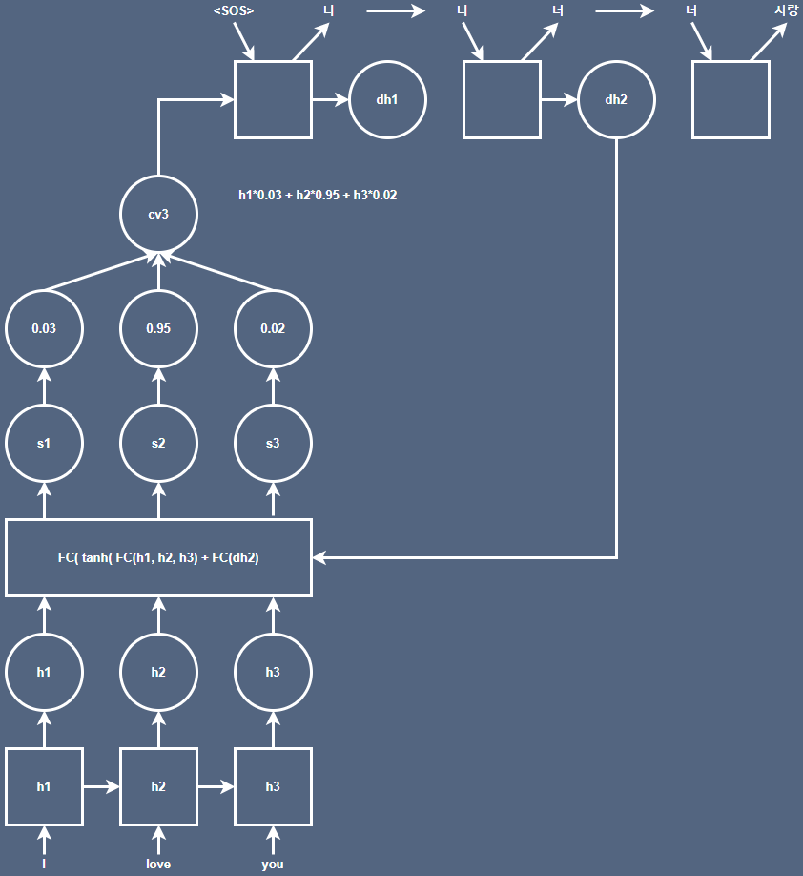
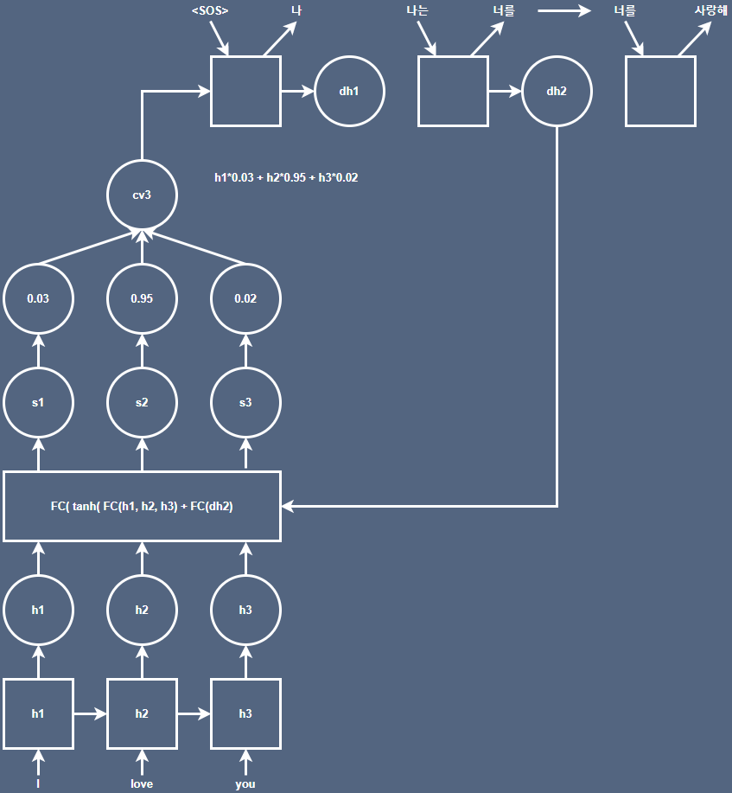
Dive into
Deep Learning
Teacher forcing
Single RNN disadvantage
Sequence to Sequence
Sequence with Attention
Teacher forcing
Transformer

Slide 6
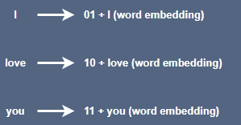
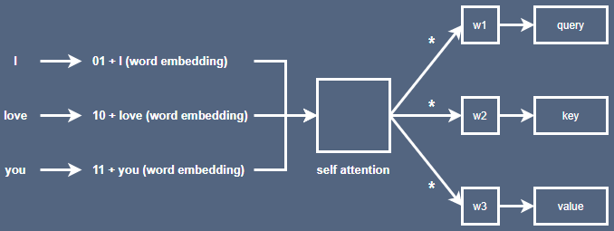
Dive into
Deep Learning
Transformer
positional encoding : RNN을 사용하지 않게 되면서 단어의 위치 및 순서 정보 시각화를 위한 encoding
ex)
Self Attention : encoder 내부에서 발생하는 attention 과정
query * key = attention score
softmax( attention score / sqrt( key vector의 차원 수) )
Attention Layer Output = Σ score * value
Single RNN disadvantage
Sequence to Sequence
Sequence with Attention
Teacher forcing
Transformer

Slide 7
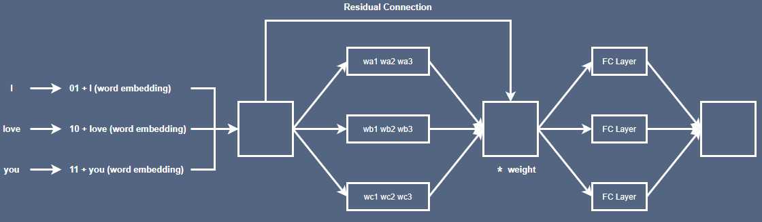
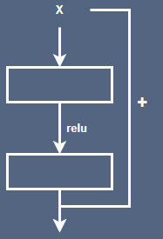
Dive into
Deep Learning
Transformer
Multi Head Attention : 여러 개의 Attention Layer를 가지는 것
FC Layer에 넣어줌으로써 input과 output의 차원의 vector를 만든다.
Residual Connection : ResNet에서 사용한 방식
Single RNN disadvantage
Sequence to Sequence
Sequence with Attention
Teacher forcing
Transformer

Slide 8
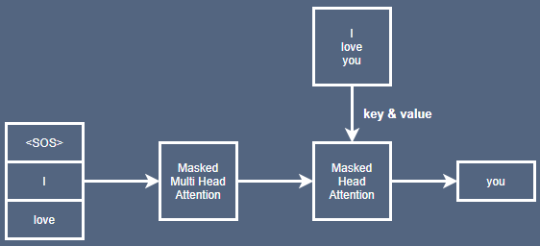
Dive into
Deep Learning
Transformer
Single RNN disadvantage
Sequence to Sequence
Sequence with Attention
Teacher forcing
Transformer
Masked Multi Head Attention :
지금까지 출력된 값들에만 Attention을 적용
Multi Head Attention :
현재 Decoder의 input 값을 query로 encoder의 최종 값을 key & value로 사용

Slide 9
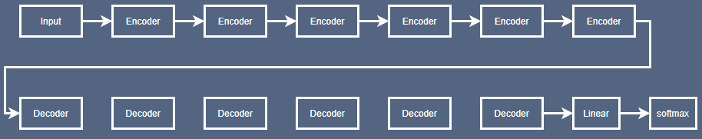
Dive into
Deep Learning
Transformer
Single RNN disadvantage
Sequence to Sequence
Sequence with Attention
Teacher forcing
Transformer
Linear Layer : softmax의 입력 값으로 들어갈 logit 생성
softmax Layer : soft max 이후 Label smoothing 적용
* Label smoothing : 0~1사이로 표현

