Slide 1


Dive into
Deep Learning
Natural Language Processing : Application
Natural Language Processing : Application / SaeBom Lee
Sentiment Analysis
Natural Language Inference

Slide 2
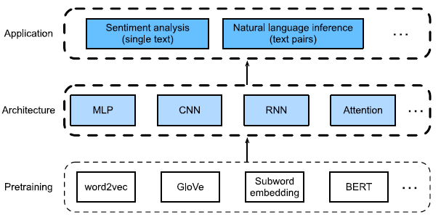
Dive into
Deep Learning
Downstream Task : 구체적으로 해결하고 싶은 문제들
감성처리(Sentiment Analysis) → 단일 텍스트(single text)
자연어추론(Natural Language Inference) → 텍스트 쌍의 관계(text pairs)
<Downstream Task 방법 도식화>
Sentiment Analysis
Natural Language Inference

Slide 3

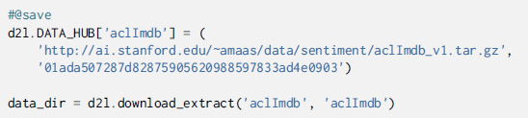
Dive into
Deep Learning
Sentiment Analysis and the Dataset
Data | Large Movie Review Dataset
Size | 25,000 Movie Revies
Label | “positive” and “negative”
1. Setting
2. Roading the Dataset
Sentiment Analysis
Natural Language Inference

Slide 4
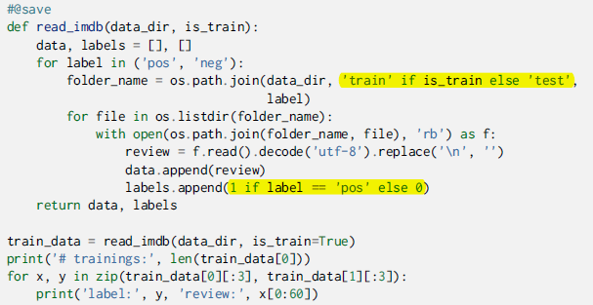

3. Corresponding label : positive → “1” / negative → “0”
Dive into
Deep Learning
0 | Normally the ~ | The Bible teaches ~ | Being someone ~
1 | 1 | 1 | 1
Sentiment Analysis
Natural Language Inference
for ~ in zip : List 여러 개로 slice해서 return
→ (1,2) (3,7) (5,4) (6,8)
1 | 3
5 | 6
2 | 7
4 | 8

Slide 5
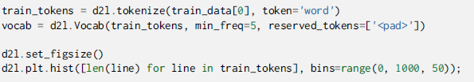
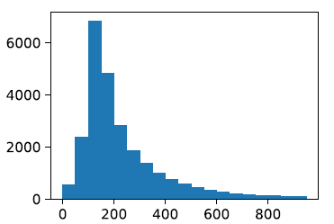

4. Tokenization and Vocabulary
Dive into
Deep Learning
min_freq = 빈도수 → min_freq = 5 : 빈도수가 5번 이산인 단어만 허용
X축을 포함한 리뷰의 갯수
한 리뷰에 포함된 단어들의 갯수
Sentiment Analysis
Natural Language Inference
5. Padding to the Same Length
한 리뷰 당 들어있는 token 수를 500으로 맞춤 →

Slide 6
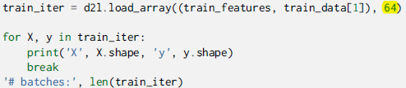
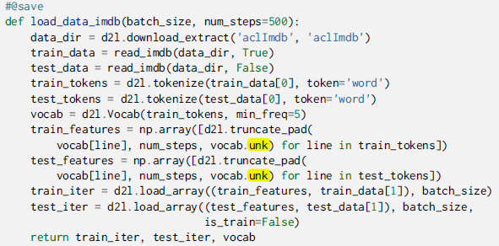
Dive into
Deep Learning
6. Creating the Data Iterator
Minibatch : 64
500
y
64
1
0
1
7. Putting All Together
Sentiment Analysis
Natural Language Inference

Slide 7
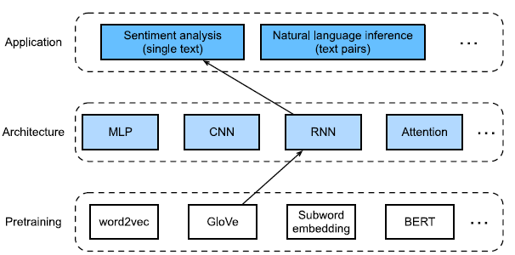
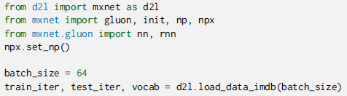
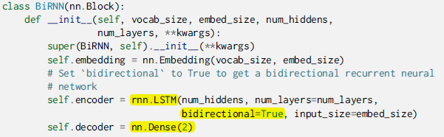
Using Recurrent Neural Networks
Dive into
Deep Learning
1. Using a Recurrent Neural Network model (+ LSTM)
Sentiment Analysis
Natural Language Inference
**kwargs : **변수 → 키원드=“ “ 로 입력할 경우 그것을 각각 키와 값으로 가져오는 “딕셔너리＂로 처리
super(). :자식클래스에서 부모클래스 내용을 사용
bidirectioinal = True : outpu의 마지막 차원수가 2*hidden_size

Slide 8
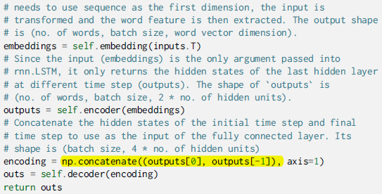
1. Using a Recurrent Neural Network model (+ LSTM)
Dive into
Deep Learning
column (axis=1)
depth (axis=2)
row (axis=0)
Sentiment Analysis
Natural Language Inference
2. Create a bidirectional RNN with tow hidden layers

Slide 9


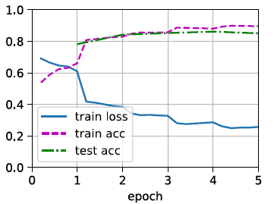
Dive into
Deep Learning
3. Loading Pre-trained Word Vectors
4. No longer update word vectors during training
5. Training and Evaluating the Model
Sentiment Analysis
Natural Language Inference

Slide 10

Dive into
Deep Learning
6. Define the prediction function
np.argmax : 가장 큰 값을 가진 index 반환
Reshape(-1,1) : 2D array
7. Classify the sentiments of two sentences
Sentiment Analysis
Natural Language Inference

Slide 11
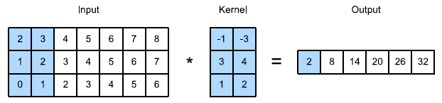

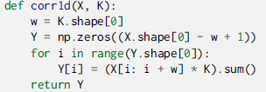
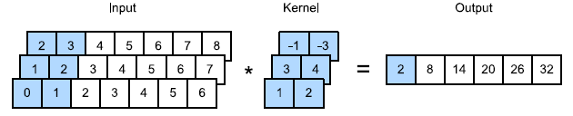
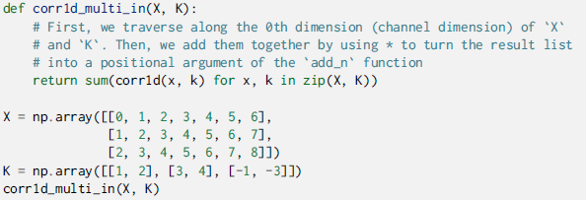
Using Convolutional Neural Networks (TextCNN)
Dive into
Deep Learning
CNN
- 1D & input channel : 1
- 2D & input channel :1
- 1D & input channel : 3
Sentiment Analysis
Natural Language Inference

Slide 12
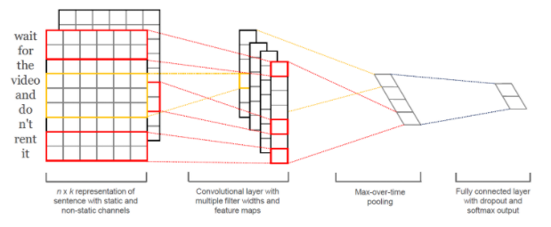
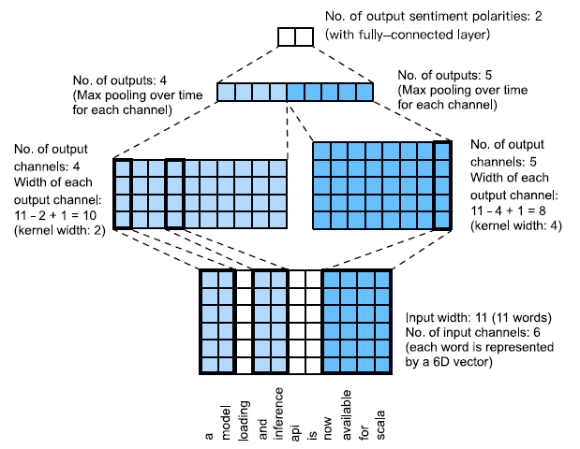
2. TextCNN
Dive into
Deep Learning
Sentiment Analysis
Natural Language Inference
n : 문장에 나오는 단어의 개수
k : word vector 차원
h : filter window size

Slide 13
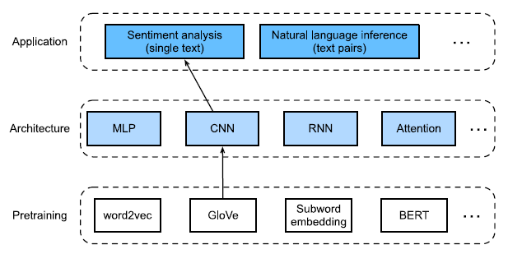
3. Using Convolutional Neural Networks (TextCNN)
Dive into
Deep Learning
Sentiment Analysis
Natural Language Inference

Slide 14
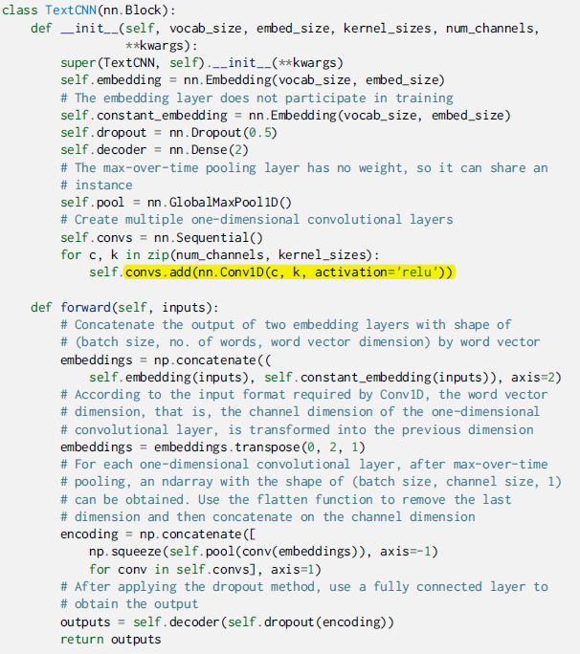
3. Using Convolutional Neural Networks (TextCNN)
Dive into
Deep Learning
self .convs : convolutional layer 만들기
Conv1D : text
Transpose( , , , ) : 축 바꾸기
Squeeze(배열,차원) : 배열에서 axis축 제거해서 1차원 배열로 만들기
axis=-1 : 현재 배열의 마지막 axis
Sentiment Analysis
Natural Language Inference

Slide 15

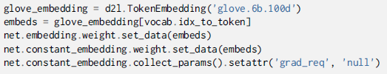

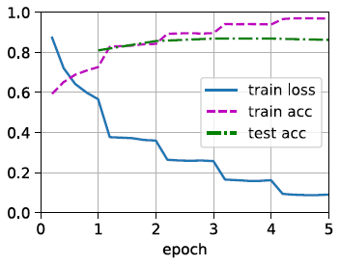
4. 3 convolutional layer with kernel widths of 3,4,5 & 100 output channels
Dive into
Deep Learning
5. Load Pre-trained Word Vectors
6. Train and Evaluate the Model
Sentiment Analysis
Natural Language Inference

Slide 16
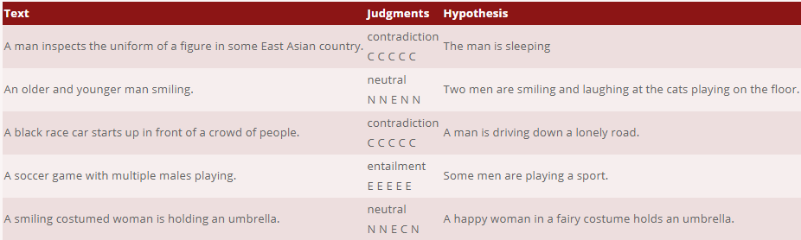
Dive into
Deep Learning
Natural Language Inference and the Dataset
Natural Language Inference
Entailment(함의) : the hypothesis can be inferred from the premise
Contradiction(모순) : the negation of the hypothesis can be inferred from premise
Neutral(중립) : all the other cases
Sentiment Analysis
Natural Language Inference
2. SNLI Dataset
Data | Stanford Natural Language Inference( SNLI)
Size | 500,000 labeled English sentence paris(570k)

Slide 17
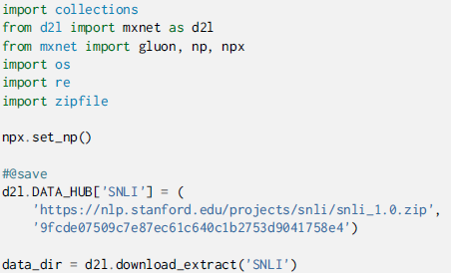
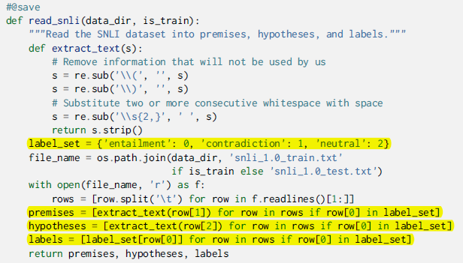
Loading the dataset
Dive into
Deep Learning
2. Reading the Dataset (데이터 너무 크므로 일부만 추출)
Sentiment Analysis
Natural Language Inference

Slide 18

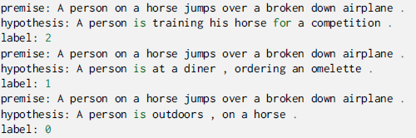


Dive into
Deep Learning
2. Reading the Dataset
Training set 약 550,000 paris, testing set 약 10,000 paris
entailment, contradiction, neutral are balanced in both the training set and testing set
Sentiment Analysis
Natural Language Inference

Slide 19
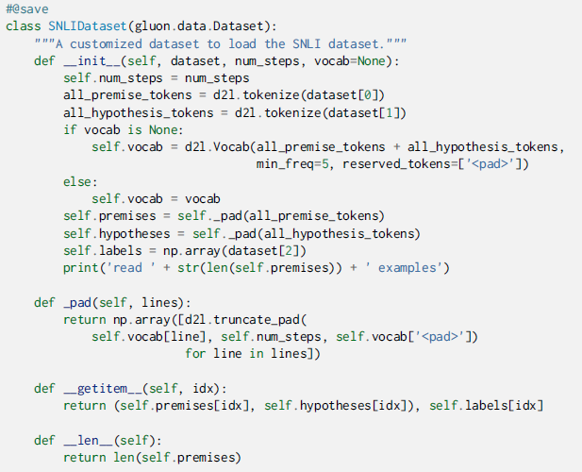
Dive into
Deep Learning
3. Defining a Class for Loading the Dataset
Sentiment Analysis
Natural Language Inference
dataset : 이전 전처리한 dataset
self . num_steps : nm.steps 기준으로 자름

Slide 20

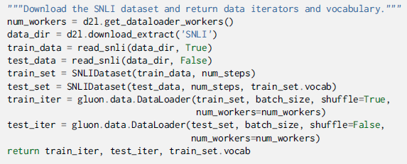


Dive into
Deep Learning
4. Putting All Things Together
2 input X[0] and X[1] ← premise and hypotheses
Y : 정답
Sentiment Analysis
Natural Language Inference

Slide 21
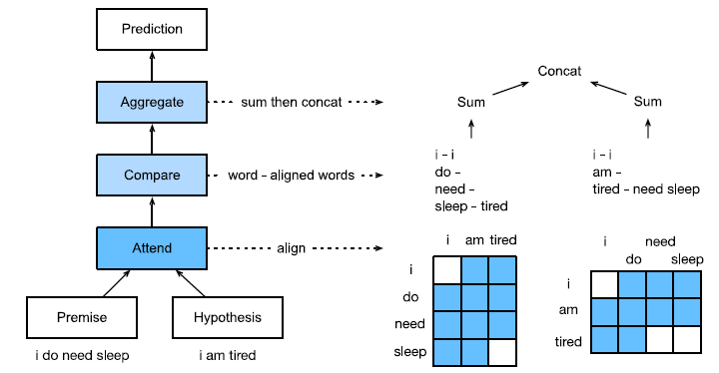
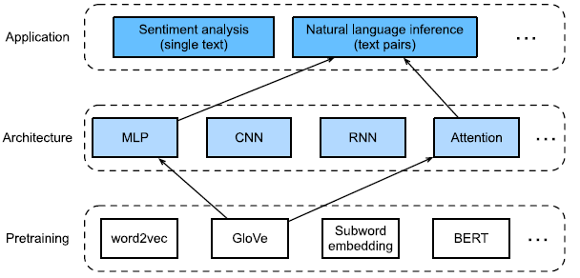
Dive into
Deep Learning
Natural Language Inference : Using Attention
Natural Language Inference : Attention
장점 : NLI 특화된 방법으로 단어의 순서 정보에 의존하지 않으며 파라미터 개수가 기존 NLI보다 적음
방법 : Attend → Compare → Aggregate
Sentiment Analysis
Natural Language Inference

Slide 22

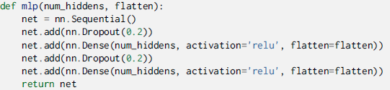


Attending
1.1 soft alignment (←→ hard alignment)
- soft alignment : 주변 단어를 보고 주변 단어의 index 유도를 통해 어떻게 스스로 학습 ← MLP 사용
- hard alignment : 사람이 직접 단어를 지정
- Premise: “ I do need sleep”
- Hypothesis : “I am tired”
의미론적 유사성으로 전제의 “I”와 가설의 “I” 일치 , 전제의 “need”와 “sleep”와 가설의 “tired”일치
1.2 soft alignment 구하기
- MLP 함수 사용해서 attention weight 구함
A = (a1; : : : ; am) : premise , B = (b1; : : : ; bn) : hypothesis
MLP network
Softmax function을 이용하여 모든 단어의 임베딩 가중 평균 계산
Dive into
Deep Learning
Sentiment Analysis
Natural Language Inference
가정에 대한 Softmax function 전제에 대한 Softmax function

Slide 23
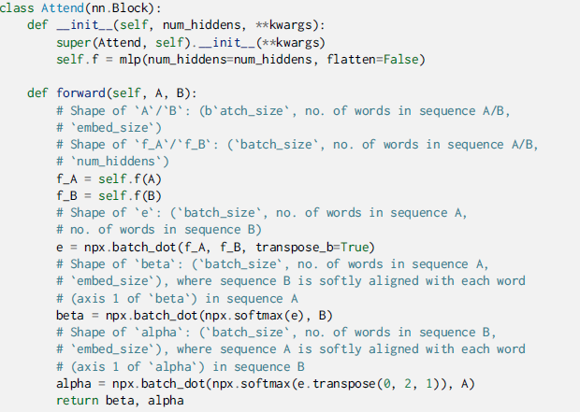
Attending
- premise (alpha) + hypotheses B
- hypotheses (bete) + premise A
Dive into
Deep Learning
Sentiment Analysis
Natural Language Inference
flatten() : 다차원 → 1차원

Slide 24

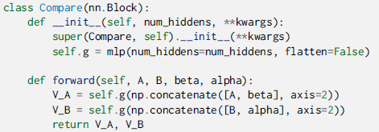



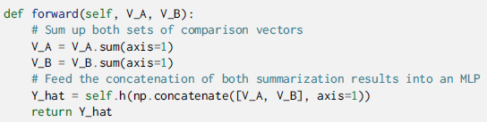
2. Comparing
MLP를 사용하여 전제와 위의 함수 식들 비교
가정에 대한 Softmax function 전제에 대한 Softmax function
Dive into
Deep Learning
A : premise , B : hypothesis
3. Aggregating
- h( ) : MLP
Sentiment Analysis
Natural Language Inference

Slide 25
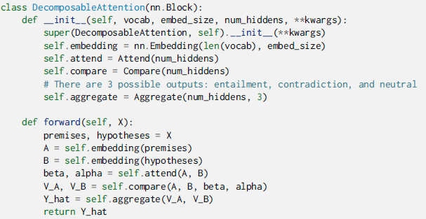
3. Aggregating
Dive into
Deep Learning
4. Putting All Things Together
Sentiment Analysis
Natural Language Inference

Slide 26
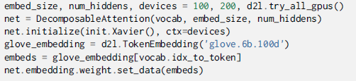
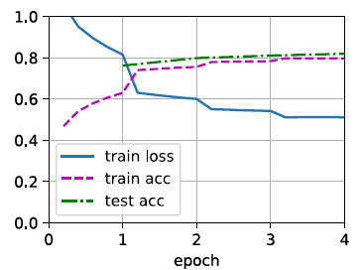
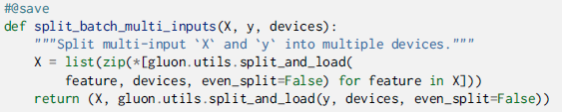

3. Training and Evaluating the Model
- Reading the dataset
Creating the Model
Multiple inputs premises and hypotheses in minibatches
Train and evaluate the model
Dive into
Deep Learning
Sentiment Analysis
Natural Language Inference

Slide 27
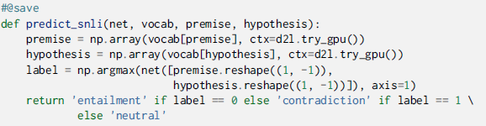

3. Training and Evaluating the Model
Train and evaluate the model
Dive into
Deep Learning
4. Using the Model
Sentiment Analysis
Natural Language Inference

