Slide 1
IIP
연구내용 진행사항 및 결과 설명
2022. 08. 18

Slide 2
Contents
Part.1
KIWI
1. INTRODUCTION
2. RELATED WORK
3. DATASET
4. METHOD
5. EXPERIMENT
6. RESULT
Part.2
Graduation Paper Idea
DATASET
MODEL

Slide 3
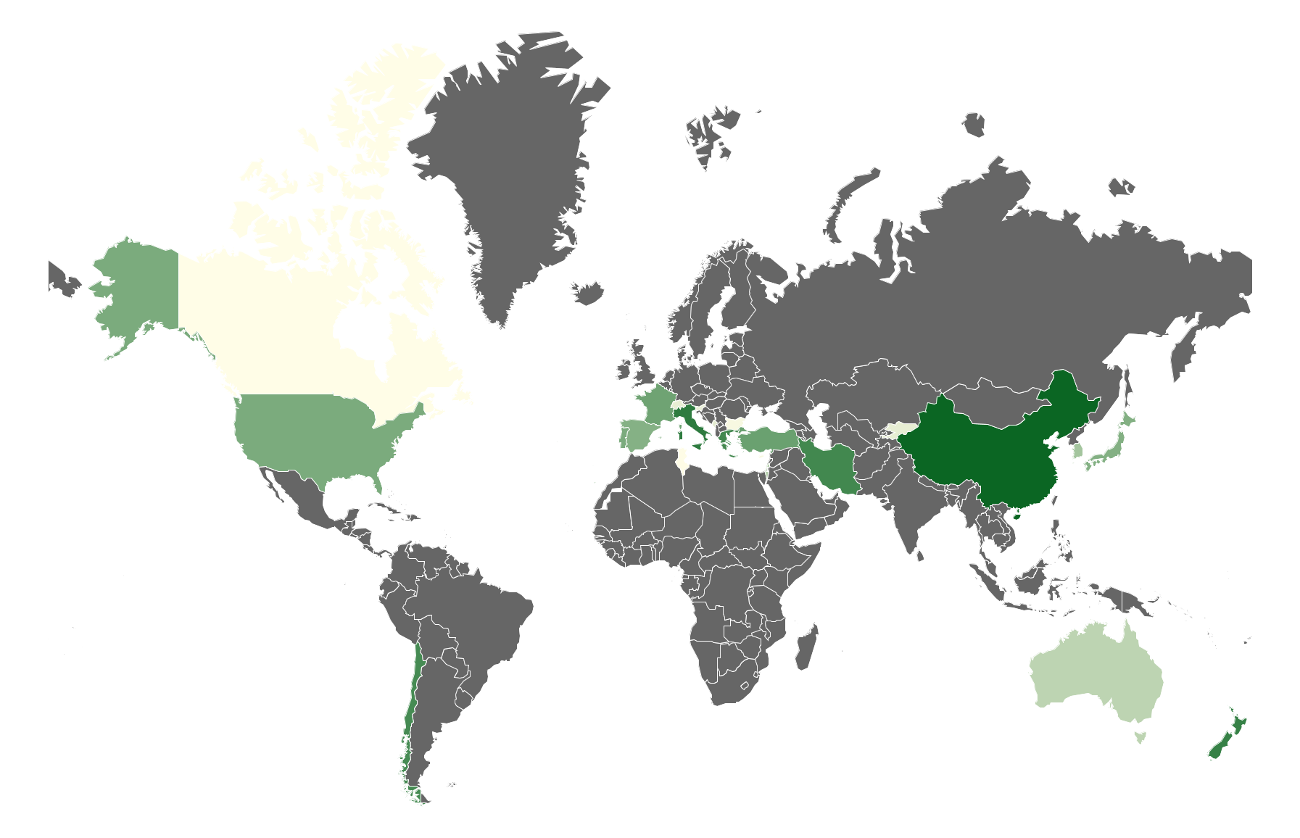
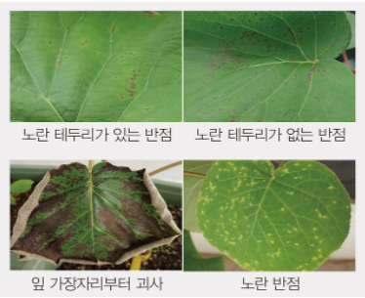
Current Progress KIWI
지난 10년 동안 키위 세계 성장률
키위 재배 면적 71.25%
키위 생산량 55.58%
INTRODUCTION
전 세계적으로 4,274,870 t
키위가 매년 생산됨
키위 병충해 질병 분류 연구는 데이터의 부족으로 인해 다양한 연구가 진행되지 않음
키위 병충해 분류의 한계
실제 필드에서 대용량 키위 데이터 셋 수집
+
딥러닝 기반 키위 자동 진단 분류 시스템이 필요함
병원체에 대한 감염이 쉽고 병원성이 높음
일반적으로 현재 재배지에서 농부의 농업 경험에 의해 수작업으로 병충해를 가시적으로 분류함
비슷한 키위 병충해 질병은 맨눈으로 진단이 어려움 ex> 궤양병의 다양성
현재 사용되는 가장 효과적인 방제는 증상이 보이는 부위의 1m 정도 안쪽까지 제거해 소각함

Slide 4
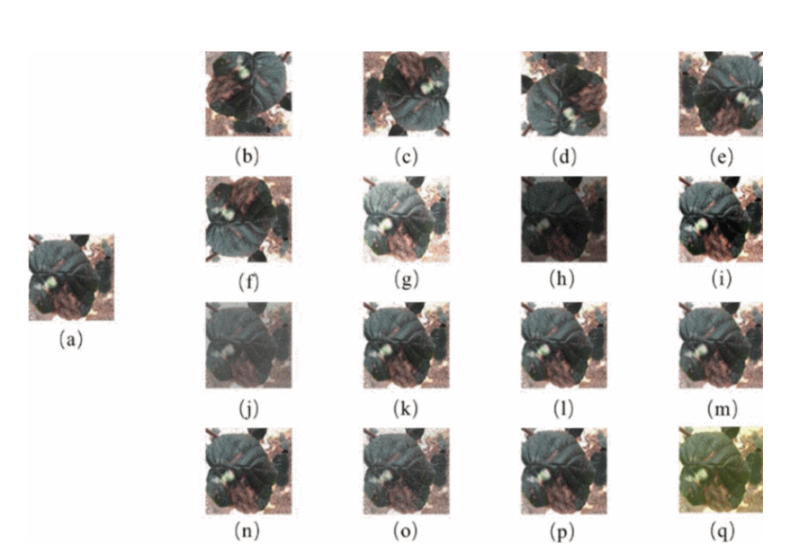
Current Progress KIWI
Description of research progress and results
RELATED WORK
¹⁾ Kiwifruit Leaf Disease Identification Using Improved Deep Convolutional Neural Networks
Models : Pretrained GoogLeNet, ResNet-20, AlexNet, Kiwi-ConvNet
Accuracy : 98.54%
Dataset
Total Images : 666
Three types of Kiwi Disease Labels : (a) kiwi leaf brown spot, (b) kiwi leaf Mosaic, (c) kiwi leaf Anthracnose
Disease | Training /testing images | Total number
Brown spot | 3871/1654 | 5525
Mosaic | 1785/765 | 2550
Anthracnose | 2244/1003 | 3247
Configuration | Value
Solver type | Nesterov’s Accelerated Gradient(NAG)
Training Epoch | 40
Base Learning Rate | 0.001
Image augmentation of kiwifruit leaf diseases & dataset
The details of training strategy
Liu, Bin, et al. "Kiwifruit Leaf Disease Identification Using Improved Deep Convolutional Neural Networks." 2020 IEEE 44th Annual Computers, Software, and Applications Conference (COMPSAC). IEEE, 2020.

Slide 5
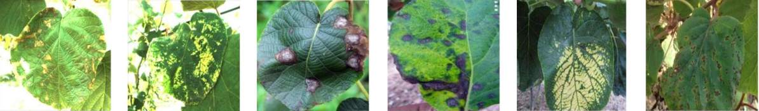
Current Progress KIWI
Description of research progress and results
RELATED WORK
²⁾ Transformer helps identify kiwifruit diseases in complex natural environments
Method : ConViT
Accuracy : 98.78%
Dataset
Total Images : 2,115
Six types of Citrus Disease Labels
(a) kiwi leaf brown spot, (b) kiwi leaf mosaic, (c) kiwi leaf anthracnose, (d) kiwi leaf black spot, (e) kiwi leaf yellow leaf, (f) kiwi leaf ulcer
3. Details of the three experimental dataset
Dataset | Kiwifruit | Augmentation kiwifruit | PlantVillage | AI Challenger
Samples | 2,115 | 25,168 | 54,306 | 35,861
Classes | 6 | 6 | 38 | 59
Crops | 1 | 1 | 14 | 10
Types | 6 | 8 | 24 | 27
Li, Xiaopeng, et al. "Transformer helps identify kiwifruit diseases in complex natural environments." Computers and Electronics in Agriculture 200 (2022): 107258.

Slide 6
Current Progress Kiwi
Description of research progress and results
DATASET
Citrus Pathogen type | Training Image | Validation Image | Test Image | Total | Image size
Kiwi Fruit Normal | 1,698 | 213 | 213 | 2,124 | 1920x1080
Kiwi Fruit Bacterial soft rot | 1,389 | 174 | 174 | 1,737 | 1920x1080
Kiwi Leaf Normal | 2,300 | 288 | 288 | 2,876 | 1920x1080
Kiwi Leaf Spot | 6,142 | 768 | 768 | 7,675 | 1920x1080
Kiwi Leaf Trips | 4,467 | 559 | 559 | 5,585 | 1920x1080
Total | 15,996 | 2,002 | 2,002 | 20,000 | 1920x1080
6
/ 22

Slide 7
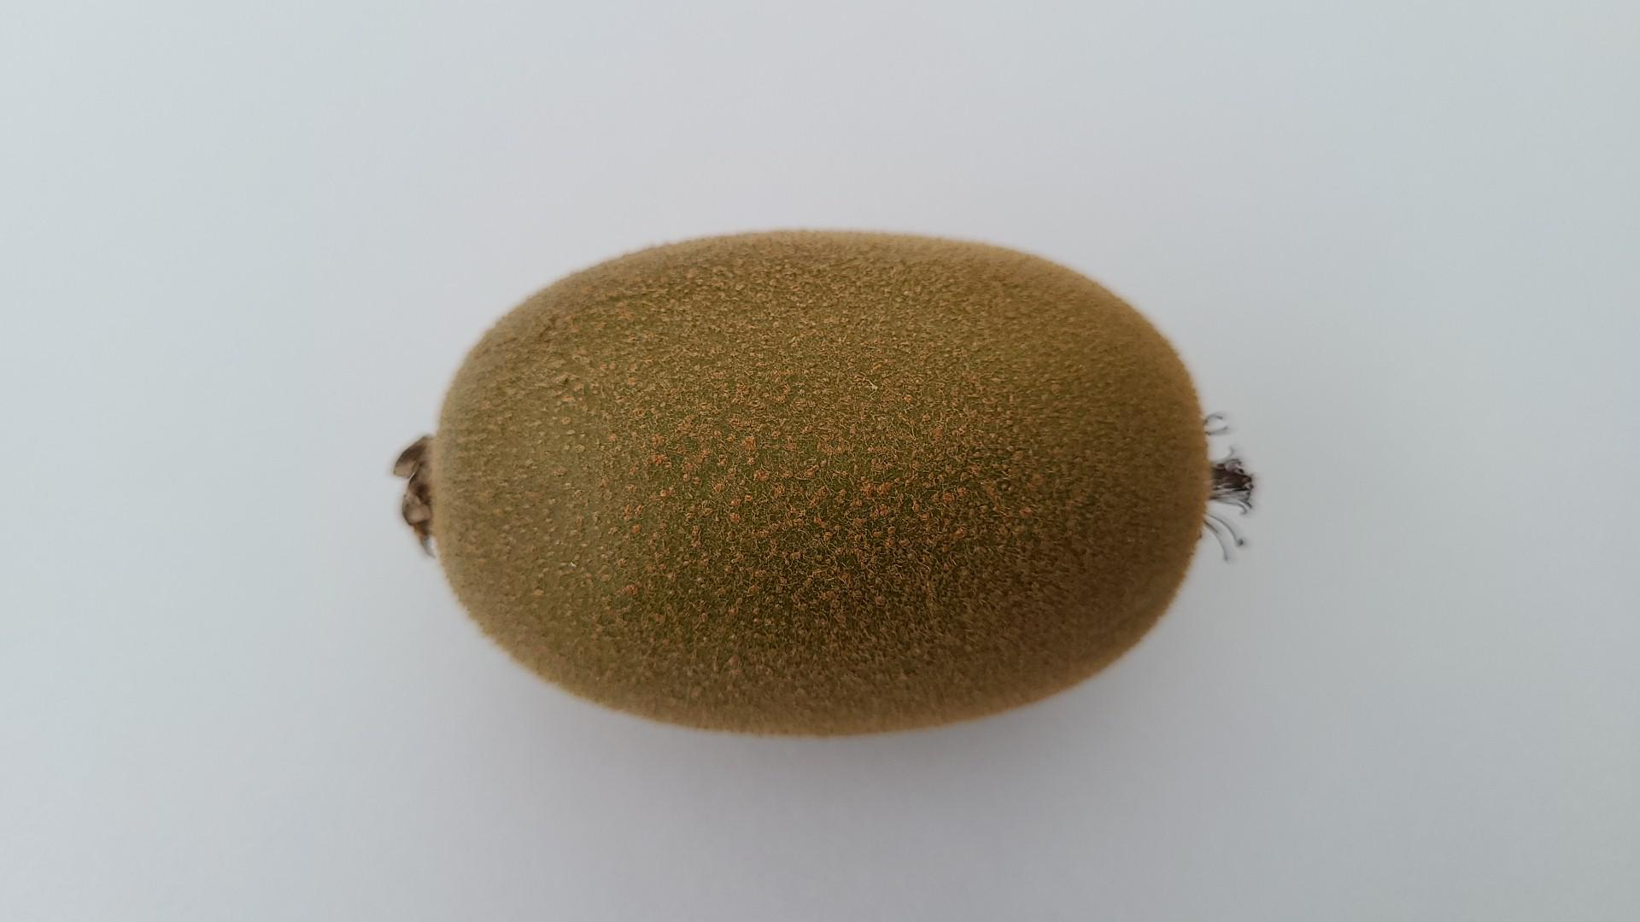
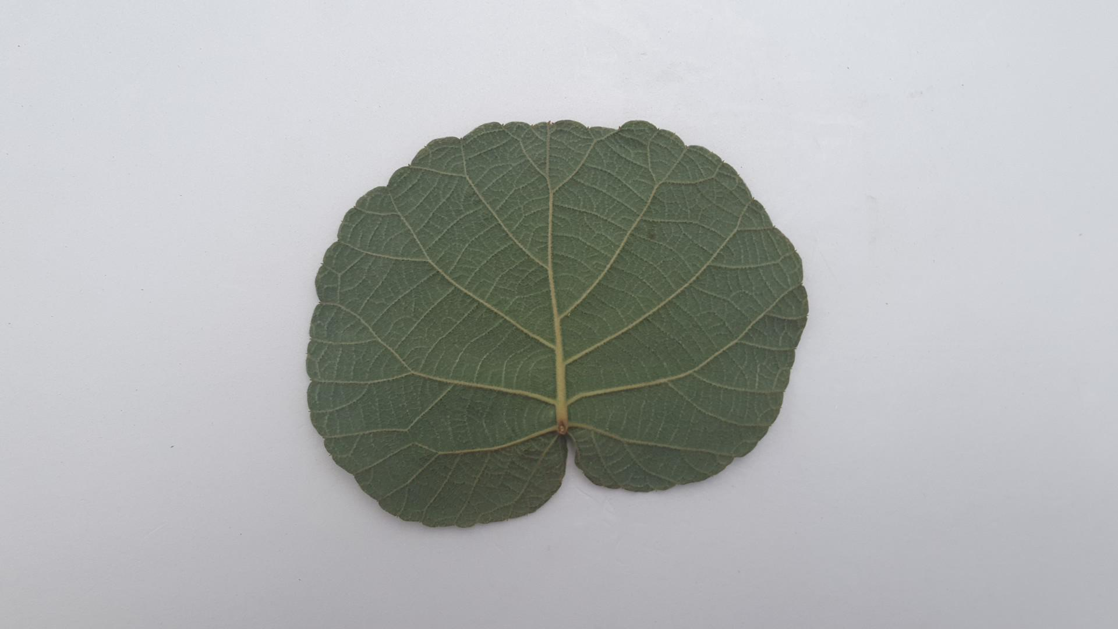
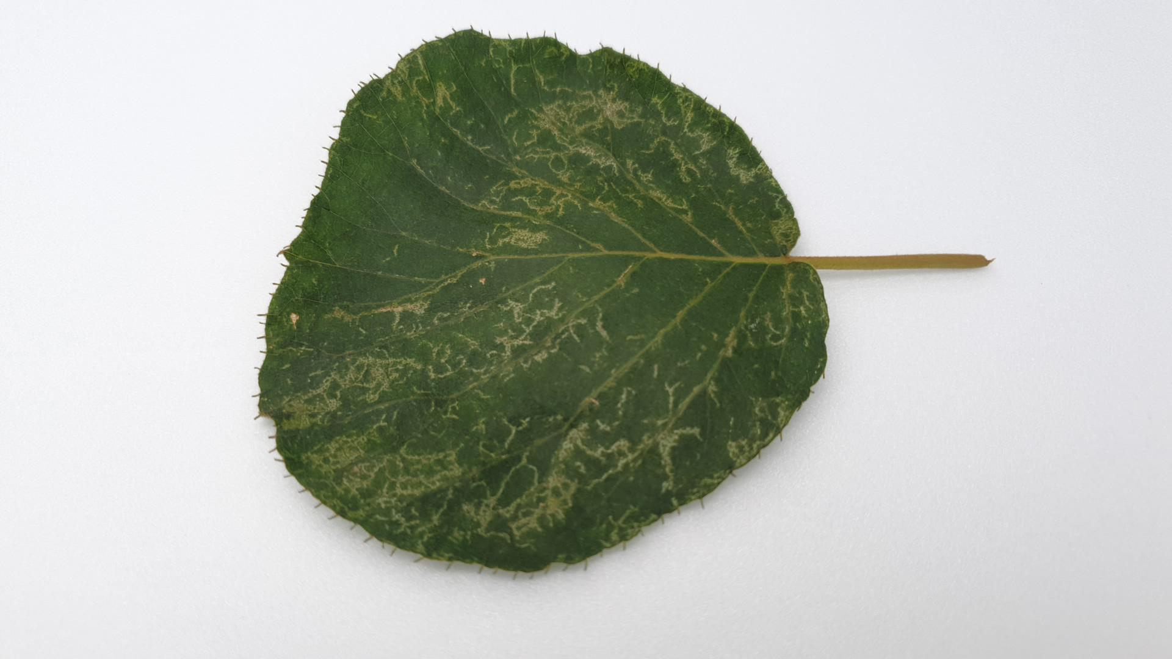
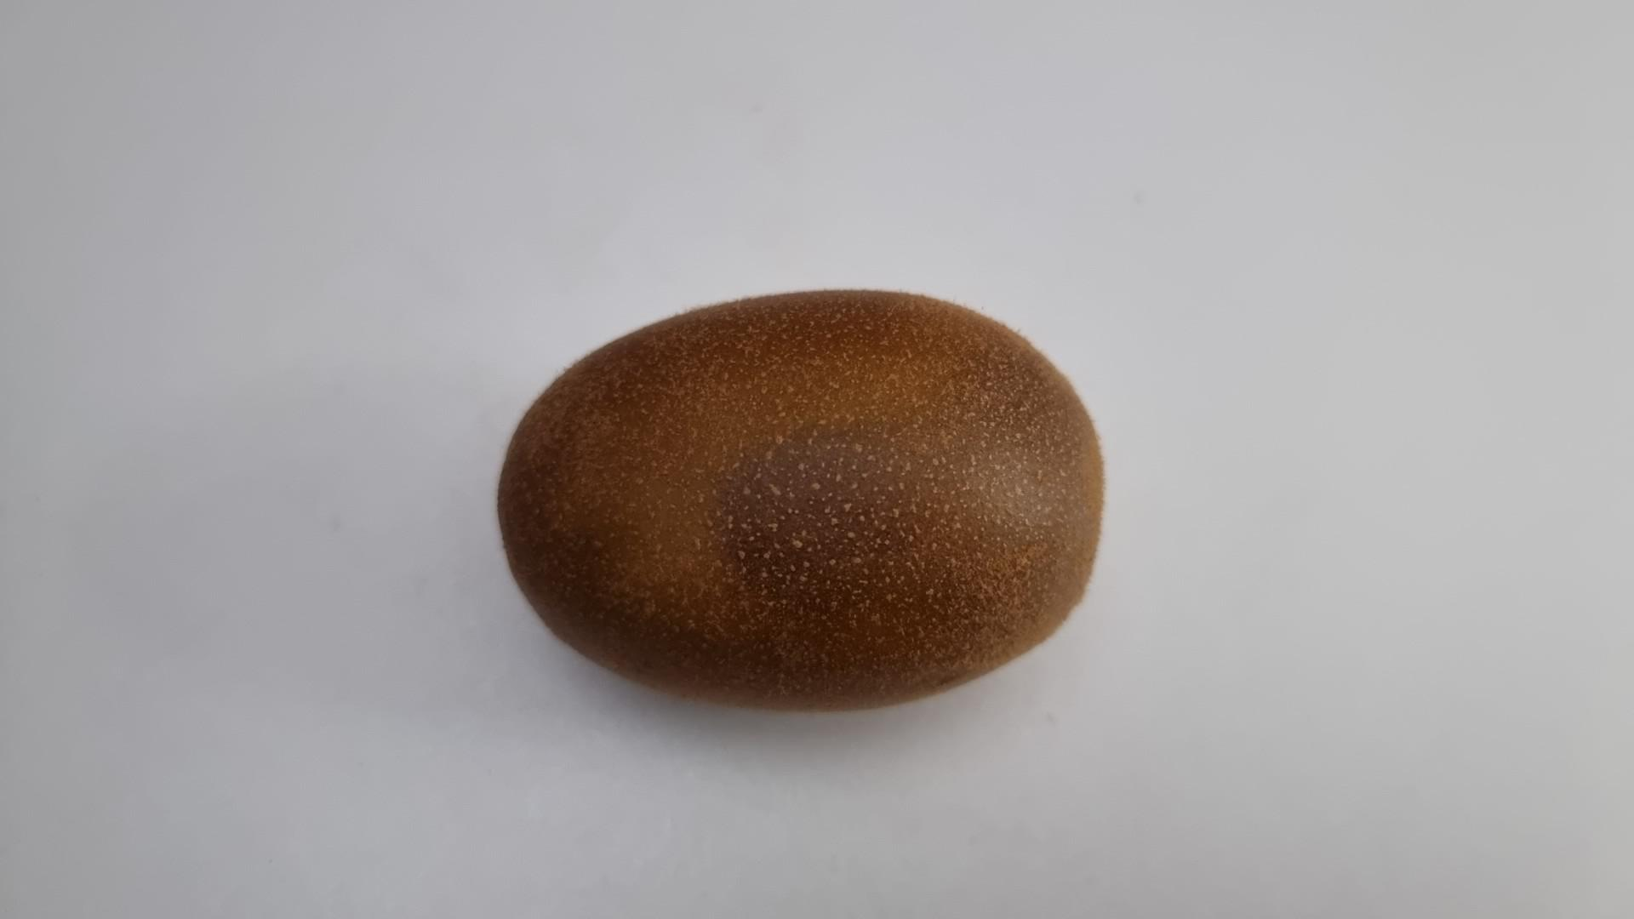
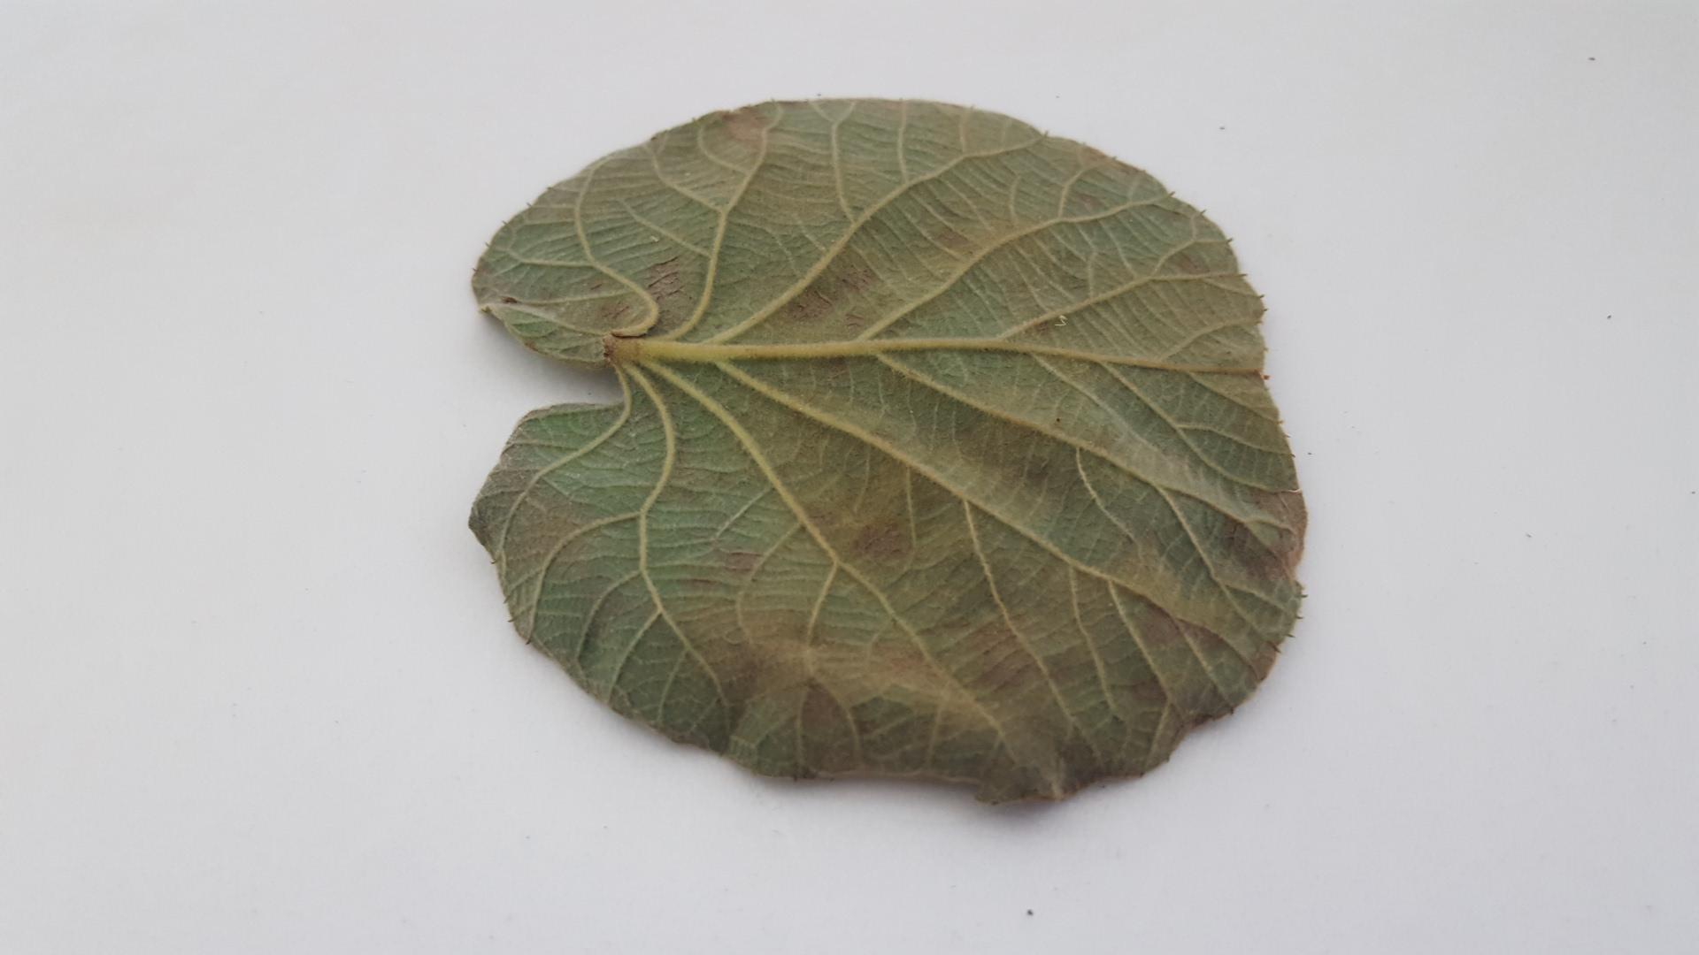
Current Progress Kiwi
Description of research progress and results
DATASET
Kiwi Fruit Normal
Kiwi Leaf Normal
Kiwi Leaf Trips
Kiwi Fruit Bacterial soft rot
Kiwi Leaf Spot
7
/ 26

Slide 8
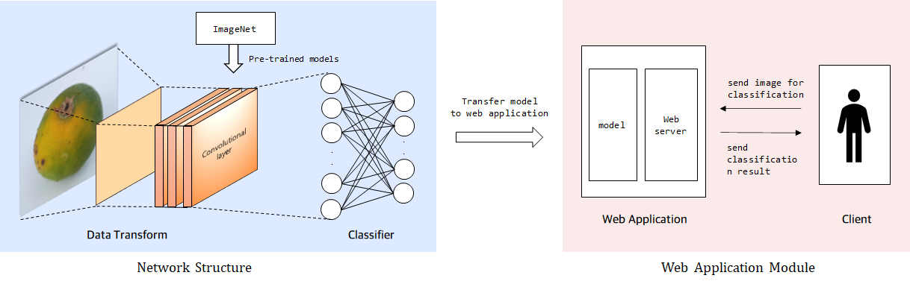
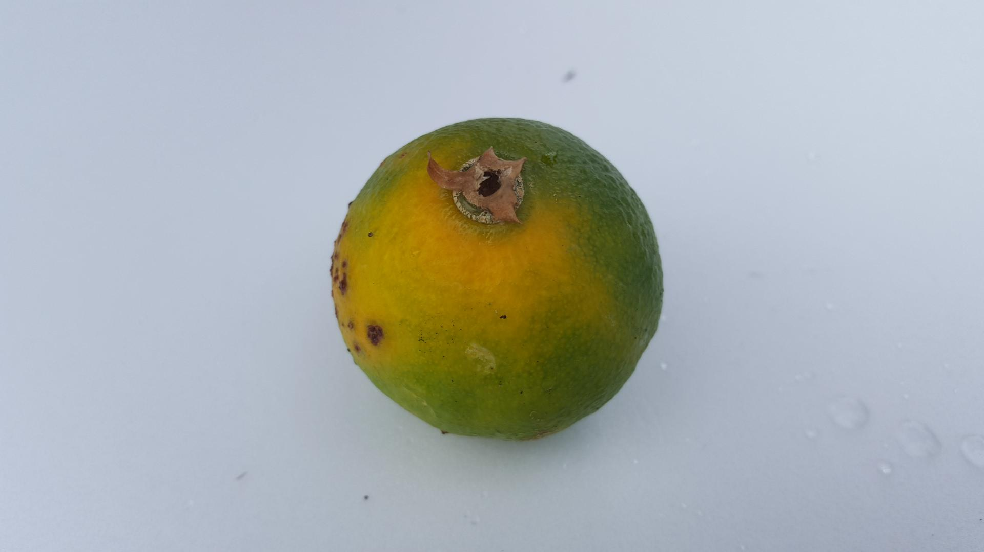
Current Progress KIWI
Description of research progress and results
EXPERIMENT
- Network Architecture
ImageNet
Pre-trained
Convolutional layer
Transfer model
to web application
Convolutional layer
Convolutional layer
send image for classification
User
.
.
model
Web server
.
.
send
classification result
Data Transform
Classifier
Web Application
Client
8
/ 26

Slide 9
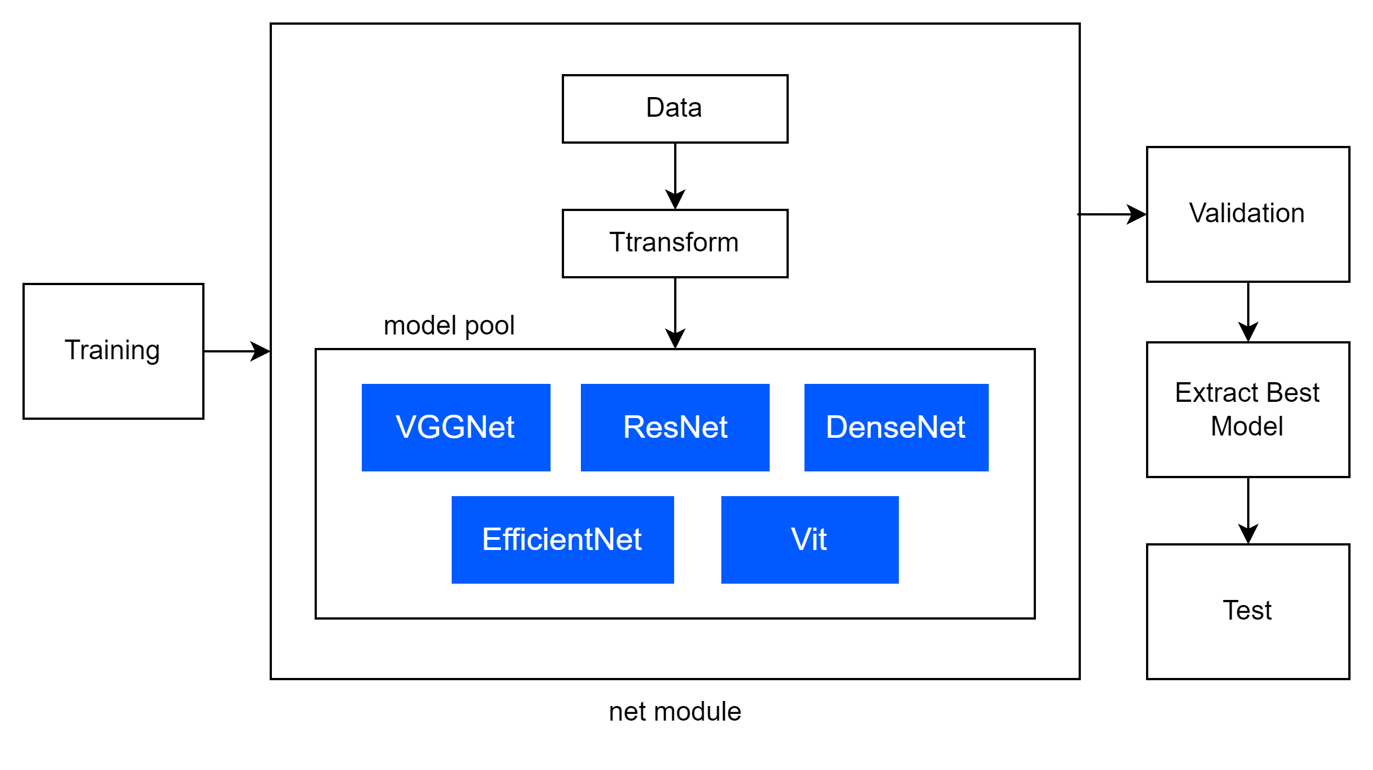
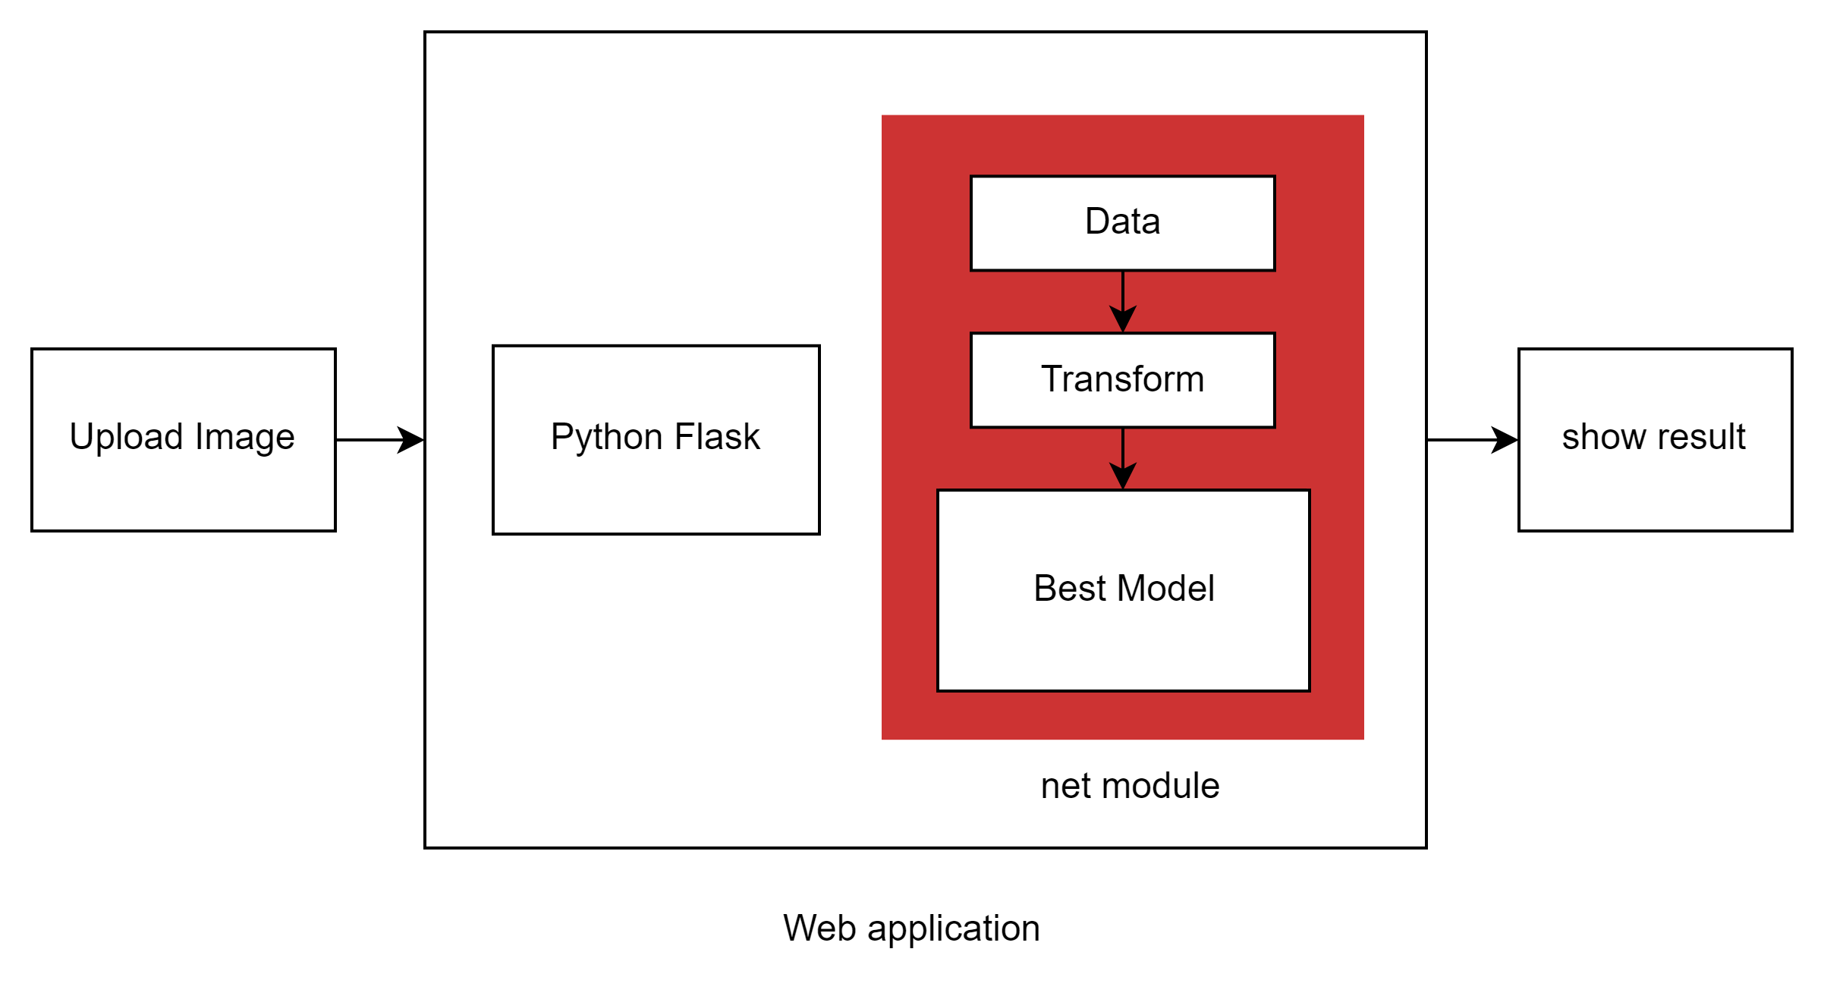
Current Progress KIWI
Description of research progress and results
EXPERIMENT
Net Module
Web Application
9
/ 26

Slide 10
Current Progress KIWI
Description of research progress and results
RESULT
- Validation Result
Model | Accuracy | F1-score | Class | Precision | Recall
VGG16 | 0.951 | 0.963 | Kiwi Fruit Normal | 0.986 | 1.0
 |  |  | Kiwi Fruit Bacterial soft rot | 1.0 | 0.981
 |  |  | Kiwi Leaf Normal | 0.976 | 0.932
 |  |  | Kiwi Leaf Spot | 0.986 | 0.908
 |  |  | Kiwi Leaf Trips | 0.875 | 0.988
 |  |  | macro avg | 0.95 | 0.96
 |  |  | weighted avg | 0.94 | 0.93
10
/ 26

Slide 11
Current Progress KIWI
Description of research progress and results
RESULT
- Validation Result
Model | Accuracy | F1-score | Class | Precision | Recall
ResNet50 | 0.953 | 0.967 | Kiwi Fruit Normal | 1.0 | 1.0
 |  |  | Kiwi Fruit Bacterial soft rot | 1.0 | 1.0
 |  |  | Kiwi Leaf Normal | 0.917 | 1.0
 |  |  | Kiwi Leaf Spot | 0.972 | 0.897
 |  |  | Kiwi Leaf Trips | 0.93 | 0.952
 |  |  | macro avg | 0.95 | 0.96
 |  |  | weighted avg | 0.94 | 0.93
11
/ 26

Slide 12
Current Progress KIWI
Description of research progress and results
RESULT
- Validation Result
Model | Accuracy | F1-score | Class | Precision | Recall
DenseNet161 | 0.907 | 0.941 | Kiwi Fruit Normal | 0.99 | 1.0
 |  |  | Kiwi Fruit Bacterial soft rot | 1.0 | 0.986
 |  |  | Kiwi Leaf Normal | 0.983 | 0.983
 |  |  | Kiwi Leaf Spot | 0.979 | 0.789
 |  |  | Kiwi Leaf Trips | 0.791 | 0.963
 |  |  | macro avg | 0.95 | 0.96
 |  |  | weighted avg | 0.93 | 0.92
12
/ 26

Slide 13
Current Progress KIWI
Description of research progress and results
RESULT
- Validation Result
Model | Accuracy | F1-score | Class | Precision | Recall
EfficientNet-b4 | 0.91 | 0.941 | Kiwi Fruit Normal | 0.995 | 0.997
 |  |  | Kiwi Fruit Bacterial soft rot | 0.996 | 0.993
 |  |  | Kiwi Leaf Normal | 0.908 | 0.968
 |  |  | Kiwi Leaf Spot | 0.995 | 0.794
 |  |  | Kiwi Leaf Trips | 0.785 | 0.975
 |  |  | macro avg | 0.94 | 0.96
 |  |  | weighted avg | 0.93 | 0.92
13
/ 26

Slide 14
Current Progress KIWI
Description of research progress and results
RESULT
- Validation Result
Model | Accuracy | F1-score | Class | Precision | Recall
VIT_B_16_ ImageNet1K | 0.917 | 0.945 | Kiwi Fruit Normal | 0.988 | 0.996
 |  |  | Kiwi Fruit Bacterial soft rot | 0.994 | 0.983
 |  |  | Kiwi Leaf Normal | 0.92 | 0.981
 |  |  | Kiwi Leaf Spot | 0.986 | 0.827
 |  |  | Kiwi Leaf Trips | 0.806 | 0.965
 |  |  | macro avg | 0.94 | 0.96
 |  |  | weighted avg | 0.93 | 0.92
14
/ 26

Slide 15
Current Progress KIWI
Description of research progress and results
RESULT
- Test Result
Model | Accuracy | F1-score | Class | Precision | Recall
VGG16 | 0.971 | 0.973 | Kiwi Fruit Normal | 1.0 | 0.991
 |  |  | Kiwi Fruit Bacterial soft rot | 0.978 | 1.0
 |  |  | Kiwi Leaf Normal | 0.884 | 0.979
 |  |  | Kiwi Leaf Spot | 0.992 | 0.952
 |  |  | Kiwi Leaf Trips | 0.978 | 0.975
 |  |  | macro avg | 0.97 | 0.98
 |  |  | weighted avg | 0.97 | 0.97
15
/ 26

Slide 16
Current Progress KIWI
Description of research progress and results
RESULT
- Test Result
Model | Accuracy | F1-score | Class | Precision | Recall
ResNet50 | 0.96 | 0.965 | Kiwi Fruit Normal | 1.0 | 0.995
 |  |  | Kiwi Fruit Bacterial soft rot | 0.994 | 1.0
 |  |  | Kiwi Leaf Normal | 0.841 | 0.972
 |  |  | Kiwi Leaf Spot | 0.984 | 0.94
 |  |  | Kiwi Leaf Trips | 0.973 | 0.953
 |  |  | macro avg | 0.97 | 0.98
 |  |  | weighted avg | 0.97 | 0.97
16
/ 26

Slide 17
Current Progress KIWI
Description of research progress and results
RESULT
- Test Result
Model | Accuracy | F1-score | Class | Precision | Recall
DenseNet161 | 0.979 | 0.981 | Kiwi Fruit Normal | 0.991 | 1.0
 |  |  | Kiwi Fruit Bacterial soft rot | 1.0 | 0.989
 |  |  | Kiwi Leaf Normal | 0.934 | 0.976
 |  |  | Kiwi Leaf Spot | 0.995 | 0.965
 |  |  | Kiwi Leaf Trips | 0.97 | 0.987
 |  |  | macro avg | 0.98 | 0.98
 |  |  | weighted avg | 0.98 | 0.98
17
/ 26

Slide 18
Current Progress KIWI
Description of research progress and results
RESULT
- Test Result
Model | Accuracy | F1-score | Class | Precision | Recall
EfficientNet-b4 | 0.972 | 0.973 | Kiwi Fruit Normal | 0.995 | 0.962
 |  |  | Kiwi Fruit Bacterial soft rot | 0.956 | 1.0
 |  |  | Kiwi Leaf Normal | 0.959 | 0.965
 |  |  | Kiwi Leaf Spot | 0.993 | 0.957
 |  |  | Kiwi Leaf Trips | 0.949 | 0.991
 |  |  | macro avg | 0.97 | 0.98
 |  |  | weighted avg | 0.97 | 0.97
18
/ 26

Slide 19
Current Progress KIWI
Description of research progress and results
RESULT
- Test Result
Model | Accuracy | F1-score | Class | Precision | Recall
VIT_B_16_ ImageNet1K | 0.971 | 0.977 | Kiwi Fruit Normal | 1.0 | 0.995
 |  |  | Kiwi Fruit Bacterial soft rot | 0.994 | 1.0
 |  |  | Kiwi Leaf Normal | 0.919 | 0.99
 |  |  | Kiwi Leaf Spot | 0.996 | 0.94
 |  |  | Kiwi Leaf Trips | 0.95 | 0.986
 |  |  | macro avg | 0.97 | 0.98
 |  |  | weighted avg | 0.97 | 0.97
19
/ 26

Slide 20
Contents
Part.1
KIWI
1. INTRODUCTION
2. RELATED WORK
3. DATASET
4. METHOD
5. EXPERIMENT
6. RESULT
Part.2
Graduation Paper Idea
DATASET
MODEL

Slide 21
Graduation Paper Idea
Description of research progress and results
DATASET
자체 구축 Dataset + 오픈 소스 Dataset
Citrus Pathogen type | Training Image | Validation Image | Test Image | Total
Kiwi Fruit Normal | 1,698 | 213 | 213 | 2,124
Kiwi Fruit Bacterial soft rot | 1,389 | 174 | 174 | 1,737
Kiwi Leaf Normal | 2,300 | 288 | 288 | 2,876
Kiwi Leaf Spot | 6,142 | 768 | 768 | 7,675
Kiwi Leaf Trips | 4,467 | 559 | 559 | 5,585
Total | 15,996 | 2,002 | 2,002 | 20,000
Training set : Validation set = 80 : 20
21
/ 26

Slide 22
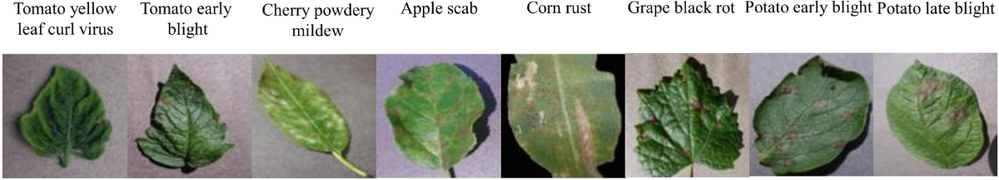
Graduation Paper Idea
Description of research progress and results
DATASET
자체 구축 Dataset + 오픈 소스 Dataset
Training set : 15,996
Training set + Validation set + Test set
Random Shuffle
Training set : Validation set = 80:20
Validation set : 2,002
Open Dataset : PlantVillage
Test set : 2,002
22
22
/ 22
/ 22

Slide 23
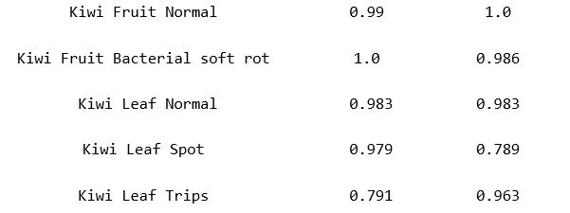
Graduation Paper Idea
Description of research progress and results
Architecture
Result Problem
Kiwi Leaf Normal
Kiwi Leaf Trips
키위 잎 분류 결과가 낮음 특히, Spot 과 Trips 분류가 어려움
Kiwi Leaf Spot
23
/ 26

Slide 24
Graduation Paper Idea
Description of research progress and results
Architecture
Model Idea
MEAL(Multi-model Ensemble via Adversarial Learning)
여러 네트워크 모델을 앙상블로 결합하면 성능이 오르는데, 총 네트워크의 크기와 추론 시간도 함께 증가하기 때문에 실제로 적용할 때는 어려움이 많은 것이 현실
MEAL 은 Teacher-Student learning 을 적용하는데, 구체적으로는 이미 학습된 여러 개의 네트워크를 복수의 teache 라고 보고, selection module 에 의해 그 중 하나를 선택적으로 사용하여 distillation 시킴으로써 최종적으로는 단일 student network 를 만듦
selection module 대신 teacher들의 ensemble을 직접적으로 사용하고, one-hot/hard label을 distillation 과정에서 배제하는 등 몇 가지 개선 사항이 적용
네트워크 구조 변경 없이도 ResNet-50의 ImageNet-1K 성능(224×224 single crop)이 TOP-1 80%를 넘음
Idea
Teacher model : Citrus → EfficientNet + DenseNet
Kiwi → VGG + ResNet
Shen, Zhiqiang, Zhankui He, and Xiangyang Xue. "Meal: Multi-model ensemble via adversarial learning." Proceedings of the AAAI Conference on Artificial Intelligence. Vol. 33. No. 01. 2019.
24
/ 26

Slide 25
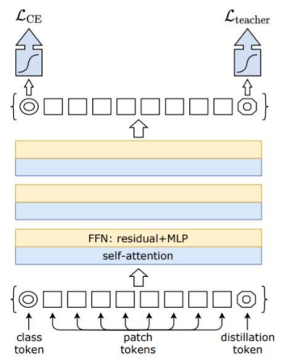
Paper Review
ConViT : Improving Vision Transformers with Soft Convolutional Inductive Biases
Background
Data-efficient image Transformers (DeiT)
ViT
CNN 기반 Model
Class token + patch tokens 을 사용한 Cross Entropy Loss
CNN 기반 모델이 inductive bias
→ Global Optimum 에 더 잘 수렴
Training data-efficient image transformers & distillation through attention (2021)
25
/ 26

Slide 26
IIP
감사합니다.
: )

