Slide 1
IIP
연구내용 진행사항
2022. 09. 01

Slide 2
Contents
Part.1
Preview
1. Experiment Result
2. Discussion
Part.2
Experiment in progress
DATASET
MODEL

Slide 3
Part.1
Preview

Slide 4
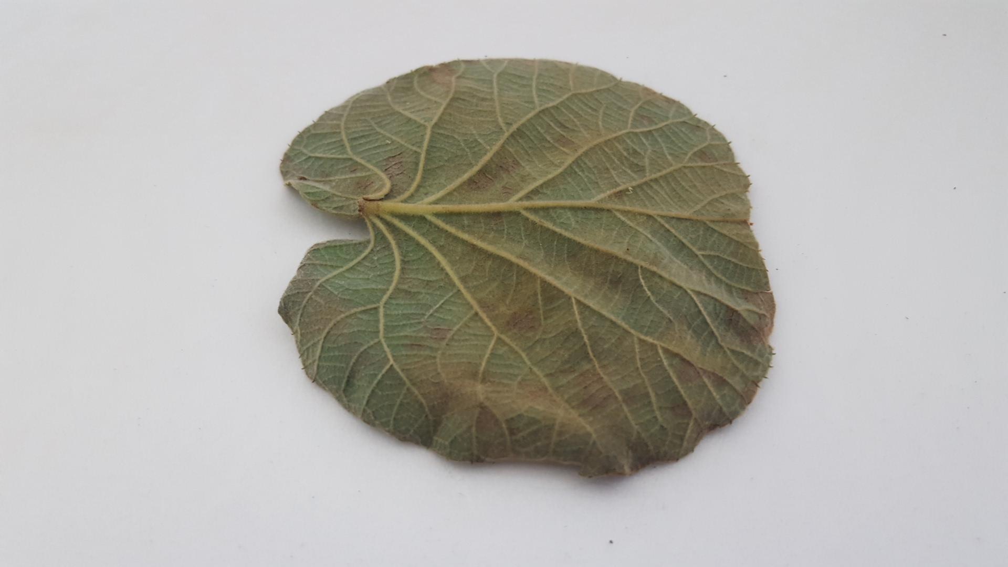
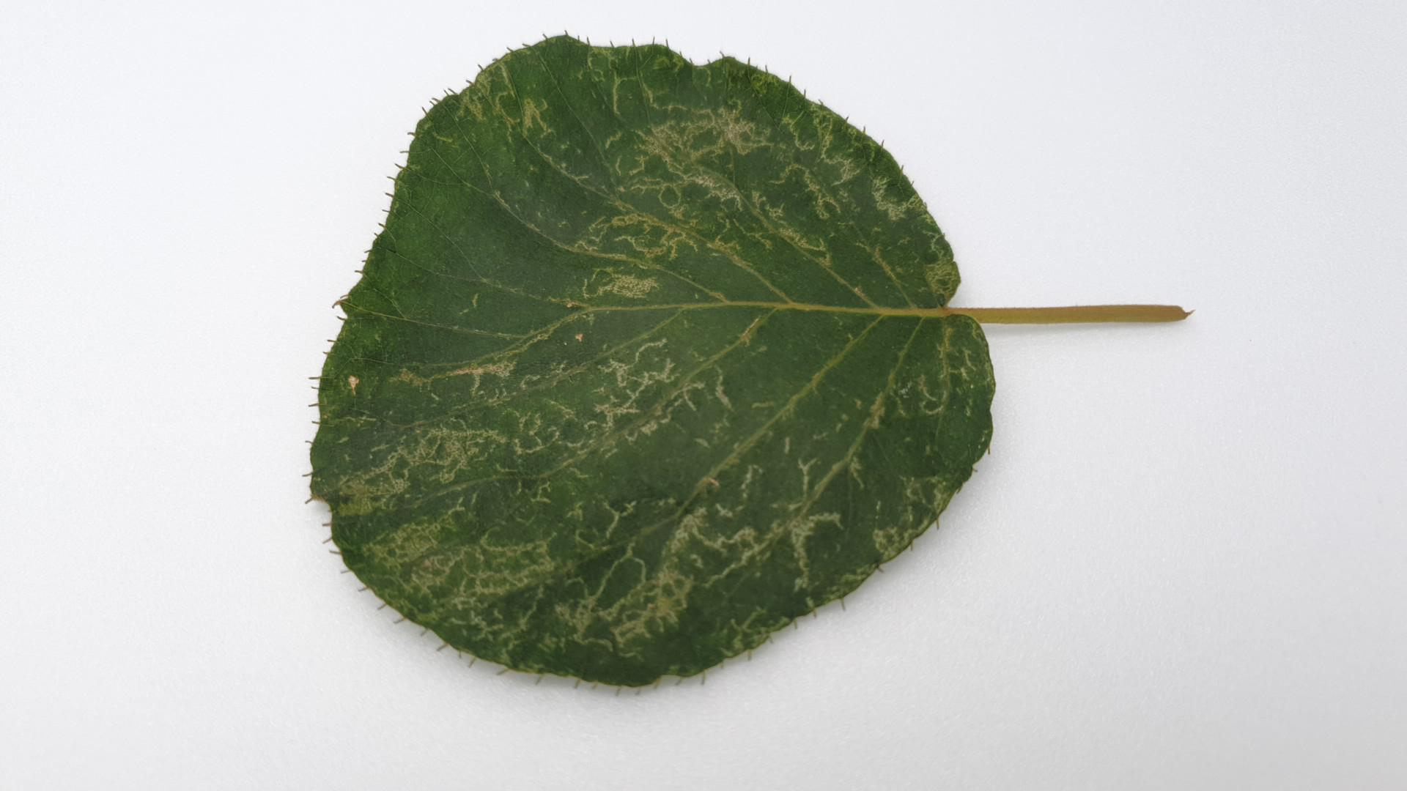
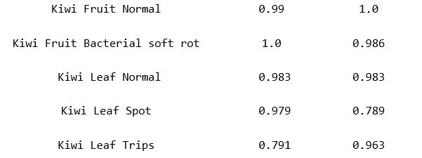
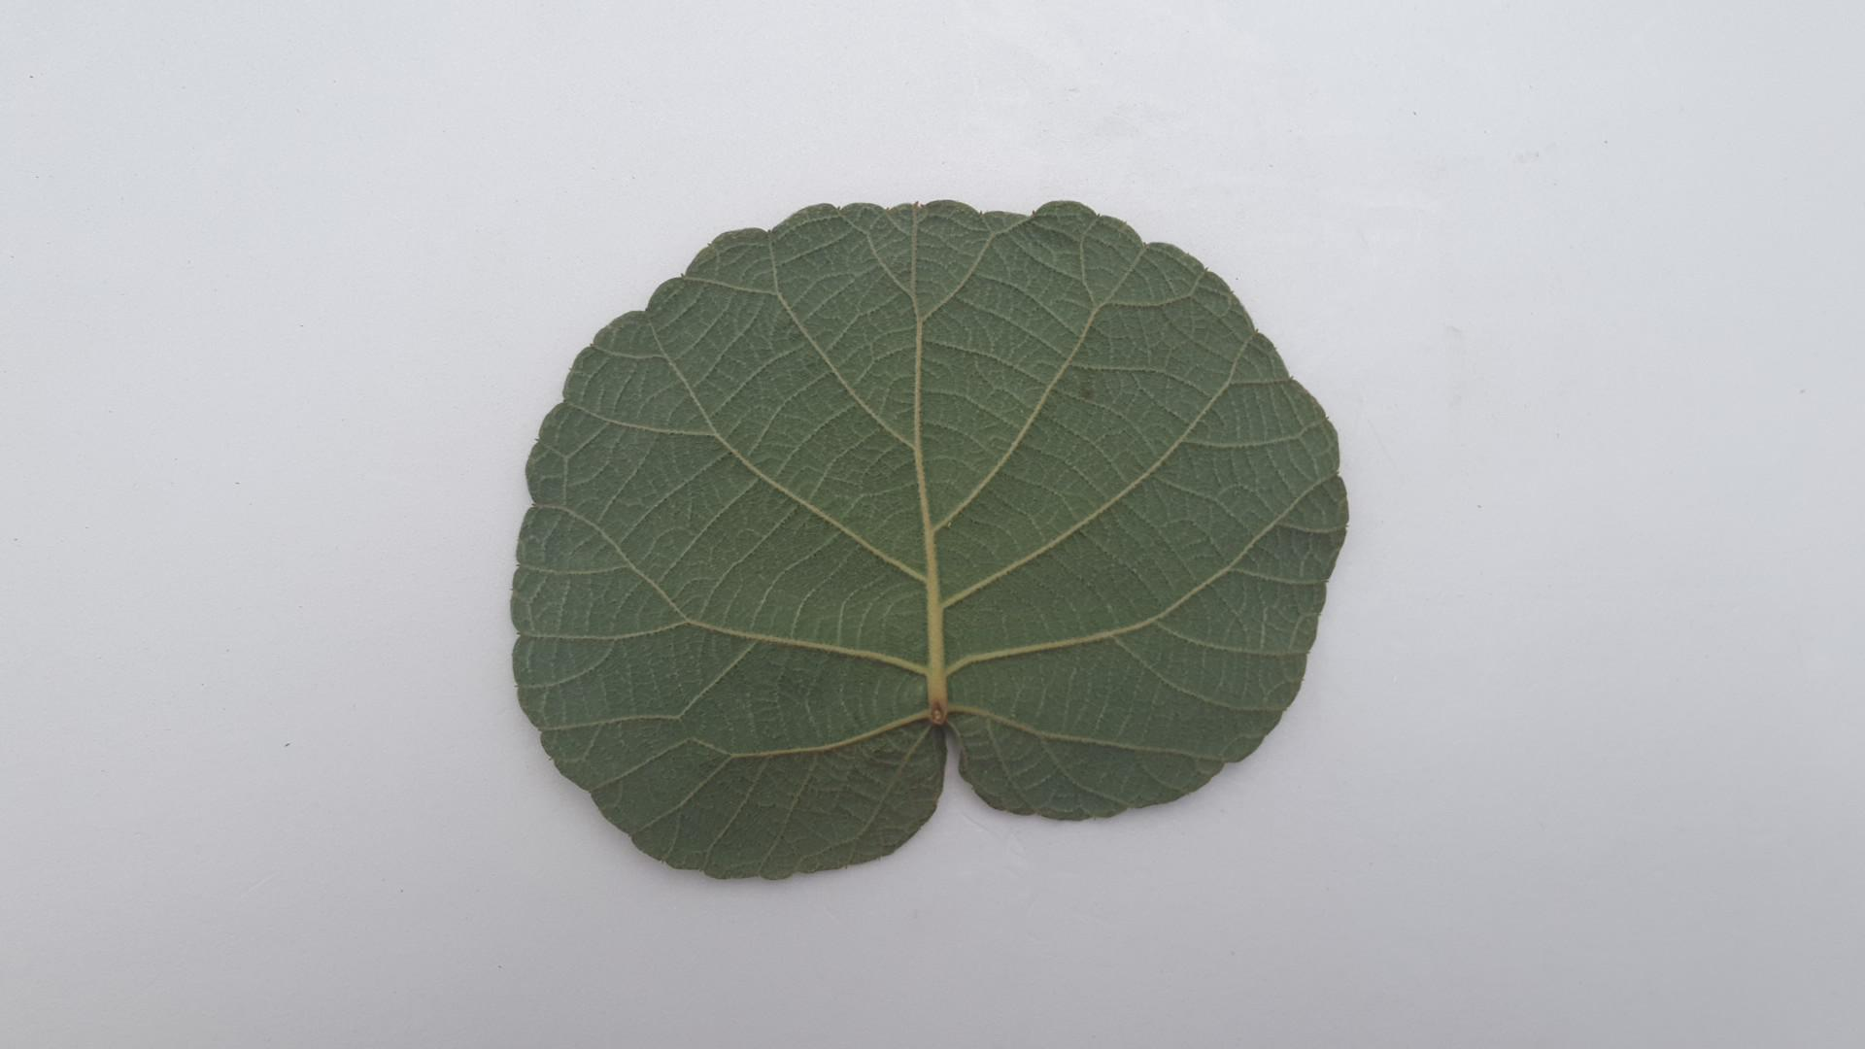
Preview
Description of research progress and results
Experiment Result
Result Problem
Kiwi Leaf Spot
Kiwi Leaf Trips
키위 잎 분류 결과 Spot 과 Trips 분류가 어려움
Kiwi Leaf Normal
4
/ 26

Slide 5
Preview
Description of research progress and results
Discussion
Discussion Ⅰ
Test Dataset
Kiwi Dataset
Training → Validation
Best model weights
Web Application

Slide 6
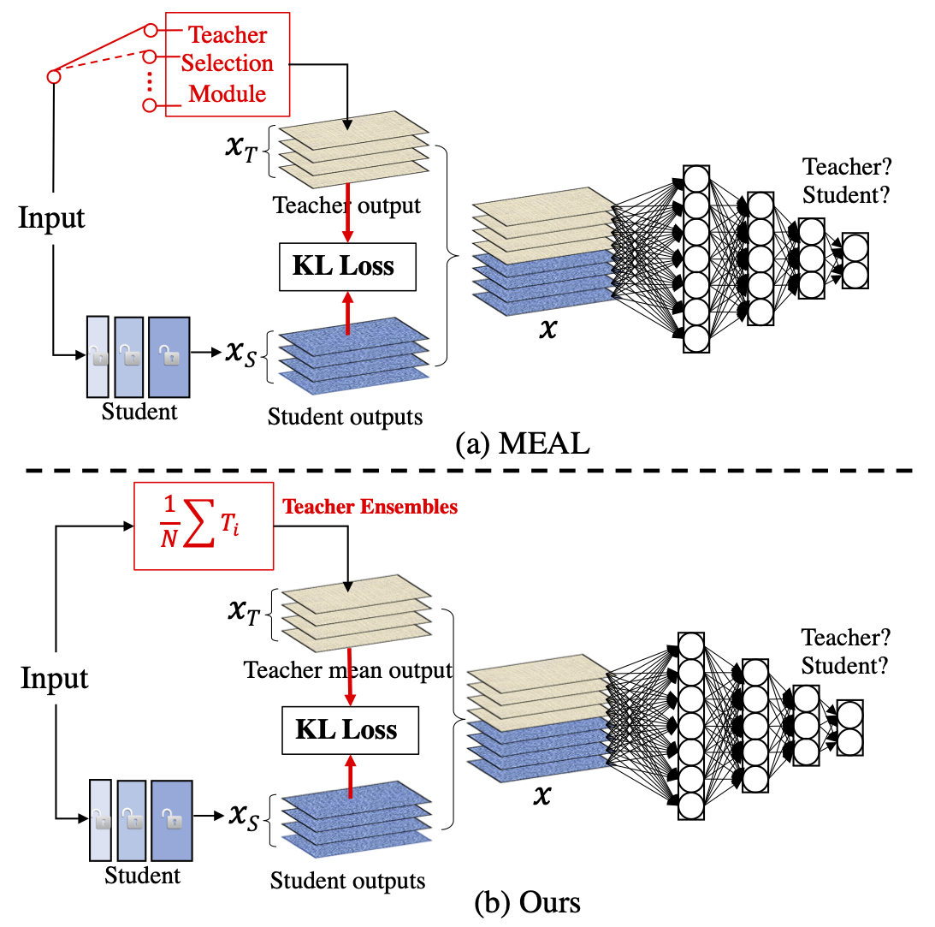
Preview
Description of research progress and results
Discussion
(ResNet, DenseNet, EfficientNet) of ensemble
MEAL(Multi-model Ensemble via Adversarial Learning)
Discussion Ⅱ
MEAL 은 Teacher-Student learning 을 적용하는데, 구체적으로는 이미 학습된 여러 개의 네트워크를 복수의 teacher 라고 보고, selection module 에 의해 그 중 하나를 선택적으로 사용하여 distillation 시킴으로써 최종적으로는 단일 student network 를 만듦
selection module 대신 teacher들의 ensemble을 직접적으로 사용하고, one-hot/hard label을 distillation 과정에서 배제하는 등 몇 가지 개선 사항이 적용
네트워크 구조 변경 없이도 ResNet-50의 ImageNet-1K 성능 (224×224 single crop)이 TOP-1 80%를 넘음
Shen, Zhiqiang, Zhankui He, and Xiangyang Xue. "Meal: Multi-model ensemble via adversarial learning." Proceedings of the AAAI Conference on Artificial Intelligence. Vol. 33. No. 01. 2019.
6
/ 26

Slide 7
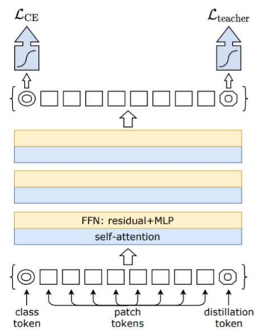
Preview
Description of research progress and results
Discussion
DeiT (Data-efficient image Transformers)
Discussion Ⅲ
EfficientNet
ViT
CNN 기반 Model
Class token + patch tokens 을 사용한 Cross Entropy Loss
CNN 기반 모델이 inductive bias
→ Global Optimum 에 더 잘 수렴
Training data-efficient image transformers & distillation through attention (2021)
7
/ 26

Slide 8
Part.2
Experiment in progress

Slide 9
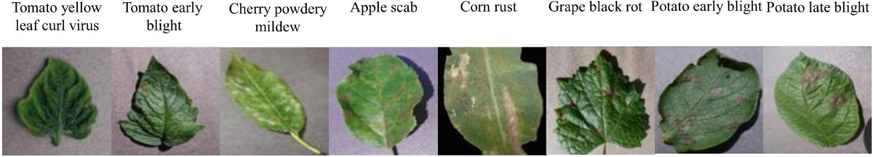
Graduation Paper Idea
Description of research progress and results
DATASET
Self-collected Dataset + Open source Dataset
Training set : 15,996
Training set + Validation set + Test set
Random Shuffle
Training set : Validation set = 7:3 → 17,000 : 3,000
Validation set : 2,002
Open Dataset : PlantVillage
Test set : 2,002
Validation of model’s effectiveness
9
9
/ 22
/ 22

Slide 10

Preview
Description of research progress and results
Discussion
Discussion Ⅰ
Best model weights
Test Dataset &
Web Application
Kiwi Dataset
Training → Validation
Best model weights

Slide 11
Preview
Description of research progress and results
Discussion
Discussion Ⅱ
(ResNet, DenseNet, EfficientNet) of ensemble
ViT
11
/ 26

Slide 12
IIP
감사합니다.
: )

