Slide 1
It’s Not Just Size That Matters: Small Language Models Are Also Few-Shot Learners
Intelligent Information Processing Lab
KiHoon Lee

Slide 2
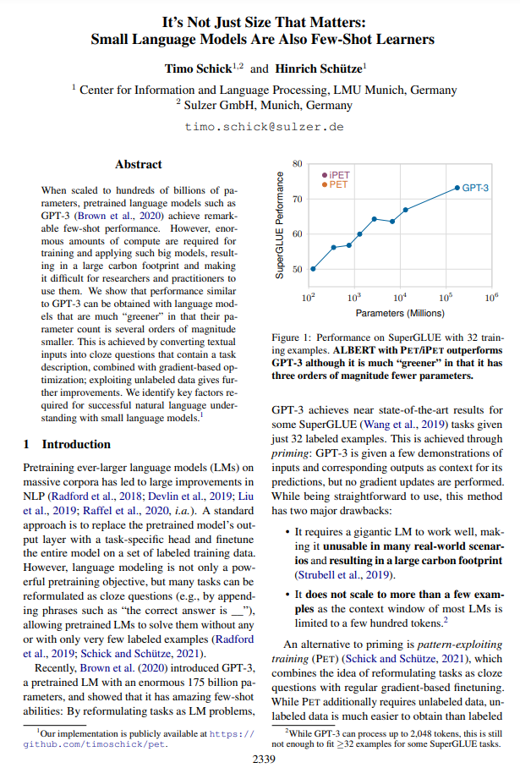
It’s Not Just Size That Matters: Small Language Models Are Also Few-Shot Learners
Paper Description
저자 : Schick, Timo, and Hinrich Schütze.
Venue : North American Chapter of the Association for Computational Linguistics (NAACL)
Publisher : Association for Computational Linguistics (ACL)
IF : 2.0 (BK21기준)
Date : June 2021
DOI: 10.18653/v1/2021.naacl-main.185
Page(s): 2339–2352
Award : Outstanding Long Paper
인용수 : 247회 (Google Scholar)

Slide 3
It’s Not Just Size That Matters: Small Language Models Are Also Few-Shot Learners
Abstract
When scaled to hundreds of billions of parameters, pretrained language models such as GPT-3 (Brown et al., 2020) achieve remarkable few-shot performance. However, enormous amounts of compute are required for training and applying such big models, resulting in a large carbon footprint and making it difficult for researchers and practitioners to use them. We show that performance similar to GPT-3 can be obtained with language models that are much “greener” in that their parameter count is several orders of magnitude smaller. This is achieved by converting textual inputs into cloze questions that contain a task description, combined with gradient-based optimization; exploiting unlabeled data gives further improvements. We identify key factors required for successful natural language understanding with small language models.
GPT-3(1750억)같이 파라미터 수를 수천억 개로 확장하면 few-shot 성능이 매우 향상됨.
But, 큰 모델을 훈련하고 적용하기에는 엄청난 양의 컴퓨팅 필요 (학습비용 약 52억원)
GPT-3와 유사한 성능인데, 파라미터 수는 1/1000 수준
How? PET(Pattern Exploiting Training)라는 훈련 방식을 통해 달성함.

Slide 4
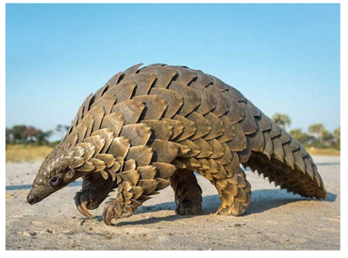
It’s Not Just Size That Matters: Small Language Models Are Also Few-Shot Learners
What is Few-shot Learning?
Query :
이 사진 속 동물은 무엇인가용

Slide 5
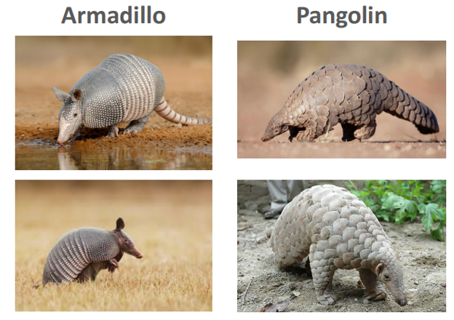
It’s Not Just Size That Matters: Small Language Models Are Also Few-Shot Learners
What is Few-shot Learning?
Query :
이 사진 속 동물은 무엇인가용

Slide 6
It’s Not Just Size That Matters: Small Language Models Are Also Few-Shot Learners
What is Few-shot Learning?
Query :
인공지능이 학습하려면?
이 사진 속 동물은 무엇인가용
각각의 동물 데이터를 1,000장씩 학습 후, Classification?

Slide 7
It’s Not Just Size That Matters: Small Language Models Are Also Few-Shot Learners
What is Few-shot Learning?
Query :
사람은?
구분하는 법을 배움
이 사진 속 동물은 무엇인가용
구분을 하는 방법을 배우는 것
Meta Learning (=Learn to Learn)

Slide 8
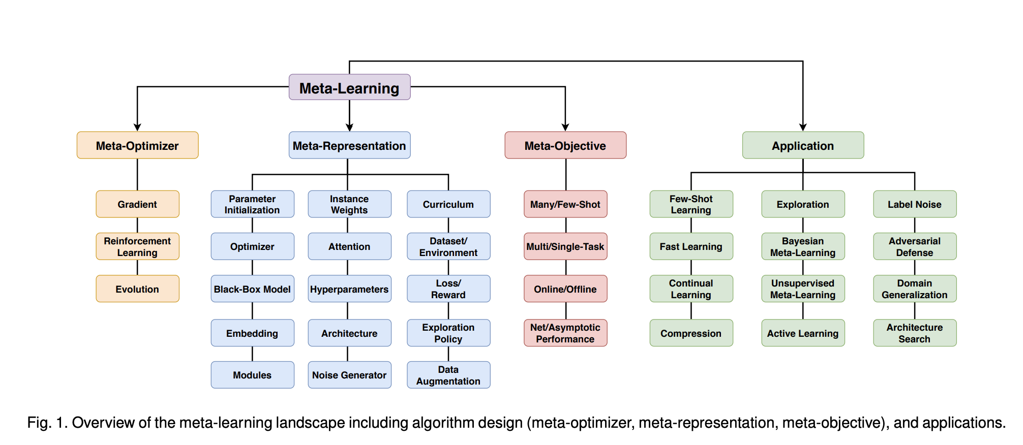
It’s Not Just Size That Matters: Small Language Models Are Also Few-Shot Learners
What is Few-shot Learning?
Meta-Learning in Neural Networks: A Survey (2020, T Hospedales)

Slide 9
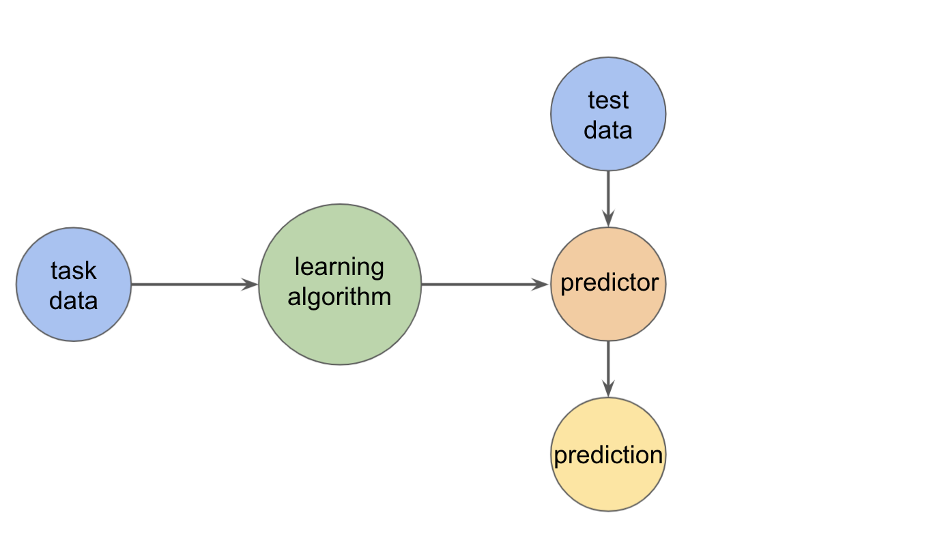
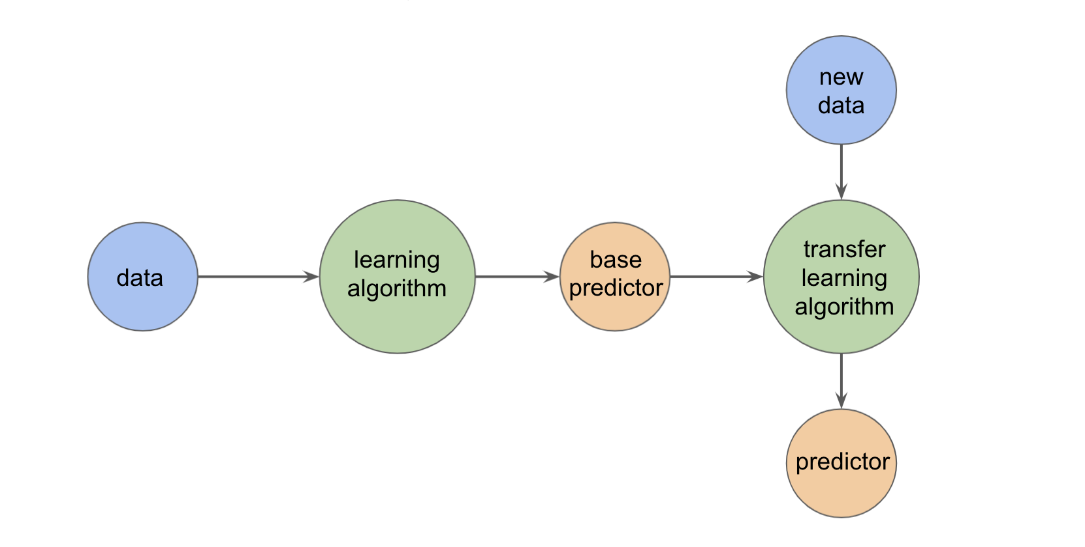
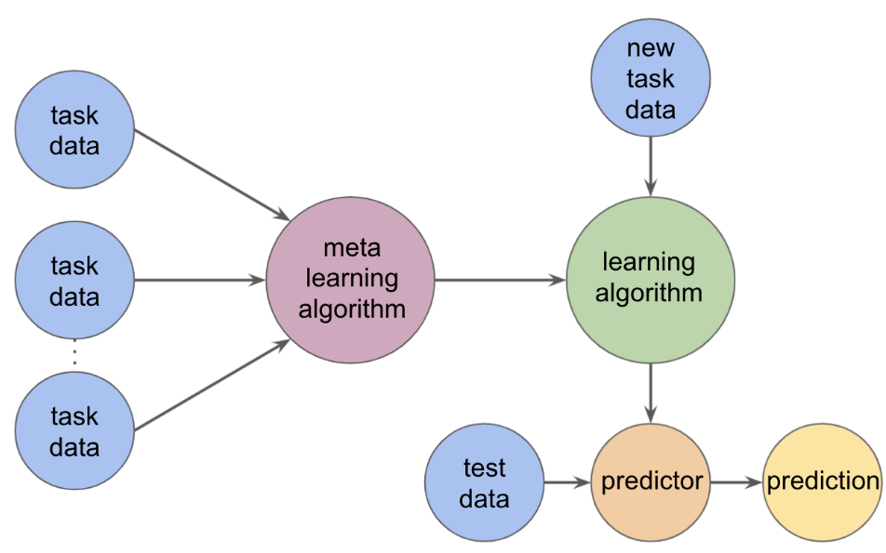
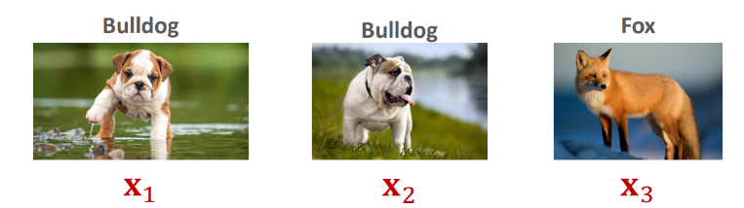
It’s Not Just Size That Matters: Small Language Models Are Also Few-Shot Learners
What is Few-shot Learning?
Supervised Learning
Transfer Learning
Meta Learning
Notes:
그림 출처 : https://prod.velog.io/@jbeen2/Introduction-to-Meta-Learning

Slide 10
It’s Not Just Size That Matters: Small Language Models Are Also Few-Shot Learners
Language Model
Training Data Corpus
Training Data Corpus
Training Data Corpus
Training Data Corpus
Training Data Corpus
Training Data Corpus
Training Data Corpus
Training Data Corpus
Training Data Corpus
Training Data Corpus
Training Data Corpus
Training Data Corpus
Unsupervised Pre-training Task
Label 없는 데이터를 학습하면서,
모델은 텍스트 자체에 대한 특징을 학습함

Slide 11
It’s Not Just Size That Matters: Small Language Models Are Also Few-Shot Learners
Unsupervised Pre-training Task
Language Modeling
Token1
Token2
Token3
Token4
Token5
…
Token n-1
Language Model
Token2
Token3
Token4
Token5
Token6
…
Token n

Slide 12


It’s Not Just Size That Matters: Small Language Models Are Also Few-Shot Learners
NLP Task
문장 유사도 평가
자연어 추론
감성 분석
질의응답
개체명 인식
문장 분류
…
BERT(버트)
…

Slide 13
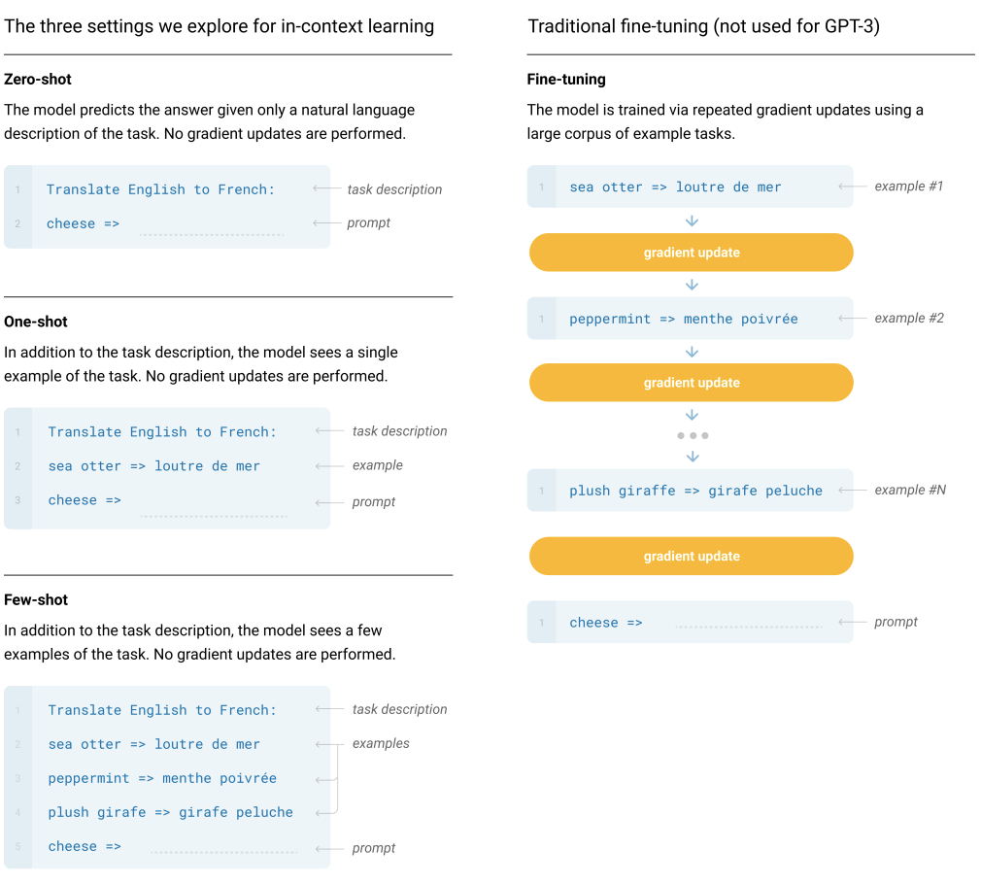
It’s Not Just Size That Matters: Small Language Models Are Also Few-Shot Learners

Slide 14
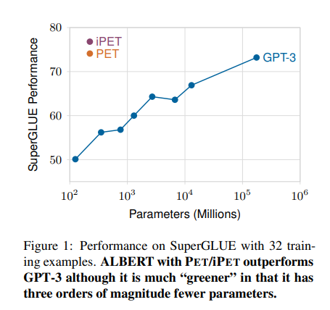
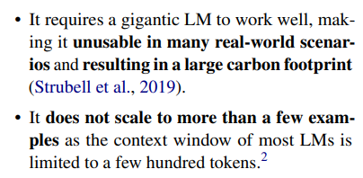
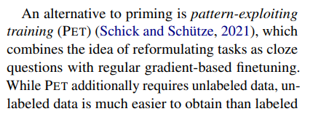
It’s Not Just Size That Matters: Small Language Models Are Also Few-Shot Learners
Introduction
Notes:
잘 작동하기 위해서 거대한 LM 필요하고,
많은 실제 세계 시나리오에서 사용할수 없고, 탄소 배출 심함.
몇가지 예시 보다 더 확장할 수 없음. 대부분의 LM이 몇백개의 토큰으로 제한되어 있기에.

Slide 15
It’s Not Just Size That Matters: Small Language Models Are Also Few-Shot Learners
PET (Pattern Exploiting Training)
Ex. QA Task
? 뭔데
대한민국의 수도는?
BERT(버트)
! 서울
대한민국의 수도는 <MASK>
BERT(버트)
Notes:
패턴을 이용한 학습

Slide 16
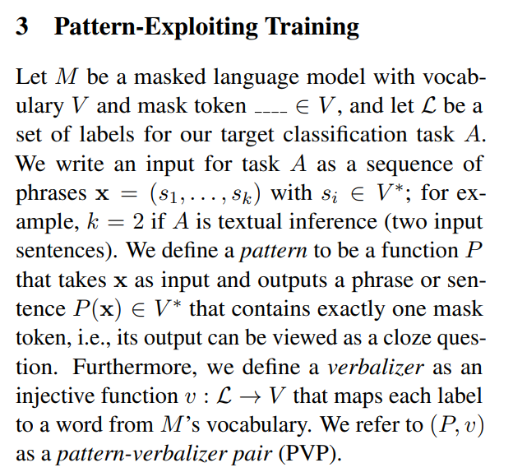
It’s Not Just Size That Matters: Small Language Models Are Also Few-Shot Learners
M : Masked Language Model
𝑉: Vocabulary
____ ∈ 𝑉 ∶ Mask Token
ℒ, 𝐴: Labels, Target classification task
𝐱 = 𝑠1, … , 𝑠𝑘 : Input for Task A
𝑠𝑖 ∈ 𝑉∗: phrase
𝑷: Pattern, 𝑤ℎ𝑒𝑟𝑒 𝑃(𝐱) ∈ 𝑉∗
𝒗: Verbalizer, ℒ → 𝑉
𝑷, 𝒗 : Pattern Verbalizer Pair(𝐏𝐕𝐏)

Slide 17
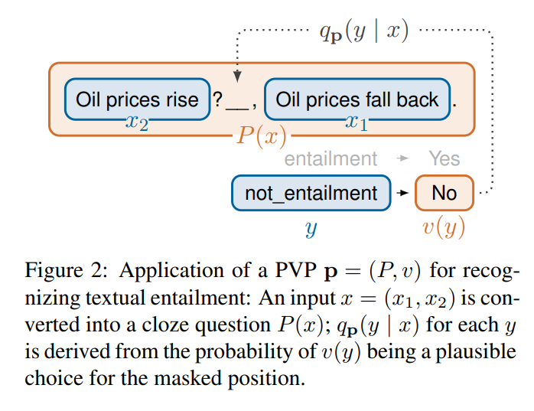
It’s Not Just Size That Matters: Small Language Models Are Also Few-Shot Learners
PET (Pattern Exploiting Training)
M : Masked Language Model
𝑉: Vocabulary
____ ∈ 𝑉 ∶ Mask Token
ℒ, 𝐴: Labels, Target classification task
𝐱 = 𝑠1, … , 𝑠𝑘 : Input for Task A
𝑠𝑖 ∈ 𝑉∗: phrase
𝑷: Pattern, 𝑤ℎ𝑒𝑟𝑒 𝑃(𝐱) ∈ 𝑉∗
𝒗: Verbalizer, ℒ → 𝑉
𝑷, 𝒗 : Pattern Verbalizer Pair(𝐏𝐕𝐏)
Task : RTE
Sent1 : Oil prices rise.
Sent2 : Oil prices fall back
Label : Entailment >Yes
Not_entailment >No
P(x) :
Oil prices rise ? ___, Oil prices fall back.
Notes:
인식

Slide 18
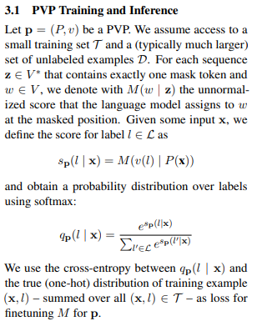


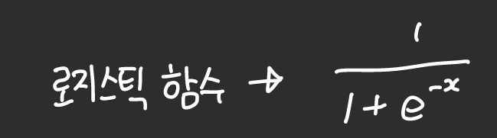

It’s Not Just Size That Matters: Small Language Models Are Also Few-Shot Learners
파라미터 변경없이 잘 수행할 수 있음.
SoftMax
Masked Language Model
Oil prices rise? ___, Oil prices fall back.
Sigmoid
일반화 SoftMax

Slide 19
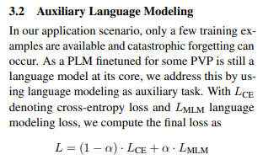


It’s Not Just Size That Matters: Small Language Models Are Also Few-Shot Learners
$$L_{CE}$$
$$L_{MLM}$$
Yes / No
Vocab
SoftMax
Masked Language Model
Oil prices rise? ___, Oil prices fall back.

Slide 20
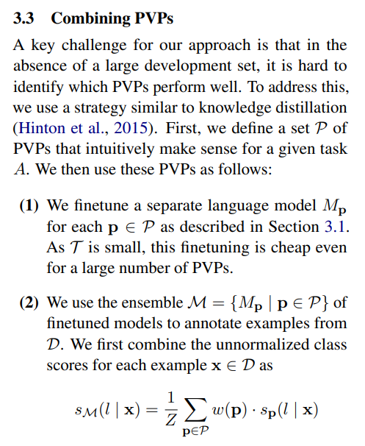
It’s Not Just Size That Matters: Small Language Models Are Also Few-Shot Learners
New Labeled Data
New Labeled Data
Oil prices rise? No, Oil prices fall back.
Oil prices rise? No, Oil prices fall back.
Masked Language Model
Masked Language Model
Oil prices rise? ___, Oil prices fall back.
“Oil prices rise?” ___, “Oil prices fall back.”
PVP1
PVP2
Oil prices rise? ___, Oil prices fall back.

Slide 21
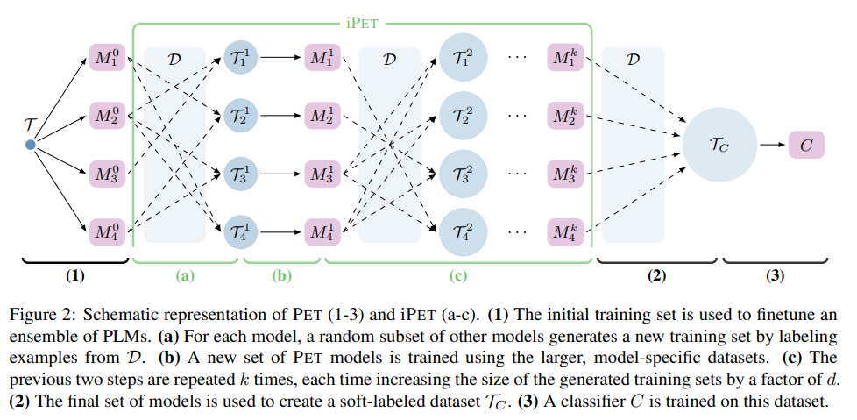
It’s Not Just Size That Matters: Small Language Models Are Also Few-Shot Learners
Iterative PET
$T$ : Training Dataset
$D$ : New labeled Data

Slide 22
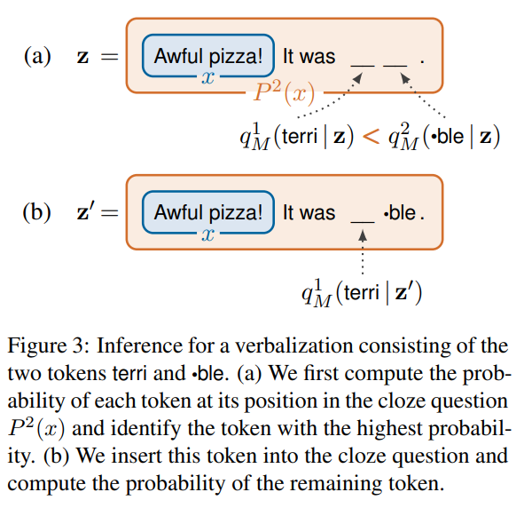
It’s Not Just Size That Matters: Small Language Models Are Also Few-Shot Learners
PET with Multiple Masks

Slide 23
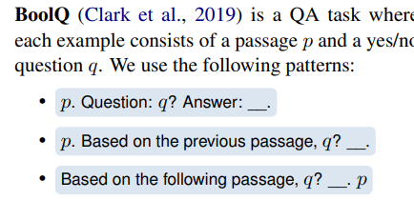
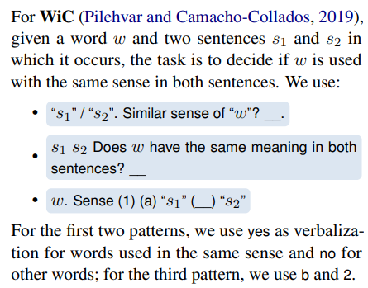
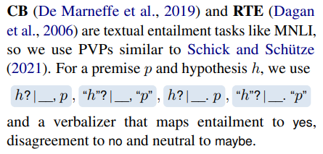
It’s Not Just Size That Matters: Small Language Models Are Also Few-Shot Learners
How to set the Pattern

Slide 24
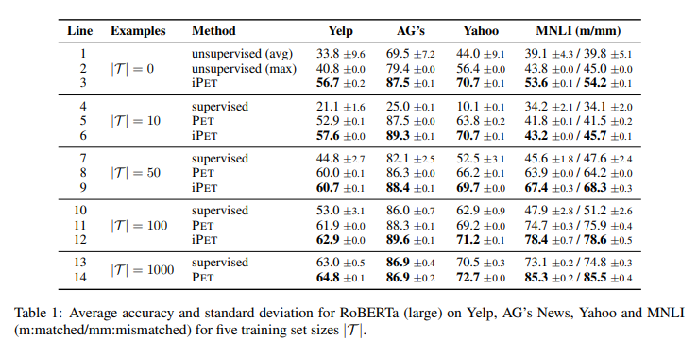
It’s Not Just Size That Matters: Small Language Models Are Also Few-Shot Learners
Result
Notes:
Yelp > 리뷰, 여러가지 요인 중에 긍정적인 이유와 부정적인 이유를 찾는 테스크
AG’s > 뉴스 제목, 기사 데이터 / 영어 뉴스 텍스트 데이터 분류 테스크
Yahoo > 야후 답변에서 수동으로 선별된 QA 데이터세트로 구성된 테스크

Slide 25
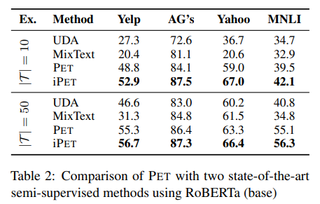
It’s Not Just Size That Matters: Small Language Models Are Also Few-Shot Learners
Result
UDA > Data Augmentation을 통해 생성된 문장을 분류 모델에 넣으면 특정 라벨에 속할 확률분포를 추출하는 방법
MixText > Semi supervised learning = 소수의 Labeled Dataset / 다수의 Unlabeled Dataset을 갖고있을때 Unlabeled Dataset을 최대한 효율적으로 활용하여 모델을 학습시키는 훈련 방법
Notes:
Yelp > 리뷰, 여러가지 요인 중에 긍정적인 이유와 부정적인 이유를 찾는 테스크
AG’s > 뉴스 제목, 기사 데이터 / 영어 뉴스 텍스트 데이터 분류 테스크
Yahoo > 야후 답변에서 수동으로 선별된 QA 데이터세트로 구성된 테스크

Slide 26
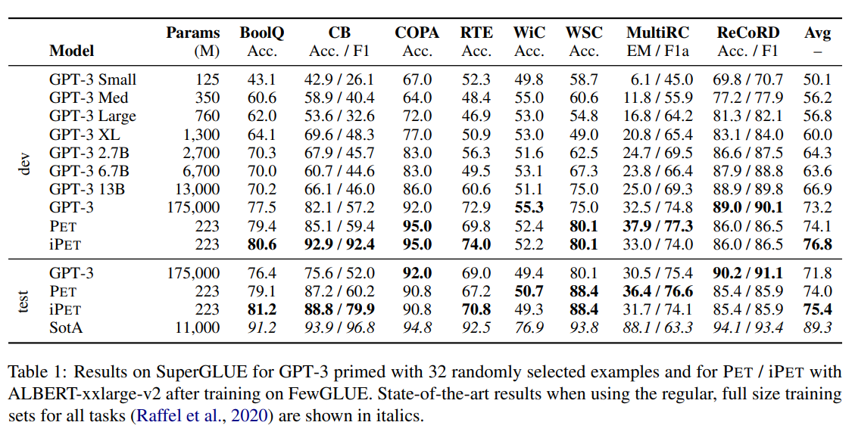
It’s Not Just Size That Matters: Small Language Models Are Also Few-Shot Learners
Result
Notes:
ALBERT >
BERT에서의 Next Sentence Prediction(NSP) 대신 두 문장 간 순서를 맞추는 방식으로 학습 (Masked LM 방식은 동일하게 활용) -> NSP 보다 SQUAD, MNLI, RACE task에서 성능 향상
RTE 하나만 겹침. 근데 albert 논문에는 89.2점임

Slide 27
It’s Not Just Size That Matters: Small Language Models Are Also Few-Shot Learners
Good

Slide 28
It’s Not Just Size That Matters: Small Language Models Are Also Few-Shot Learners
Conclusion
Pattern Exploiting Training. 패턴을 이용하는 학습을 제안함.
Input을 하나의 빈칸(Mask)를 포함하는 Cloze 질문으로 Mapping 하는 Pattern을 이용하여, Cloze Question으로 문제를 재정의 함.
정답 label를 하나의 토큰으로 표현해주는 Verbalizers를 사용함.
PVP(Pattern Verbalizers Pair)를 이용해서 사전학습된 언어 모델의 지식를 downstream task를 푸는 데에 사용하는 것을 보임.
Multiple Token을 사용하면서, PET를 사용하여 다양한 Task를 풀 수 있게 제안함.
SuperGLUE Task에서 Few-shot Text Classification 한정으로, 훨씬 적은 파라미터로 GPT랑 성능이 비슷하거나, 더 능가함을 보임.
Labeled Data가 많이 없을 때 사용하면 좋을 듯 함.
한계
Hand-crafted Patterns을 사용함.
어떤 Pattern이 좋은 결과를 내는지, 안좋은 결과를 내는지 알 수 없음.
모든 Task에서 사용할 수 있지는 않음.

Slide 29
It’s Not Just Size That Matters: Small Language Models Are Also Few-Shot Learners
감사합니다.
Schick, Timo, and Hinrich Schütze. "Exploiting Cloze-Questions for Few-Shot Text Classification and Natural Language Inference." Proceedings of the 16th Conference of the European Chapter of the Association for Computational Linguistics: Main Volume. 2021.
Schick, Timo, and Hinrich Schütze. "It’s Not Just Size That Matters: Small Language Models Are Also Few-Shot Learners." Proceedings of the 2021 Conference of the North American Chapter of the Association for Computational Linguistics: Human Language Technologies. 2021.

