Slide 1


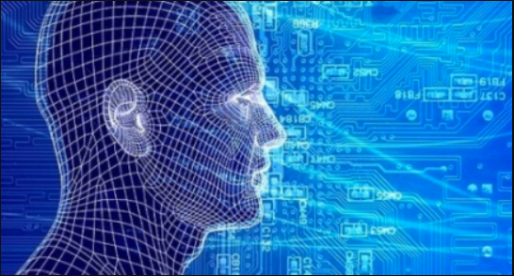
6. Convolutional Neural Networks
6 May 2021
Yunsang Joo

Slide 2
Yunsang Joo
Index
From Fully-Connected Layers to Convolutions
Convolutions for Images
Padding and Stride
Multiple Input and Multiple Output Channels
Pooling
Convolutional Neural Networks(LeNet)
Convolutional Neural Networks

Slide 3
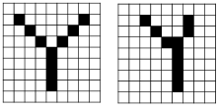

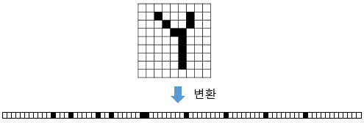
Yunsang Joo
1. From Fully-Connected Layers to Convolutions
Constraining the MLP Channels
3X3 3X3X3
Convolutional Neural Networks

Slide 4
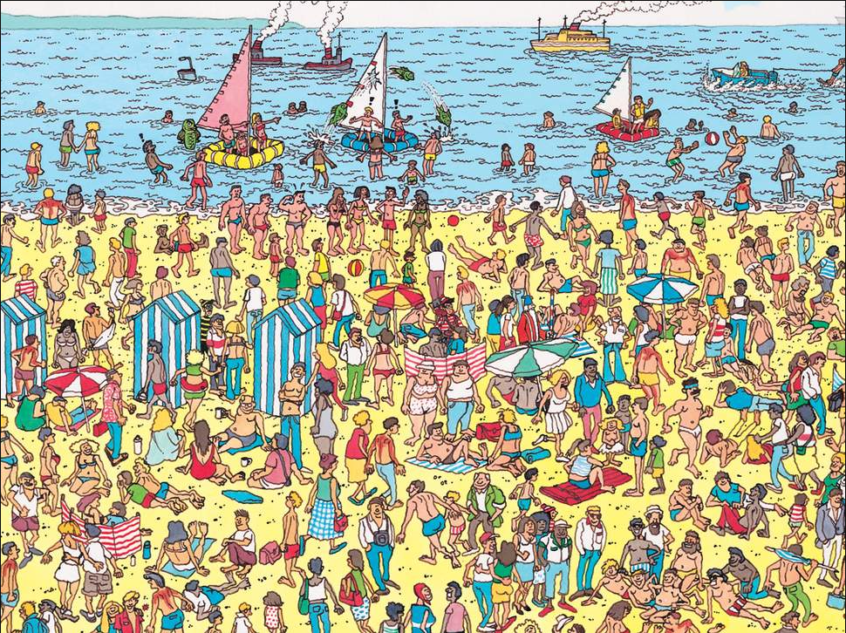

Yunsang Joo
1. From Fully-Connected Layers to Convolutions
Translation Invariance
: waldo의 위치에 상관없이 같은 출력을 갖는다.
Locality
: Filter는 전체를 다 보는게 아닌 일부분에 집중한다.
An image of the “Where’s Waldo” game.
Convolutional Neural Networks

Slide 5
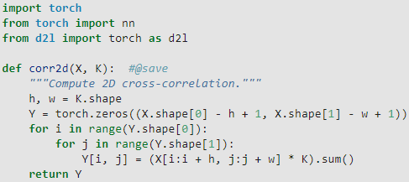
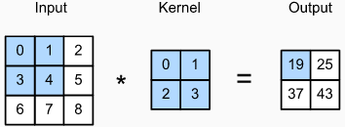

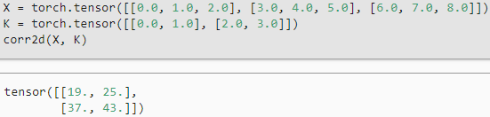
Yunsang Joo
2. Convolutions for Images
The Cross-Correlation Operation
3x3 2x2 2x2
Convolutional Neural Networks

Slide 6
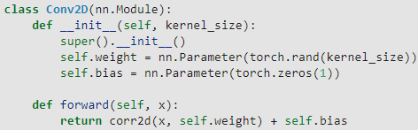
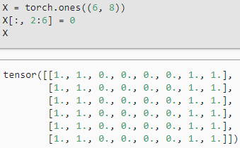
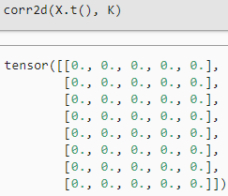
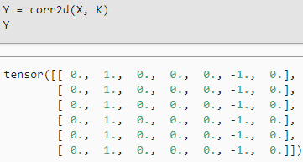
Yunsang Joo
2. Convolutions for Images
Convolutional Layers
Object Edge Detection in Images
X.t
1 | 1 | 1 | 1 | 1 | 1
1 | 1 | 1 | 1 | 1 | 1
0 | 0 | 0 | 0 | 0 | 0
0 | 0 | 0 | 0 | 0 | 0
0 | 0 | 0 | 0 | 0 | 0
0 | 0 | 0 | 0 | 0 | 0
1 | 1 | 1 | 1 | 1 | 1
1 | 1 | 1 | 1 | 1 | 1
Convolutional Neural Networks

Slide 7
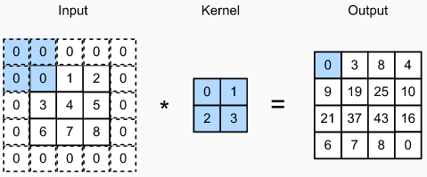
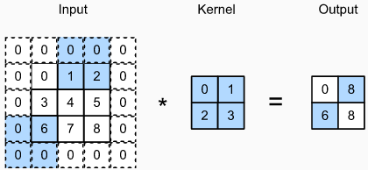

Yunsang Joo
3. Padding and Stride
Padding
Stride
3x3 2x2 4x4
3x3 2x2 2x2
$$O=floor(\frac{I−K+2P}{S}+1)$$
Padding=1 Padding=2 Stride=2
Convolutional Neural Networks

Slide 8
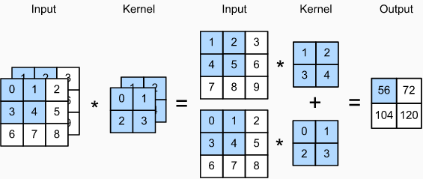




Yunsang Joo
4. Multiple Input and Multiple Output Channels
Multiple Input Channels
Convolutional Neural Networks

Slide 9


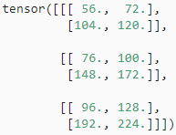
Yunsang Joo
4. Multiple Input and Multiple Output Channels
Multiple Output Channels
Convolutional Neural Networks

Slide 10
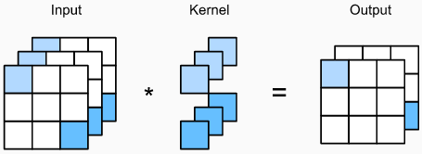
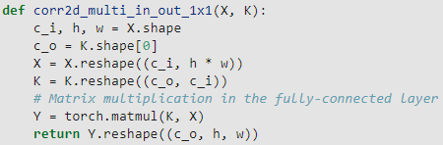
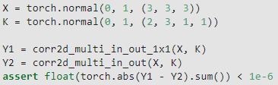
Yunsang Joo
4. Multiple Input and Multiple Output Channels
1 X 1 Convolutional Layer
Convolutional Neural Networks

Slide 11
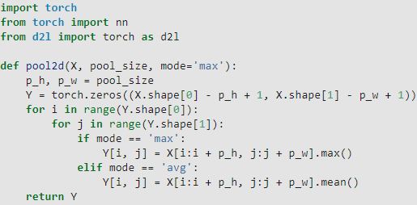
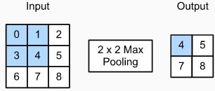
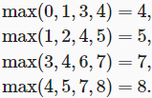


Yunsang Joo
5. Pooling
Maximum Pooling and Average Pooling
Convolutional Neural Networks

Slide 12
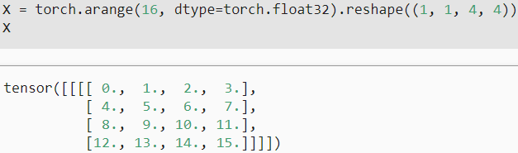
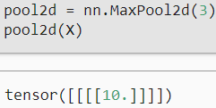
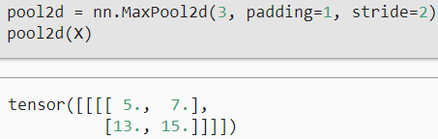
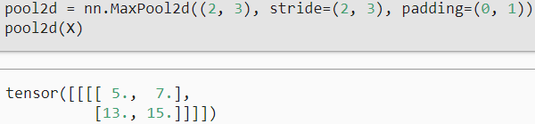
Yunsang Joo
5. Pooling
Padding and Stride
h, w
Convolutional Neural Networks

Slide 13
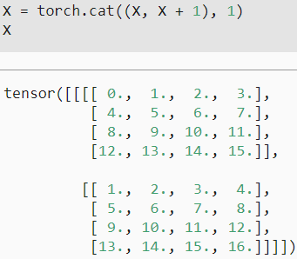
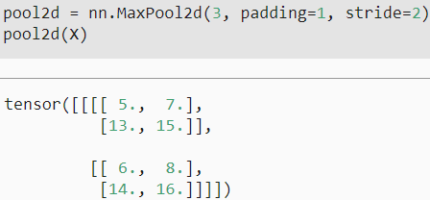
Yunsang Joo
5. Pooling
Multiple Channels
Convolutional Neural Networks

Slide 14
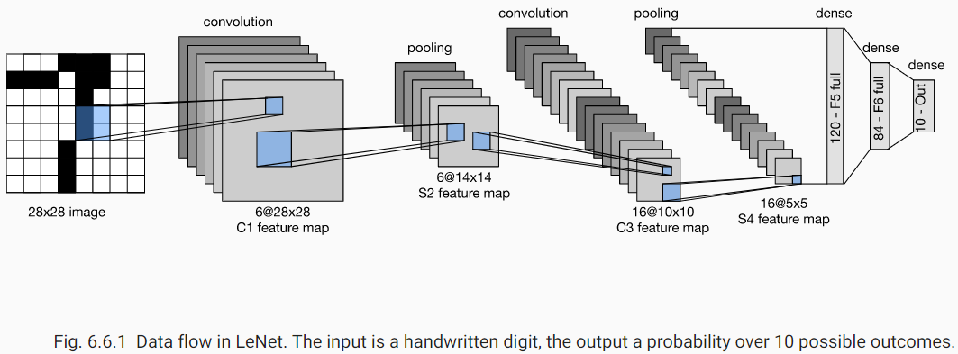
Yunsang Joo
6. Convolutional Neural Networks(LeNet)
LeNet
Convolutional Neural Networks

Slide 15
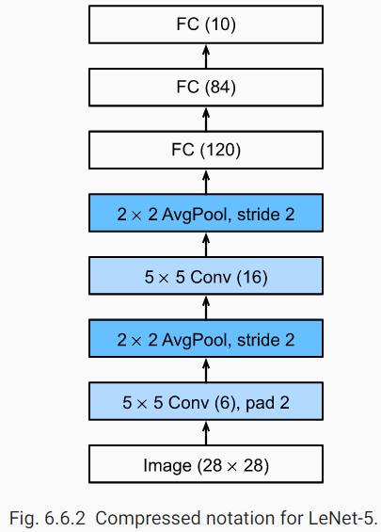
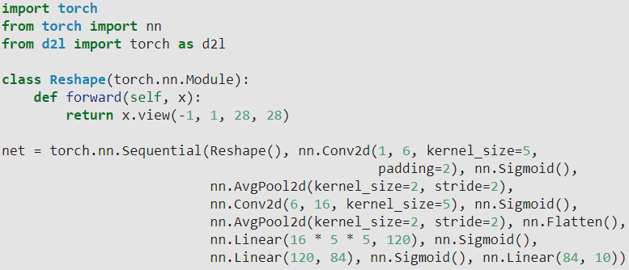
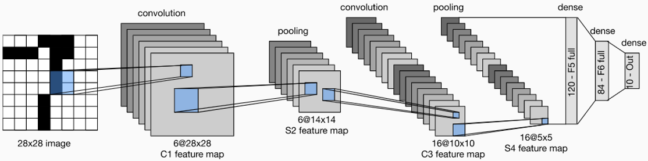
Yunsang Joo
6. Convolutional Neural Networks(LeNet)
LeNet
Convolutional Neural Networks

Slide 16
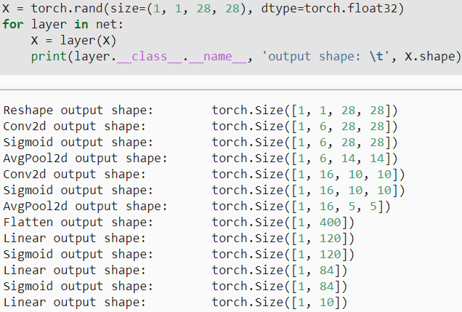
Yunsang Joo
6. Convolutional Neural Networks(LeNet)
LeNet
Convolutional Neural Networks

Slide 17
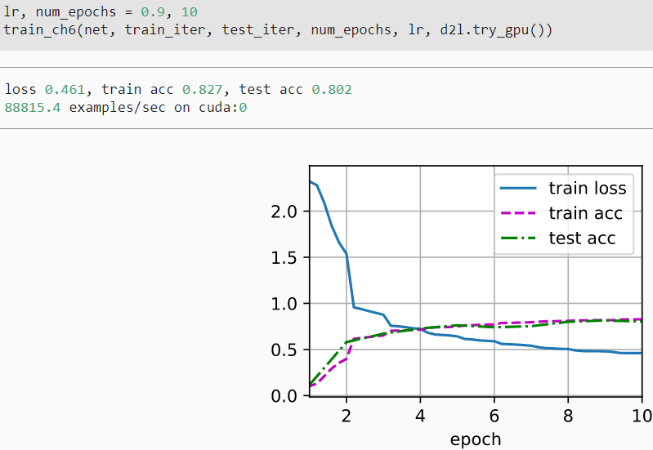
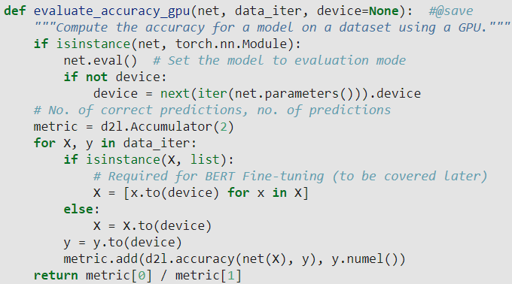
Yunsang Joo
6. Convolutional Neural Networks(LeNet)
LeNet
Convolutional Neural Networks

