Slide 1
IIP Lab Seminar
Multi-modal Deep Learning
Aug. 2022
Intelligent Information Processing Lab
JunHo Yoon

Slide 2
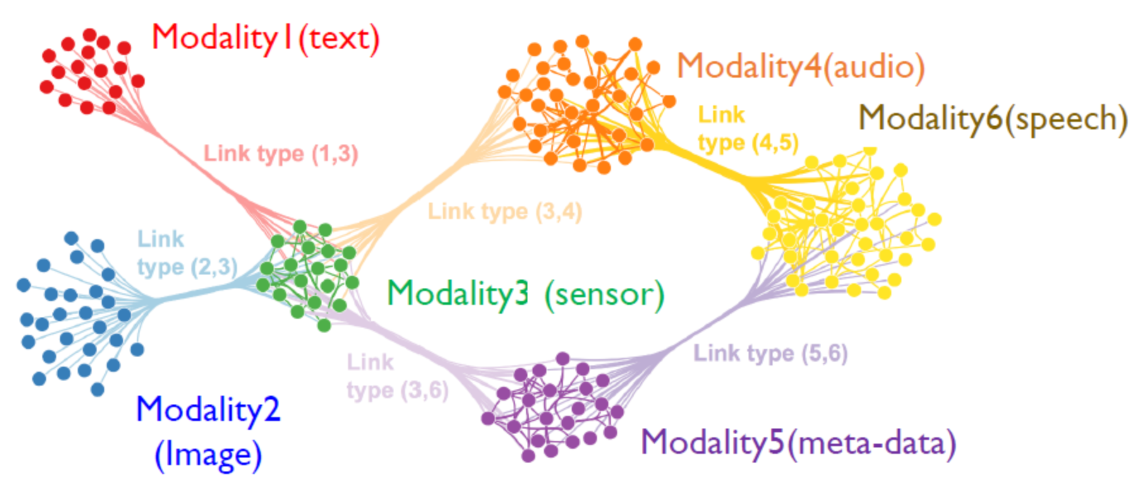
IIP Lab Seminar. Multi-modal Deep Learning / RoBERTa MFT
Multimodal Learning
■ Modality
인간의 감각기관으로 부터 수집되는 다양한 형태의 데이터를 사용하여 모델을 학습
Vision / Text / Speech / Touch / Smell / (+Meta data)
Key Point : 각각의 데이터의 특성을 통합

Slide 3
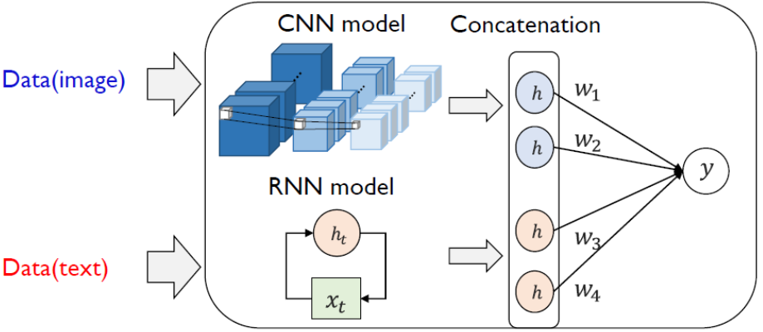
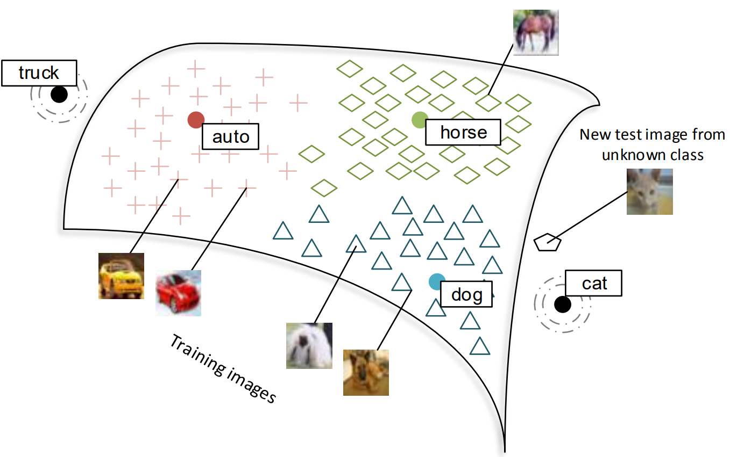
IIP Lab Seminar. Multi-modal Deep Learning / RoBERTa MFT
Multimodal Learning
■ Model의 통합
각 모델의 예측 값을 통합
Ex) Ensemble
■ Embedding Vector의 통합
신경망을 통해 추출된 Embedding Vector를 선형 결합
■ 데이터 차원의 통합
추출된 Embedding Vector를 차원이 같은 데이터로 변환

Slide 4
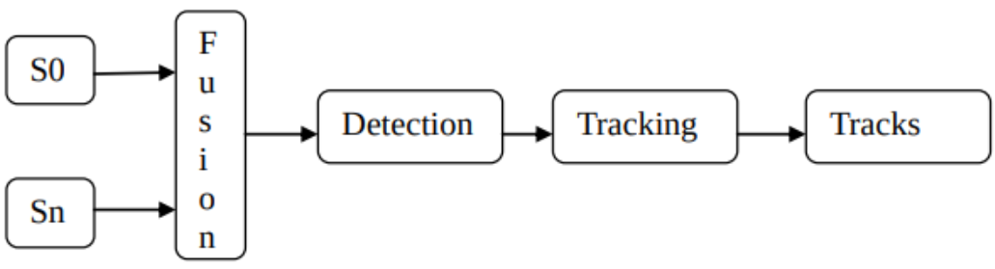
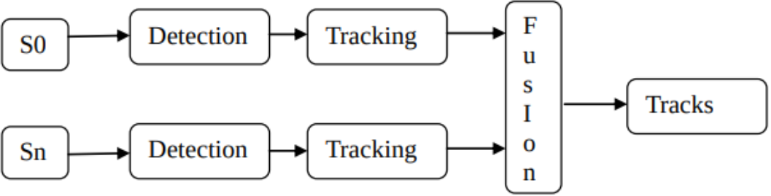
IIP Lab Seminar. Multi-modal Deep Learning / RoBERTa MFT
Multimodal Learning
■ Task
Representation : Multi-modal Data를 어떻게 요약할 것인지
Alignment : 각 Modality 데이터의 관계를 파악
Fusion : 각 Modality 데이터를 결합하여 Target 값을 예측
Co-learning : Knowledge가 부족한 특정 Modality 데이터를 다른 특성의 데이터를 사용하여 보완
Translation : Entity를 다른 Modality의 Entity로 변환(생성)
■ Existing Method
Early Fusion : 결합(투영)한 이후 데이터의 특징 추출 → 인지 (Cognitive)
Late Fusion : 각 데이터의 특징을 추출한 이후 결합 → 지각 (Perception)
[ early fusion ]
[ late fusion ]

Slide 5
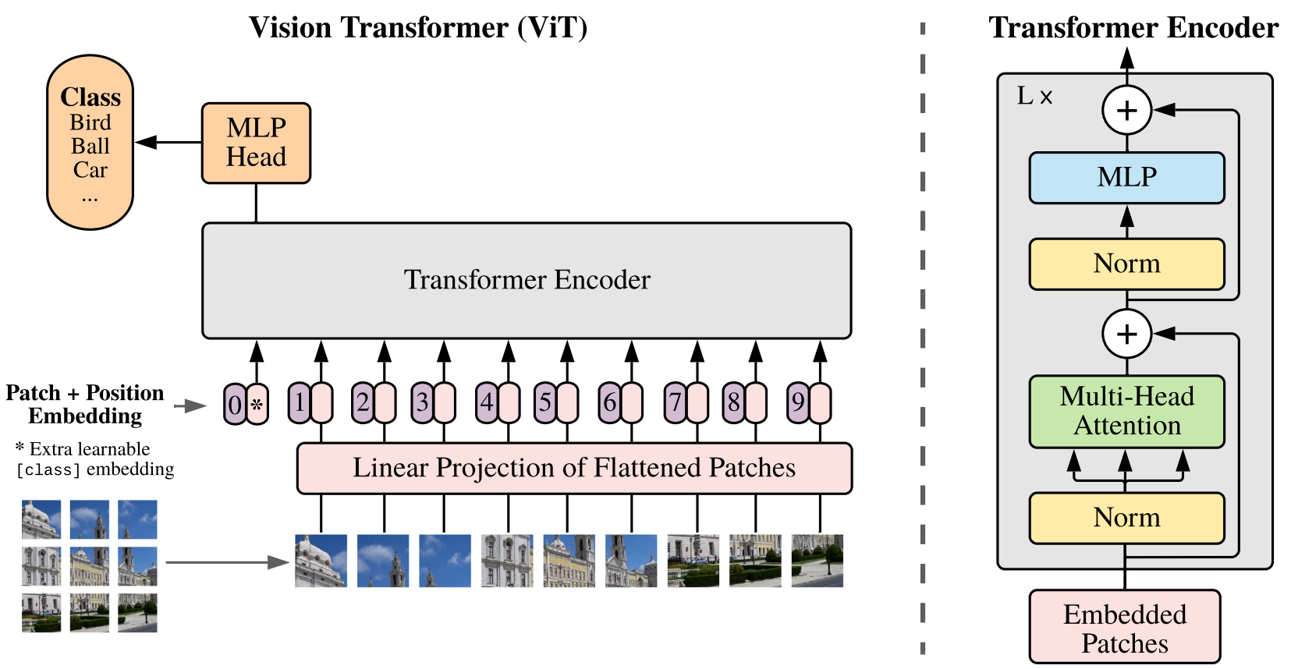
IIP Lab Seminar. Multi-modal Deep Learning / RoBERTa MFT
Base Model
■ Vision Transformer
Contributions
이미지 분류에서 Convolution 기법을 사용하지 않고 유의미한 성능을 달성함
이미지 패치(patch)를 단어와 같이 처리
Transformer의 Encoder를 컴퓨터 비전에 적용 → 향후 ViT 발전 가능
Limitations
대용량 데이터가 필요한 사전학습
■ RoBERTa MFT with Late Fusion
Contribution
대용량 데이터가 필요한 사전학습 대신 부족한 특성을 다른 데이터로 부터 보완

Slide 6

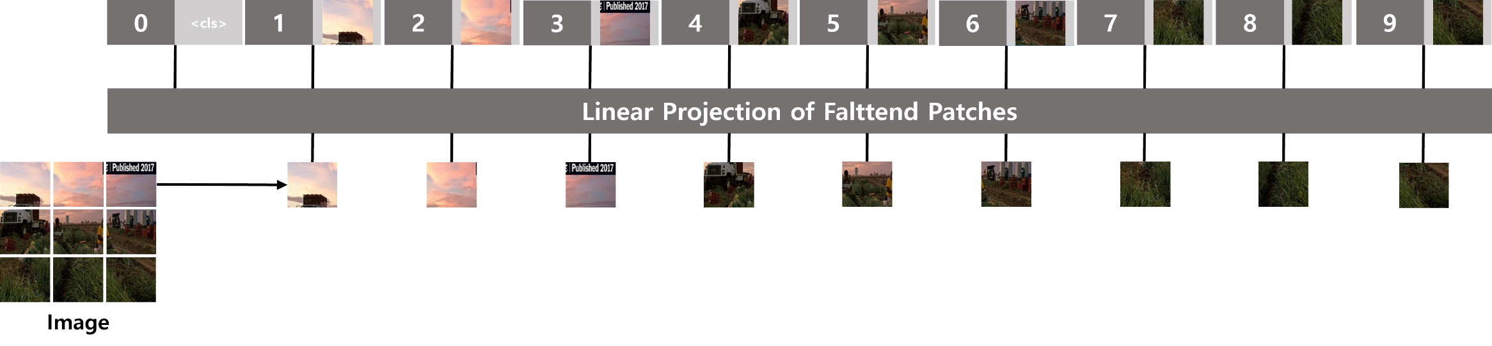
IIP Lab Seminar. Multi-modal Deep Learning / RoBERTa MFT
Input Embedding
■ Image & Text – RoBERTa MFT: RoBERTa based Multimodal Fusion Transformer
Input
0
<cls>
1
*
2
*
3
*
4
*
5
*
6
*
7
*
8
*
9
*
0
Token Embedding
x
Attention Mask
+
Patch + Position Embedding

Slide 7

IIP Lab Seminar. Multi-modal Deep Learning / RoBERTa MFT
Proposed model
■ RoBERTa MFT with Late Fusion
Image
Image
[CLS]
Vision Transformer
Encoder
Image
[CLS]
Class
Label: 0
Label: 1
Label: 2
Label: 3
Label: 4
.
.
.
Label: 11
Label: 12
Label: 13
Label: 14
Image
Emb
Image
Context
MLP
Vision Transformer
Input Embedding
Late
Fusion
Text
Text
[CLS]
Transformer
Encoder
Early_F
[CLS]
Text
Emb
Early_F
Context
Early
Fusion
Transformer
Input Embedding

Slide 8
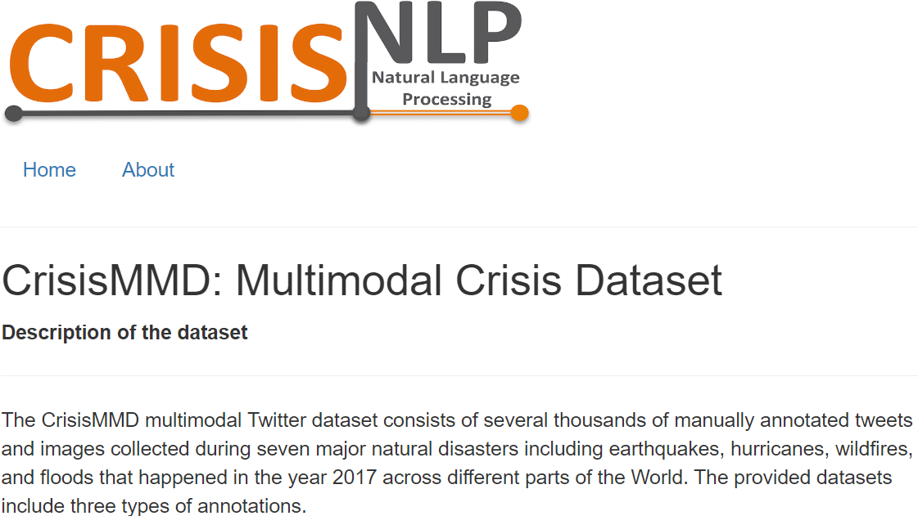
IIP Lab Seminar. Multi-modal Deep Learning / RoBERTa MFT
Dataset
■ CrisisMMD: Multimodal Crisis Dataset
Title: CrisisMMD: Multimodal Twitter Datasets from Natural Disasters
ICWSM 2018:12th International AAAI Conference on Web and Social Media
Citation : 170
Title: Analysis of Social Media Data using Multimodal Deep Learning for Disaster Response
ISCRAM 2020: 17th International Conference on Information Systems for Crisis Response and Management
Citation: 33

Slide 9
IIP Lab Seminar. Multi-modal Deep Learning / RoBERTa MFT
Dataset
■ Details
Crisis name | Keywords | Start date | End date
Hurricane Irma | Hurricane Irma, Irma storm, Storm Irma, Irma Hurricane, Irma | Sep 6 2017 | Sep 21 2017
Hurricane Harvey | Hurricane Harvey, Harvey, HurricaneHarvey, Tornado | August 25 2017 | September 20 2017
Hurricane Maria | Hurricane Maria, Maria Storm, Maria Cyclone, Maria Tornado, Tropical Storm Maria, HurricaneMaria, puerto rico | September 20 2017 | November 13 2017
Hurricane Maria | California fire, California wildfire, Wildfire California, USA Wildfire, California wildfires | October 10 2017 | October 27 2017
Mexico earthquake | mexico earthquake, mexicoearthquake | September 20 2017 | October 6 2017
Iraq-Iran earthquake | kuwait earthquake, iran earthquake, halabja earthquake, Iraq earthquake | November 13 2017 | November 19 2017
Sri Lanka floods | flood Sri Lanka, FloodSL, SriLanka flooding, SriLanka floods, SriLanka flood, typhoon mora, cyclone mora, mora, CycloneMora | May 31 2017 | July 3 2017

Slide 10
IIP Lab Seminar. Multi-modal Deep Learning / RoBERTa MFT
Experiment
■ Experiment-Task
Task | Classes | Train | Valid | Test
Task 1: Informative vs Not informative | Informative, Not informative | 9601 | 1573 | 1534
Task 2: Humanitarian categories | Affected individuals, Infrastructure and utility damage, Injured or dead people, Missing or found people, Rescue, volunteering or donation effort, Vehicle damage, Other relevant information, Not humanitarian Infrastructure and utility damage, vehicle damage Affected individuals, Injured or dead people, Missing or found people | 6126 | 998 | 955
Task 3: Damage severity assessment | Severe damage, Mild damage, Little or no damage | 2468 | 529 | 529

Slide 11
IIP Lab Seminar. Multi-modal Deep Learning / RoBERTa MFT
Experiment - Metrics
■ Uni-modal (Image-only)
precision / recall / f1-score / accuracy
Modality | Model | Test | Task1 | Task2 | Task3
Uni-modal | Vision Transformer | precision | 0.690667 | 0.425683 | 0.366788
 |  | recall | 0.648160 | 0.375454 | 0.337594
 |  | f1-score | 0.656819 | 0.389839 | 0.298926
 |  | accuracy | 0.726863 | 0.636654 | 0.595464
 | (pre-trained) Vision Transformer | precision | 0.866137 | 0.730936 | 0.600962
 |  | recall | 0.830486 | 0.694242 | 0.558586
 |  | f1-score | 0.844454 | 0.710652 | 0.574363
 |  | accuracy | 0.868976 | 0.820950 | 0.695653

Slide 12
IIP Lab Seminar. Multi-modal Deep Learning / RoBERTa MFT
Experiment - Metrics
■ Uni-modal (Text-only)
precision / recall / f1-score / accuracy
Modality | Model | Test | Task1 | Task2 | Task3
Uni-modal | RoBERTa | precision | 0.786744 | 0.511860 | 0.371661
 |  | recall | 0.750553 | 0.453004 | 0.388342
 |  | f1-score | 0.763186 | 0.471834 | 0.348446
 |  | accuracy | 0.803135 | 0.684822 | 0.640832
 | (pre-trained) RoBERTa | precision | 0.831771 | 0.726929 | 0.555136
 |  | recall | 0.808472 | 0.719403 | 0.429016
 |  | f1-score | 0.818128 | 0.720974 | 0.430969
 |  | accuracy | 0.844856 | 0.800007 | 0.654065

Slide 13
IIP Lab Seminar. Multi-modal Deep Learning / RoBERTa MFT
Experiment - Metrics
■ Multi-modal (Late Fusion)
precision / recall / f1-score / accuracy
Modality | Model | Test | Task1 | Task2 | Task3
Multi-modal | (Image) ViT (Text) RoBERTa Score Fusion | precision
 |  | recall
 |  | f1-score
 |  | accuracy
 | (Image) ViT (Text) RoBERTa Feature Fusion | precision
 |  | recall
 |  | f1-score
 |  | accuracy

Slide 14
IIP Lab Seminar. Multi-modal Deep Learning / RoBERTa MFT
Experiment - Metrics
■ Multi-modal (Proposed Model)
precision / recall / f1-score / accuracy
Modality | Model | Test | Task1 | Task2 | Task3
Multi-modal | RoBERTa MFT w/o Late Fusion (Ours) | precision
 |  | recall
 |  | f1-score
 |  | accuracy
 | RoBERTa MFT w/ Late Fusion (Ours) | precision
 |  | recall
 |  | f1-score
 |  | accuracy

Slide 15
IIP Lab Seminar. Multi-modal Deep Learning / RoBERTa MFT
Ablation Study - Metrics
■ RoBERTa MFT | Question Query
Text → Question Query (T) : What section is this photo about?
precision / recall / f1-score / accuracy
Modality | Model | QQ | Test | Task1 | Task2 | Task3
Multi-modal | (Image) ViT (Text) RoBERTa Score Fusion | 10% | f1-score
 |  |  | accuracy
 | (Image) ViT (Text) RoBERTa Feature Fusion | 10% | f1-score
 |  | F | accuracy
 | RoBERTa MFT w/o Late Fusion (Ours) | 10% | f1-score
 |  |  | accuracy
 | RoBERTa MFT w/ Late Fusion (Ours) | 10% | f1-score
 |  | F | accuracy

Slide 16
IIP Lab Seminar. Multi-modal Deep Learning / RoBERTa MFT
Thank you ☺
JunHo Yoon 윤준호
Department of Computer Engineering, Gachon University | Researcher
Tel. +82-31-750-8822 Mobile. +82-10-9110-6257
E-mail. junho6257@gachon.ac.kr

