Slide 1

GOLF BALL
Tracking
IIP Lab / JunHo Yoon
Problem
Solution
R&D Contents
Research Plans
I am looking for undergraduate or graduate students to work on research projects in AI, Smart Sensor Network and Intelligent Security. Please feel free to contact me by e-mail.
Intelligent Information Processing Lab. - iip.gachon.ac.kr

Slide 2
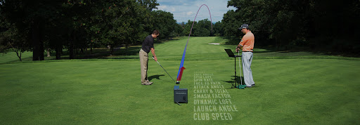
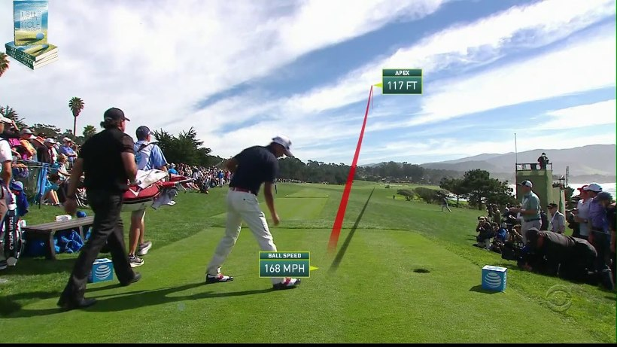
GOLF BALL
Tracking
Problem
Trackman
Problem
Solution
R&D Contents
Research Plans

Slide 3
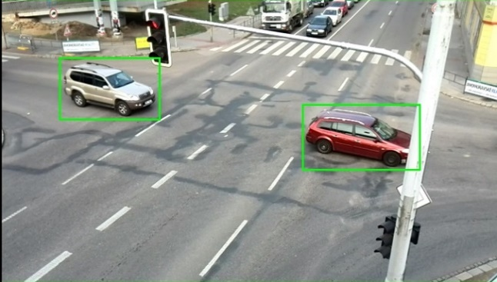
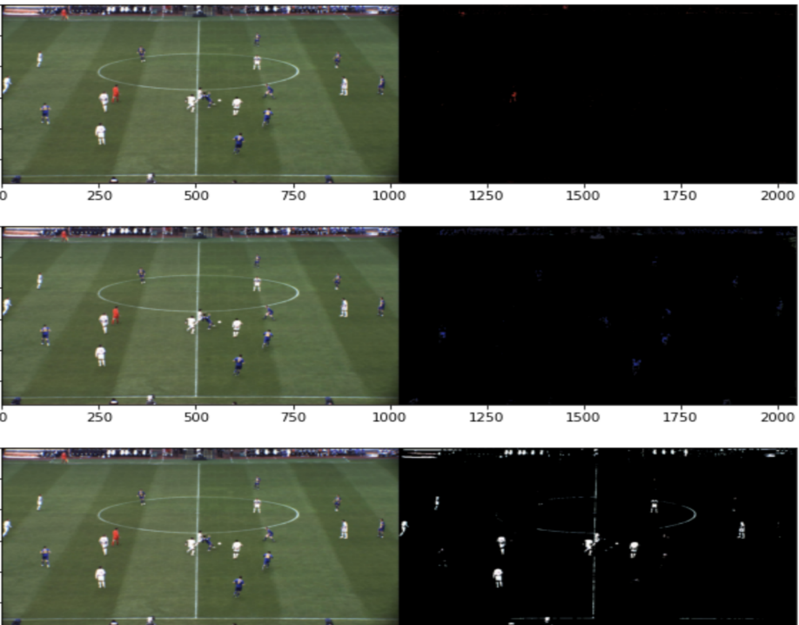
GOLF BALL
Tracking
Solution
ROI(Region of Interest)
Color Masking
Problem
Solution
R&D Contents
Research Plans

Slide 4
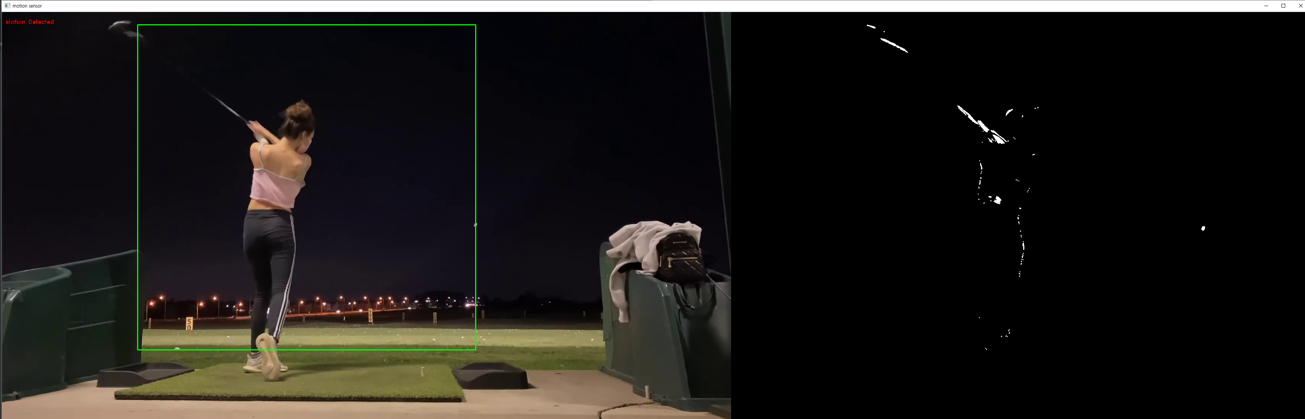
GOLF BALL
Tracking
Solution
Motion Detection
Problem
Solution
R&D Contents
Research Plans

Slide 5
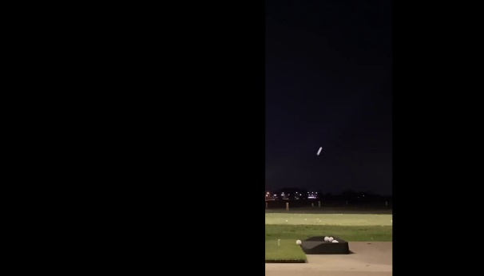



GOLF BALL
Tracking
R&D Contents
Read Video
c = t
b = t - 1
a = t - 2
Problem
Solution
R&D Contents
Research Plans
3D array → 2D array
Motion Detection

Slide 6
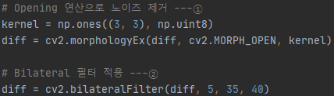
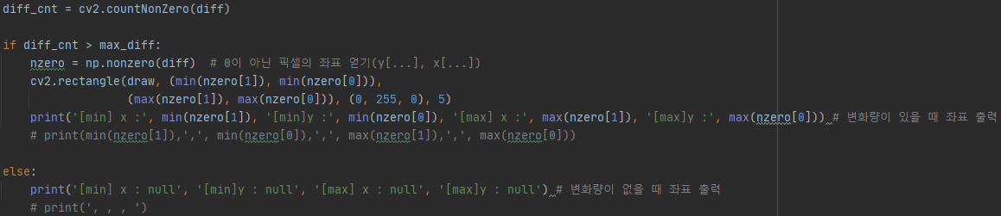
GOLF BALL
Tracking
R&D Contents
Remove Noise
Problem
Solution
R&D Contents
Research Plans
Draw The Area & Output of Coordinate Values

Slide 7
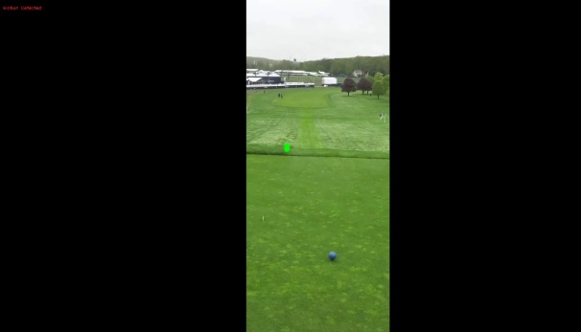
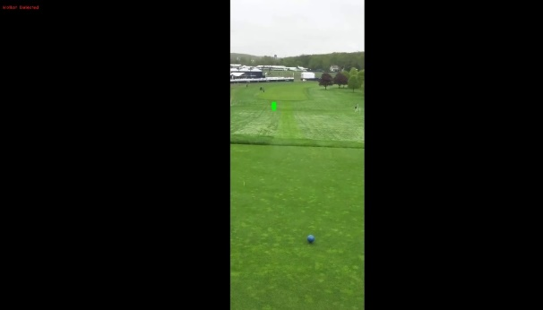

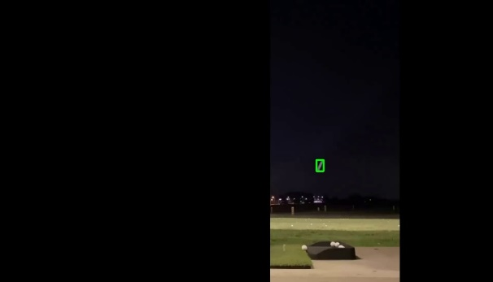


GOLF BALL
Tracking
R&D Contents
Tiger Woods Swings with Slow Motion 2019 4K 60 FPS
frame. 64
frame. 65
frame. 66
Problem
Solution
R&D Contents
Research Plans
Fun weekend vlog + Cooking at home, golf range
frame. 19
frame. 20
frame. 21

Slide 8
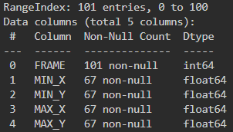
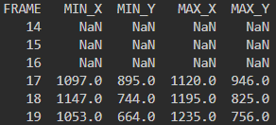
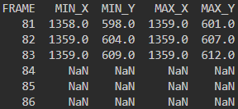
GOLF BALL
Tracking
R&D Contents
Frame-by-frame coordinate values
Problem
Solution
R&D Contents
Research Plans
frame. 1 ~ frame. 16
NaN
frame. 84 ~ frame. 101
NaN

Slide 9
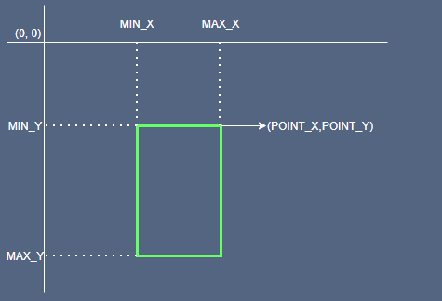
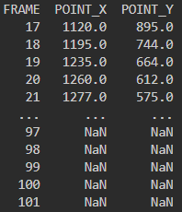
GOLF BALL
Tracking
R&D Contents
Useage Dataset
Problem
Solution
R&D Contents
Research Plans

Slide 10
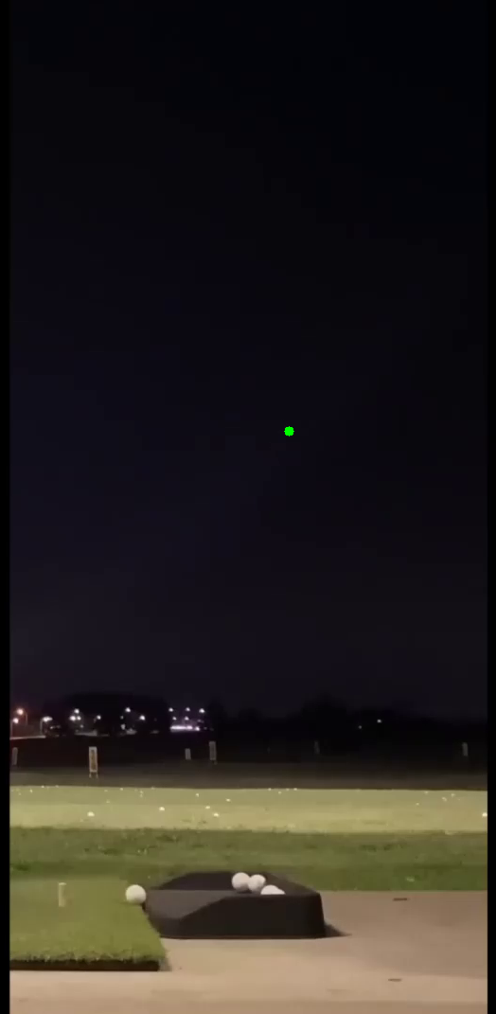
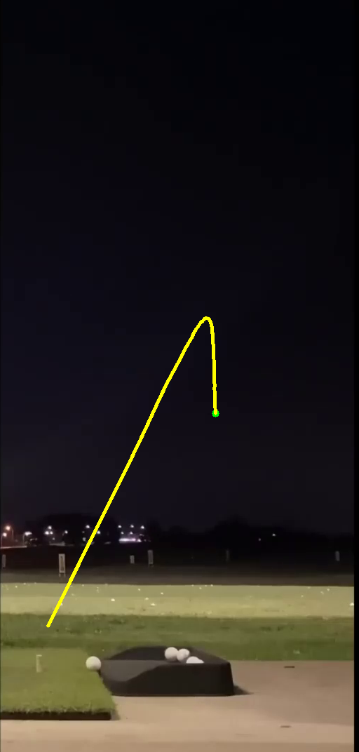

GOLF BALL
Tracking
Research Plans
Golf Ball Tracking
Problem
Solution
R&D Contents
Research Plans
detection
tracking
predict

Slide 11
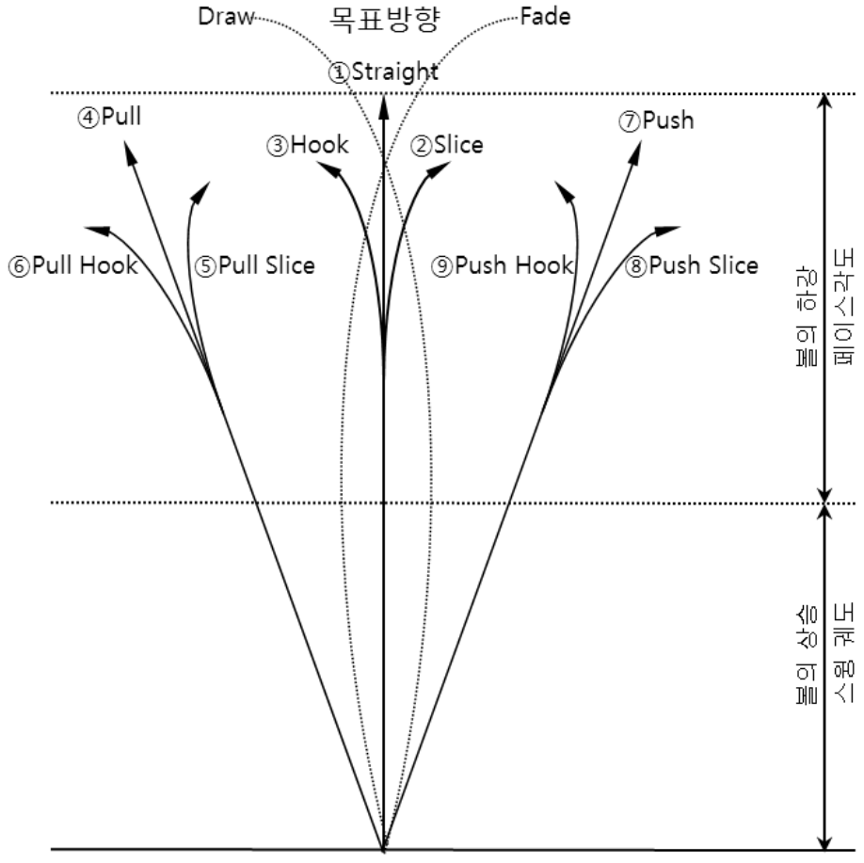
GOLF BALL
Tracking
Research Plans
Golf Ball Track
Problem
Solution
R&D Contents
Research Plans

Slide 12
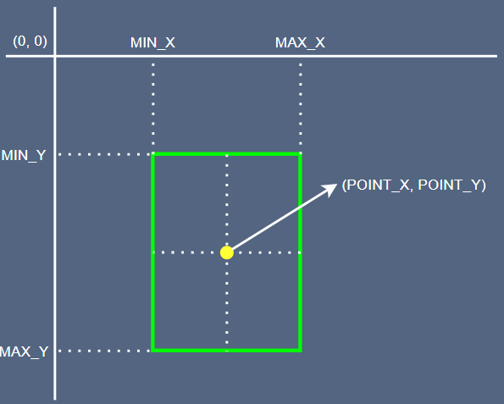
GOLF BALL
Tracking
Research Plans
Change Coordinate
Problem
Solution
R&D Contents
Research Plans

Slide 13
GOLF BALL
Tracking
Research Plans
Data Pre-processing
frame. 1 ~ frame. 16 → remove
frame. 17 ~ frame. 83 → learning
frame. 84 ~ frame. 101 → predict
Problem
Solution
R&D Contents
Research Plans

Slide 14
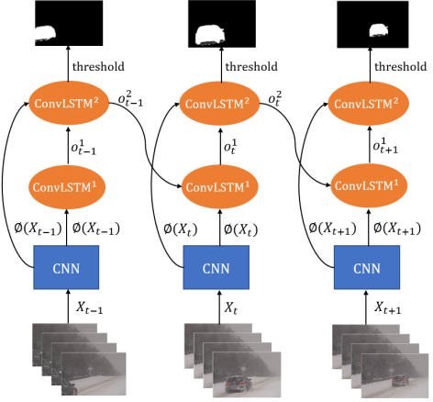
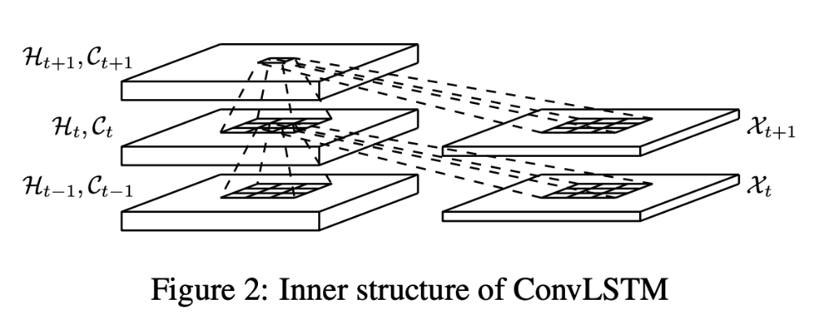



GOLF BALL
Tracking
Research Plans
Conv-LSTM
Conv-LSTM
Problem
Solution
R&D Contents
Research Plans
t - 1
t
t +1
learning
predict

