Slide 1
IIP Lab Seminar
Paper Review
MERL: Multimodal Event Representation Learning in Heterogeneous Embedding Spaces
Jul. 2022
Intelligent Information Processing Lab
JunHo Yoon

Slide 2
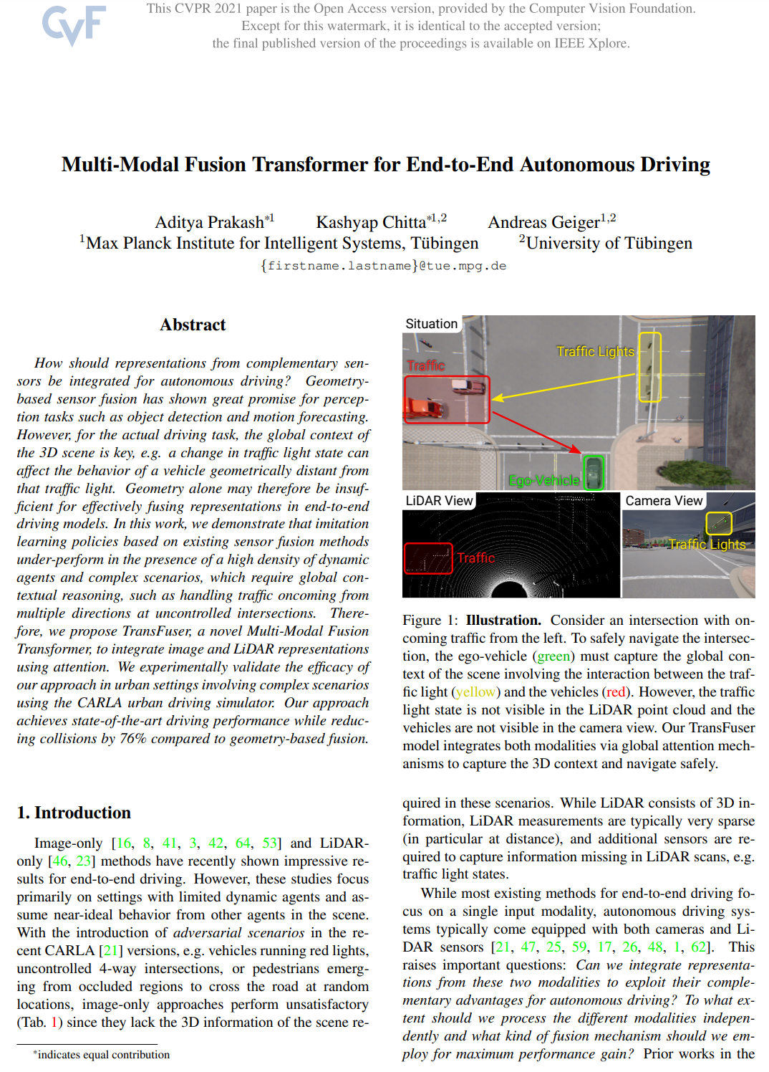
IIP Lab Seminar. MERL: Multimodal Event Representation Learning in Heterogeneous Embedding Spaces
Overview
■ Paper Description
Title : MERL: Multimodal Event Representation Learning in Heterogeneous Embedding Spaces
Venue : AAAI 2021
Impact Score (IS) : 25.57
Date : May. 2021
Citations : 2

Slide 3
IIP Lab Seminar. MERL: Multimodal Event Representation Learning in Heterogeneous Embedding Spaces
Event Representation
Event A
1) she
2) attend
3) baby
Event B
1) he
2) take care
3) kid
Event C
1) she
2) attend
3) meeting
Event C
Event A
Event B

Slide 4
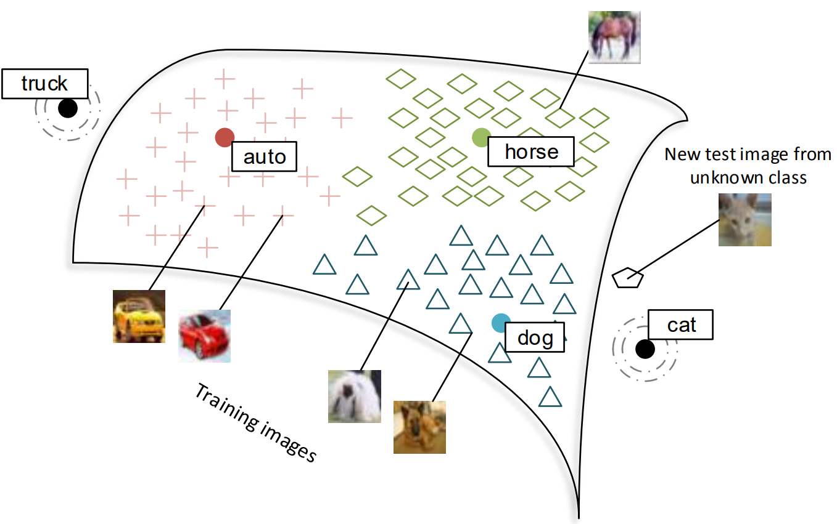
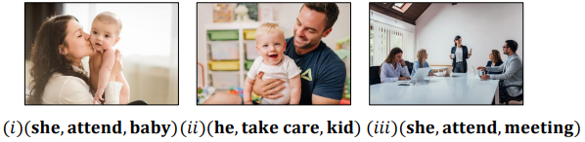
IIP Lab Seminar. MERL: Multimodal Event Representation Learning in Heterogeneous Embedding Spaces
Introduction
Event Representation Learning
triple (subject, predicate, object)
Multi-modal Event Representation Learning
triple (subject, predicate, object)
image

Slide 5
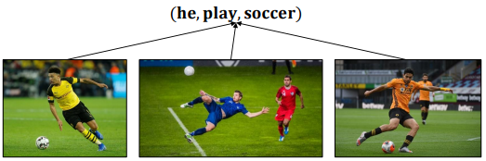
IIP Lab Seminar. MERL: Multimodal Event Representation Learning in Heterogeneous Embedding Spaces
Problem
Exist Method
추출된 Embedding Vector의 차원이 같은 데이터로 변환
Extis Method Problem
1) Text에 비해 이미지가 상대적으로 다양하기 때문에 다른 공간에 매핑되어야함
2) Text는 하나의 포인트가 아니라 이미지 전체를 나타낼 수 있어야함

Slide 6
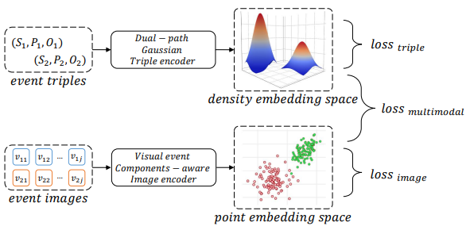
IIP Lab Seminar. MERL: Multimodal Event Representation Learning in Heterogeneous Embedding Spaces
Method
Embedding
triple : density embedding
image : point embedding

Slide 7
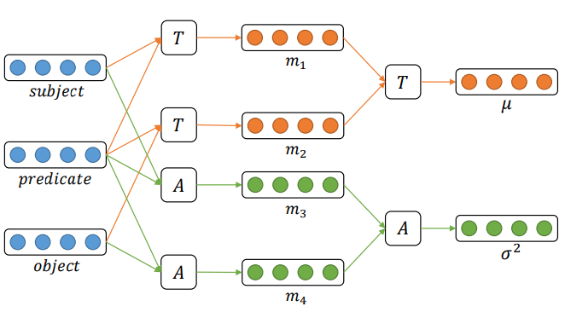
IIP Lab Seminar. MERL: Multimodal Event Representation Learning in Heterogeneous Embedding Spaces
Triple Embedding
Dual-path Gqussian Triple Encoder
m1,3 = subject, predicate
m2,4 = predicate, object
T = m1, m2 평균
A = m3, m4 표준편차

Slide 8
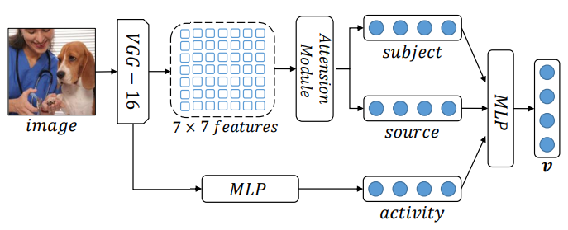
IIP Lab Seminar. MERL: Multimodal Event Representation Learning in Heterogeneous Embedding Spaces
Image Embedding
Visual Event Components-aware Image Encoder
Attention Module → subject, source
MLP → activity
subject : Vet
source : Dog
activity : Clipping

Slide 9
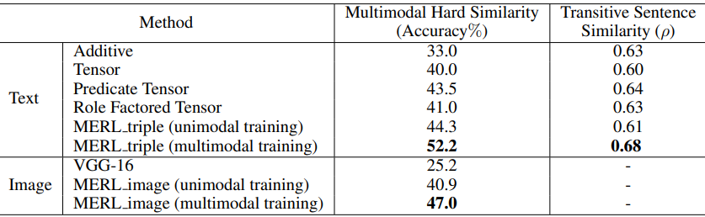
IIP Lab Seminar. MERL: Multimodal Event Representation Learning in Heterogeneous Embedding Spaces
Experiment
Multimodal Event Similarity
같은 Event에 대한 Modal(Image, Text)별 유사성

Slide 10
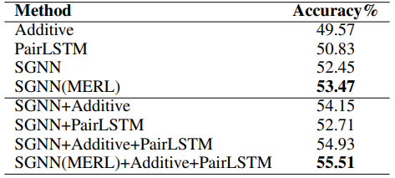
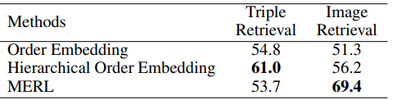
IIP Lab Seminar. MERL: Multimodal Event Representation Learning in Heterogeneous Embedding Spaces
Experiment
Script Event Prediction
Script Event에서 다음 장면 예측
Cross-modal Event Retrival
Event Triple에 대한 가장 유사한 이미지 탐색

Slide 11
IIP Lab Seminar. MERL: Multimodal Event Representation Learning in Heterogeneous Embedding Spaces
Conclusion
Contribution
1) 단일 Modal 방식과 Multi-modal 학습 방식을 비교하여 Multi-modal Learning의 중요성을 보임
2) Modal별 데이터를 기존 방식인 같은 공간 안에 표현하지 않고 다른 공간에 표현함으로써 새로운 방향성을 제시함
3) Modal별 전체를 학습하지 않고 subject, predicate, object로 표현하고 학습해 성능을 향상시킴
Review
1) 같은 공간 안에 표현하는 Embedding 방식에 대해 문제가 있음을 서술했으나, 비교 평가 시 같은 공간에 표현했을때가 누락됨
2) 학습 데이터 구축 시 Text 데이터를 제외한 Image 데이터의 경우 연구원이 직접 수집함
3) 모델 성능 평가 시 기존 방식보다 성능이 좋으나 전체적으로 정확도가 낮음

Slide 12
IIP Lab Seminar. Multi-Modal Fusion Transformer for End-to-End Autonomous Driving
Thank you ☺
JunHo Yoon 윤준호
Department of Computer Engineering, Gachon University | Researcher
Tel. +82-31-750-8822 Mobile. +82-10-9110-6257
E-mail. junho6257@gachon.ac.kr

