Slide 1
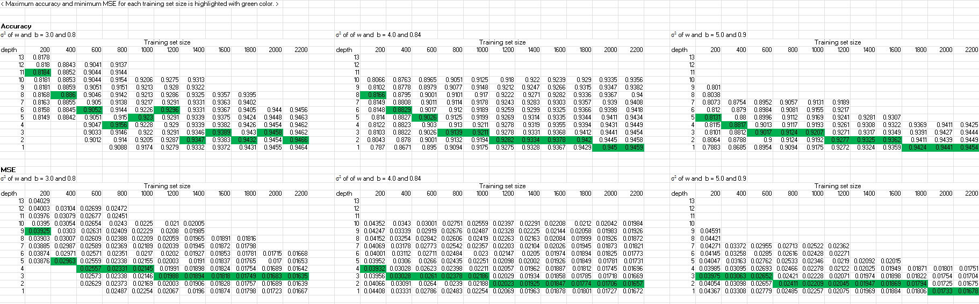
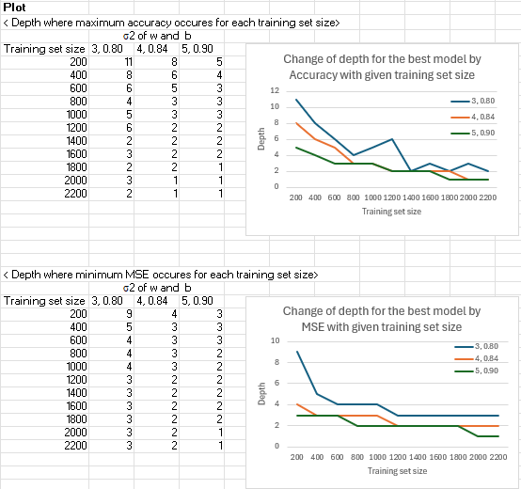
Title: Effect of depth of NNGP on the accuracy and MSE of the models

