Slide 1
WEB PROGRAMMING
19013139 Myeong Su Choi
Notes:
Hello, I’m Myeong Su Choi. Let’s start the presentation.

Slide 2

Table of contents
The goal and summary of the project
Wireframe on the main page
Description of each function
3 – 1. User Authentication
3 – 2. Comment function
3 – 3. Like function
3 – 4. Simple order function
3 – 5. Profile management function
3 – 6. Search function
3 – 7. Other function
Notes:
The table of contents is as follows.
First, I will present the goal and summary of the project, wireframe on the main page and brief description of each function in order.

Slide 3
“The goal and summary of the project”
Notes:
First, “The goal and summary of the project”

Slide 4

Creating an clothing shopping site
Users on the shopping site can log in or sign up for membership, click ‘Like’ button, make purchases, search for items, leave product reviews, and view their liked and purchased products on their profiles.
Notes:
The goal of the project is “Creating an clothing shopping site”
Users on the shopping site can log in or sign up for membership, click ‘Like’ button, make purchases, search for items, leave product reviews, and view their liked and purchased products on their profiles.

Slide 5
Aim to implement the following functions.
User Authentication , It provides log in and membership services.
Comment function , It provides a function to comment on the product.
Like function , It provides the ability to press the Like button for the product.
Simple order function , It provides a simple purchasing function.
Profile management function , It gives users the ability to modify their profile, and it gives users the ability to view the products they have pressed the ‘Like’ button and the products they have purchased.
Search function , It provides the ability to find the product user’s want.
Notes:
I aim to implement the following functions.
There are user authentication, comment function, like function, simple order function, profile management function and search function.

Slide 6
“Wireframe on the main page”
Notes:
Second, “Wireframe on the main page”

Slide 7
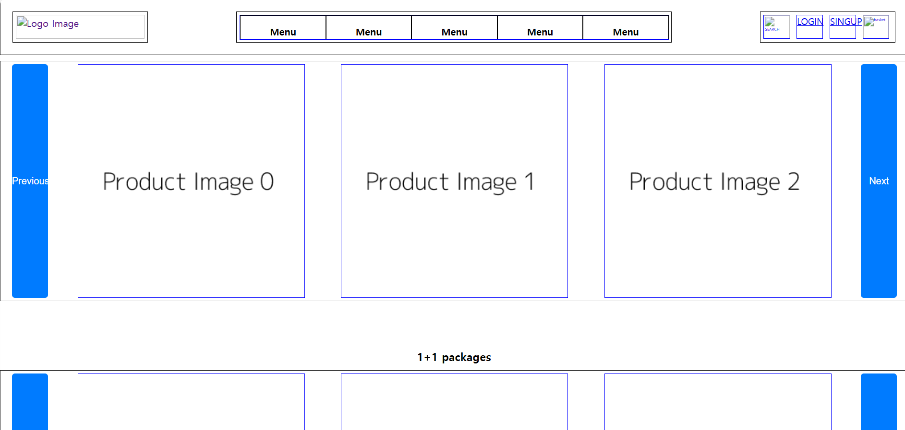
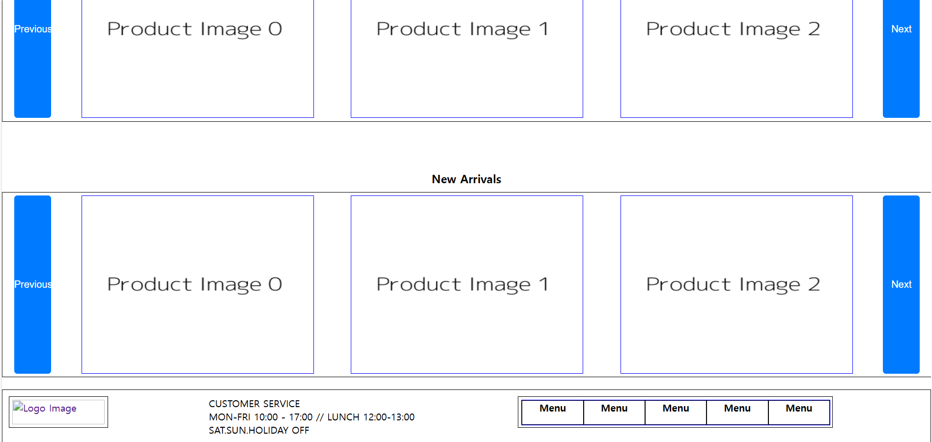
- Wireframe -
Notes:
This is the wireframe of the main page.

Slide 8
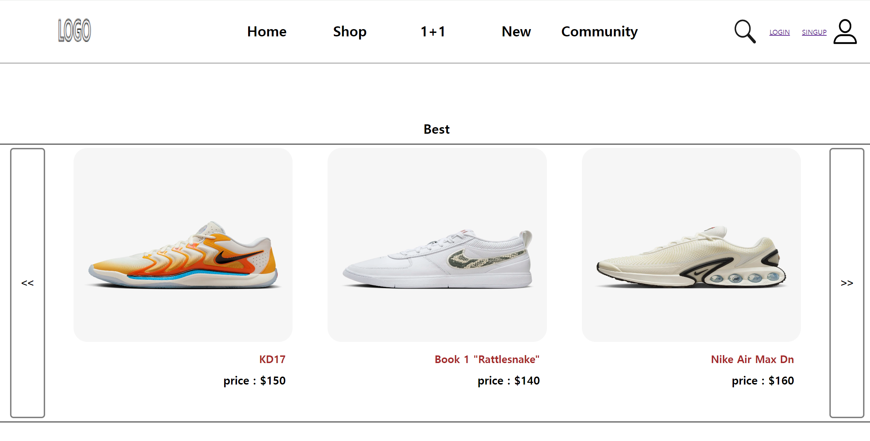
- A real screen -
Notes:
And this is a real screen.

Slide 9
“Description of each function”
Notes:
Thrid, “Description of each function”

Slide 10
1. User authentication
Notes:
The first is user authentication.

Slide 11
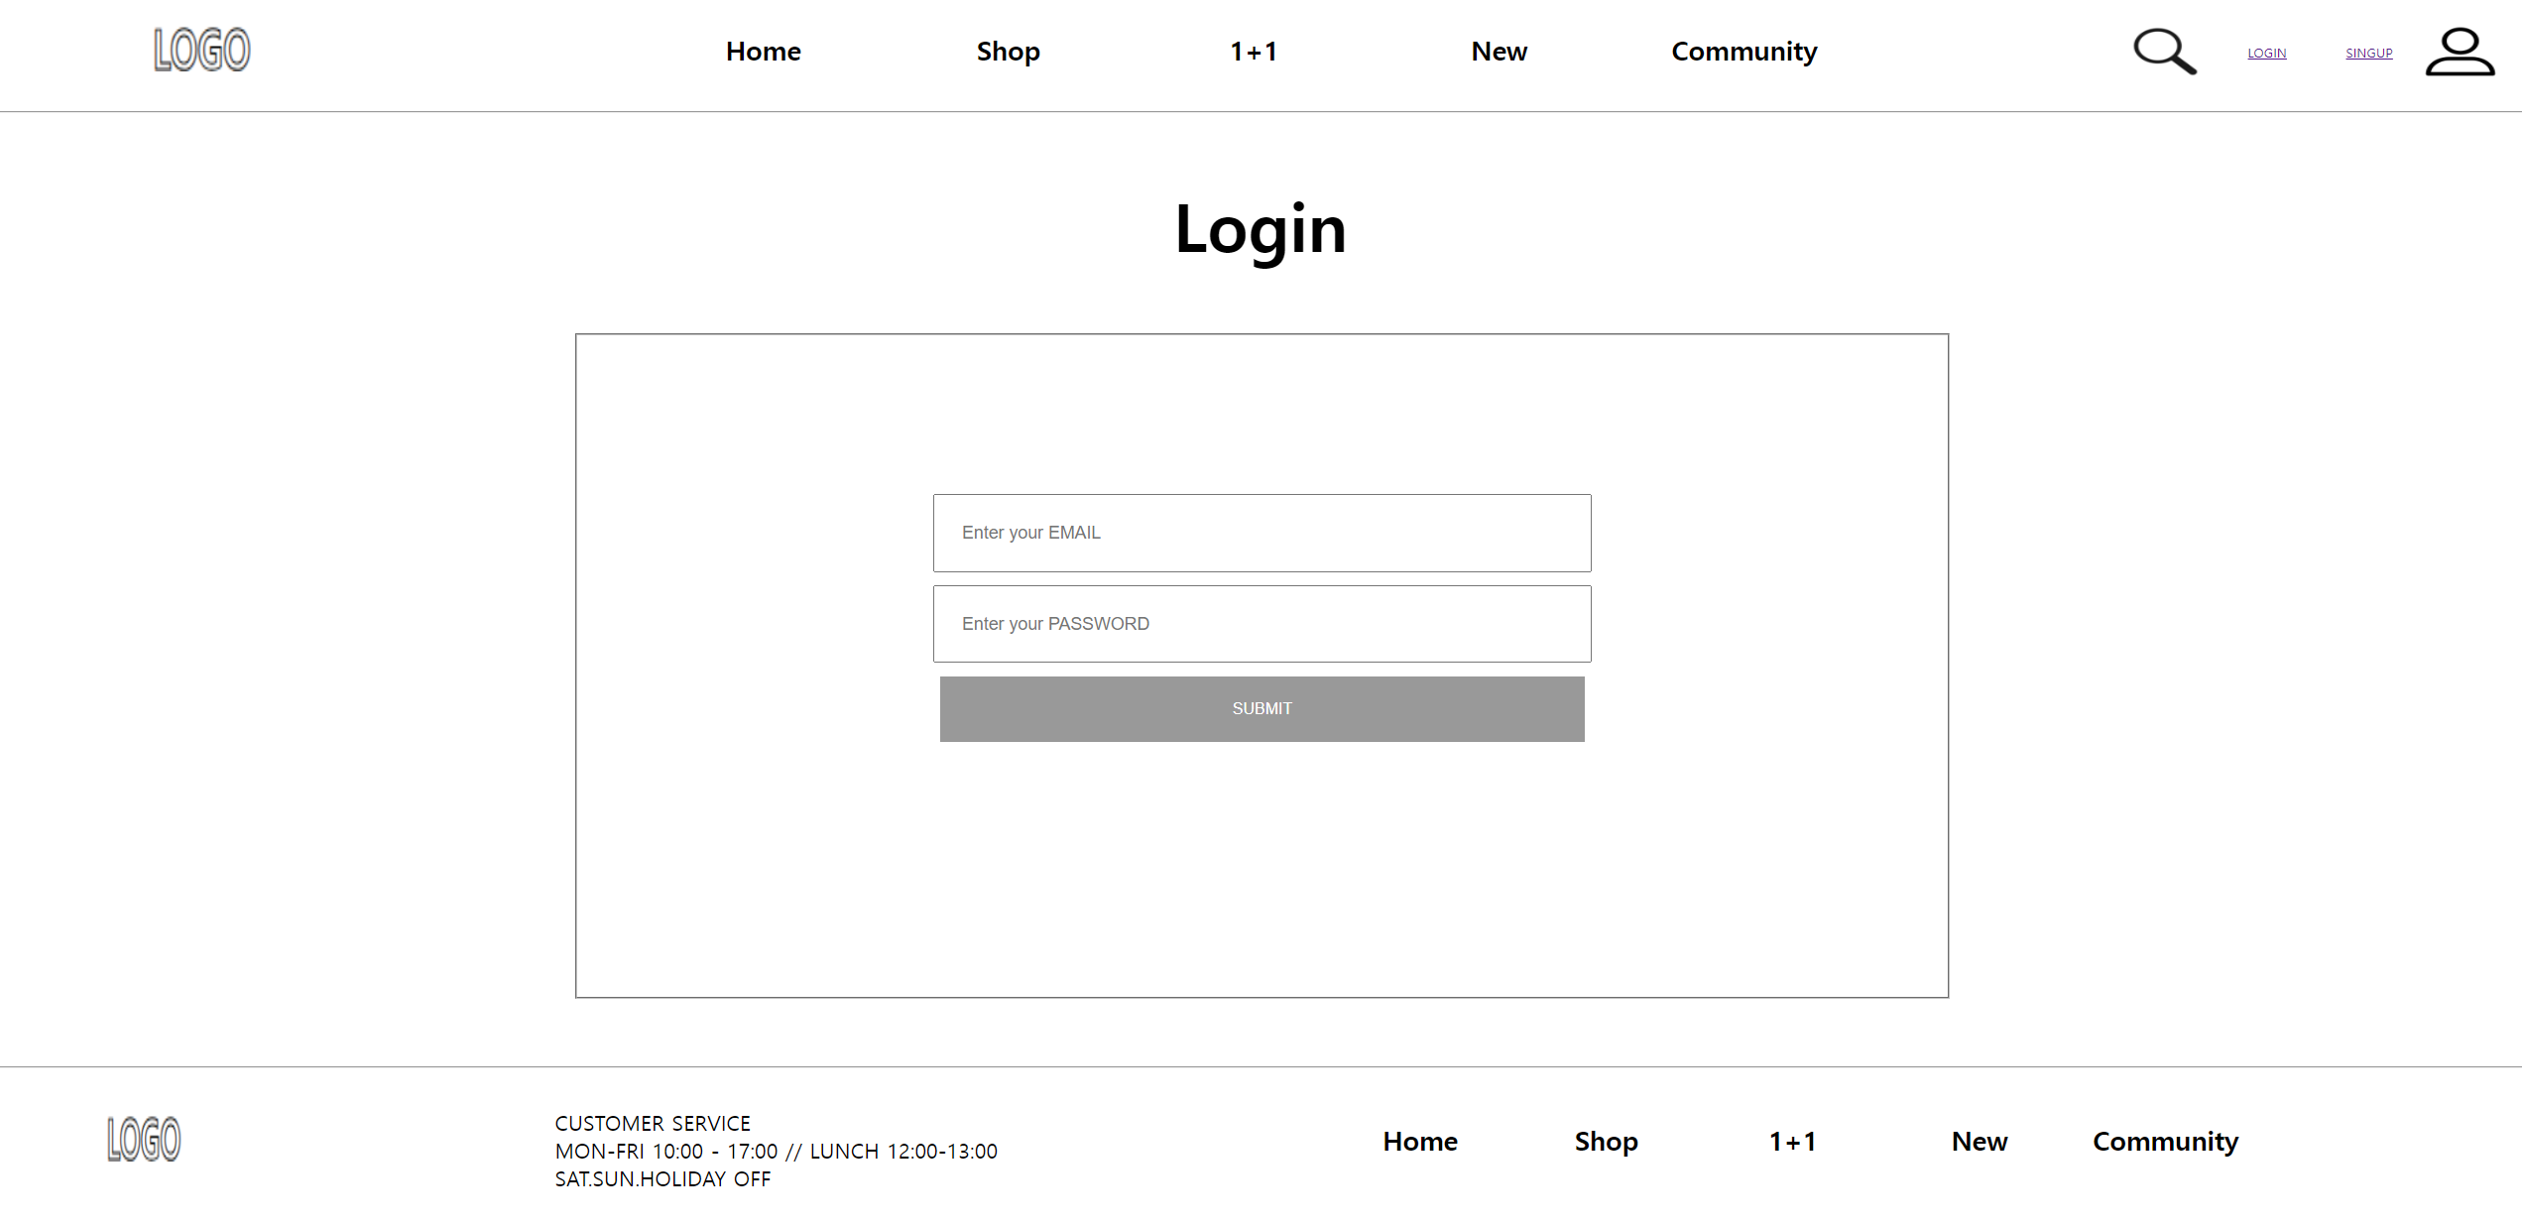
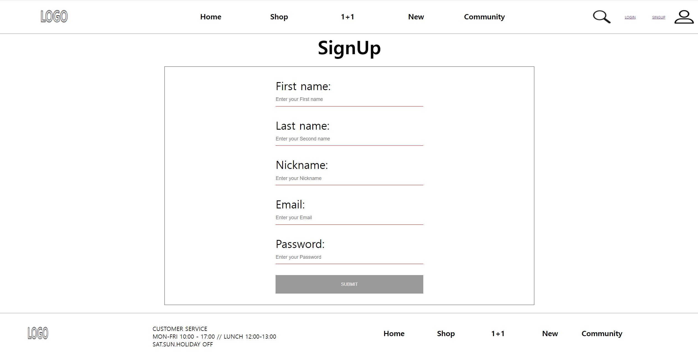
Login
Join membership
Notes:
The following is the screen when the user attempts to log in and join

Slide 12
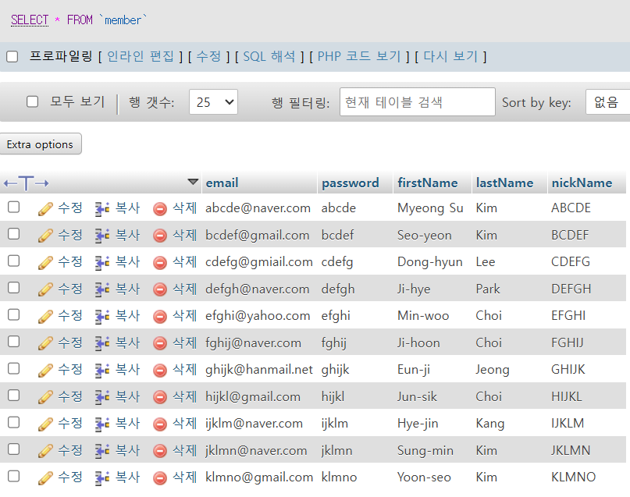
How does it work?
The following is an initialization of a table named member in a database named project with the following data.
Notes:
Let’s see how it works.
The following is an initialization of a table named member in a database with the following data.

Slide 13
How does it work?
< Code inside the login.php file >
<section class="login-section">
<form method="post" action="homepage.php">
<h2 style="font-size: 50px">Login</h2>
<fieldset>
<div>
<input type="email" name="email" placeholder="Enter your EMAIL" required> <br>
</div>
<div>
<input type="password" name="password" placeholder="Enter your PASSWORD" required>
</div>
<div>
<button type="submit">Submit</button>
</div>
<?php if(isset($_SESSION['message']) && $_SESSION['message'] == 1) { ?>
<p style="color : red">Your email and password do not match. Please try again.</p>
<?php } $_SESSION['message'] = 0;?>
</fieldset>
</form>
</section>
Notes:
This code is inside the login.php file.
When a user enters their own email and password to log in, the data is transferred to the hompage.php file via post method.

Slide 14
How does it work?
<?php
session_start();
if(isset($_POST['email']) && isset($_POST['password'])) {
$_SESSION['useremail'] = $_POST['email'];
$_SESSION['userpass'] = $_POST['password'];
$user = 'root';
$pass = '';
/*
An error occurred because it matched the existing MySQL port number, so I changed the port number to 3307 and proceeded with the project.
*/
$db = mysqli_connect('localhost:3307', $user, $pass) or die('Unable to connect. Check your connection parameters');
mysqli_select_db($db, 'project') or die(mysqli_error($db));
$query = 'SELECT *
FROM member';
$result = mysqli_query($db, $query) or die(mysqli_error($db));
while($row = mysqli_fetch_array($result)) {
extract($row);
if($_SESSION['useremail'] == $email && $_SESSION['userpass'] == $password) {
$_SESSION['logged'] = 1;
$_SESSION['logged_email'] = $_SESSION['useremail'];
break;
}
$_SESSION['logged'] = 0;
}
if($_SESSION['logged'] == 0) {
$_SESSION['message'] = 1;
echo "<script>window.location.href = 'login.php';</script>";
exit();
}
}
?>
< Code inside the homepage.php file >
Reference : https://developer.mozilla.org/en-US/docs/Web/API/Window/location#value
Notes:
This code is in the homepage.php file.
클릭
If there is an email and password delivered in the post method, save each data as a session variable.
클릭 클릭
After that, if there is data in the member table, insert the logged-in email value in the session variable.
If the data is not in the member table after connecting to the database, display the login.php file screen again with the message.
클릭
The session variable message determines whether to display a message or not
클릭
and how to redirect the screen is referred to in the official document at the bottom right.
Similar logic flows when signing up for membership.

Slide 15
2. Comment function
Notes:
Second is comment function.

Slide 16
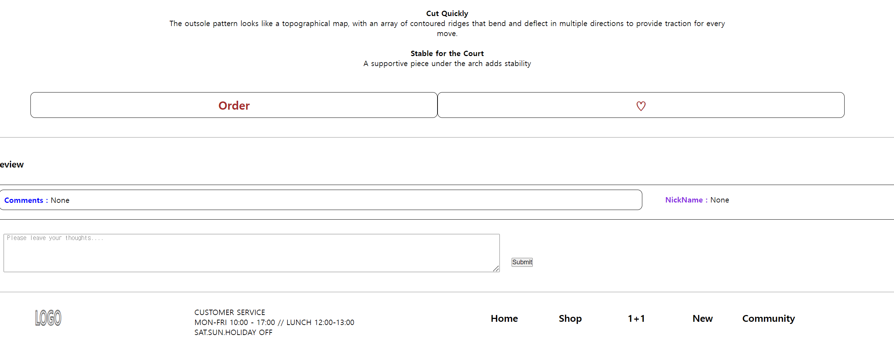
Notes:
When a user clicks on a product, there is a space where they can comment under the description of the product.
If user leaves a comment like “It’s very good”

Slide 17
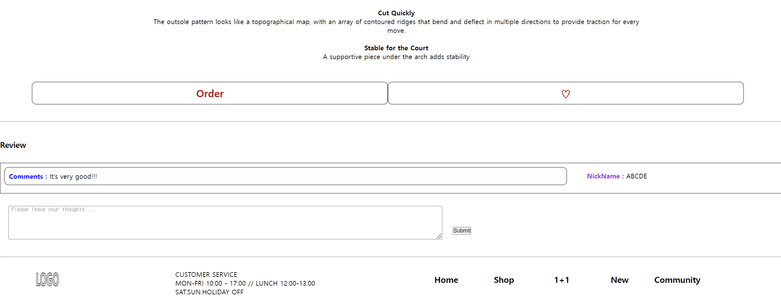
Notes:
We can see the new comments displayed with user’s nickname.

Slide 18
How does it work?
< Code inside the product.php file >
<form method="post" action="product.php?id=<?php echo $product_ID; ?>">
<fieldset style="display: flex;">
<div style="margin: 20px;">
<textarea name="comment" id="comment" rows="5" cols="150" placeholder=" Please leave your thoughts...." required></textarea>
</div>
<div style="margin-top: 70px; margin-left: 5px;">
<button type="submit">Submit</button>
</div>
</fieldset>
</form>
Notes:
Let’s see how it works.
This code sends the data to the product.php file as a post method for the comments to be added, including the product number information in the url.

Slide 19
How does it work?
< Code inside the product.php file >
if(isset($_POST['comment'])) {
$postComment = $_POST['comment'];
if(isset($_SESSION['logged_email'])) {
$logged_email = $_SESSION['logged_email'];
$user = 'root';
$pass = '';
$db = mysqli_connect('localhost:3307', $user, $pass) or die('Unable to connect. Check your connection parameters');
mysqli_select_db($db, 'project') or die(mysqli_error($db));
$postCommentEscaped = mysqli_real_escape_string($db, $postComment);
$query = "INSERT into comment(comment, email, productID)
VALUES ('$postCommentEscaped', '$logged_email', '$product_ID')";
$result = mysqli_query($db, $query) or die(mysqli_error($db));
echo '<meta http-equiv="refresh" content="0">';
exit();
}
else {
?>
<script> window.alert("Please log in"); </script>
<?php
}
Notes:
This code put the data delivered in the post method into the variable, and if user is logged in, put the new data in the comment table.

Slide 20
3. Like function
Notes:
Next is the like function, and I will briefly explain what kind of function it is due to time constraints from now.

Slide 21
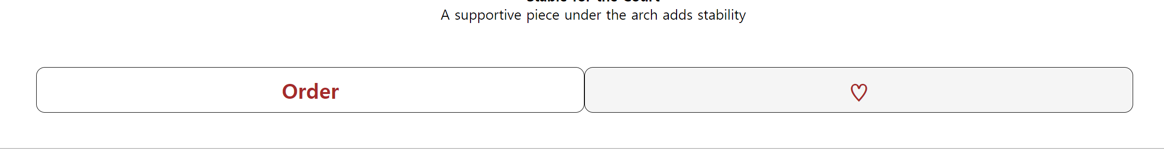
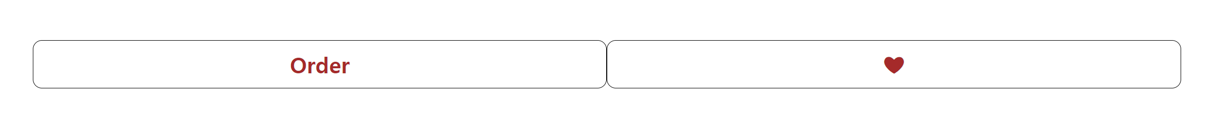
Notes:
Click on the product and click on the blank heart under the product description to change it to a filled heart.

Slide 22
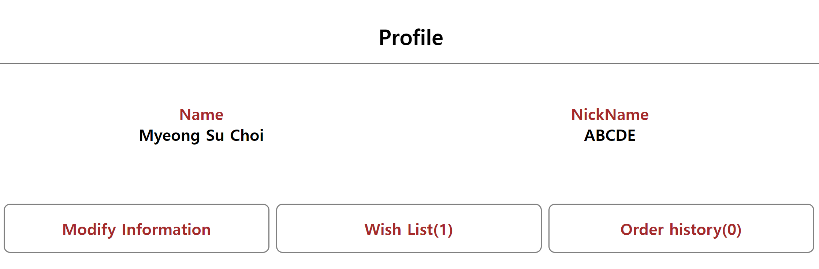
Notes:
And when user goes to the user's profile, user can see items that have been added to the wish list.

Slide 23
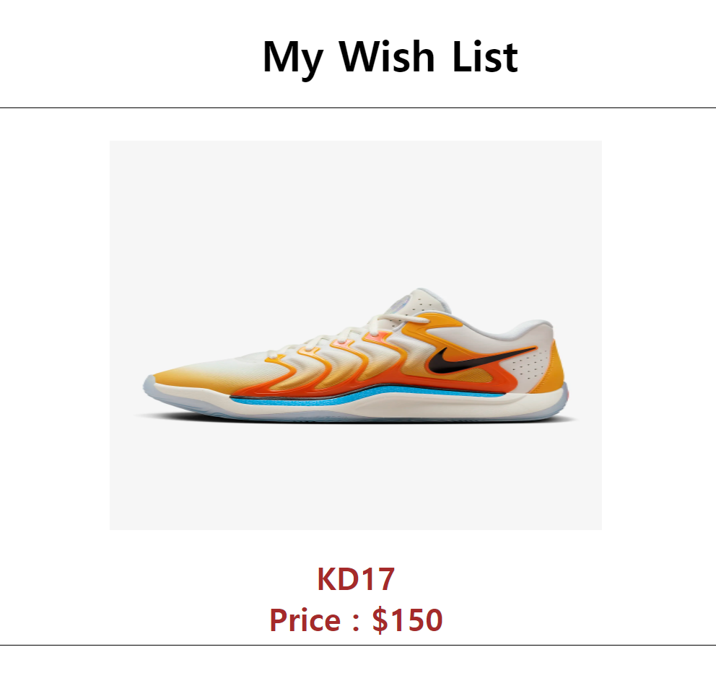
Notes:
And if user goes into the wish list, user will get a product that user press like button.

Slide 24
4. Simple order function & 5. Profile management function
Notes:
The order function operates on a similar logic as the like function. The profile management function displays user’s name and nickname as shown in the image earlier, along with buttons to modify information, view the wish list, and see user’s order history.

Slide 25
6. Search function
Notes:
Next is search function.

Slide 26
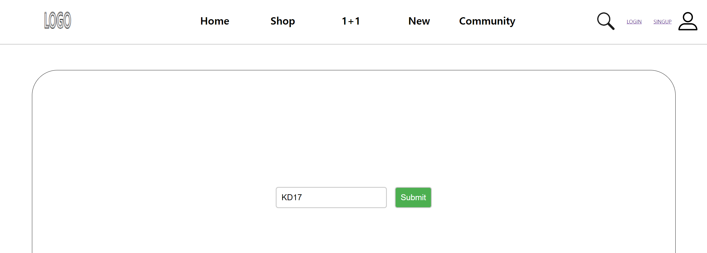
Notes:
When the user clicks on the magnifying glass-shaped image at the top of the screen, a screen appears to search for the product. When searching for a specific product

Slide 27
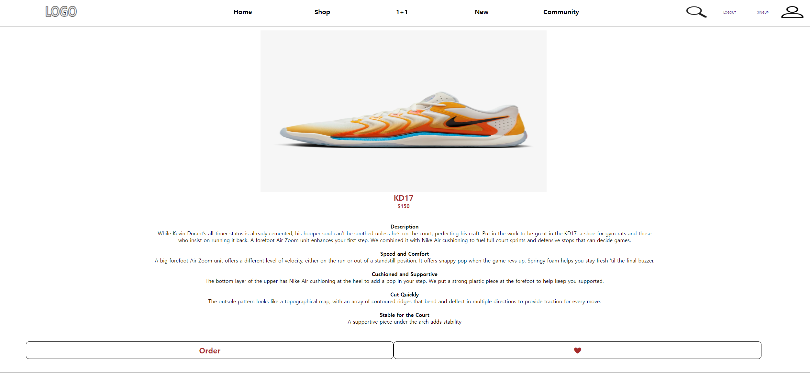
Notes:
The product will be displayed on the screen.

Slide 28
7. Other function
Notes:
Next is other function

Slide 29

Notes:
The above image is the main page screen. If user press the buttons on both sides of the displayed screen

Slide 30
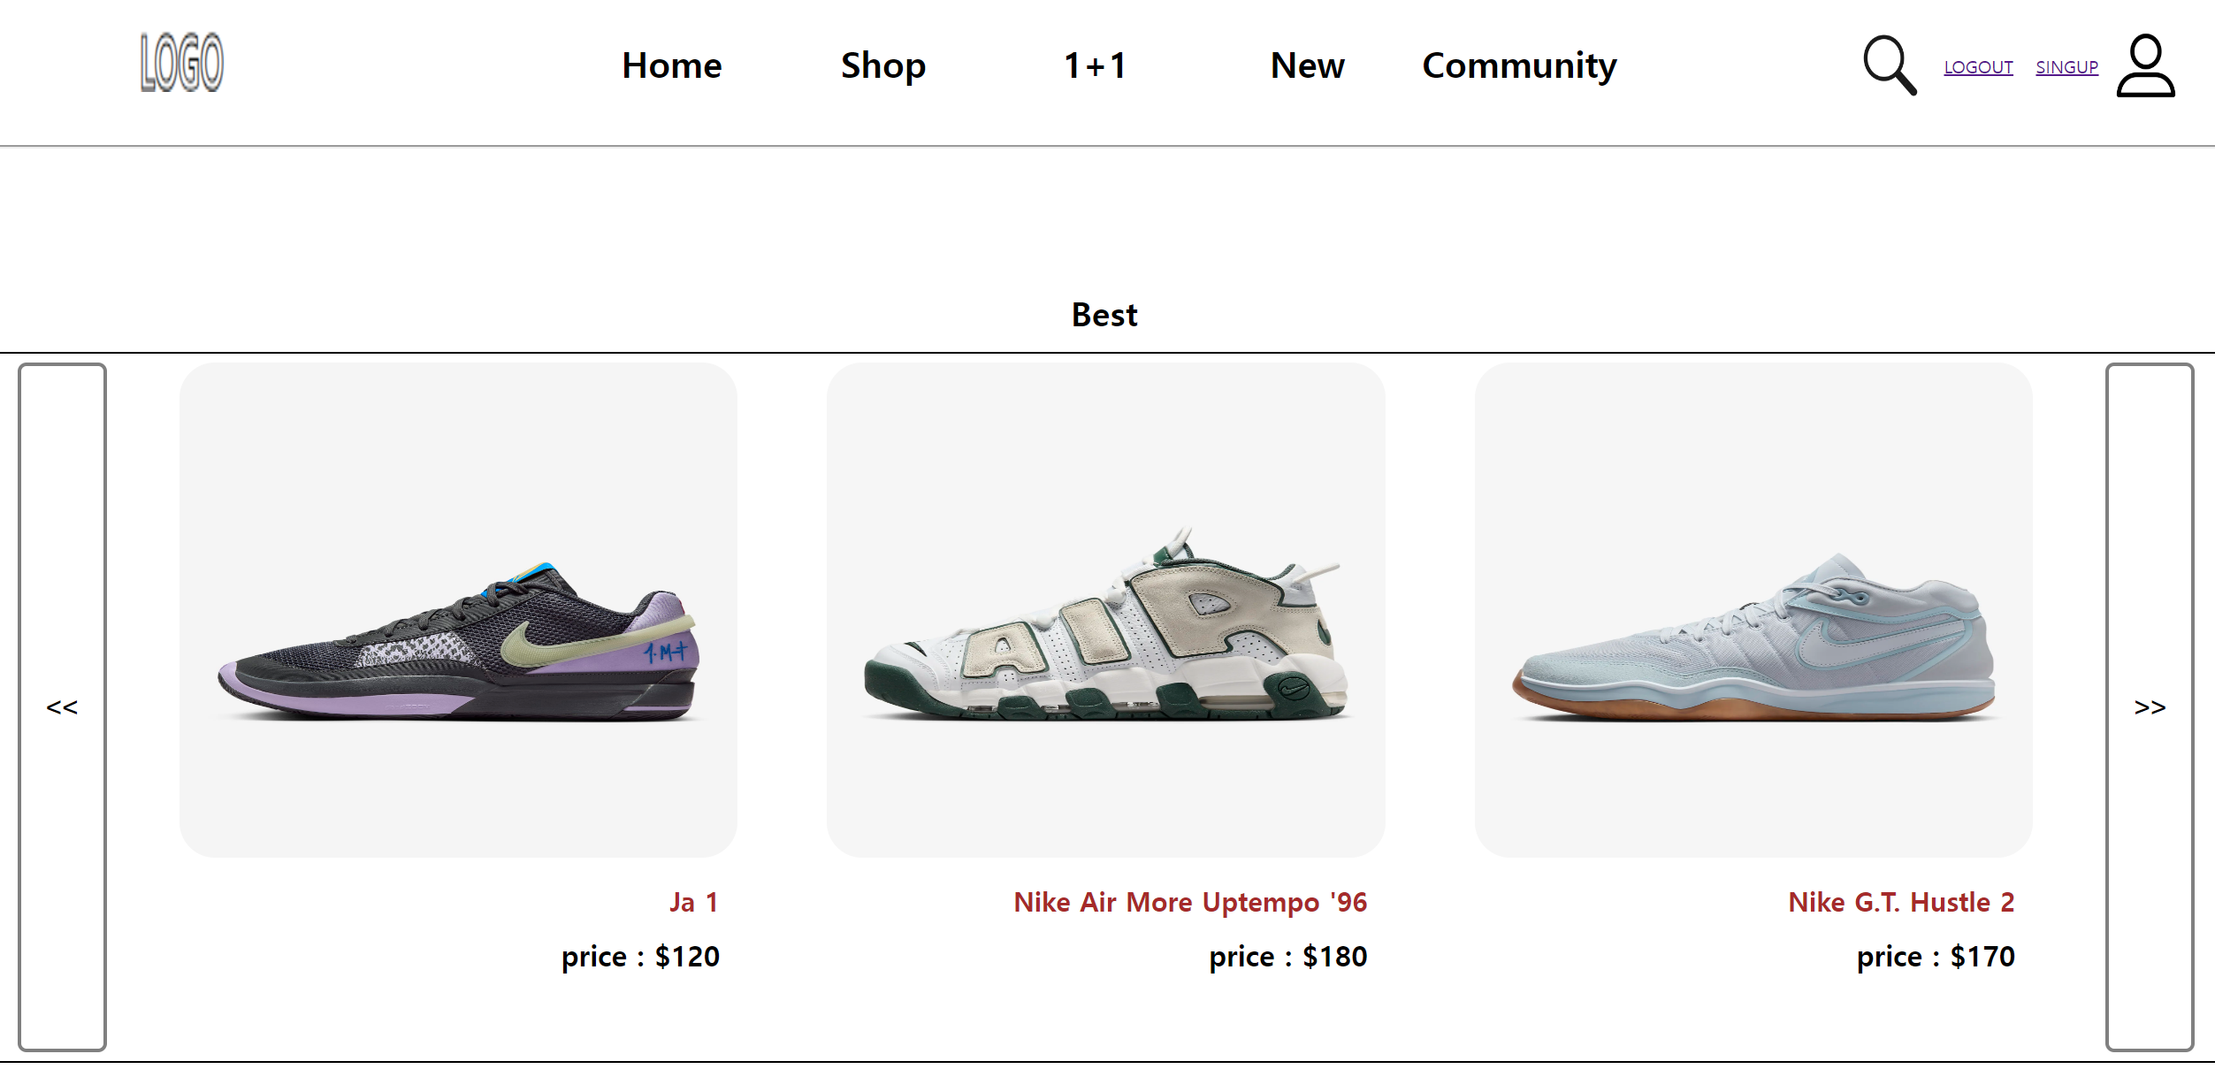
Notes:
The following items appear on the screen.

Slide 31
Thank you
Notes:
That concludes my presentation.
Thank you for listening.

