Slide 1
Blueprint Communication and You
What you Must Know for Properly
Transmitting Data in Blueprint

Slide 2
What is Blueprint Communication?
A means for separate individual objects to interact with each other
Imagine a Light Blueprint and a LightSwitch Blueprint
How would you get one to work with the other?
Useful for doing things like:
Broadcasting an event to a number of listeners
Telling a specific object to do something
Querying another object for
Status
State
Property values
Variable values
Results
Etc.

Slide 3
A Simple Primer
UE4 has no way to just “send a broad signal to everyone”
Trivia: we did this a long time ago in UE2, but it isn’t very efficient
Communication will always involve the following:
A Sending Blueprint
At least one Receiving Blueprint
Communication will always require a reference at some point
In other words, one party - the Sender or the Receiver - has to become aware of the other
This is because, as stated above, there is no broad spectrum communication system
All Blueprint communication is 1-way
Blueprints can send data back and forth, but it requires both Blueprints to set up their own individual paths of communication
Queries are possible, but are initiated by the Sender (still 1-way)

Slide 4
Communication Types
For our purposes, there are 3 primary Blueprint communication Methods:
Direct Communication
Blueprint Interface message calls
Event Dispatchers
If you come up with other types, they’re probably extensions of these three.
Probably.

Slide 5
When to Use Different Types - At a Glance
The first question is the flow of communication
Is the sender pushing the data out to the receiver(s)? If yes,
Direct communication
Blueprint Interface Communication
Are the receivers actively listening for the sender to do something? If yes,
Event Dispatchers
Second question is which party can get a reference to the other
Can the Sender get a reference to the Receiver(s)? If yes,
Direct communication
Blueprint Interface Communication
Can only the Receivers get a reference to the Sender? If yes,
Event Dispatchers
It becomes easier to answer these questions with a little practice!

Slide 6
Direct Blueprint Communication - Concept
One Blueprint is talking to another
Sender gains access to Receiver
Sender can then
query data and variables
Send data and update variables
Call functionality on the Receiver
Always 1-to-1 communication, not 1-to-many
You can use flow control techniques such as Loops to talk to many things
Each iteration of the loop is still 1-to-1!

Slide 7
Direct Blueprint Communication - When to Use It
You already know the following:
The Sending object
The Receiving object(s) - or you at least have a clear way to get a reference to them
What functionality or data you’re going to tap into
Basically, you know everything that could ever happen between these two things, you just need to make something happen.
If you don’t know everything:
You will likely wind up making a lot of Branch (If) nodes
If it’s a Box, open it
If it’s a Light, toggle it
This is generally not good. You should probably be using a different form of communication.

Slide 8
Direct Blueprint Communication in Action
Sender gets a reference to the Receiver
Many, many ways to do this. Examples would be:
Assigned at the start of game (BeginPlay)
Overlaps
Get All Objects/Actors of Class (very slow, use with caution)
Sender may need to Cast this reference to the thing it wants to talk to
This is is just a test to verify what it is you are talking to
We will cover Casting in much more depth later
If the Cast is successful, then the connection is complete
Sender can send data to or pull data from the receiver
Sender can call functions directly on the receiver

Slide 9
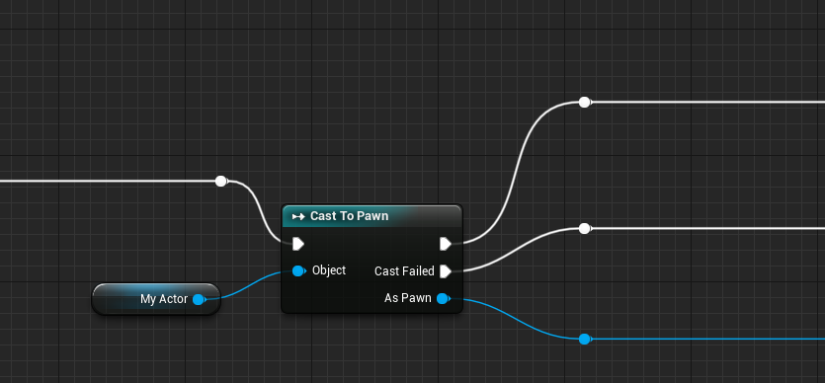
Casting: What it Looks Like (from Sender)
If Cast succeeds
Incoming Execution
Cast node
If Cast fails
Reference
Cast output gives access to functionality for the cast class

Slide 10
A Word on Casting
Casting confuses a lot of non-coder types (it’s a programming term)
Think of Casting as just a way to verify what you’re talking to
Once you’ve Cast to a given type, only then can you access its functionality
If a Cast fails, you can always Cast to something else:
We get a reference to some actor or object, then:
Cast it to a Door. Was that successful?
No.
Cast it to a Light. Was that successful?
No.
Cast it to a Weasel. Was that successful?
Yes.
Awesome! Set the Weasel’s bWearingAPartyHat Boolean property to True!
If you already have a reference of the proper type, you don’t need to Cast!

Slide 11
Casting and Object Orientation
Consider the following Class hierarchy:
(indentation denotes inheritance)
Object
Actor
Pawn
Character
Wendy
Michael
John
Peter
In this example game you could possess and control Wendy, Michael, John, and Peter.
Casting to Wendy gives you access to the things that are specific to Wendy, but you cannot access things specific to Michael, John or Peter
If you need access to the things that all possessable characters can do, you would cast to the next class up: Character
Technically, Wendy is an Object, Actor, Pawn, Character, and is also Wendy.
All these things would test True on a Cast!
Not all of them are guaranteed to give you access to the functionality you need.
Casting to a too-high parent class locks out out of specific functionality found only in lower child classes.
Casting to a too-low child class lowers flexibility and eliminates the possibility of accessing sibling classes without further testing.
When adding functionality to your Blueprint classes, keep the hierarchy in mind!
Shared concepts belong higher in base classes
Don't duplicate work

Slide 12
(Demonstration of Direct Comms/Casting) Questions about Direct Communication?

Slide 13
Blueprint Interfaces - Concept
A way to specify functionality without any kind of implementation
Example:
Tell 2 different people to acquire their favorite food
Person One makes a pizza from scratch
Person Two orders Chinese takeout
Both did different things, even though you gave them the same command
The nice thing:
Interfaces don’t really care whether or not the Receiving object knows about them.
Imagine Person Three is a robot and doesn’t eat. They wouldn’t respond to the command.
That’s okay! The game won’t crash!
Interfaces are still 1-to-one communication!
The Sender still needs some reference to Receiver

Slide 14
Blueprint Interfaces: How They Work
Interfaces are a unique form of communication: they their own asset
You make them in the Content Browser. More later.
You send data - called Interface Messages - through that asset to listening objects
By default, nothing receives Interface Messages
You have to implement the Blueprint Interface onto the Blueprints that will be receiving
Unless you do this, the Blueprint Interface does nothing
This means that anything that doesn’t need to respond to an Interface Message simply doesn’t have to implement the Interface
Only Receivers need to actually implement an Interface.
Anything can send Interface Messages, whether it implements the Interface or not.
It is perfectly safe to send Interface Messages to objects that don’t implement the appropriate Blueprint Interface
Nothing will happen because the object “doesn’t care” about the incoming message

Slide 15
Blueprint Interfaces - When to Use Them
When you are sending a signal to some other object, and you don’t really care what it does once it receives the signal
In fact, you don’t even care if the Receiver knows about the signal!
You just want to send a signal to an object; if they know what to do with it, great!
Example:
Interaction: I hit the B Button, and we send out an InteractWithThings signal.
Doors know that they should open.
Lights know they should toggle.
Potted plants don’t do anything. They don’t care that you are interacting with them.
We don’t care whether they react or not!
The implementation (if there is one) is the Receiver’s problem!
Fun fact: Interfaces can be used for communication between sub-levels!

Slide 16
Blueprint Interfaces in Action
Create them in the Content Browser
(right click > Blueprints submenu > Blueprint Interface)
In the Blueprint Interface Editor, you automatically get your first function.
You can setup inputs/outputs if you like.
You can’t set up any functionality (no other nodes)
In fact, the graph is grayed out and locked!
Implement the Interface
In the receiving class, go under Class Settings.
Under Implemented Interfaces, add your new Interface.
Recompile
You can now create an event in your graph named the same thing as your function!
Now when this class receives the message for that Interface function, something happens!
NOTE: Only Receivers actually need to implement an interface.
Anyone can call them.
From the earlier example, only the Door and Light would implement. Plant wouldn’t need to.

Slide 17
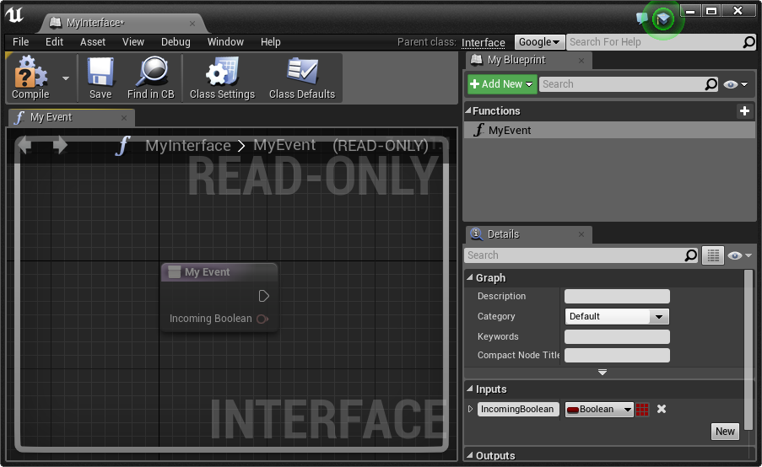
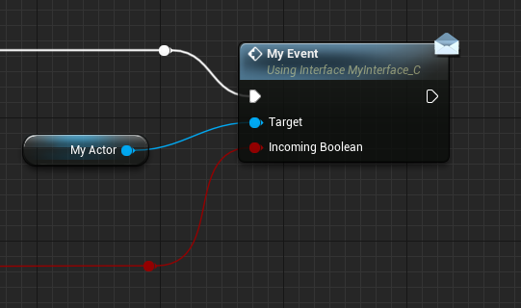
Implementing Interfaces: Events
If the Interface Function has no return value (Output) it gets implemented as an Event on the Receiving object
Can still have Inputs
Interface Editor
Event graph on Sender

Slide 18
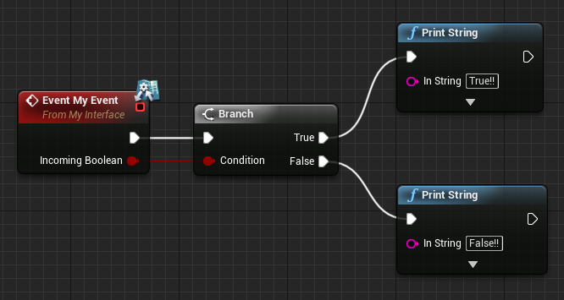
Implementing Interfaces: Events (Continued)
If the Interface Function has no return value (Output) it gets implemented as an Event on the Receiving object
Can still have Inputs
Interface Editor
Event graph on Receiver after Interface is implemented and Blueprint recompiled

Slide 19
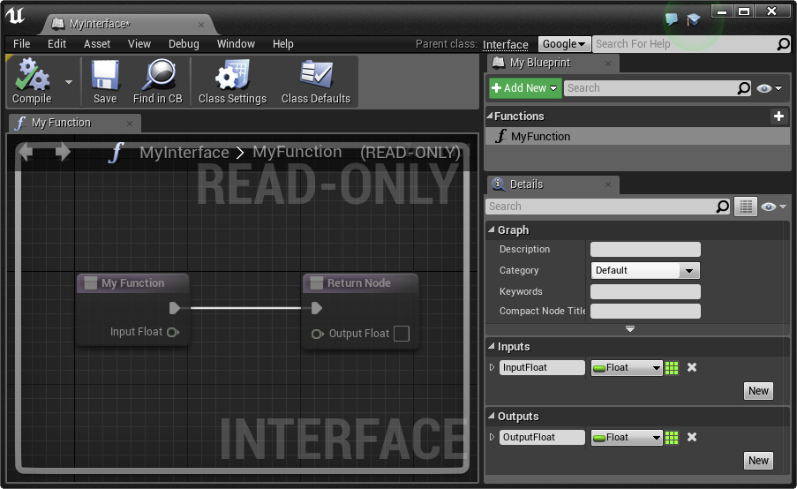
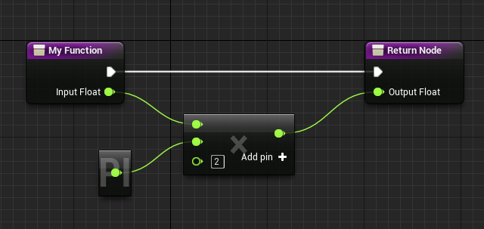
Implementing Interfaces: Functions
If the Interface Function does have a return value (Output) it gets implemented as a Function on the Receiving object
Useful when the Sender needs to perform functionality on the Receiver and then get something back from it
Interface Editor
Function graph on Receiver after Interface is implemented and Blueprint recompiled

Slide 20
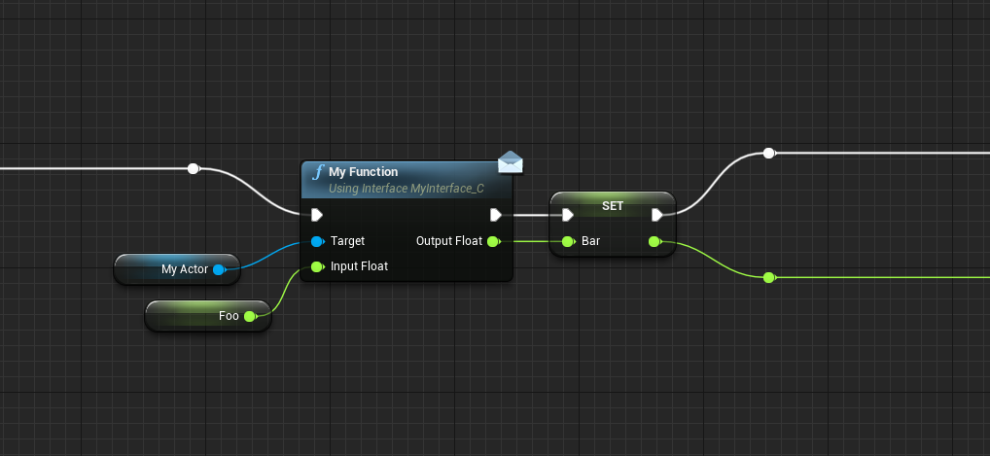
Implementing Interfaces: Functions (Continued)
Once the Function has been implemented on the Receiver, it can then be called by the Sender
Interface Message
Calling Function on Receiver
Reference to Receiver
Event graph on Sender

Slide 21
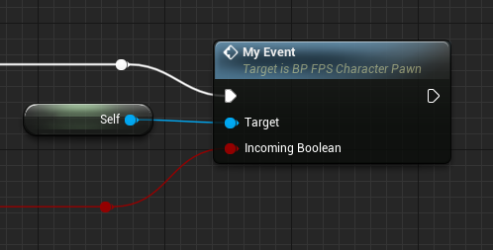
Bonus Trick: Self-calling Interface Functionality
Once an Interface Function has been implemented on the Receiver, the Receiver can then call that functionality on itself!
This is useful to guarantee that a given object has a certain set of functionality
Think of this like a shortcut so you don’t have to repeatedly setup the same functions on objects that inherit from different class hierarchy branches

Slide 22
(Demonstration of Interfaces) Questions about Blueprint Interfaces?

Slide 23
Event Dispatchers - Concept
A way to establish a listening-type relationship so that the Receiver is “listening” for an event on the Sender to take place. It can then respond however it likes.
They’re a lot like Twitter
You set up an Event Dispatcher on the sender
This is like setting up a Twitter account
Any number of Receivers can Bind to this Event Dispatcher
This is like the Receiver(s) following the Sender’s Twitter feed
NOTE: Receiver will need some initial reference to the Sender to make the Bind!
The Sender Calls the Event Dispatcher
This is like making a Tweet, which is just sent out into the ether
There may be no one following the Sender, so maybe no one gets the Tweet
The Receivers who had an Event Bound to that Event Dispatcher can then react accordingly
Followers saw the Tweet and do something in response

Slide 24
Event Dispatchers - When to Use Them
When you have a single event on a Sender that needs to be received by a lot of different Receivers, each doing their own thing
The Sender cannot receive a return value from Receivers
You start off knowing who the Sender is
But you don’t know or care who the Receivers are
You plan to setup n-number of Receivers later
The Receivers call all get a reference (know about) the Sender
The Receivers also know when to start listening for specific events
Also potentially know when to stop listening!
Depending on your setup, it may be dangerous to leave a Bind in place forever
In these cases, you will need to Unbind

Slide 25
Event Dispatchers in Action
In the Sender Class
Create a new Event Dispatcher in the My Blueprint panel
If you have to pass along any data (like current Health) that becomes an Input
We’ll discuss Signatures in a moment...
At some point in your Event Graph your sender must Call this Event Dispatcher
Drag a reference to the Event Dispatcher into the Graph, choose Call.
In the Receiver Class
You must have a reference to the sender! It’s your responsibility to get that!
Once you’ve confirmed the Sender class is the one you want (you might need to Cast here)...
You Bind to the Event Dispatcher by name
Create a Custom Event from the Event Pin
That Custom Event will be fired whenever the Sender calls their Event Dispatcher
Know that you may need to stop listening at some point
This means unbinding the event.
This is very easy if you stored a reference to the Sender class before Binding.
If no objects have made a Bind to an Event Dispatcher:
When the Dispatcher is called, no one is listening and nothing happens. This is perfectly safe.

Slide 26
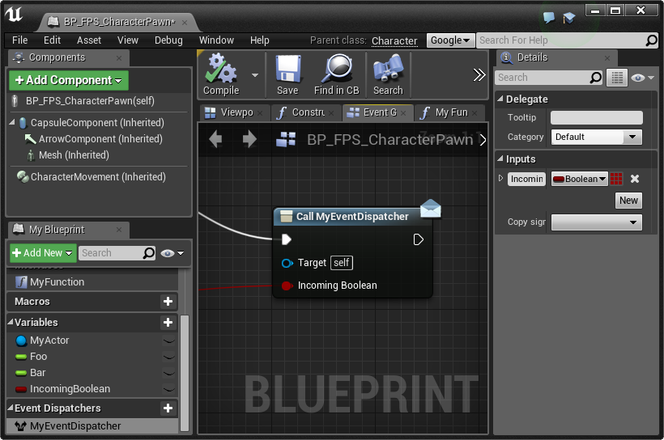
Event Dispatchers on the Sender
From the Sender’s perspective, you only need to setup the Event Dispatcher and then Call it at some point in the Event Graph
Generally in response to some important event happening on the Sender
Notice that the Call does not require a reference to any other object! Instead, the Sender calls the Dispatcher on itself!
Sender’s Event Graph

Slide 27
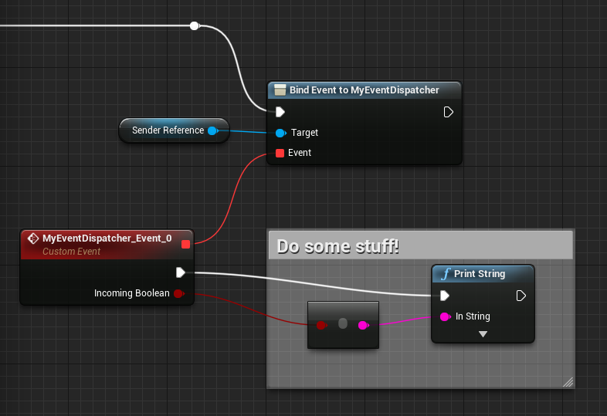
Event Dispatchers on the Receiver
Any object wanting to become an Event Dispatch Receiver must:
Have or obtain a reference to the Sender object
Bind its own Custom Event to that Dispatcher
This Custom Event must have the same Signature as the Event Dispatcher (more later)
Once the Bind is complete, the next time the Dispatcher is called, the Receiver’s Custom Event will fire in response!
← Now you know what that little red line is for!
Receiver’s Event Graph

Slide 28
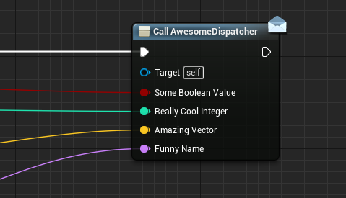
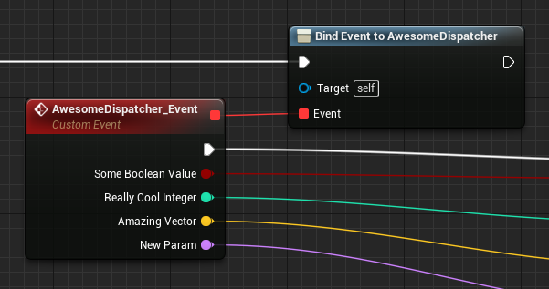
Event Dispatcher Signatures
Signatures are a specific combination of inputs on a Dispatcher
These can be shared if you are going to be creating a Dispatcher for an already existing event
Signatures can be used to make Dispatchers intelligent
Test the input data, do different things based on what you find
Unreal does most of the heavy lifting for managing signatures
But if you’re trying to Bind an already existing Custom Event, the signature must match!

Slide 29
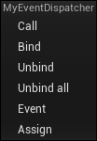
Event Dispatcher Options
When you drag an Event Dispatcher into an Event Graph or try to access one from a Receiving object, you see a lot of options. What do they all mean?
Call - This will broadcast the Event Dispatcher to any Receivers, if there are any
Bind - This will create a Bind node, used to bind a specific Custom Event so it fires in response to the Dispatcher
Unbind - Creates an Unbind node, used to unbind a specific Custom Event from an Event Dispatcher so you’re no longer “listening” for it
Unbind All - Creates an Unbind All node, which will unbind all events from this Dispatcher across all objects in the game. No more listeners!
Event - Adds a Custom Event with a Signature matching the Event Dispatcher
Assign - a Bind node with an attached Custom Event that has a Signature matching the Event Dispatcher

Slide 30
(Demonstration of Event Dispatchers) Questions about Event Dispatchers?

Slide 31
Conclusion
Lots of ways to get Blueprints to communicate
In many cases, more than one approach will apply
Just because there are other ways to do it doesn’t necessarily mean you’re wrong!
Also doesn’t mean you’re right.
Consider all the angles discussed here and it should become clear which one to use
Teams need to work together to determine best approach
Unify and standardize!
Agree on what types of approaches are to be used under what circumstances
If everyone is handling communication a bit differently, it’s hard to work together!
Blueprint Coding Standards
Make them early!
Use them immediately!
Enforce them for all projects!
Note: Every team and game is different. Epic does not have a single standard that applies to every situation. Work with your team and find the standards and methods that work best for you and your projects!

Slide 32
Questions?

