Slide 2
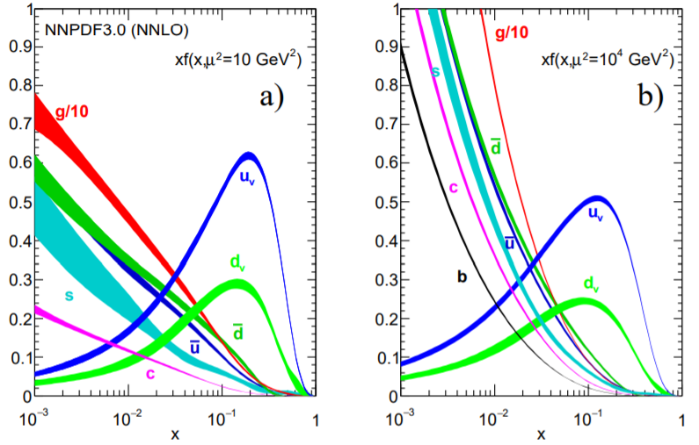
x f(x)
x f(x)

