Slide 1
Localised Internet Scanning Infrastructure
Supervisor: Dr. Stephen Farrell
Jordan Myers
03/04/2019

Slide 2
Overview
Background
Design
Implementation Issues
Demo

Slide 3
Background & Related Work
Internet Scanning
Internet scanning uses:
Researchers:
Studying and analysing the internet
Finding security & privacy issues
Attackers:
Vulnerable host detection
Notes:
Good: monitoring patch rollouts, adoption of new/improved protocols, cipher suites,
Bad: looking for targets

Slide 4
Background & Related Work
Internet Scanning
IPv4 address space allows for up to 4,294,967,296 addresses
Almost 80% of horizontal scan traffic is from large scans targeting >1% of IPv4 address space [1]
Censys.io – internet scanning “search engine”
Continually scans internet
Allows querying of scan results
Notes:
~18 million addresses reserved for private networks and ~270 million addresses reserved for multicast addresses
Horizontal scanning: scanning large number of hosts on single port
[1] 2014 study

Slide 5
This Project
Motivation:
More localised scans could produce more actionable results
Goal:
Build an infrastructure to do such scans (overall project)
Create datastore for scan data that supports easy data analysis and visualisation (my project)
Notes:
Localised scans - ~Ireland sized
“Results that are easier to translate into mitigations”

Slide 6
Problem
The Data
Results from scanning hosts in a specific country that listen on port 25 (mail servers)
Data collected for additional ports when the same host is used for multiple services
P22 (SSH)
P25 (SMTP)
P110 (POP3)
P143 (IMAP)
P443 (HTTPS)
P587 (SMTP)
P993 (IMAPS)

Slide 7
Problem
The Data
Data for Ireland:
~25,000 hosts
Over 3,000 fields for some hosts
Over 5,600 unique fields in total
Notes:
Data for each host is JSON format
<Switch to Kibana>

Slide 8
Design & Implementation Considerations
Sensitivity of data
Internet access
Internet-facing machine for scanning
‘Internal’ machine for storage and analysis
Open source
Notes:
Near real-time data import and analysis – security implications: external -> internal transfer

Slide 9
Solution
Elastic Stack
Elasticsearch
Search engine based on Lucene
Supports schema-less JSON documents
Open-core
Kibana
Data visualisation tool
Notes:
Open source version with limited/core functionality

Slide 10
Solution
Tools
General
Install elastic stack
Extract data subset
Elasticsearch
View indices
Delete index
Bulk insert file

Slide 11
Solution
Production Requirements
Tooling installs Elastic Stack (and required dependencies)
Webserver (e.g. nginx)
TLS cert
Hardware
As much RAM as possible
Notes:
Let’s Encrypt if internet facing, self-signed if ‘internal’

Slide 12
Problems Encountered
Elasticsearch Crash on Bulk Insert
Problem
ES would crash when attempting to bulk insert data
Cause
Java OutOfMemory error
Relatively large overhead using default Elasticsearch settings
5 primary shards, 1 replica
Solution
Elasticsearch template with reduced number of shards & no replicas
Set heap size to 50% available RAM
Notes:
Cluster -> Nodes -> Indexes -> Shards [Lucene Index]

Slide 13
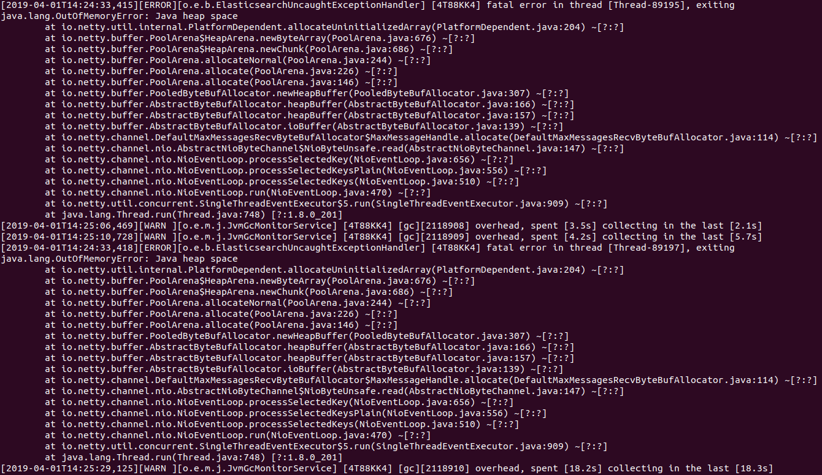
Problems Encountered
Java OutOfMemory Error

Slide 14
Demo
Data Subset
Subset of data – aviation companies in Ireland
Script used to extract subset using DNS name
Notes:
Rough subset – entire record searched for dns name
Issues with reverse dns lookups for older scans – ips change

Slide 15
Sample Queries
Search
GET av-records-fresh-geo-ie*/_search
{
"query": {
"match_phrase": {
"doc.ip": "37.18.144.35"
}
},
"_source": ["doc.company", "doc.ip", "doc.domain", "doc.run_date"],
"sort": [
{
"doc.run_date": {
"order": "desc"
}
}
]
}

Slide 16
Sample Queries
Group By
GET records-fresh-ie-*/_search
{
"query": { "match_all": {}},
"aggs": {
"groupby": {
"terms": {
"field": "doc.p443.data.http.redirect_response_chain.request.tls_handshake.server_certificates.certificate.parsed.subject_key_info.fingerprint_sha256.keyword",
"size": 10
}
}
},
"_source": "false",
"size": 5
}

Slide 17
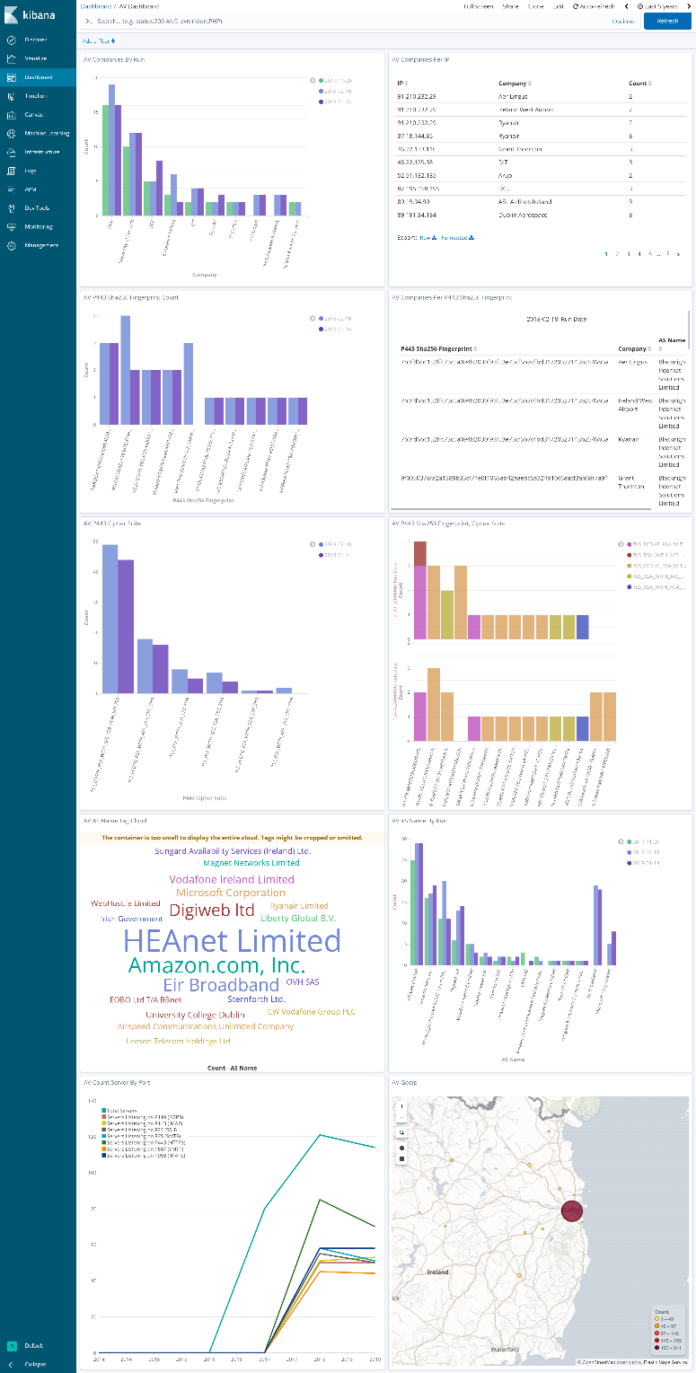
Kibana
Aviation Data Dashboard

Slide 18
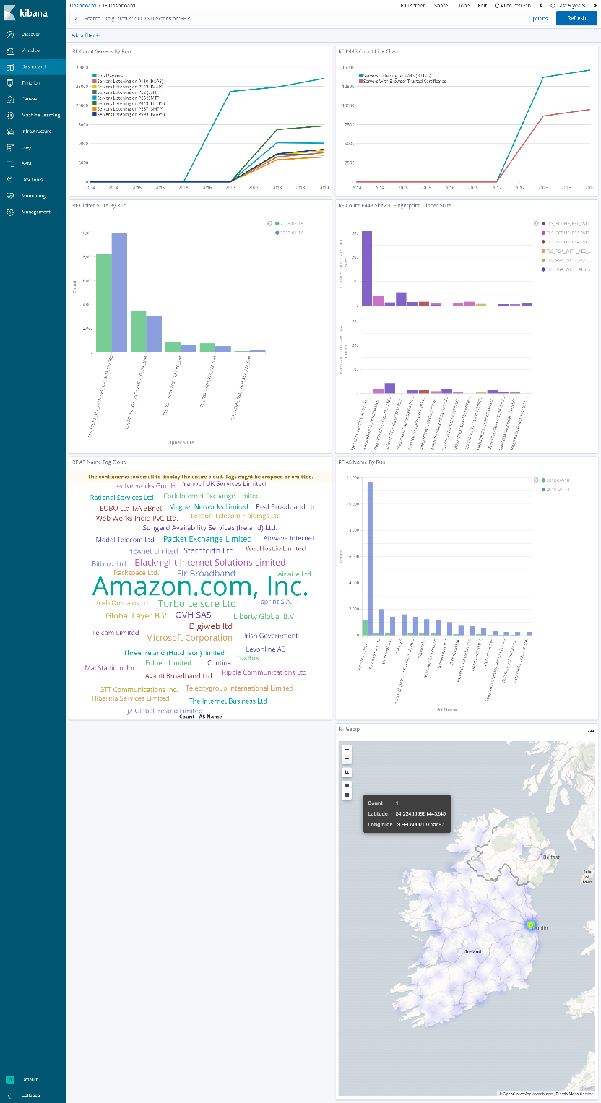
Kibana
Ireland Data Dashboard

Slide 19
References
[1] Durumeric, Z., Bailey, M., & Halderman, J. A. (2014). An Internet-Wide View of Internet-Wide Scanning. Proceedings of the 23rd USENIX Security Symposium (USENIX Security 14), 65–78.

Slide 20
Questions ?

Slide 21
Thank You

