Slide 1
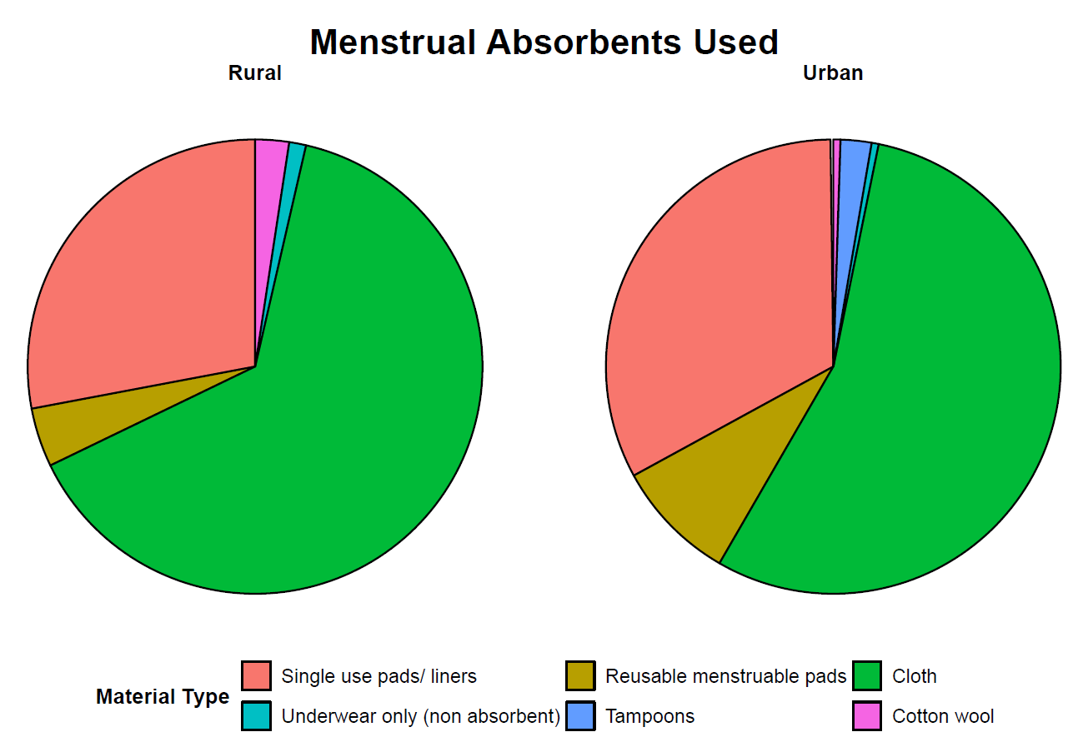
2%
1%
1%
2%
1%
28%
33%
4%
9%
55%
64%

