Slide 1

BABYBLACKJACK
webapp game
CSC648 Section 01 Team05

Slide 2
BABYBLACKJACK
The inspiration behind this web game was to deliver a real life blackjack game experience to the users.

Slide 3
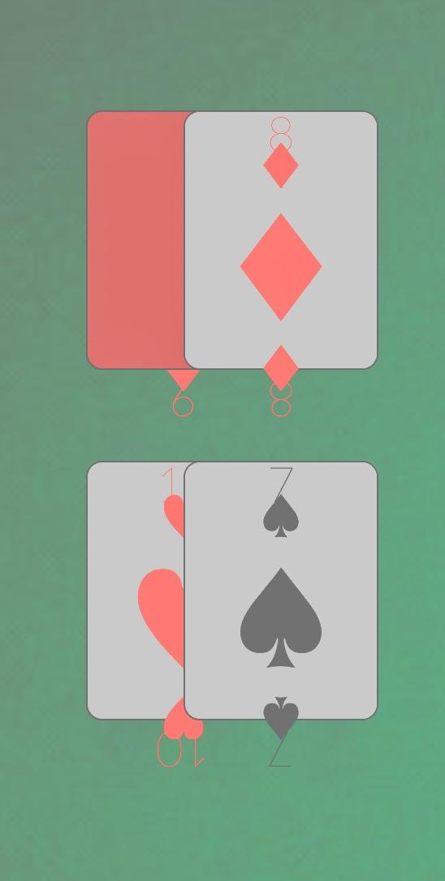
Functionality
User sign-up
User Log -in
Play Game
Players wallet
Betting

Slide 4
Functional Correctness
Deployed Front -end & Back-end properly
Database work fully
Single player function
Blackjack game

Slide 5
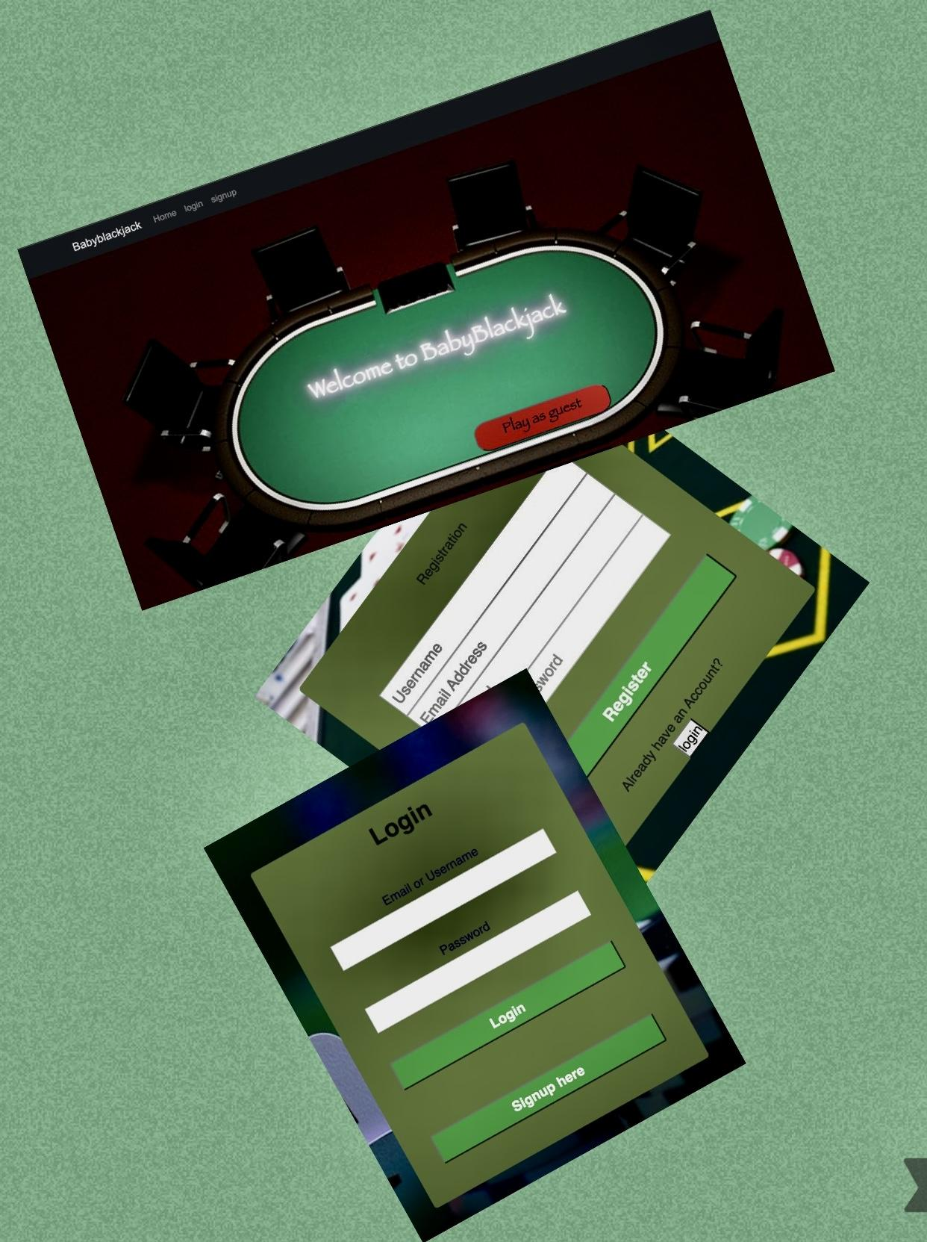
User Interface
Easy to use
Easy UI color Schemes
Web pages work as intended

Slide 6
Resources and Software
Node.js - to deploy server for web sites and back-end API services.
React - to build interactive user interface and develop application by creating reusable components.
Google Firebase - to help building a blackjack web game using its Cloud Functions, Authentication, Realtime Database, Cloud Firestore, and Cloud Messaging.
mySQL - to provide database services for the web application to manage and organize servers.

Slide 7
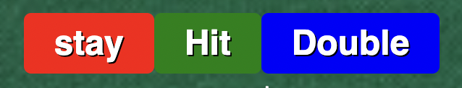
Let’s review some conceptsDem
Let’s play!
Start your initial bet
Press Hit
Keep playing until you win
Max bet is $100
Wallet will be update every time you win or lose the bet

Slide 8
Credits !
BabyBlackJack is developed by a team of 6 San francisco State university students.

Slide 9
Future Development aspects
*Multiplayer function
*Inviting and getting rewards
*Having avatar that represents the users
*Video chatting with players while playing game

Slide 10

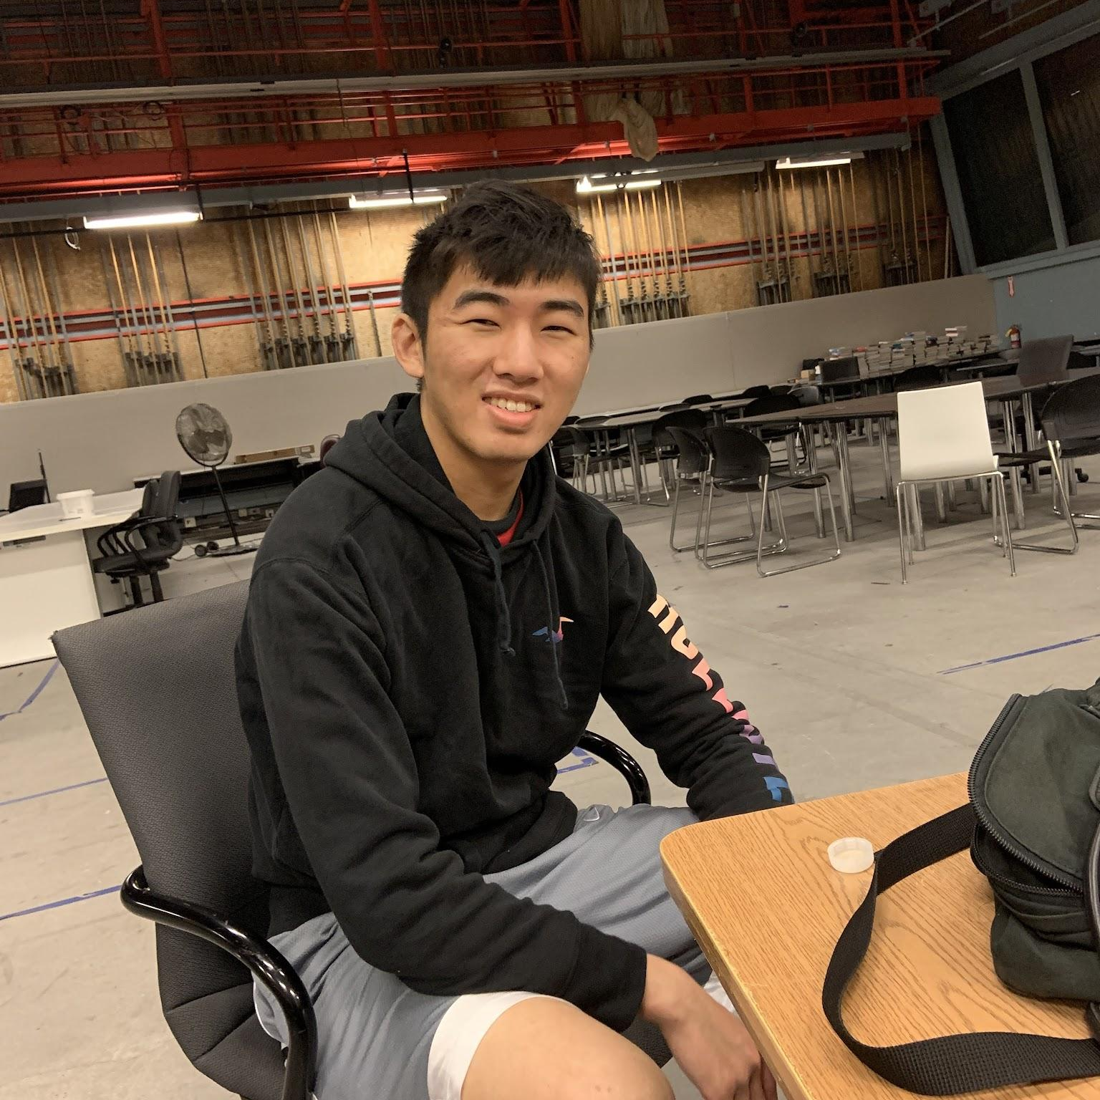
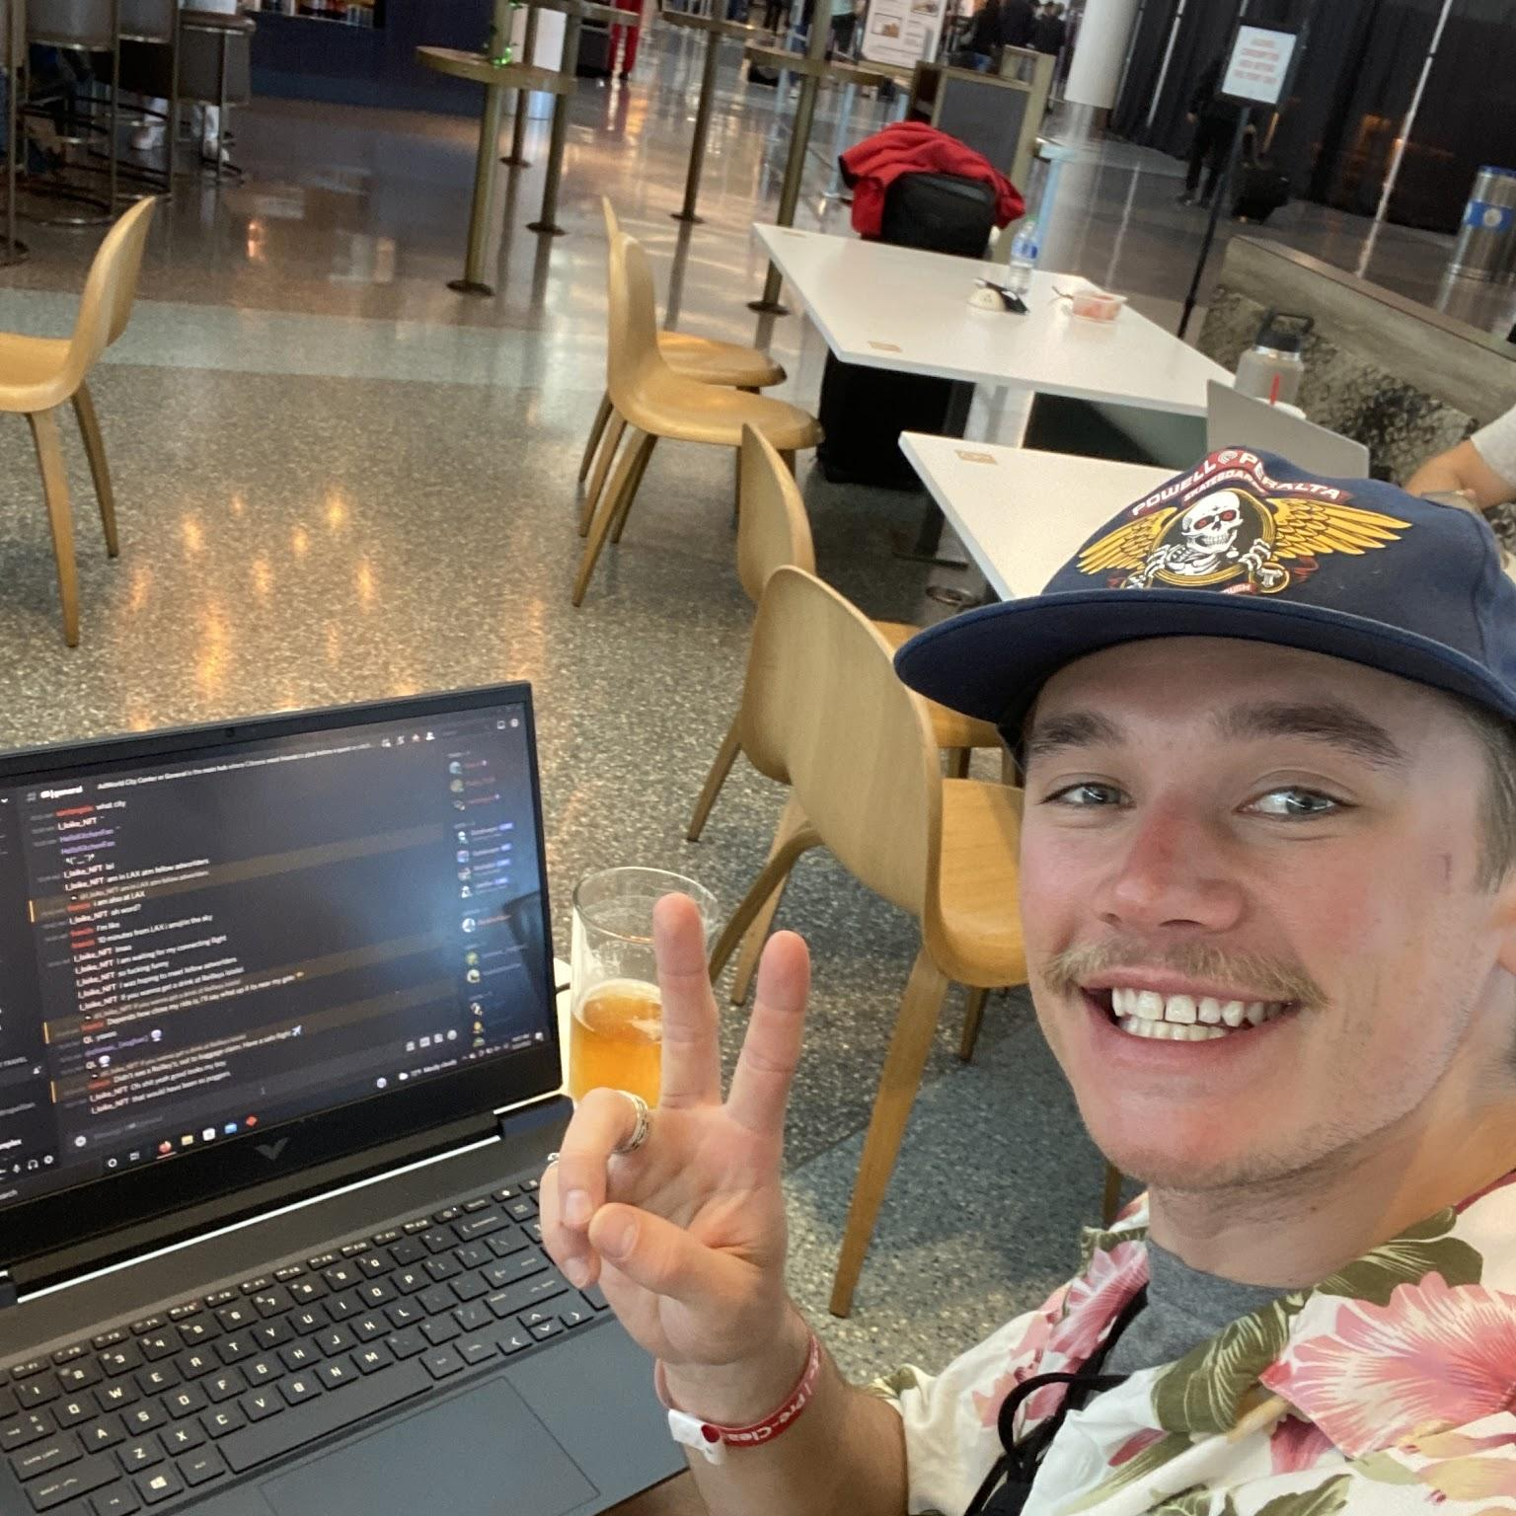
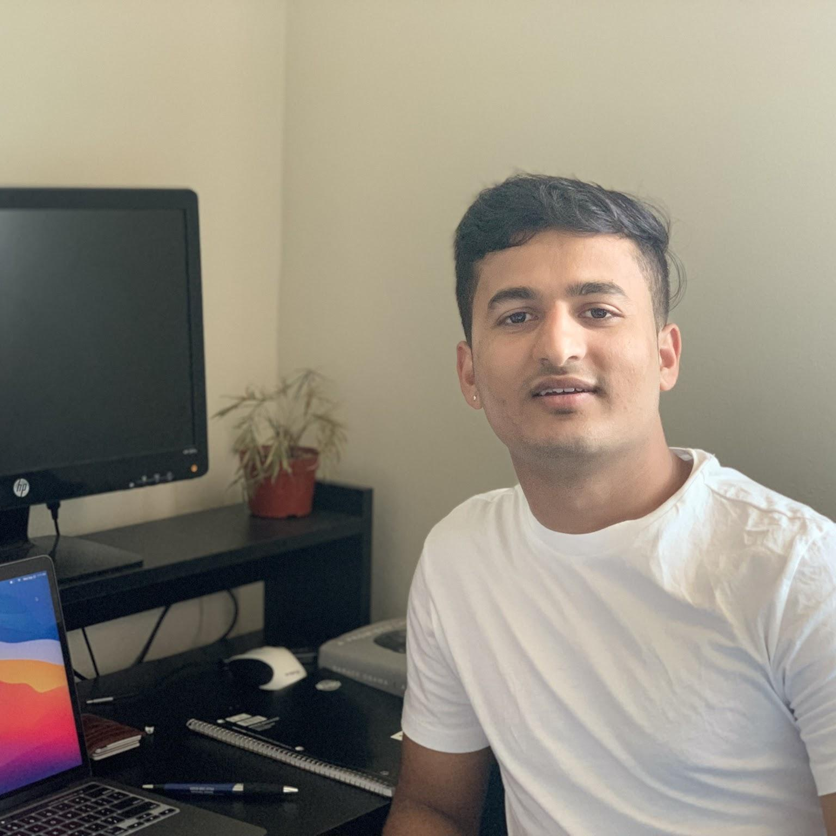


Team Members
Seng Maw TEAM LEAD & Scrum Master
Tyler Hsieh BACKEND LEAD &
Github Master
Lane Maimone BACKEND LEAD
Pritam Gautam FRONT END LEAD
Sneha Shrestha FRONT END LEAD
Nathaniel Miller BACKEND LEAD

Slide 11
Thank You :)

