Slide 1

Data Engineer Course
Project Defense
Presented by:
Andreas Wagner
Boris Tsonkov
Yue Wang
Project Leader
Sébastien Sime

Slide 2

Welcome to the Salary Estimation Application
The team: Andreas Wagner, Boris Tsonkov, Yue Wang.
Purpose: Addressing salary estimation for job postings.
User benefits: Enhanced career decision-making through accurate salary insights.
Interface: Simple API for accessing the trained model.
Specific focus: Data-related job postings.
Notes:
This report introduces a newly developed application by Andreas Wagner, Boris Tsonkov, and Yue Wang. The application was developed job seekers to rectify a common problem encountered during job posting: an improved way of making estimates on salaries with a better degree of accuracy. The development of the application was focused mainly on the ETL process that is relevant for Data Engineering experience. The application also leverages a Machine Learning (ML) model to give end-users an estimate of their probable salaries, leading towards better, more informative career choices. We provided a simple yet efficient API interface to access the trained model and we zoomed specifically on Data-related job postings.

Slide 3


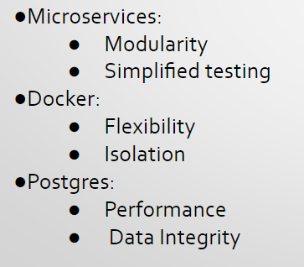
Technology Decisions
Notes:
Explain the methodology that we followed before we move to the data sources. How were decisions made to go in the direction we went?
Defining what the project would look like down the road was very difficult at the conception phase when we didn’t have enough knowledge of the technologies we will have to use. Coming up with the main purpose the application will serve was elusive and we were exploring the suggested data sources. After the initial brainstorming, it became apparent that the Salary information will play a key role and we began to search for a data sources that will have plenty of postings with disclosed salary and at the same time will have open public APIs.
Explain that we started with the exploration of the provided data sources. We decided that we want to split the project into microservices and that they should be implemented by Docker containers. Using microservices in application development offers a number of benefits: Scalability, Flexibility in Technology, CI/CD is easier, App Crash prevention, Better Maintainability, Improved Productivity, Reusable Code, Granular Scaling. To manage the workload the microservices are a good option to split the tasks between the project members.
Why Docker is a good choice - Consistent Environment, Isolated Environments, Portable (physical or virtual), Complements Microservice Architecture (managing them independently), Rapid Deployment and Scaling, Suitable for CI/CD.
Why Postgres is a good choice - Because of Advanced SQL Compliance, Performance and Scalability, Open-source approach, Multi-platform Support, PostgreSQL is often chosen for applications that require dependable data integrity, robust feature support, and customizable solutions without the high costs associated with other enterprise database systems. Whether it's a complex system with high transaction rates or a simple application requiring a reliable and light database, Postgres is frequently a top choice.
Initially we created two databases, MongoDB would hold the raw data and after transformation we would store the useful data into Postgres. MongoDB is a popular NoSQL database known for its flexibility, scalability, and performance, particularly well-suited for applications that handle large volumes of unstructured data. However, down the road, the Postgres service became more sophisticated and the MongoDB became redundant.
Using Uvicorn as the server for FastAPI applications offers a host of benefits that make it a compelling choice for developers:High Performance, Asynchronous Support, Automatic Interactive API Documentation, Modern Python Features, Development Speed and Ease of Use.
REMARK: - microservices (chatgpt) - docker container - postgres database for transformed data -> efficient and consumes little storage (chatgpt) - mongodb for raw and application data because flexible schema -> easy to adept (removed during the project), api server: uvicorn from fastAPI because easy to use

Slide 4
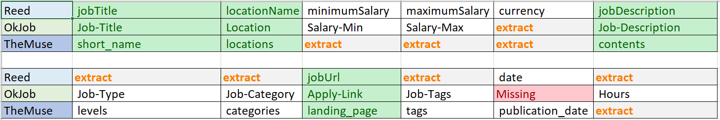



Data Sources
Overview of initial job boards considered with public APIs.
Final selection of data sources: okjob.io, reed.co.uk, themuse.com.
Benefits of chosen sources: Open APIs facilitating easy data retrieval.
Notes:
This application relies on job boards with public API, treating each of them as an essential source of salary information, job title categorization and job descriptions. The list we evaluated at the start is as follows - arbeitnow.com, jobicy.com, jooble.org, okjob.io, reed.co.uk, themuse.com, and adzuna.com. As well as Indeed.com, Glassdoor.com, LinkedIn.com, but these providers have protection against data scraping.
We pivoted toward job boards that will offer as much overlap as possible and will provide Salary information. Thus, the following sources have been selected:
Reed - jobTitle, locationName, minimumSalary, maximumSalary, currency, jobDescription, jobUrl, date;
OkJob - Job-Title, Location, Salary-Min, Salary-Max, Job-Description, Job-Type(Remote,100% Salary, Four Days), Job-Tags(SaaS), Job-Category (IT), Hours, Apply-Link
TheMuse - short_name, locations, contents(description includes Salary - <br>$16.00 - $24.00<br><br>This pay range represents the base hourly rate or base annual full-time salary), levels(Junior), categories, landing_page, tags, publication_date

Slide 5
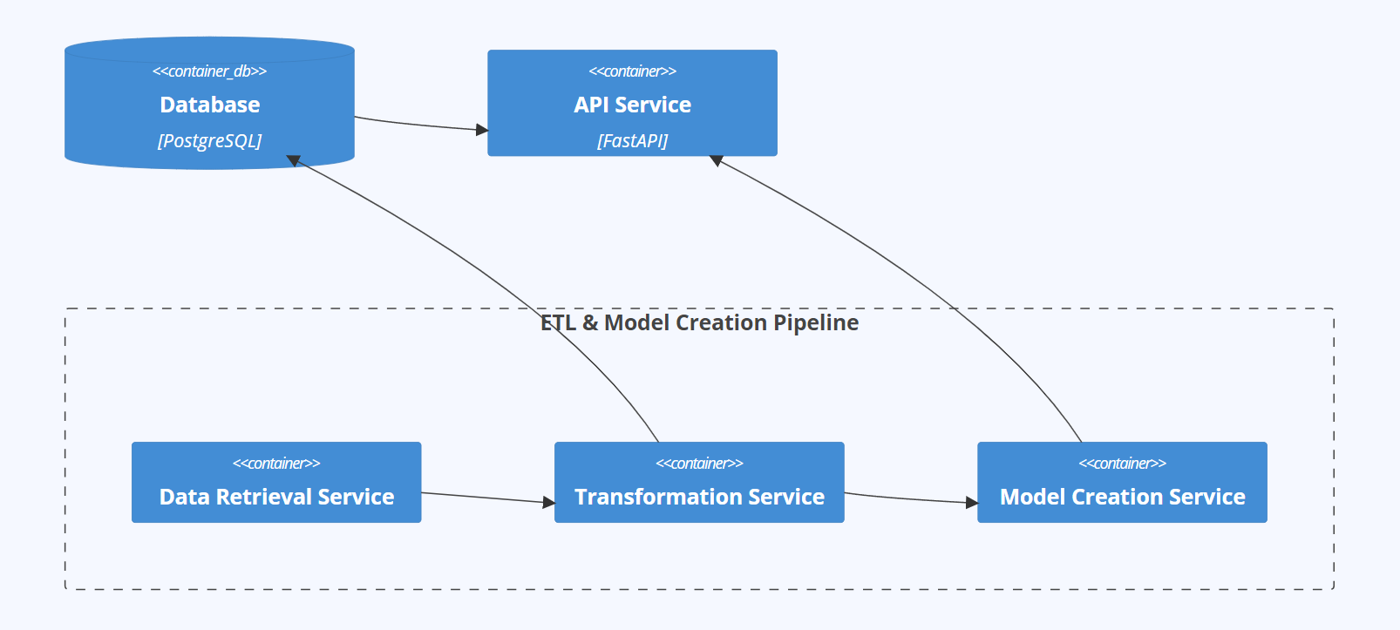
System Architecture
Notes:
Why we selected the technologies
2 slides one for the architecture and one for the data flow
Sys Architecture contains 5 services, 3 services connected to pipeline (executed one after another) ETL model creation pipeline:
1-postgres server
2-API server
3-Data retrieval
4-Transformation and storage
5-Data Model

Slide 6
Microservices Interaction
1. Initialization and Installation:
The database is set up and remains permanently active to continuously store data.
During installation, the entire ETL and model creation pipeline is initiated, comprising the data retrieval, transformation, and model creation services. These services terminate upon completion of their tasks.
After installation, the API service is launched and remains continuously active to provide users access to the system's functionality.
2. Automatic Updates:
A cronjob is added to periodically (e.g., every Sunday at 23:00) initiate the update pipeline to ensure the data and models remain up to date.
During automatic updates, the data retrieval, transformation, and model creation services are restarted to refresh the data and models. These services terminate upon completion of their tasks.
3. Ensuring Availability:
A special script named "restart_services.sh" is utilized to ensure that the database and API service are automatically restarted upon system reboot or failure to ensure continuous availability.
Notes:
setup/installation:
setup database (keeps running)
run initial data retrieval/transformation/model creation pipeline (services end after they did their work)
start api service (keeps running)
add cronjob for the update pipeline
run test to validate everything is fine
automatically run cronjob at sunday 23:00 for the update pipeline:
data retrieval/transformation/model creation (services end after they did their work
ensure that database and api will be restarted in case of a system shutdown or failure -> restart_services.sh
REMARK: we could mention here also the “life time” of our services, the pipeline is started at the setup stage to make the initial data retrieval (get huge amount of data), each service does its task and then ends the pipeline will also be used for frequent updates run once per week (sunday 23:00) to get new data the database and the api service will be started and are never supposed to stop their work, we made sure that these services will be restarted if shutdown

Slide 7
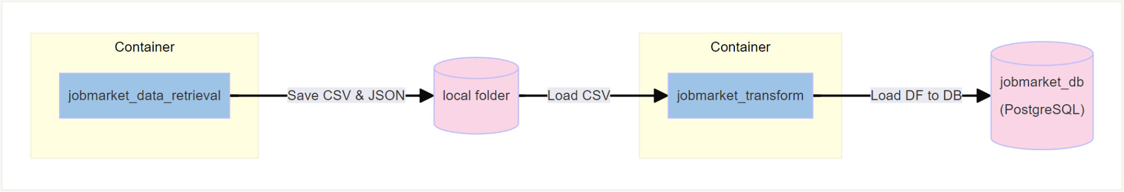
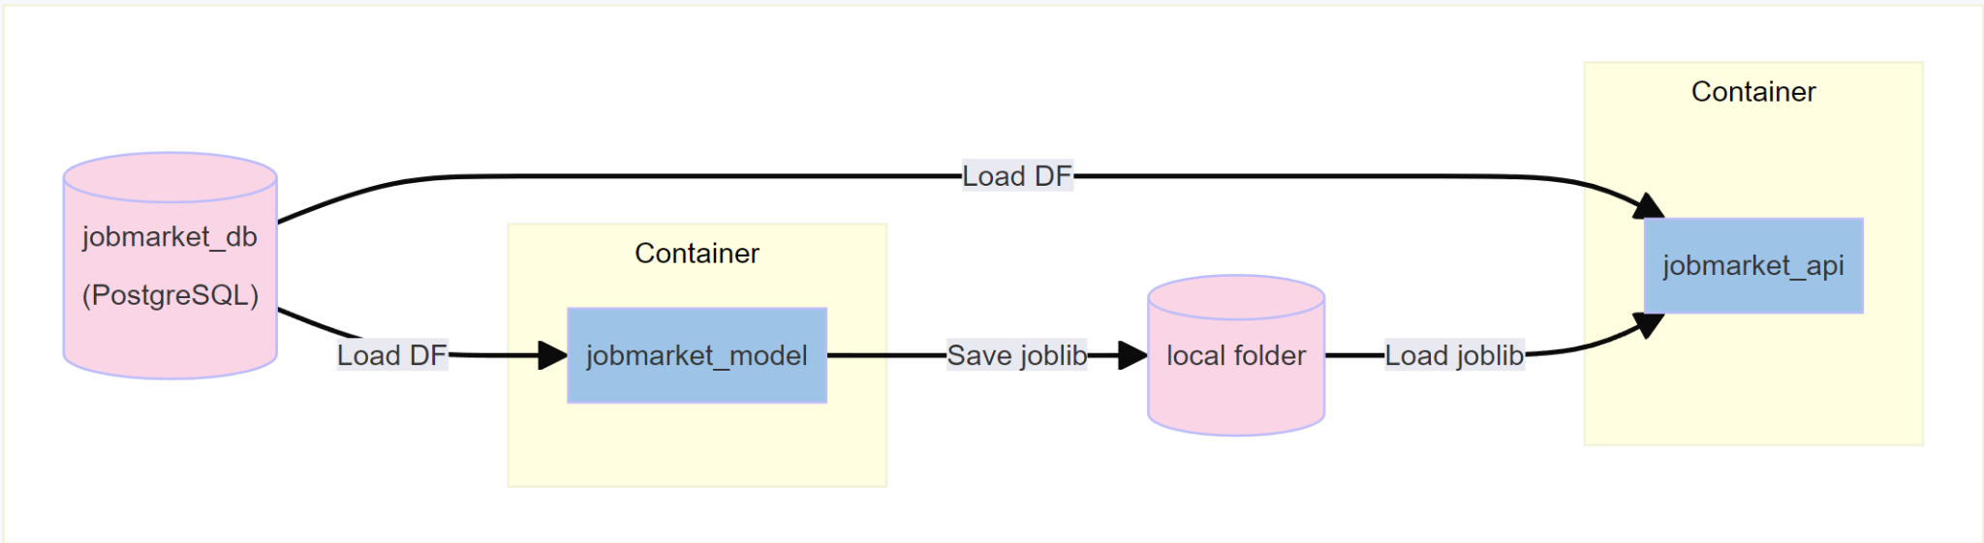
Data Flow
Notes:
Explain the diagram

Slide 8
Data Retrieval Service
data retrieval saves the job offers from the api response
add a “source id” for each job offer
merges all the subcall data into one file that is then saved in json and csv format
usage: data_retrieval_command [-h] [-s START_INDEX] [-e END_INDEX] [-l SLEEP_TIME] {init,update}
Data retrieval tool that can perform initial data retrieval or an update ('init' or 'update')
positional arguments:
{init,update} data retrieval, can either do the initial data retrieval or and update ('init' or 'update')
Notes:
We use only API calls, depending on the data source, sometimes the main call is followed by a number of sub-calls.
We have a mechanism here that stores a 100 records per file until the cap of 10,000 records is reached.
creation of json and csv files
Then we merge those files into a single one that gets stored in the persistent volume of the container.
For one of the data sources we saved the detailed description that came in HTML format for future exploration and enrichment that will guarantee greater accuracy of our ML model.
REMARK: data retrieval saves the job offers from the api response , add a “source id” for each job offer and merges all the subcall data into one file that is then saved in json and csv format
With main.py command here we can execute it in 2 different states:
argument = 'init'
argument = 'update'. these are controlled by environment variable PIPELINE_ACTION
we also have different parameter for the initial data retrieval (for testing, that it doesn´t get too big)
The only difference between the two is that the first one is using a step for the API calls where we can specify the start and the end index. Thanks to this and the sleep time we avoid breaching the API limitations because we have to accumulate a lot of data.

Slide 9
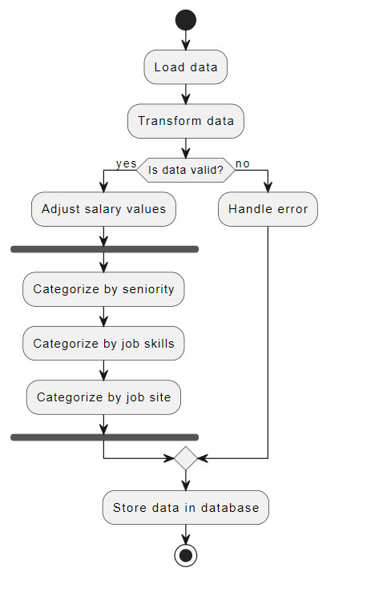
Transformation Service - Transform Data
Load CSV
New DF column “Salary Period” - per hour, per day, per week, per month, ph, pd;
Validation if the salary info is present;
Recalculate salary to yearly values;
Seniority - strategic, principal, staff vs trainee, junior, apprentice, entry level;
Skills and Category: nlp = spacy.load('en_core_web_sm')
Validate DF before storing in the DB
Notes:
How many services are involved – single one as it is the transform container.
The `determine_salary_period` function identifies salary periods like "per hour", "per day", "per week", "per month", "ph", "pd" by using a regex to match the given periods to the job descriptions.
The `transform_salary_to_yearly` function converts salaries to their annual equivalents using specified conversion rates
The spaCy model en_core_web_sm is a small-sized model for processing English text. We take advantage of the Tokenization: This model can split text into words, punctuation marks, and other elements (tokens); and Lemmatization: The model reduces words to their base or root form (lemma), aiding in standardizing variations of the same word (e.g., "walking" to "walk"). This model is typically used in scenarios where speed and efficiency are more critical than having the deepest level of linguistic detail.

Slide 10
Transformation Service - Store Data
job title | Name of our job classification
published | Date of job offer, if missing date of data retrieval will be used
salary minimum | Yearly minimum salary figure
salary maximum | Yearly maximum salary figure
currency | Our model will use this information to create a prediction in €
location | Name of the country and additional information like city, state …, contains currently unused fields
experience | Name of our experience classification
skills | List of elements of our skill classifications
job category | unused at the moment, can save a list of categories
data source and source id | used to ensure that no duplicates will be saved
job offer URL | another way to ensure that no duplicates are saved
There are close to 100.000 job offers currently in our database.
Notes:
Two constraints -
”unique_data_source_id” : ensures that data_source and its related id are only saved once to avoid duplicates
“unique_joboffer” : another check to avoid duplicates, ensures that joboffer_url is unique in the case that 2 of our data sources get their data from the same source (could be the case for okjob?, they got their information from linkedin)
Make a reference to the README on Git Hub
close to 100.000 job offers currently in our database

Slide 11
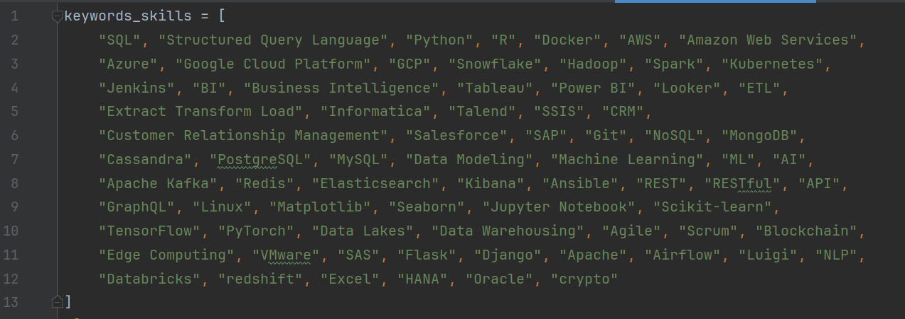
Model Creation Service
jobSkillsSumFrequency
1.28
-2.40
3.14
0.35
-0.71
skills_frequency = Counter(all_skills)
The most sought after skills will be given the most weight when we apply the StandardScaler()
Model Evaluation
Between LinearRegression, RandomForestRegressor, DecisionTreeRegressor, the latter returned the highest coefficient of determination (R-squared). In general the performance of the model should be improved by the introduction of more features.
Model training structure
Two separate pipelines - pipeline_min_salary and pipeline_max_salary.
numeric_transformer … StandardScaler()
categorical_transformer … OneHotEncoder()
job_level_transformer … OrdinalEncoder()
Notes:
Short explanation: instead of 1 model for the avg value we do 2 models, more relevant to have upper and lower limit
The .score() method provides a quantitative measure of the model's performance. Specifically, this method returns the coefficient of determination, commonly known as 𝑅2 (R-squared).

Slide 12
Salary Predictions API Service
Fast API Endpoints
user functions:
prediction:
POST /make_prediction get requested values, create dataframe and make predictions
info:
GET /job_titles return titles list
GET /countries return country list
GET /skills return skills list
GET /experience return experience list
Server Uvicorn fastAPI

Slide 13
Outlook & Potentials
Database was build in a way that enables insertion of future data sources, not all fields are used yet but it should easy to add more
Integration a CI/CD Pipeline
splitting the pipeline in 3 separate microservices is too complicated, we also removed the 2nd database -> easier implementation of the pipeline with airflow
more ML models and selection according to score
enable scalability with kubernetes

