Slide 1

Data Engineer Course
Project Defense
Presented by:
Andreas Wagner
Boris Tsonkov
Project Leader
Sébastien Sime

Slide 2

Welcome to the Salary Estimation Application
The team: Andreas Wagner, Boris Tsonkov, Yue Wang.
Purpose: Addressing accuracy in salary estimations for job postings.
Main features: ETL process focus, leveraging ML for salary predictions.
User benefits: Enhanced career decision-making through accurate salary insights.
Interface: Simple API for accessing the trained model.
Specific focus: Data-related job postings.

Slide 3

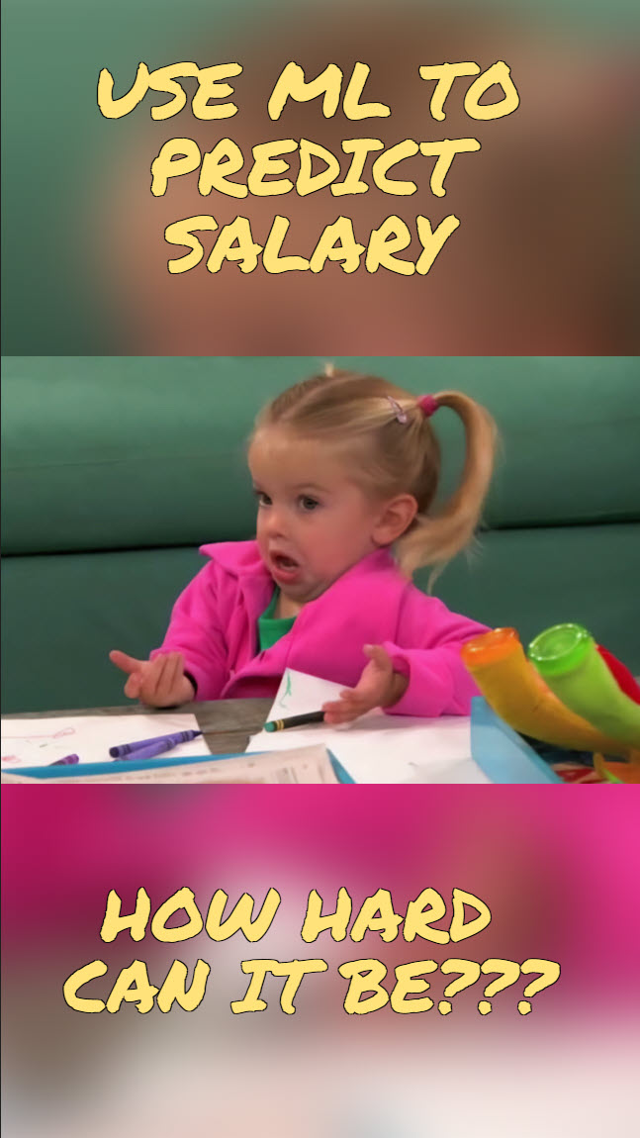
Slow and hard first steps with long meetings and prolonged discussions
Sticking strictly to the provided project description
Failing with the first idea to use main stream sources and Web Scraping
Research for sources with open APIs
Publicly shared salary ranges is the hot new thing
Notes:
Explain the methodology that we followed before we move to the data sources. How were decisions made to go in the direction we went?

Slide 4



Data Sources
Overview of initial job boards considered with public APIs.
Challenges faced: Data scraping protections at major providers like Indeed and LinkedIn.
Final selection of data sources: okjob.io, reed.co.uk, themuse.com.
Benefits of chosen sources: Open APIs facilitating easy data retrieval.
Sample data links provided for transparency and reference.
Notes:
Add the amount of data we are retrieving.

Slide 5
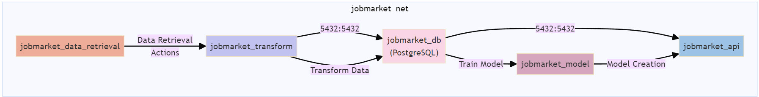
System Architecture
The Docker compose setup for the update pipeline is defined to manage dependencies between containers sequentially
IV DockerFiles → V Docker Images → V Containers → I Network
Notes:
Why we selected the technologies
2 slides one for the architecture and one for the data flow

Slide 6
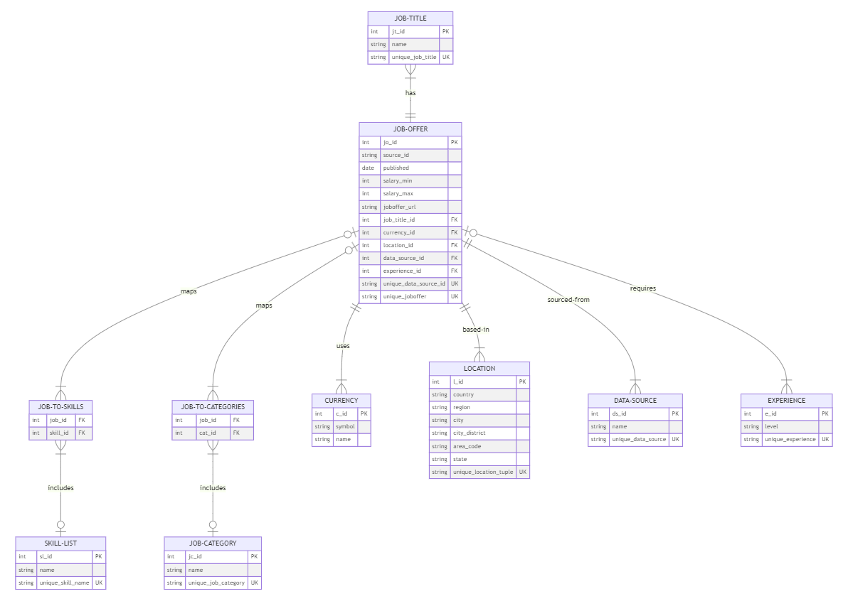
Data Retrieval
Slide 5: Data Retrieval Application
Title: Data Retrieval Process
Content: Explains the steps involved in the data retrieval phase, including folder structure creation, database initialization, and initial data collection.
Visuals: A flowchart illustrating the sequence of operations from directory setup to data storage and the Postgres schema

Slide 7
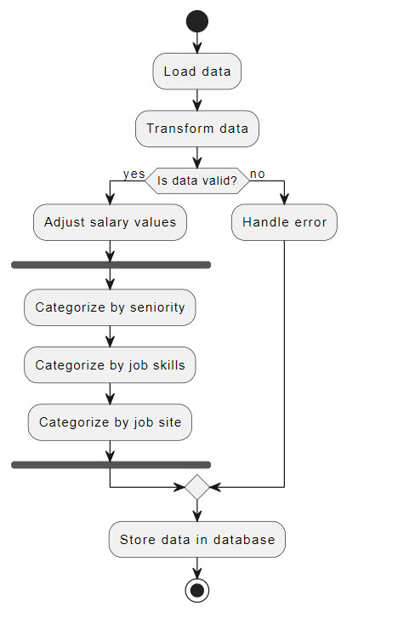
Transforming Data
Slide 6: Data Transformation
Title: Transforming Data and Training Models
Content: Details the process of unifying data from various sources, extracting useful features, and training the machine learning model.
Visuals: A flow diagram depicting data transformation and model training processes.
Notes:
How many services are involved – single one as it is the transform container

Slide 8
Slide 7: API Application Container
Title: API for Salary Predictions
Content: Describes the setup of the Fast API server and the functionalities provided by different endpoints.
Visuals: Diagrams of API calls and responses, showcasing how users can interact with the API to get salary predictions.

Slide 9
Services
1. Initial setup and data collection
2. Update pipeline, run these apps as decribed above
3. Restart trigger that should ensure services keep running
Notes:
Elaborate on the improvements like using Airflow if we had more time to work on the project.

Slide 10
Notes:
Sum up of all the work, problems > result
What else could be added or changed for the next 6 months… next iteration
Add comment on the missing CI/CD pipeline

