Slide 1
MALIGNANT-COMMENTS
-CLASSIFIER-
PROJECT
-Presented By-
Vivek Anand

Slide 2
INTRODUCTION
This project is related to the scenario of proliferation of social media enables people to express their opinions widely online. However, at the same time, this has resulted in the emergence of conflict and hate, making online environments uninviting for users. Although researchers have found that hate is a problem across multiple platforms, there is a lack of models for online hate detection.
Online hate, described as abusive language, aggression, cyberbullying, hatefulness, and many others has been identified as a major threat on online social media platforms. Social media platforms are the most prominent grounds for such toxic behavior.

Slide 3
INTRODUCTION
There has been a remarkable increase in the cases of cyberbullying and trolls on various social media platforms. Many celebrities and influences are facing backlashes from people and must come across hateful and offensive comments. This can take a toll on anyone and affect them mentally leading to depression, mental illness, self-hatred, and suicidal thoughts.
Internet comments are bastions of hatred and vitriol. While online anonymity has provided a new outlet for aggression and hate speech, machine learning can be used to fight it.

Slide 4
INTRODUCTION
The problem we sought to solve was the tagging of internet comments that are aggressive towards other users. This means that insults to third parties such as celebrities will be tagged as unoffensive, but “u are an idiot” is clearly offensive.
Our goal is to build a prototype of online hate and abuse comment classifier which can used to classify hate and offensive comments so that it can be controlled and restricted from spreading hatred and cyberbullying.

Slide 5
Business Problem
Business problem in this project, build a model with the help of NLPT & ML to predict categories of COMMENT i.e., Malignant or Not . In other word, Our goal is to build a prototype of online hate and abuse comment classifier which can used to classify hate and offensive comments so that it can be controlled and restricted from spreading hatred and cyberbullying.

Slide 6
Motivation
My motivation behind solving this classification problem is that it will help us to classify comments in social media.

Slide 7
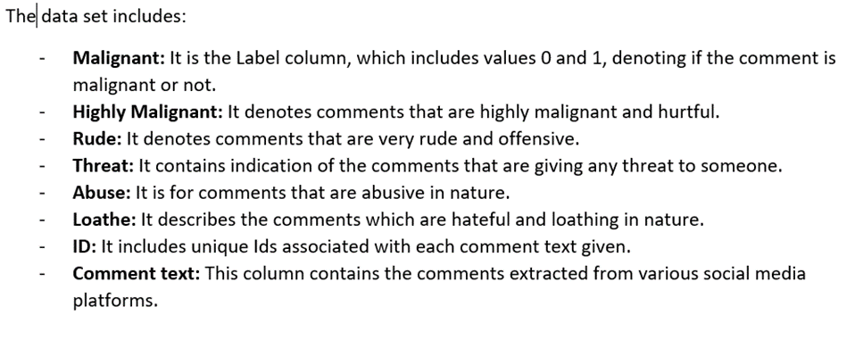
Review of Dataset
Review of Dataset is basically related to comprehensive summary of dataset as well as descriptions of input variables and output variable.

Slide 8
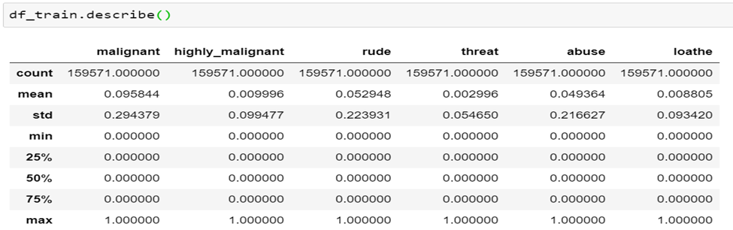
Statistical Descriptions
The statistical descriptions of dataset using Dataframe.describe() command in python, which tells the following statistical descriptions:

Slide 9
Data Preprocessing
Data pre-processing in Machine Learning is a crucial step that helps enhance the quality of data to promote the extraction of meaningful insights from the data. In simple words, data pre-processing in Machine Learning is a data mining technique that transforms raw data into an understandable and readable format.

Slide 10
Data Preprocessing Conti..
Steps in Data Pre-processing in Machine Learning:
Read dataset and make it in proper format.
Encode labels
Convert all cases to lower
Remove punctuations
Remove Stopwords
Check stats of messages
Convert all texts into vectors
Import classifier
Train and test
Check the accuracy/confusion matrix.

Slide 11
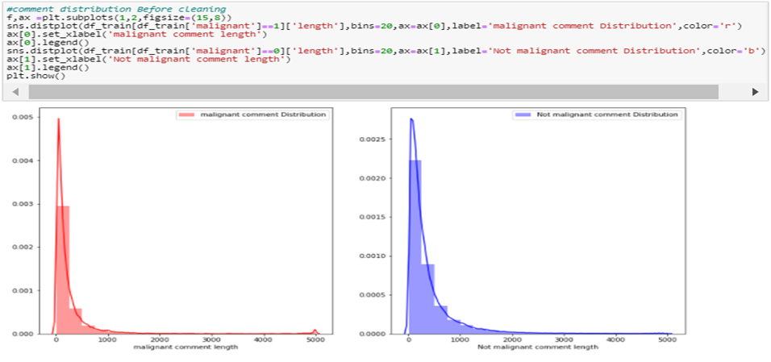
Data Visualizations
1.Comment Distribution Before cleaning

Slide 12

Data Visualizations Conti..
2. Comment Distribution After Cleaning

Slide 13
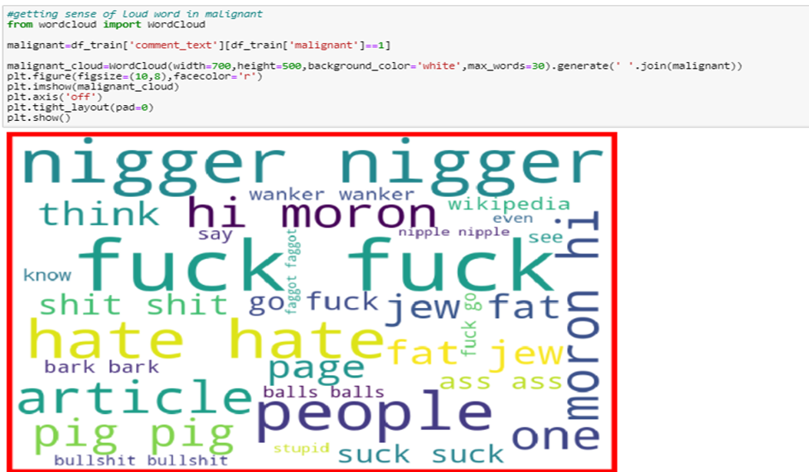
Data Visualizations Conti..
3.Getting sense of Loud word in Comment

Slide 14
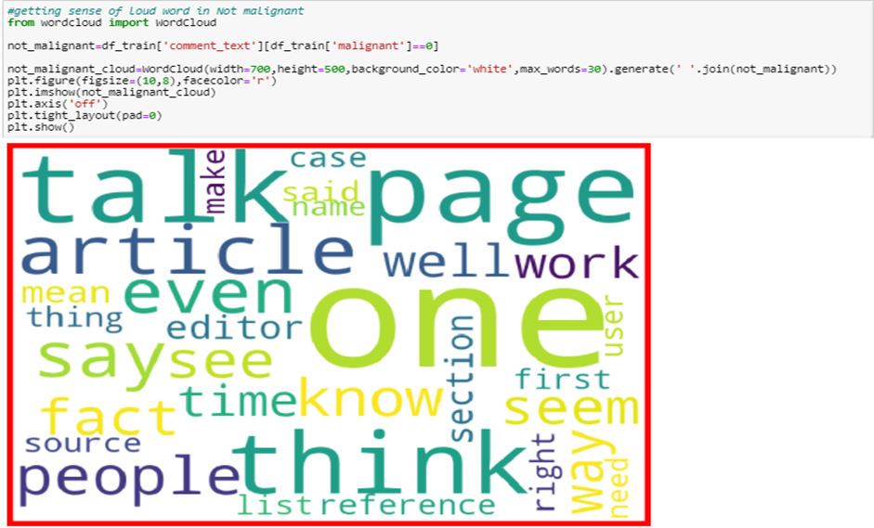
Data Visualizations Conti..
4.Getting sense of loud word in Comment

Slide 15
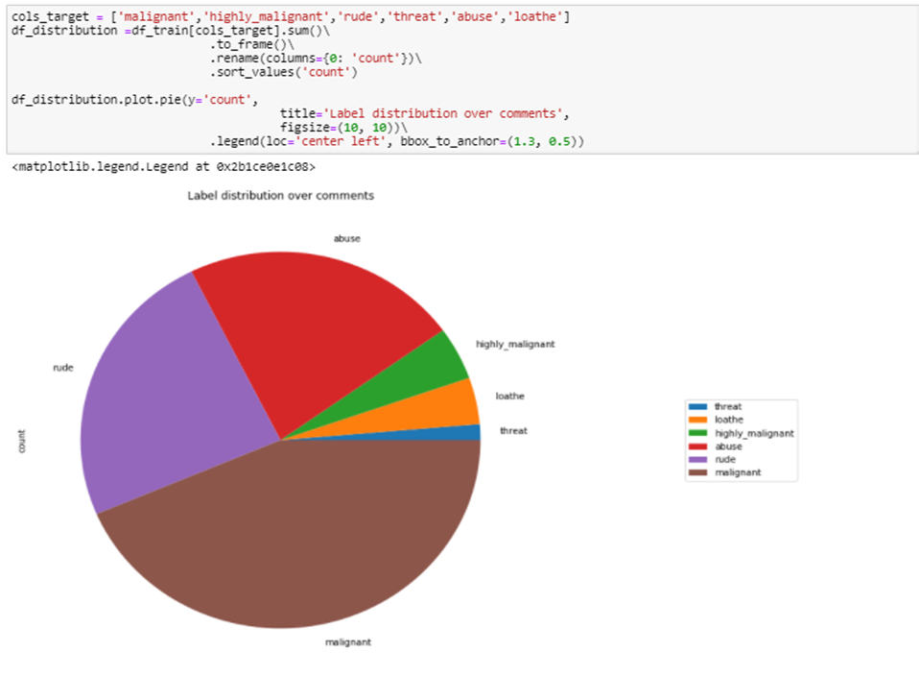
Data Visualizations Conti..
4.Visualizations of Target Value

Slide 16
Model Development and Evaluation
In this dataset we build a model to predict whether a news is fake i.e., “1” or not fake i.e.,”0”.
Testing of Identified Approaches (Algorithms)
• Convert all texts into vectors
• Import classifier
• Train and test

Slide 17
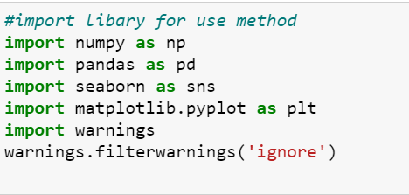
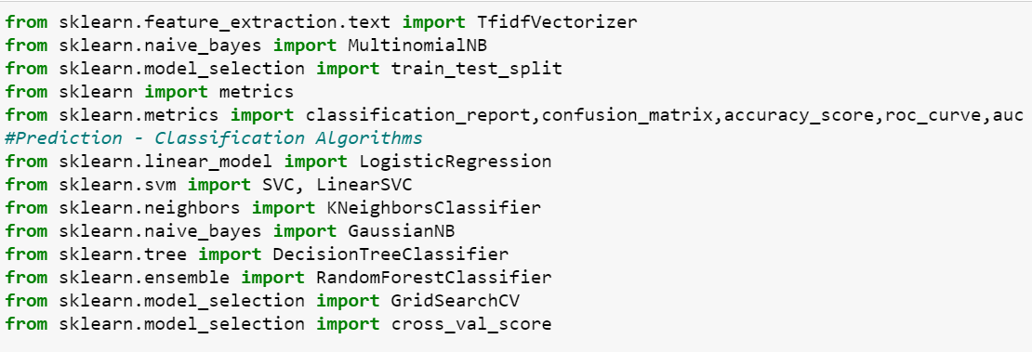
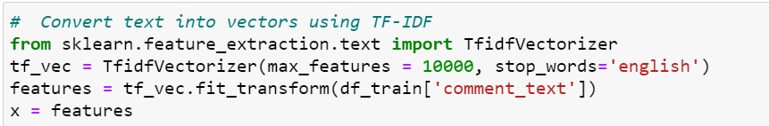
Used Library :-

Slide 18
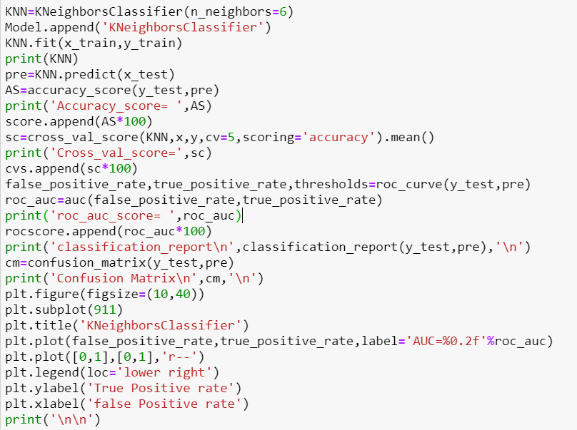
Model Development and Evaluation Conti..
1.kneighborsclassifier algorithm

Slide 19
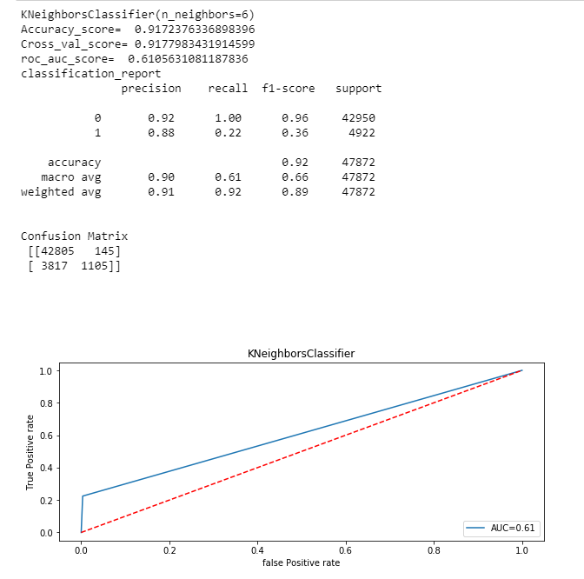
Model Development and Evaluation Conti..

Slide 20
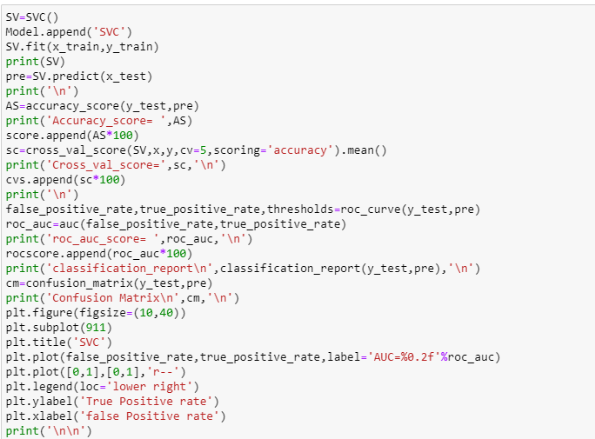
Model Development and Evaluation Conti..
2. svc algorithm

Slide 21
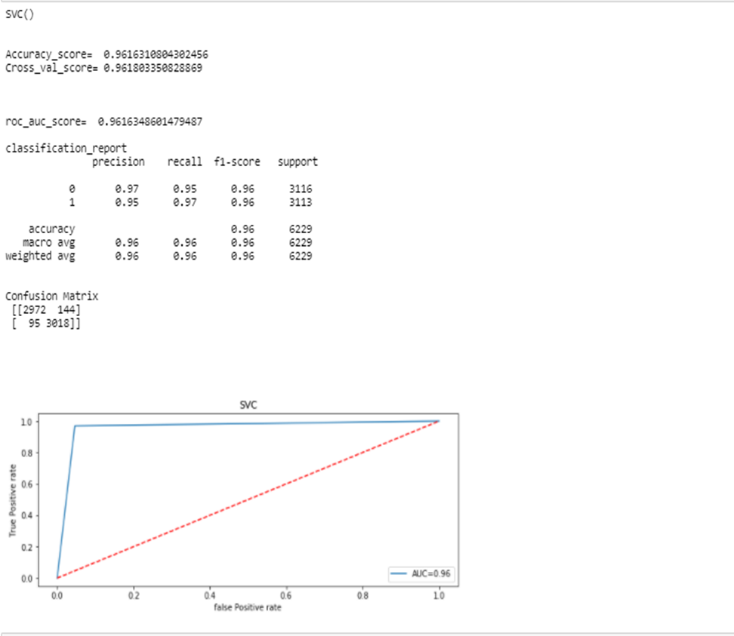
Model Development and Evaluation Conti..

Slide 22
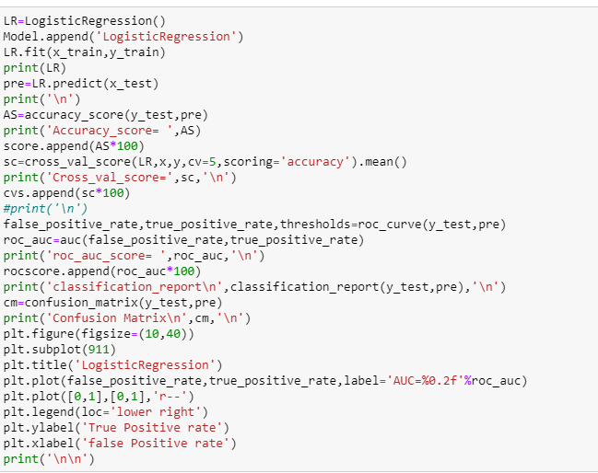
Model Development and Evaluation Conti..
3. Logistic regression

Slide 23
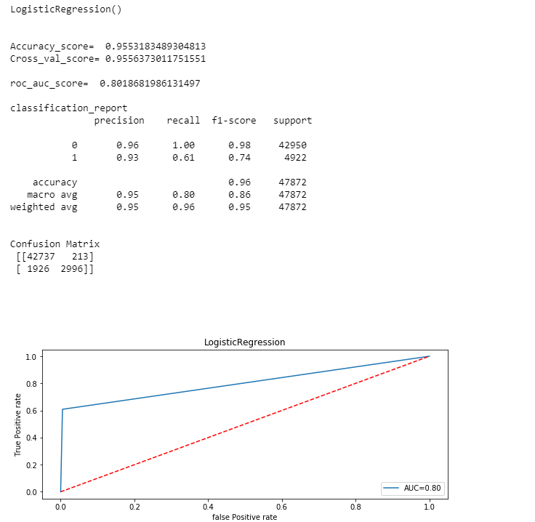
Model Development and Evaluation Conti..

Slide 24
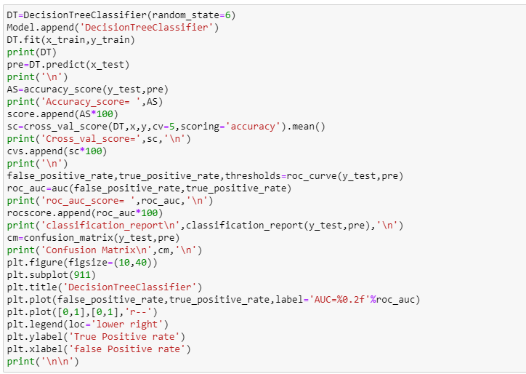
Model Development and Evaluation Conti..
4. Decision tree classifier

Slide 25
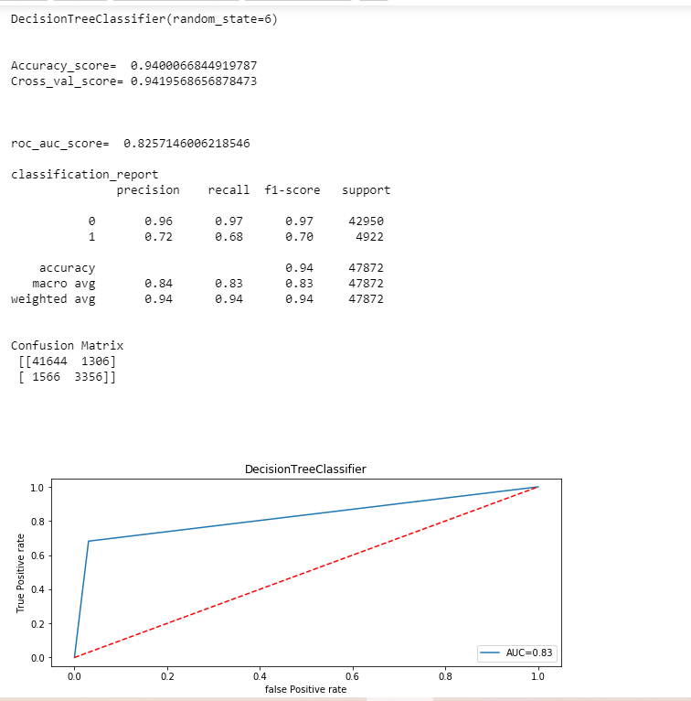
Model Development and Evaluation Conti..

Slide 26
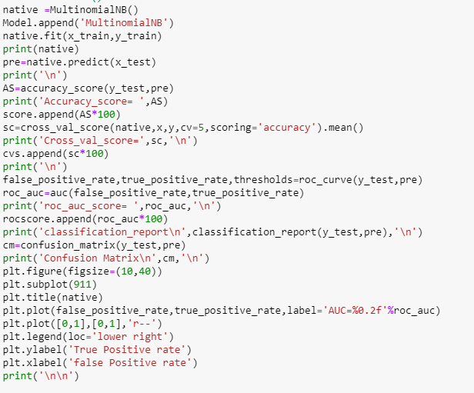
Model Development and Evaluation Conti..
5.MultinomialNB

Slide 27
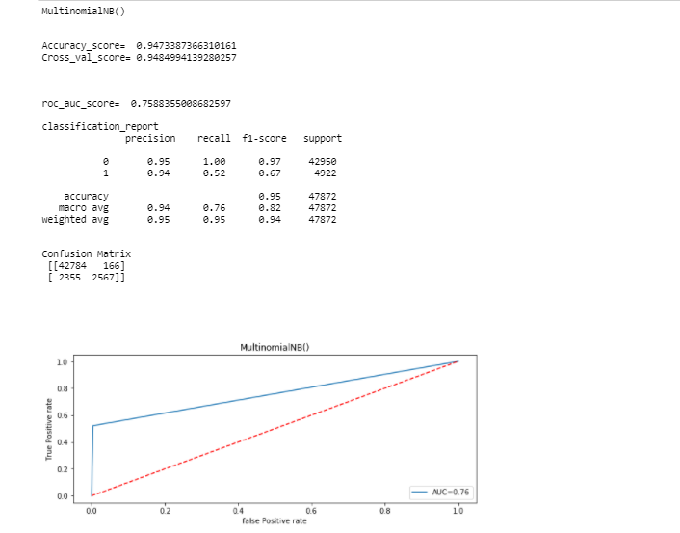
Model Development and Evaluation Conti..

Slide 28
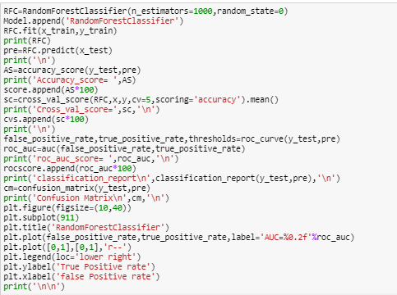
Model Development and Evaluation Conti..
6. RandomForestClassifier

Slide 29
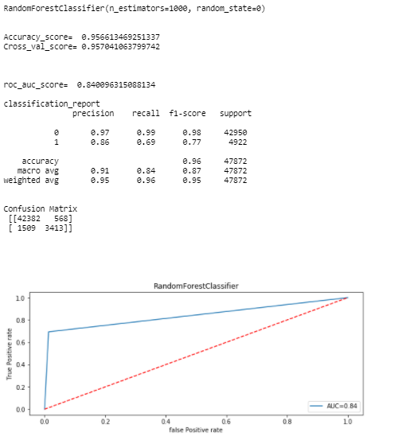
Model Development and Evaluation Conti..

Slide 30
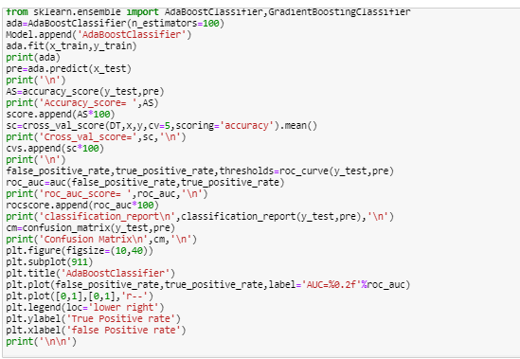
Model Development and Evaluation Conti..
6. AdaBoostClassifier

Slide 31
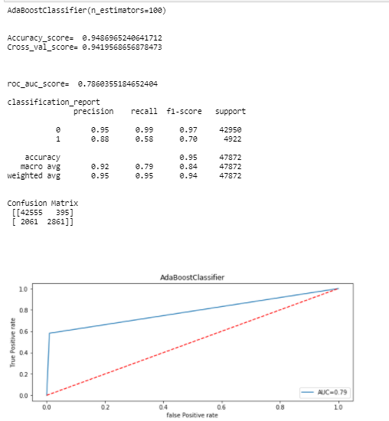
Model Development and Evaluation Conti..

Slide 32
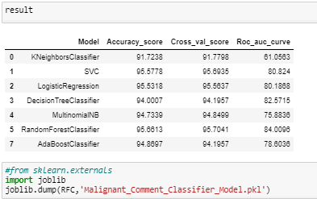
Results

Slide 33
CONCLUSION
After analyzing data, visualization, and modelling, we conclude that using the Random Forest Classifier is suitable for modelling of comment's category prediction.

Slide 34
Thank You..

