Slide 1
Predicting Coronary artery disease Using Data Mining Techniques
Mohammad Husain- B160589CS
Sushant Pradhan- B160598CS
Rebaka Tejaswi - B160552CS
Rahul Kumar- B160756CS
Department of Computer Science and Engineering NIT Calicut
5 April 2019
Predicting Coronary artery disease Using Data Mining Techniques
5 April 2019

Slide 2


Outline
Abstract
Introduction
Dataset
Problem Statement
Decision Tree
Random Forest
Logistic Regression
SVM (Support Vector Machine)
K-NN (K Nearest Neighbour)
Naïve Bayes
Multilayer perceptron
Predicting Coronary artery disease Using Data Mining Techniques
2 / 23
Predicting Coronary artery disease Using Data Mining Techniques
5 April 2019
Predicting Coronary artery disease Using Data Mining Techniques

Slide 3
Abstract
We are using the Heart Disease Data Set provided in UCI Machine Learning Repository.
In our project we aim to use various data mining models to predict the occurrence of Coronary artery disease.
We will also be analyzing the accuracy of each model and suggest the best model for this data set.
Predicting Coronary artery disease Using Data Mining Techniques
3 April 2019
3 / 23
Predicting Coronary artery disease Using Data Mining Techniques
5 April 2019

Slide 4
Introduction
Coronary artery disease develops when the major blood vessels that supply heart with blood, oxygen and nutrients (coronary arteries) become damaged or diseased. Cholesterol-containing deposits (plaque) in arteries and inflammation are usually to blame for coronary artery disease.
When plaque builds up, it narrows the diameter of our coronary arteries, decreasing blood flow to the heart. Eventually, the decreased blood flow may cause chest pain (angina), shortness of breath, or other coronary artery disease signs and symptoms. A complete blockage may cause Myocardial infarction (MI), commonly known as a heart attack.
Predicting Coronary artery disease Using Data Mining Techniques
3 April 2019
4 / 23
Predicting Coronary artery disease Using Data Mining Techniques
5 April 2019

Slide 5
Dataset
Dataset is taken from UCI and consists of 303 Tuples, each having 13 features and 1 target attribute.
Age - age in years
Sex - sex (1 = male; 0 = female)
Cp - chest pain type -- Value 1: typical angina -- Value 2: atypical angina -- Value 3: non-anginal pain -- Value 4: asymptomatic
Trestbps - resting blood pressure (in mm Hg on admission to the hospital)
Chol- serum cholesterol in mg/dl
Fbs - (fasting blood sugar > 120 mg/dl) (1 = true; 0 = false)
Predicting Coronary artery disease Using Data Mining Techniques
5 / 23
Predicting Coronary artery disease Using Data Mining Techniques
5 April 2019
5 April 2019

Slide 6
Dataset
Restecg - resting electrocardiographic results -- Value 0: normal -- Value 1: having ST-T wave abnormality (T wave inversions and/or ST elevation or depression of > 0.05 mV) -- Value 2: showing probable or definite left ventricular hypertrophy by Estes' criteria
Thalach - maximum heart rate achieved
Exang - exercise induced angina (1 = yes; 0 = no)
Oldpeak - ST depression induced by exercise relative to rest
Slope - slope: the slope of the peak exercise ST segment -- Value 1: upsloping -- Value 2: flat -- Value 3: down sloping
Ca - number of major vessels (0-3) colored by fluoroscopy
Predicting Coronary artery disease Using Data Mining Techniques
6 / 23
Predicting Coronary artery disease Using Data Mining Techniques
5 April 2019
5 April 2019

Slide 7
Dataset
13. Thal - 3 = normal; 6 = fixed defect; 7 = reversable defect
14. Target - goal attribute
-- Value 0: < 50% diameter narrowing
-- Value 1: > 50% diameter narrowing
Predicting Coronary artery disease Using Data Mining Techniques
7 / 23
Predicting Coronary artery disease Using Data Mining Techniques
5 April 2019
5 April 2019

Slide 8
Problem Statement
In our project we aim to use various data mining models to predict Coronary artery disease. We will also be analyzing the accuracy of each model and proposing the best model amongst them.
Predicting Coronary artery disease Using Data Mining Techniques
8 / 23
Predicting Coronary artery disease Using Data Mining Techniques
5 April 2019
5 April 2019

Slide 9
Predicting Coronary artery disease Using Data Mining Techniques
9 / 23
Predicting Coronary artery disease Using Data Mining Techniques
5 April 2019
5 April 2019

Slide 10
Decision Tree
A Decision tree is a flowchart like tree structure,
where each internal node denotes a test on an
attribute, each branch represents an outcome of the
test, and each leaf node (terminal node) holds a class
label.
Predicting Coronary artery disease Using Data Mining Techniques
10 / 23
Predicting Coronary artery disease Using Data Mining Techniques
5 April 2019
5 April 2019

Slide 11
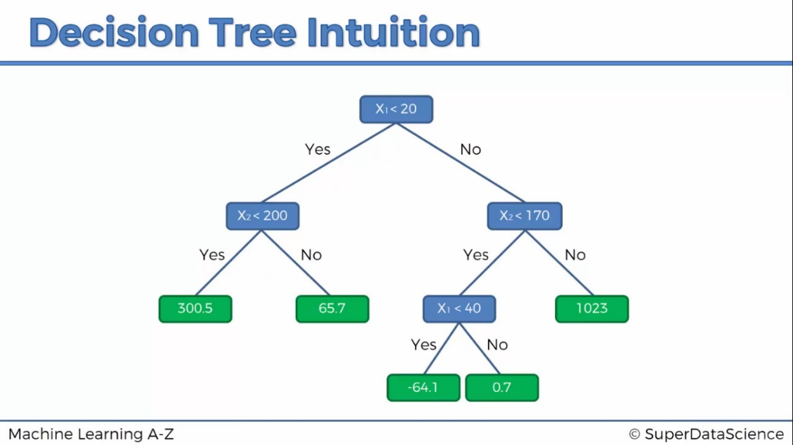
Decision Tree
Predicting Coronary artery disease Using Data Mining Techniques
11 / 23
Predicting Coronary artery disease Using Data Mining Techniques
5 April 2019
5 April 2019

Slide 12
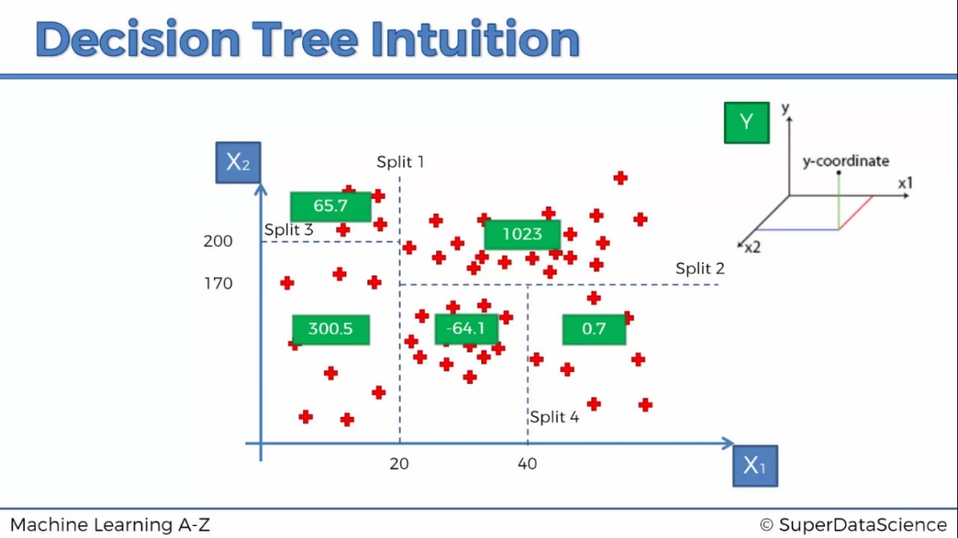
Decision Tree
Predicting Coronary artery disease Using Data Mining Techniques
12 / 23
Predicting Coronary artery disease Using Data Mining Techniques
5 April 2019
5 April 2019

Slide 13
Contd.
We split the data into training and test set in the ratio 80:20.
We have built a decision tree classifier.
We fit the test set data into this classifier.
Finally, we predicted the accuracy of this classifier.
Accuracy achieved: 0.80327
Predicting Coronary artery disease Using Data Mining Techniques
13 / 23
Predicting Coronary artery disease Using Data Mining Techniques
5 April 2019
5 April 2019

Slide 14
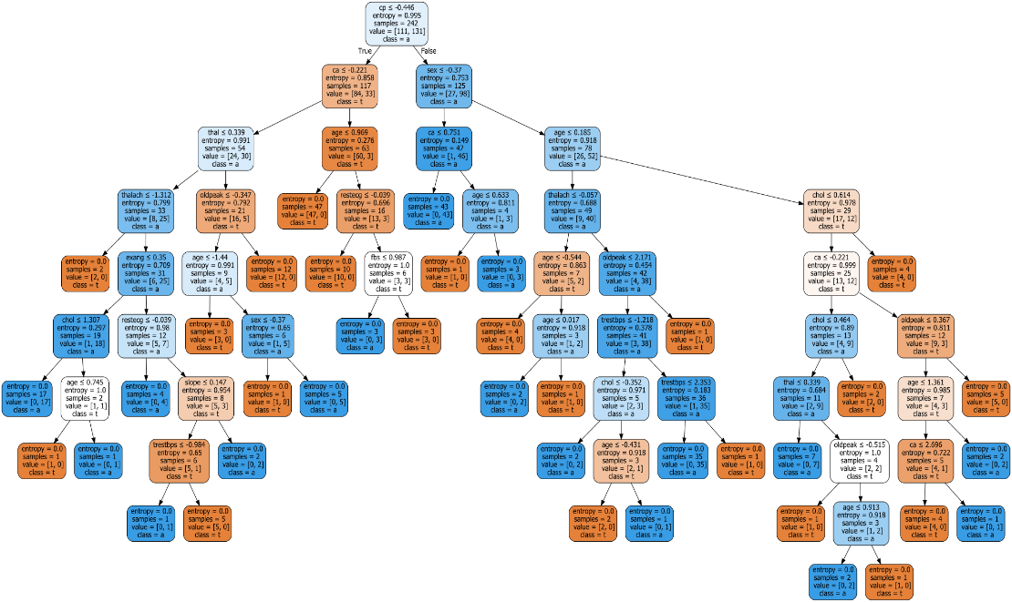
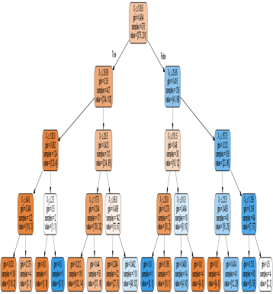
Contd.
Decision Tree Visualised
Predicting Coronary artery disease Using Data Mining Techniques
3 April 2019
14 / 23
5 April 2019

Slide 15
Random Forest
We have split the data into training and test sets in the ratio 80:20, similarly as in previous model.
We have created Random forest model using ten different Decision trees and tested our model with the test data.
Accuracy achieved: 0.86885
Predicting Diabetes Using Data Mining Techniques
3 April 2019
15 / 23
Predicting Coronary artery disease Using Data Mining Techniques
5 April 2019

Slide 16
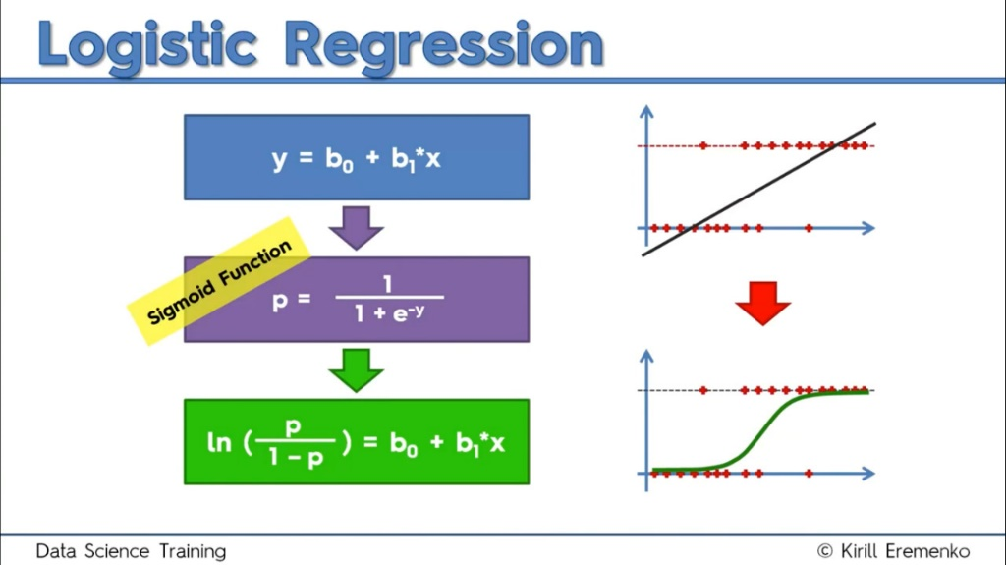
Logistic Regression
Predicting Diabetes Using Data Mining Techniques
3 April 2019
16 / 23
Predicting Coronary artery disease Using Data Mining Techniques
5 April 2019

Slide 17
Logistic Regression
We have split the data into training and test sets in the ratio 80:20, similarly as in previous model.
We then built Logistic Regression model and tested our model with the test set.
Accuracy achieved: 0.85245
Predicting Diabetes Using Data Mining Techniques
3 April 2019
17 / 23
Predicting Coronary artery disease Using Data Mining Techniques
5 April 2019

Slide 18
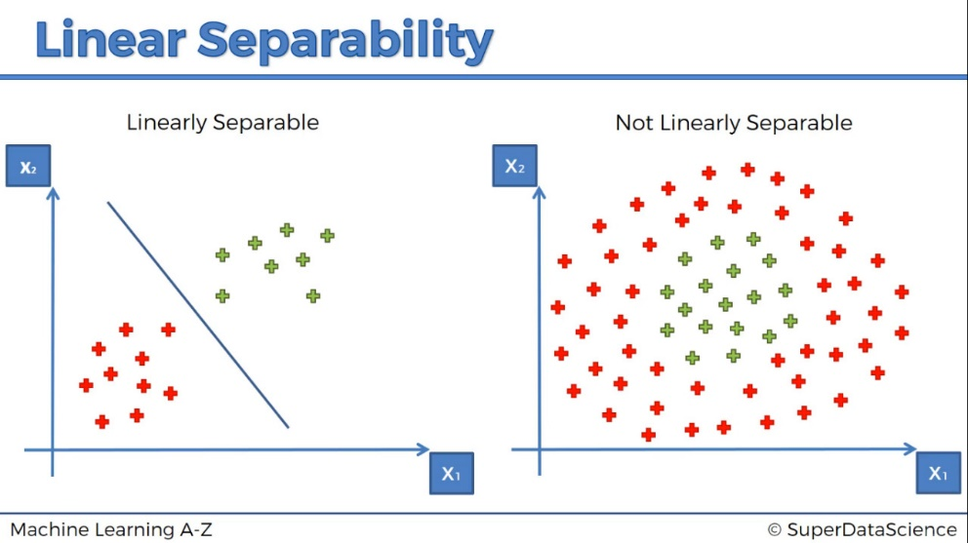
Support Vector Machine
Predicting Diabetes Using Data Mining Techniques
3 April 2019
18 / 23
Predicting Coronary artery disease Using Data Mining Techniques
5 April 2019

Slide 19
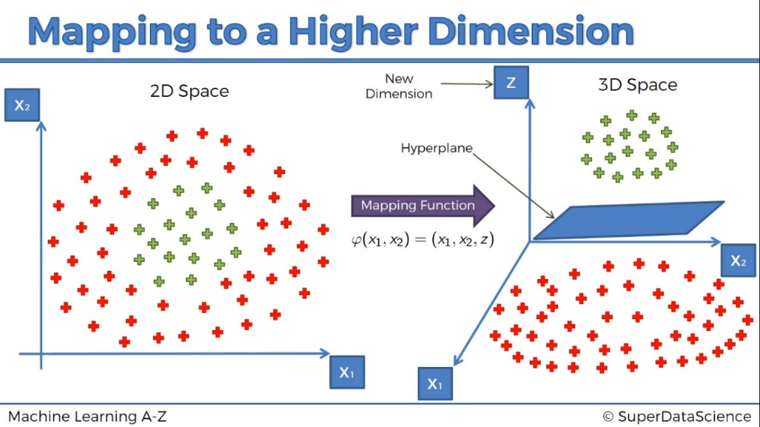
Support Vector Machine
Predicting Diabetes Using Data Mining Techniques
3 April 2019
19 / 23
Predicting Coronary artery disease Using Data Mining Techniques
5 April 2019

Slide 20
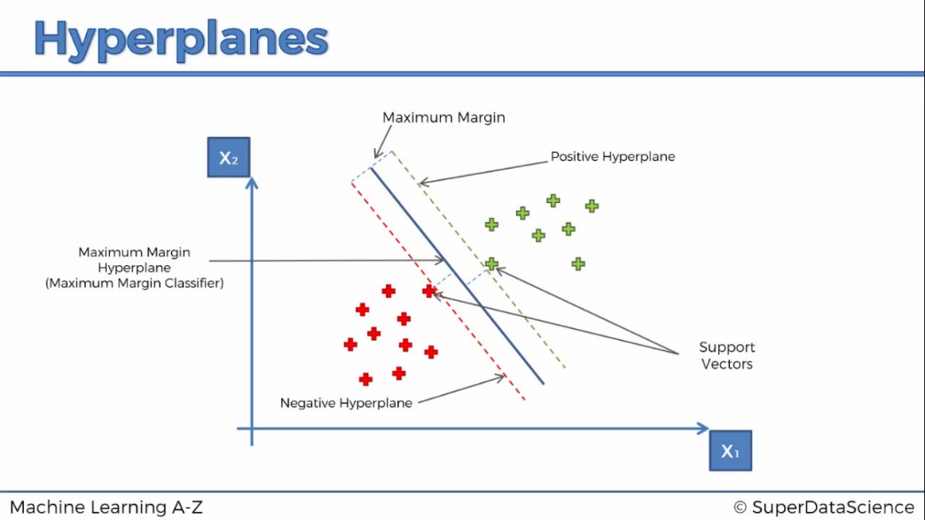
Support Vector Machine
Predicting Diabetes Using Data Mining Techniques
3 April 2019
20 / 23
Predicting Coronary artery disease Using Data Mining Techniques
5 April 2019

Slide 21
Support Vector Machine
We have split the data into training and test sets in the ratio 80:20, similarly as in previous model.
We then built SVM model using different kernel functions like:
Linear
Accuracy achieved: 0.819672
RBF(Radial Basis Function)
Accuracy achieved: 0.86885
Predicting Diabetes Using Data Mining Techniques
3 April 2019
21 / 23
Predicting Coronary artery disease Using Data Mining Techniques
5 April 2019

Slide 22
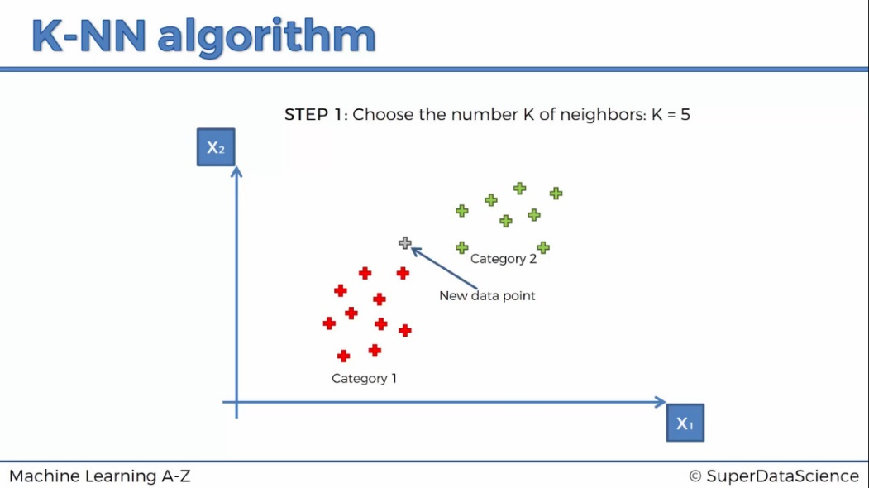
K Nearest Neighbours
Predicting Diabetes Using Data Mining Techniques
3 April 2019
22 / 23
Predicting Coronary artery disease Using Data Mining Techniques
5 April 2019

Slide 23
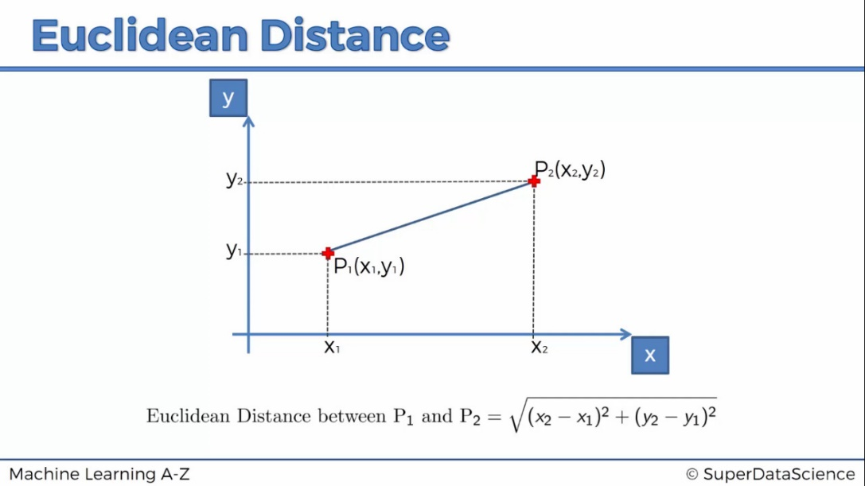
K Nearest Neighbours
Predicting Diabetes Using Data Mining Techniques
3 April 2019
23 / 23
Predicting Coronary artery disease Using Data Mining Techniques
5 April 2019

Slide 24
K Nearest Neighbours
Idea behind K-NN algorithm is that, an object is classified by a majority vote of its neighbors, with the object being assigned to the class most common among its k nearest neighbors.
We have split the data into training and test sets in the ratio 80:20, similarly as in previous model.
Then we fit the K-NN algorithm on training dataset.
We have taken :K=5, metric = minikowski(Euclidean distance)
Accuracy achieved: 0.836065
Predicting Diabetes Using Data Mining Techniques
3 April 2019
24 / 23
Predicting Coronary artery disease Using Data Mining Techniques
5 April 2019

Slide 25

Naive Bayes Classifier
Naive Bayes classification model is based on Bayes’ Theorem.
$P\left(A | B\right)=P\left(B | A\right)∗\frac{P\left(A\right)}{P\left(B\right)}$
In our model we are using Gaussian Naive Bayes algorithm for the classification.
We have split the data into training and test sets in the ration 80:20, similarly as in previous model.
Accuracy achieved: 0.803278
Predicting Diabetes Using Data Mining Techniques
3 April 2019
25 / 23
Predicting Coronary artery disease Using Data Mining Techniques
5 April 2019

Slide 26
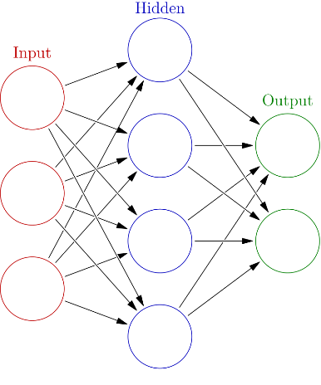
Multilayer Perceptron Classifier
A multilayer perceptron (MLP) is a class of feedforward artificial neural network.
A MLP consists of, at least, three layers of nodes: an input layer, a hidden layer and an output layer.
Source: Wikipedia
Predicting Diabetes Using Data Mining Techniques
3 April 2019
26 / 23
Predicting Coronary artery disease Using Data Mining Techniques
5 April 2019

Slide 27
Multilayer Perceptron Classifier
We have split the data into training and test sets in the ration 80:20, similarly as in previous model.
In our model we have used 13 input neurons , 7 neurons in hidden layer and one single output neuron.
Accuracy achieved: 0.852459
Predicting Diabetes Using Data Mining Techniques
3 April 2019
27 / 23
Predicting Coronary artery disease Using Data Mining Techniques
5 April 2019

Slide 28
Conclusion
Predicting Diabetes Using Data Mining Techniques
3 April 2019
28 / 23
Predicting Coronary artery disease Using Data Mining Techniques
5 April 2019

Slide 29
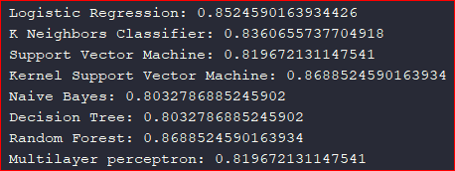
Conclusion
The accuracies of seven different models in predicting the occurrence of a Coronary artery disease have been summarized in the previous slides.
The proposed model of Support Vector Machines and Random Forest both display the best accuracy of 86% for this dataset.
Predicting Diabetes Using Data Mining Techniques
3 April 2019
29 / 23
Predicting Coronary artery disease Using Data Mining Techniques
5 April 2019

Slide 30
References
[1] Kaggle “Heart Disease UCI ” Internet: https://www.kaggle.com/ronitf/heart-disease-uci, [Mar. 16, 2019]
[2] Mayoclinic “Coronary artery disease - Symptoms and causes” Internet: https://www.mayoclinic.org/diseases-conditions/coronary-artery-disease/symptoms-causes/syc-20350613, [Mar. 25 , 2019]
[3] Wikipedia “Multilayer perceptron” Internet: https://en.wikipedia.org/wiki/Multilayer_perceptron, [Apr. 3, 2019]
Predicting Coronary artery disease Using Data Mining Techniques
5 April 2019

Slide 31
Thank You
Predicting Diabetes Using Data Mining Techniques
3 April 2019
31 / 23
Predicting Coronary artery disease Using Data Mining Techniques
5 April 2019

