Slide 1
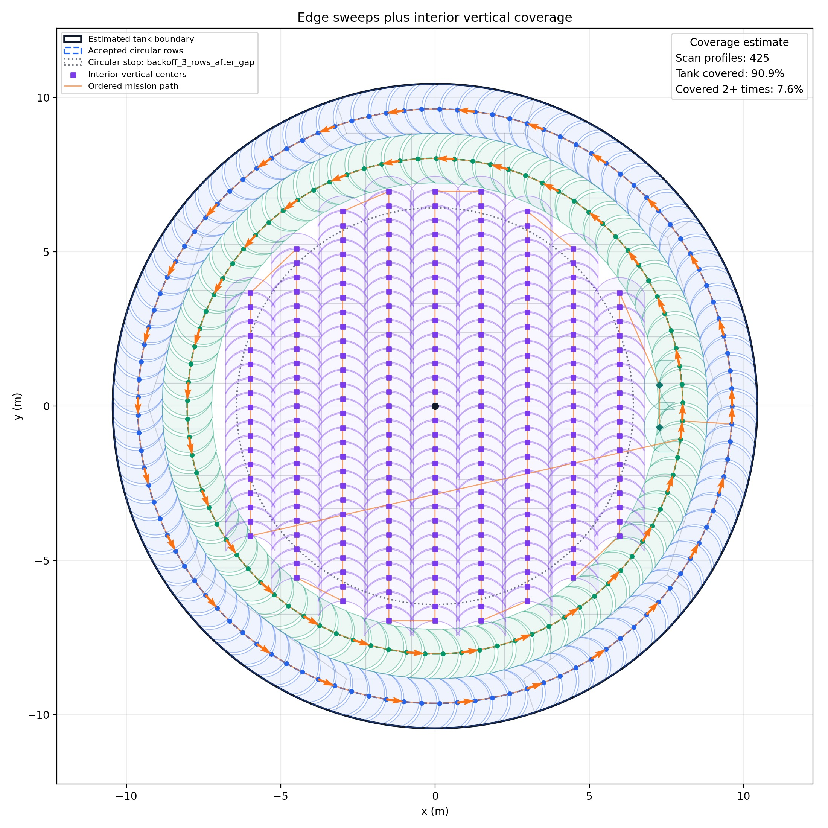
Tank Scan Planner
Progress check: DXF import to scan-profile placement
Import tank floor drawings
Build usable geometry
Place scan profiles for early coverage tests
3
v1
tank sizes tested
current deck scope
65 ft planner preview
1/5

Slide 2
HOW THE TOOL WORKS
Current Build Flow
1
2
3
4
5
Read DXF
Estimate tank
Edge sweeps
Interior fill
Export
lines, arcs, circles, layers
center and circular boundary
clean circular rows near wall
vertical scan columns
JSON, CSV, preview image
Simple geometry first
Planner decisions stay visible
No full optimization yet
The goal right now is confidence: import correctly, place scans clearly, and see what fails.
2/5

Slide 3
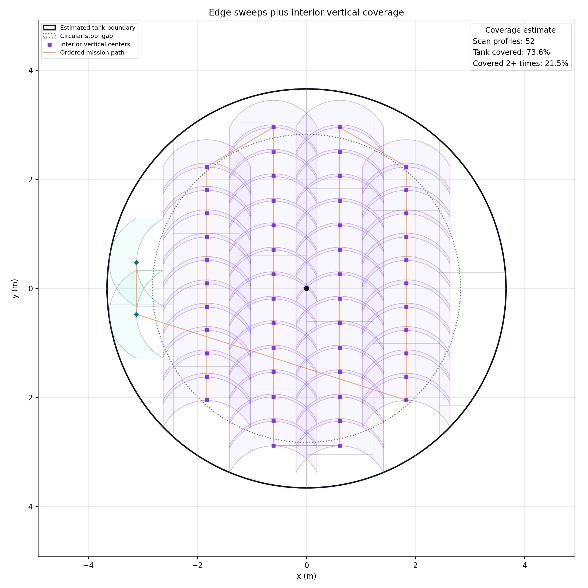
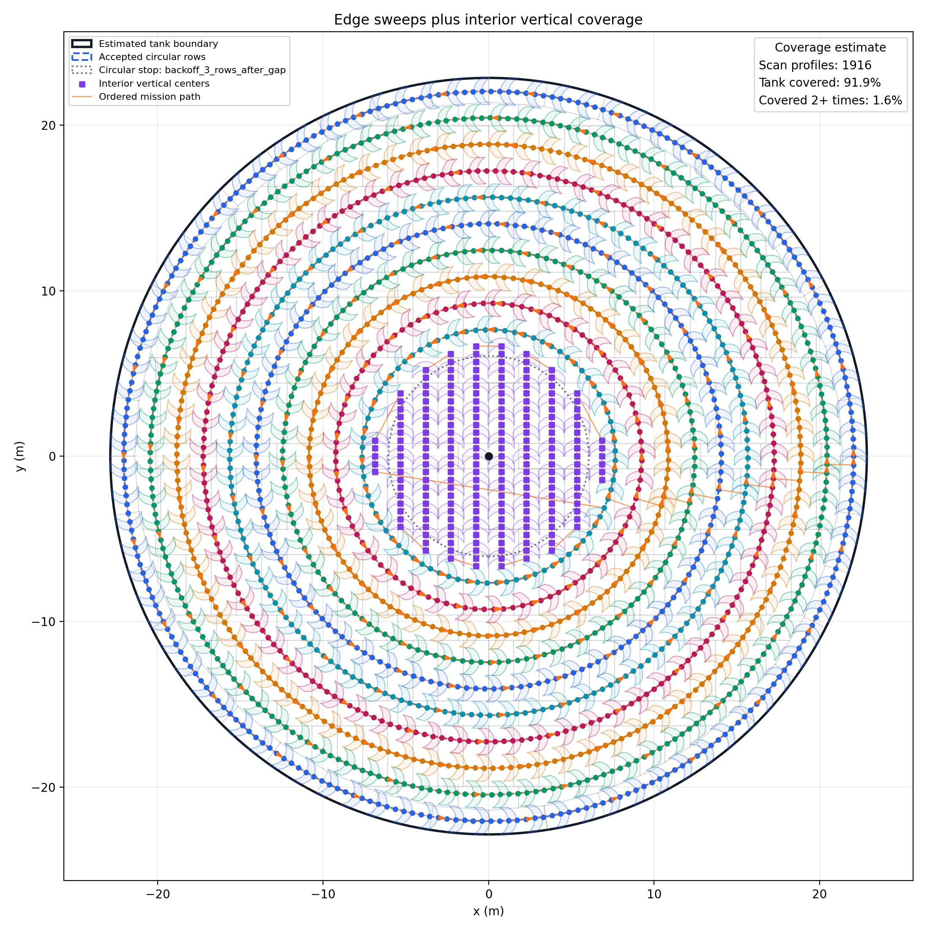
THREE DXF TANK SIZES
Generalization Check
24 ft
65 ft
150 ft
Small tank: circular rows stop early
Mid-size: edge rows + interior fill
Large tank: many edge rows before interior
3/5

Slide 4
WHAT THE ALGORITHM IS DOING
Placement Logic
Start near the wall
Add circular rows only while they wrap cleanly
Switch to vertical columns for the center area
Use rotated side columns for narrow leftover gaps
Key rule
Do not force a scan pattern where the geometry no longer fits well.
4/5

Slide 5
PROGRESS CHECK
Status And Next Work
Working Now
Next Risks To Solve
DXF geometry importer
Reusable rainbow scan profile
Adaptive edge sweep logic
Interior vertical fill preview
Mission export + coverage preview
Better exact overlap math
Cleaner transition between stages
More tank shapes and messy DXFs
Runtime improvements
Field validation against real robot constraints
Main takeaway: the planner is becoming a repeatable geometry pipeline, not a one-off drawing.
5/5

