Slide 1
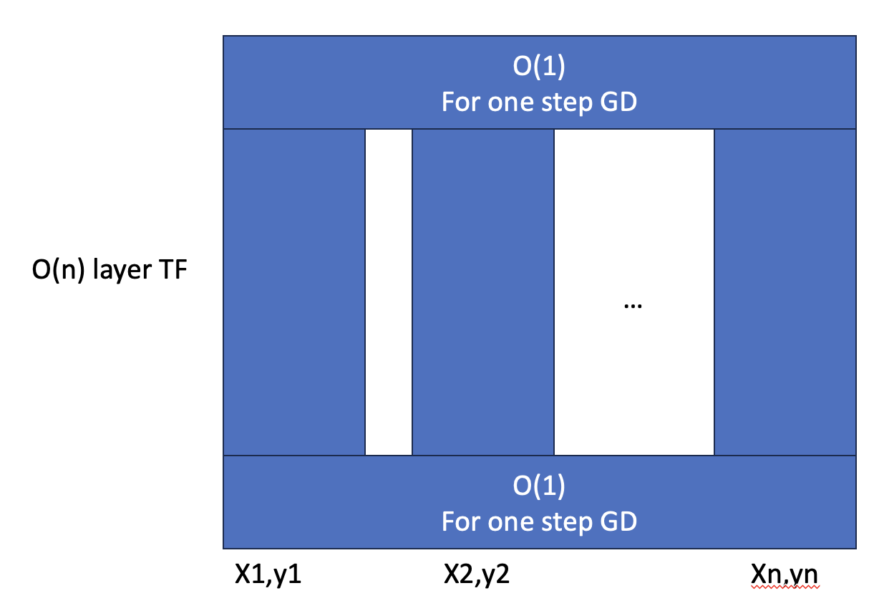
Motivation:
Literature knows Transformer performs ICL using GD under certain case:

Slide 2
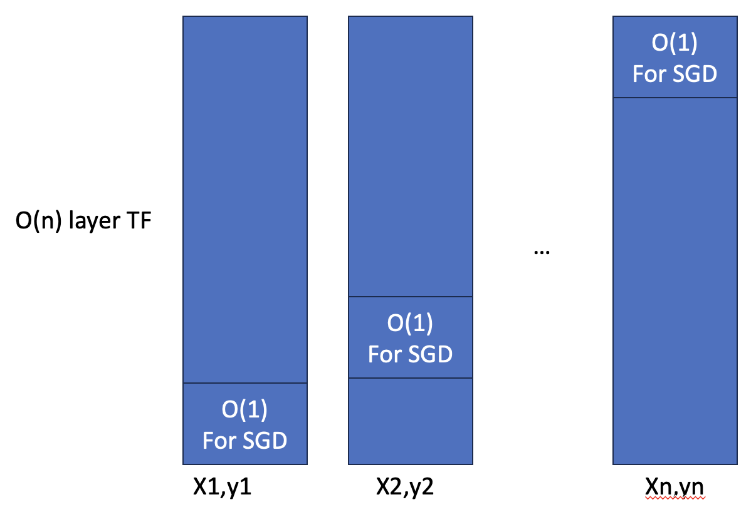
Question:
Will Transformer perform ICL using SGD?

Slide 3
Project Goal: We want to show that during training: Under certain case (data + model) (p1) Transformer does SGD (existing work on theory)

Slide 4
Project Goal: We want to show that during training: Under certain case (data + model) (p1) Transformer does SGD (existing work on theory) (p0) Transformer does GD first, then does SGD (phase transition)

Slide 5
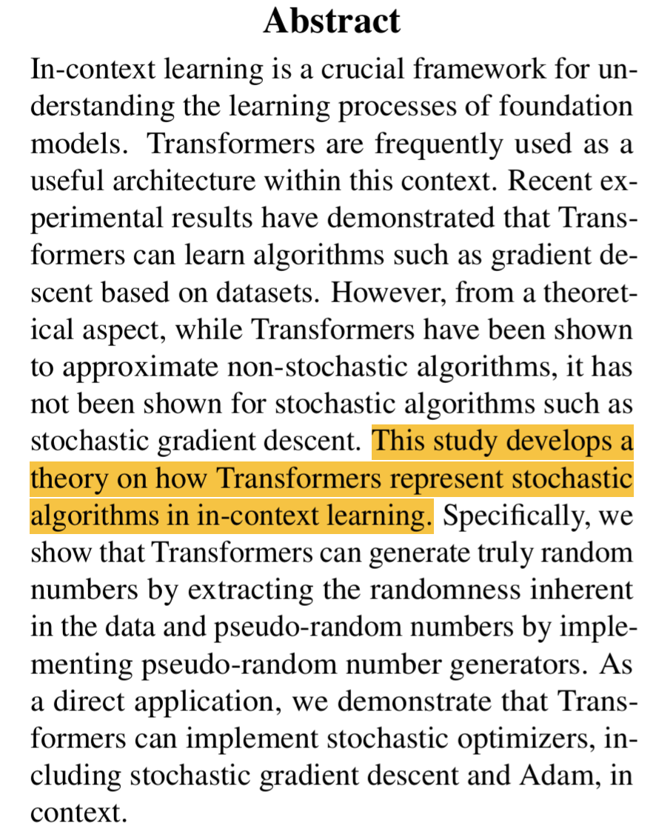
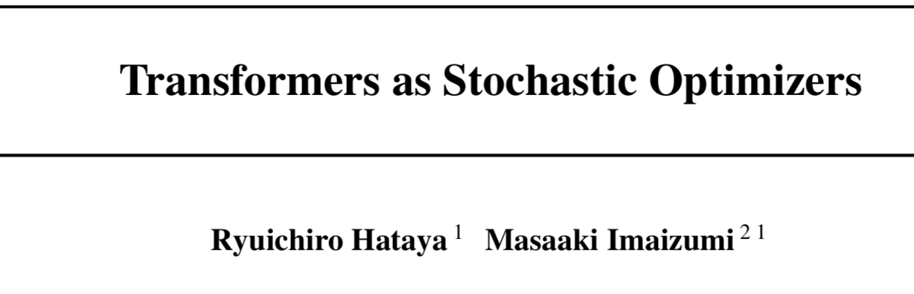
Project Goal: We want to show that during training: Under certain case (data + model) (p1) Transformer does SGD (existing work on theory) (p0) Transformer does GD first, then does SGD (phase transition)

Slide 6
Project Goal: We want to show that during training: Under certain case (data + model) (p1) Transformer does SGD (existing work on theory) (p0) Transformer does GD first, then does SGD (phase transition)
training dynamic
easy to learn
lower loss

Slide 7
Data: SGD vs GD (chat-GPT)
SGD good at | GD good at | Connection to our coding
large-scale datasets | small-scale problems | Several or tens of ICL samples cannot count as large scale
non-convex loss landscape => local minima and saddle points SGD‘s stochasticity => poor local minima | convex | We can design the underline task of ICL as non-convex functions: sin, cos, neural network.
 | high precision SGD introduces noise

Slide 8
Choices on data: any paper show TF can do GD on non-linear?
data | description
y=sin(wx) | non-convex
y=sigmoid(MLP(x)) scalar output with sigmoid to bound |y| | non-convex
y=|MLP(x)| vector output with normalization to bound |y| | non-convex

Slide 9
Model (Thanks to Liu---she saved me weeks to understand what is going on ICL=GD. She and my translation might be wrong w.v.l.p., correct me if that’s the case…)
loss applied on
x1 y1 x2 y2 x3 y3 x4 y4
[x1,y1] [x2,y2] [x3,y3] [x4,y4]
TF
TF
x1 y1 x2 y2 x3 y3 x4,y4
[x1,y1] [x2,y2] [x3,y3] [x4,0]
ICL in my eye
ICL in ICL=GD

Slide 10
Model (Thanks to Liu---she saved me weeks to understand what is going on ICL=GD. She and my translation might be wrong w.v.l.p., correct me if that’s the case…)
loss applied on
x1 y1 x2 y2 x3 y3 x4 y4
[x1,y1] [x2,y2] [x3,y3] [x4,y4]
TF
TF
x1 y1 x2 y2 x3 y3 x4,y4
[x1,y1] [x2,y2] [x3,y3] [x4,0]
No ICL=GD mathematical analysis on this!
ICL in ICL=GD

Slide 11
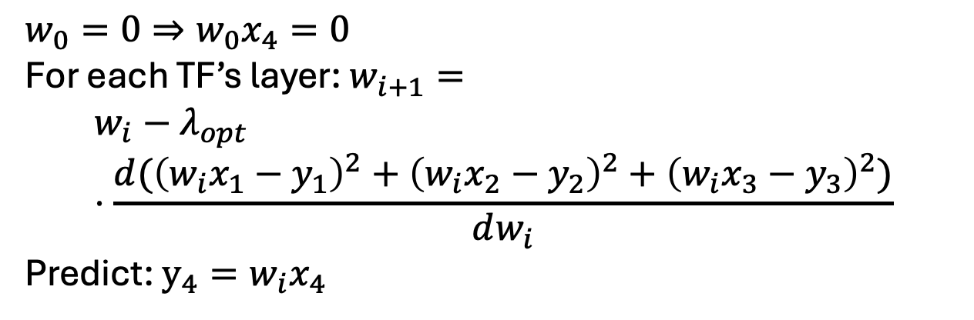
Model (Thanks to Liu---she saved me weeks to understand what is going on ICL=GD. She and my translation might be wrong w.v.l.p., correct me if that’s the case…)
loss applied on
[x1,y1] [x2,y2] [x3,y3] [x4,y4]
TF
$w_{0}=0⇒w_{0}x_{4}=0$
For each TF’s layer: $w_{i+1}=$
$$w_{i}−λ_{opt}⋅\frac{d({\left(w_{i}x_{1}−y_{1}\right)}^{2}+{\left(w_{i}x_{2}−y_{2}\right)}^{2}+{\left(w_{i}x_{3}−y_{3}\right)}^{2})}{dw_{i}}$$
Predict: $y_{4}=w_{i}x_{4}$
[x1,y1] [x2,y2] [x3,y3] [x4,0]
ICL in ICL=GD

Slide 12
Recall Question:
Will Transformer perform ICL using SGD?

Slide 13
Model (Thanks to Liu---she saved me weeks to understand what is going on ICL=GD. She and my translation might be wrong w.v.l.p., correct me if that’s the case…)
loss applied on
[x1,y1] [x2,y2] [x3,y3] [x4,y4]
TF
Nano GPT is easier than LSA on this task. However, the results in the literature is based on LSA.
[x1,y1] [x2,y2] [x3,y3] [x4,0]
ICL in ICL=GD

Slide 14
Step1: choose data does SGD perform better than GD on these tasks?
data | description
y=sin(wx) | non-convex
y=sigmoid(MLP(x)) scalar output with sigmoid to bound |y| | non
y=|MLP(x)| vector output with normalization to bound |y|

Slide 15
data | initialize | x,y comes from
y=sin(wx) | w=0, y=0 | x uniform [-2, 2] w uniform [-4pi,4pi]
y=sigmoid(MLP(x)) | w_final=0, y=0.5 | x uniform [-1,1]^d
y=|MLP(x)| | w_final=0, y= [1/sqrt(d),…, 1/sqrt(d)] | x uniform [-1,1]^d

Slide 16
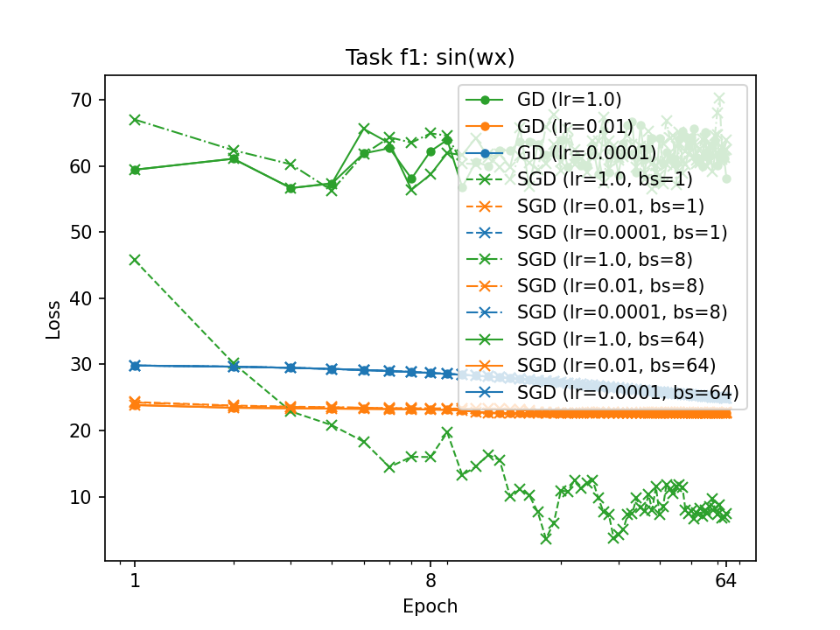

Slide 17
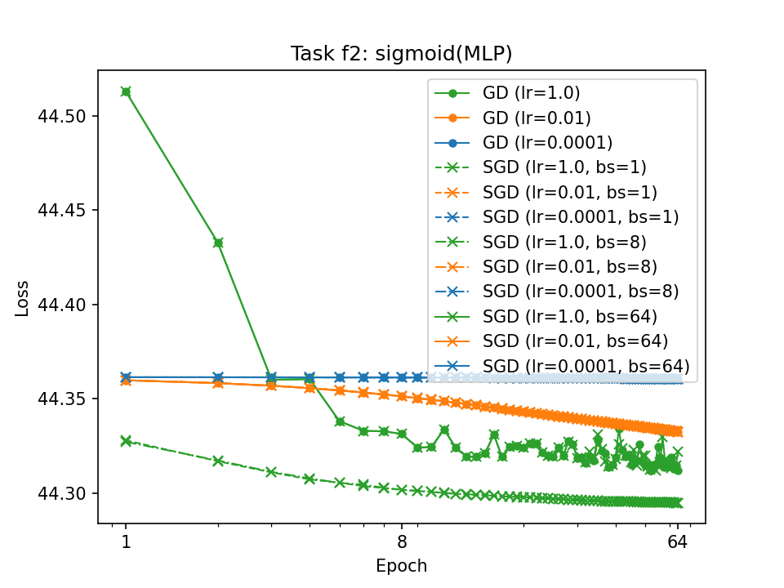

Slide 18
