Slide 1
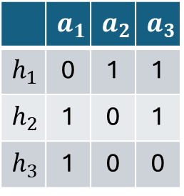


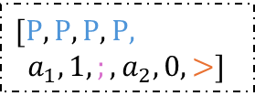
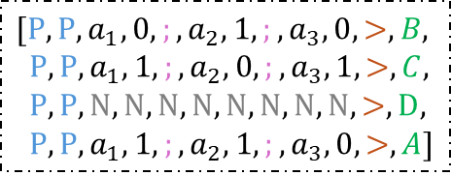

$$𝓗=\{h_{1},h_{2},h_{3}\}$$
$$C$$
 | $$a_{1}$$ | $$a_{2}$$ | $$a_{3}$$
$$h_{1}$$ | 0 | 1 | 1
$$h_{2}$$ | 1 | 0 | 1
$$h_{3}$$ | 1 | 0 | 0
Transformer
$$[P,P,a_{1},0,;,a_{2},1,;,a_{3},0,>,B,$$
$P,P,a_{1},1,;,a_{2},0,;,a_{3},1,>,C,$
$P,P,N,N,N,N,N,N,N,N,>,D,$
$P,P,a_{1},1, ;,a_{2},1,;,a_{3},0,>,A]$
$[P,P,P,P$,
$a_{1},1,;,a_{2},0, >]$
$$𝓓=\{\left(a_{1},1\right),\left(a_{2},1\right)\}$$

