Slide 1

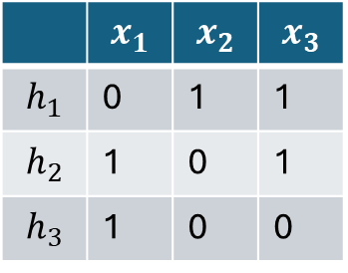



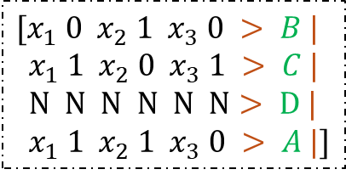

Given Hypothesis space $ℋ$ and dataset $𝒟$, can Transformer identify the correct hypothesis?
$$C$$
$$ℋ=\{h_{1},h_{2},h_{3}\}$$
Transformer
 | $$x_{1}$$ | $$x_{2}$$ | $$x_{3}$$
$$h_{1}$$ | 0 | 1 | 1
$$h_{2}$$ | 1 | 0 | 1
$$h_{3}$$ | 1 | 0 | 0
$$[x_{1} 0 x_{2} 1 x_{3} 0 > B |$$
$x_{1} 1 x_{2} 0 x_{3} 1 > C |$
$N N N N N N> D |$
$x_{1} 1 x_{2} 1 x_{3} 0 > A |]$
$$[ x_{1} 1 x_{2} 0 x_{1} 1 ] >$$
$$𝒟=\{\left(x_{1},1\right),\left(x_{2},1\right)\}$$

