Slide 1





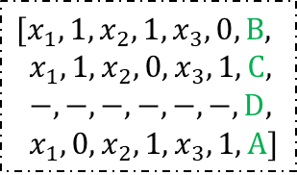
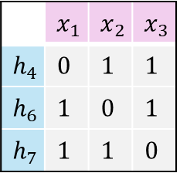

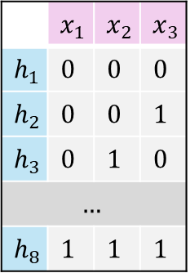
hypothesis universe
$$𝓗=\{h_{4},h_{6},h_{7}\}$$
$$0$$
$$1$$
$$C$$
hypothesis space
 | $$x_{1}$$ | $$x_{2}$$ | $$x_{3}$$
$$h_{1}$$ | $$0$$ | $$0$$ | $$0$$
$$h_{2}$$ | $$0$$ | $$0$$ | $$1$$
$$h_{3}$$ | $$0$$ | $$1$$ | $$0$$
$$…$$
$$h_{8}$$ | $$1$$ | $$1$$ | $$1$$
Transformer
 | $$x_{1}$$ | $$x_{2}$$ | $$x_{3}$$
$$h_{4}$$ | $$0$$ | $$1$$ | $$1$$
$$h_{6}$$ | $$1$$ | $$0$$ | $$1$$
$$h_{7}$$ | $$1$$ | $$1$$ | $$0$$
$$[x_{1},1,x_{2},1,x_{3},0,B,$$
$x_{1},1,x_{2},0,x_{3},1,C,$
$−,−,−, −,−,−, D,$
$x_{1},0,x_{2},1,x_{3},1,A]$
$$[x_{2},0,x_{1},1,>]$$
context query
$$S_{K}=\left(x_{2},0,x_{1},1\right)$$
hypothesis table
hypothesis prefix
ICL sequence

