Slide 1

Scripting for Success in Hollywood
CS 109 Final Project by
J. Ben Cook, W. Ryan Lee, Conor Myhrvold, & Daniel Newman

Slide 2
Introduction / Overivew

Slide 3
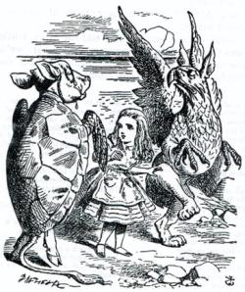


Data Collection
Web Scraping
BeautifulSoup module (Python)
Movie scripts from SimplyScripts.com & DailyScript.com
Used both TXT and HTML formatted scripts with valid IMDB numbers
Collected 396 scripts

Slide 4


Data Collection
Rotten Tomatoes Metadata
RT Developers API
RT ID, genre, scores, ratings, runtimes, years, MPAA ratings, actors
IMDB Metadata
Large metadata dataset
Box office earnings, budgets, award nominations

Slide 5
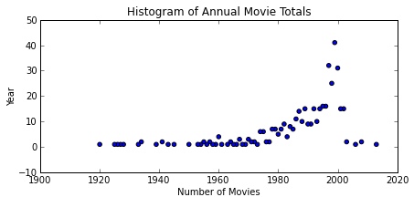
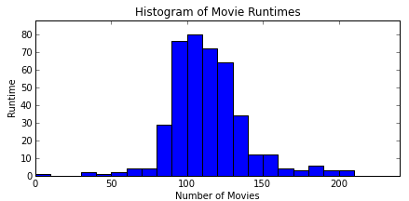
Exploratory Data Analysis
Histograms & Summary Statistics
Pandas + matplotlib
Histograms for visualization
Ensure sufficient sampling in all categories
Approximate normals (runtimes, MPAA); right-skewed (budgets, gross); left-skewed (ratings)

Slide 6
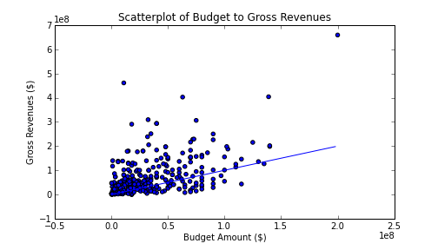
Exploratory Data Analysis
Initial Correlation Analysis
Scatter budget to gross revenues at the box office
Basis for improvement with scripts (R2 = 0.264)

Slide 7
Latent Dirichlet Allocation (LDA)
Script Dimensionality Reduction:
Each document is a distribution over topics
Each topic is a distribution over words
LDA used for dimensionality reduction
Topic 8 | Topic 16 | Topics 37
------------------------------------------
sword | battleship | brother
knights | telescope | children
castle | officers | sister
sarge | guard | daddy
bridge | meat | baby
swords | senior | told
field | rank | everyone
others | petty | done
trees | terror | alright
draws | continues | always

Slide 8
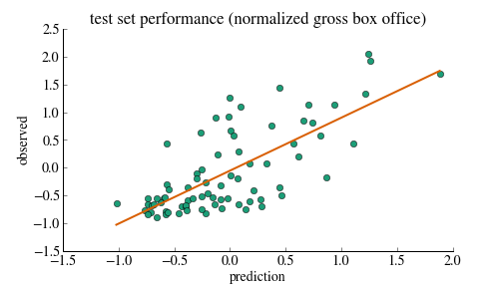
Predicting Gross Box Office Revenues
Bayesian Ridge Regression:
50 topics, audience score, R-rating, genre

