Slide 1
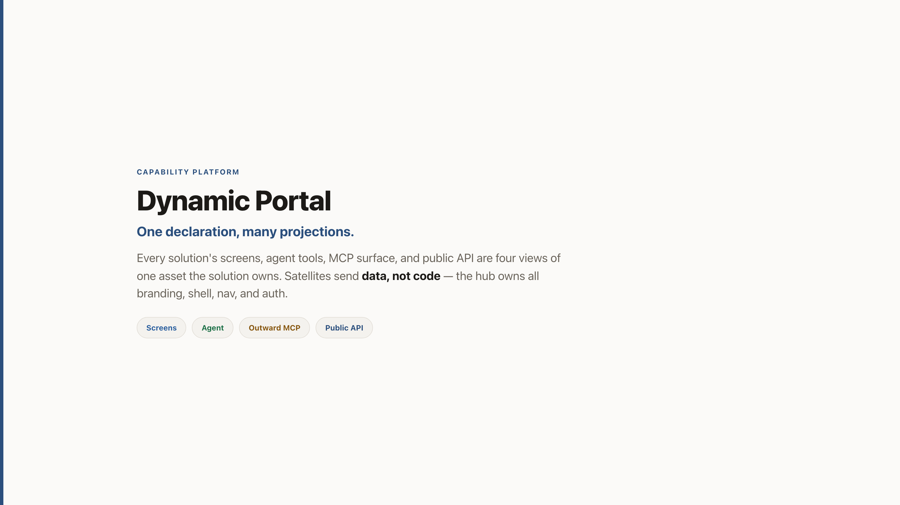
Notes:
CAPABILITY PLATFORM
Dynamic Portal
One declaration, many projections.
Every solution's screens, agent tools, MCP surface, and public API are four views of one asset the solution owns. Satellites send data, not code — the hub owns all branding, shell, nav, and auth.
Screens
Agent
Outward MCP
Public API

Slide 2
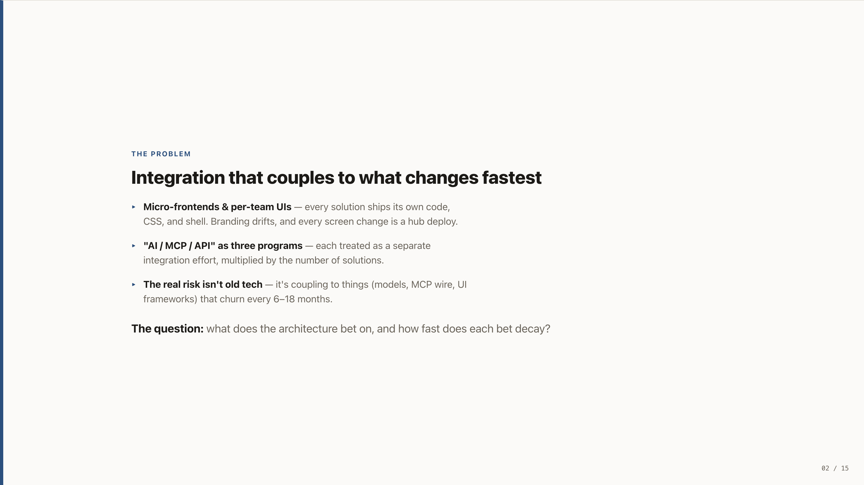
Notes:
THE PROBLEM
Integration that couples to what changes fastest
Micro-frontends & per-team UIs — every solution ships its own code, CSS, and shell. Branding drifts, and every screen change is a hub deploy.
"AI / MCP / API" as three programs — each treated as a separate integration effort, multiplied by the number of solutions.
The real risk isn't old tech — it's coupling to things (models, MCP wire, UI frameworks) that churn every 6–18 months.
The question: what does the architecture bet on, and how fast does each bet decay?

Slide 3
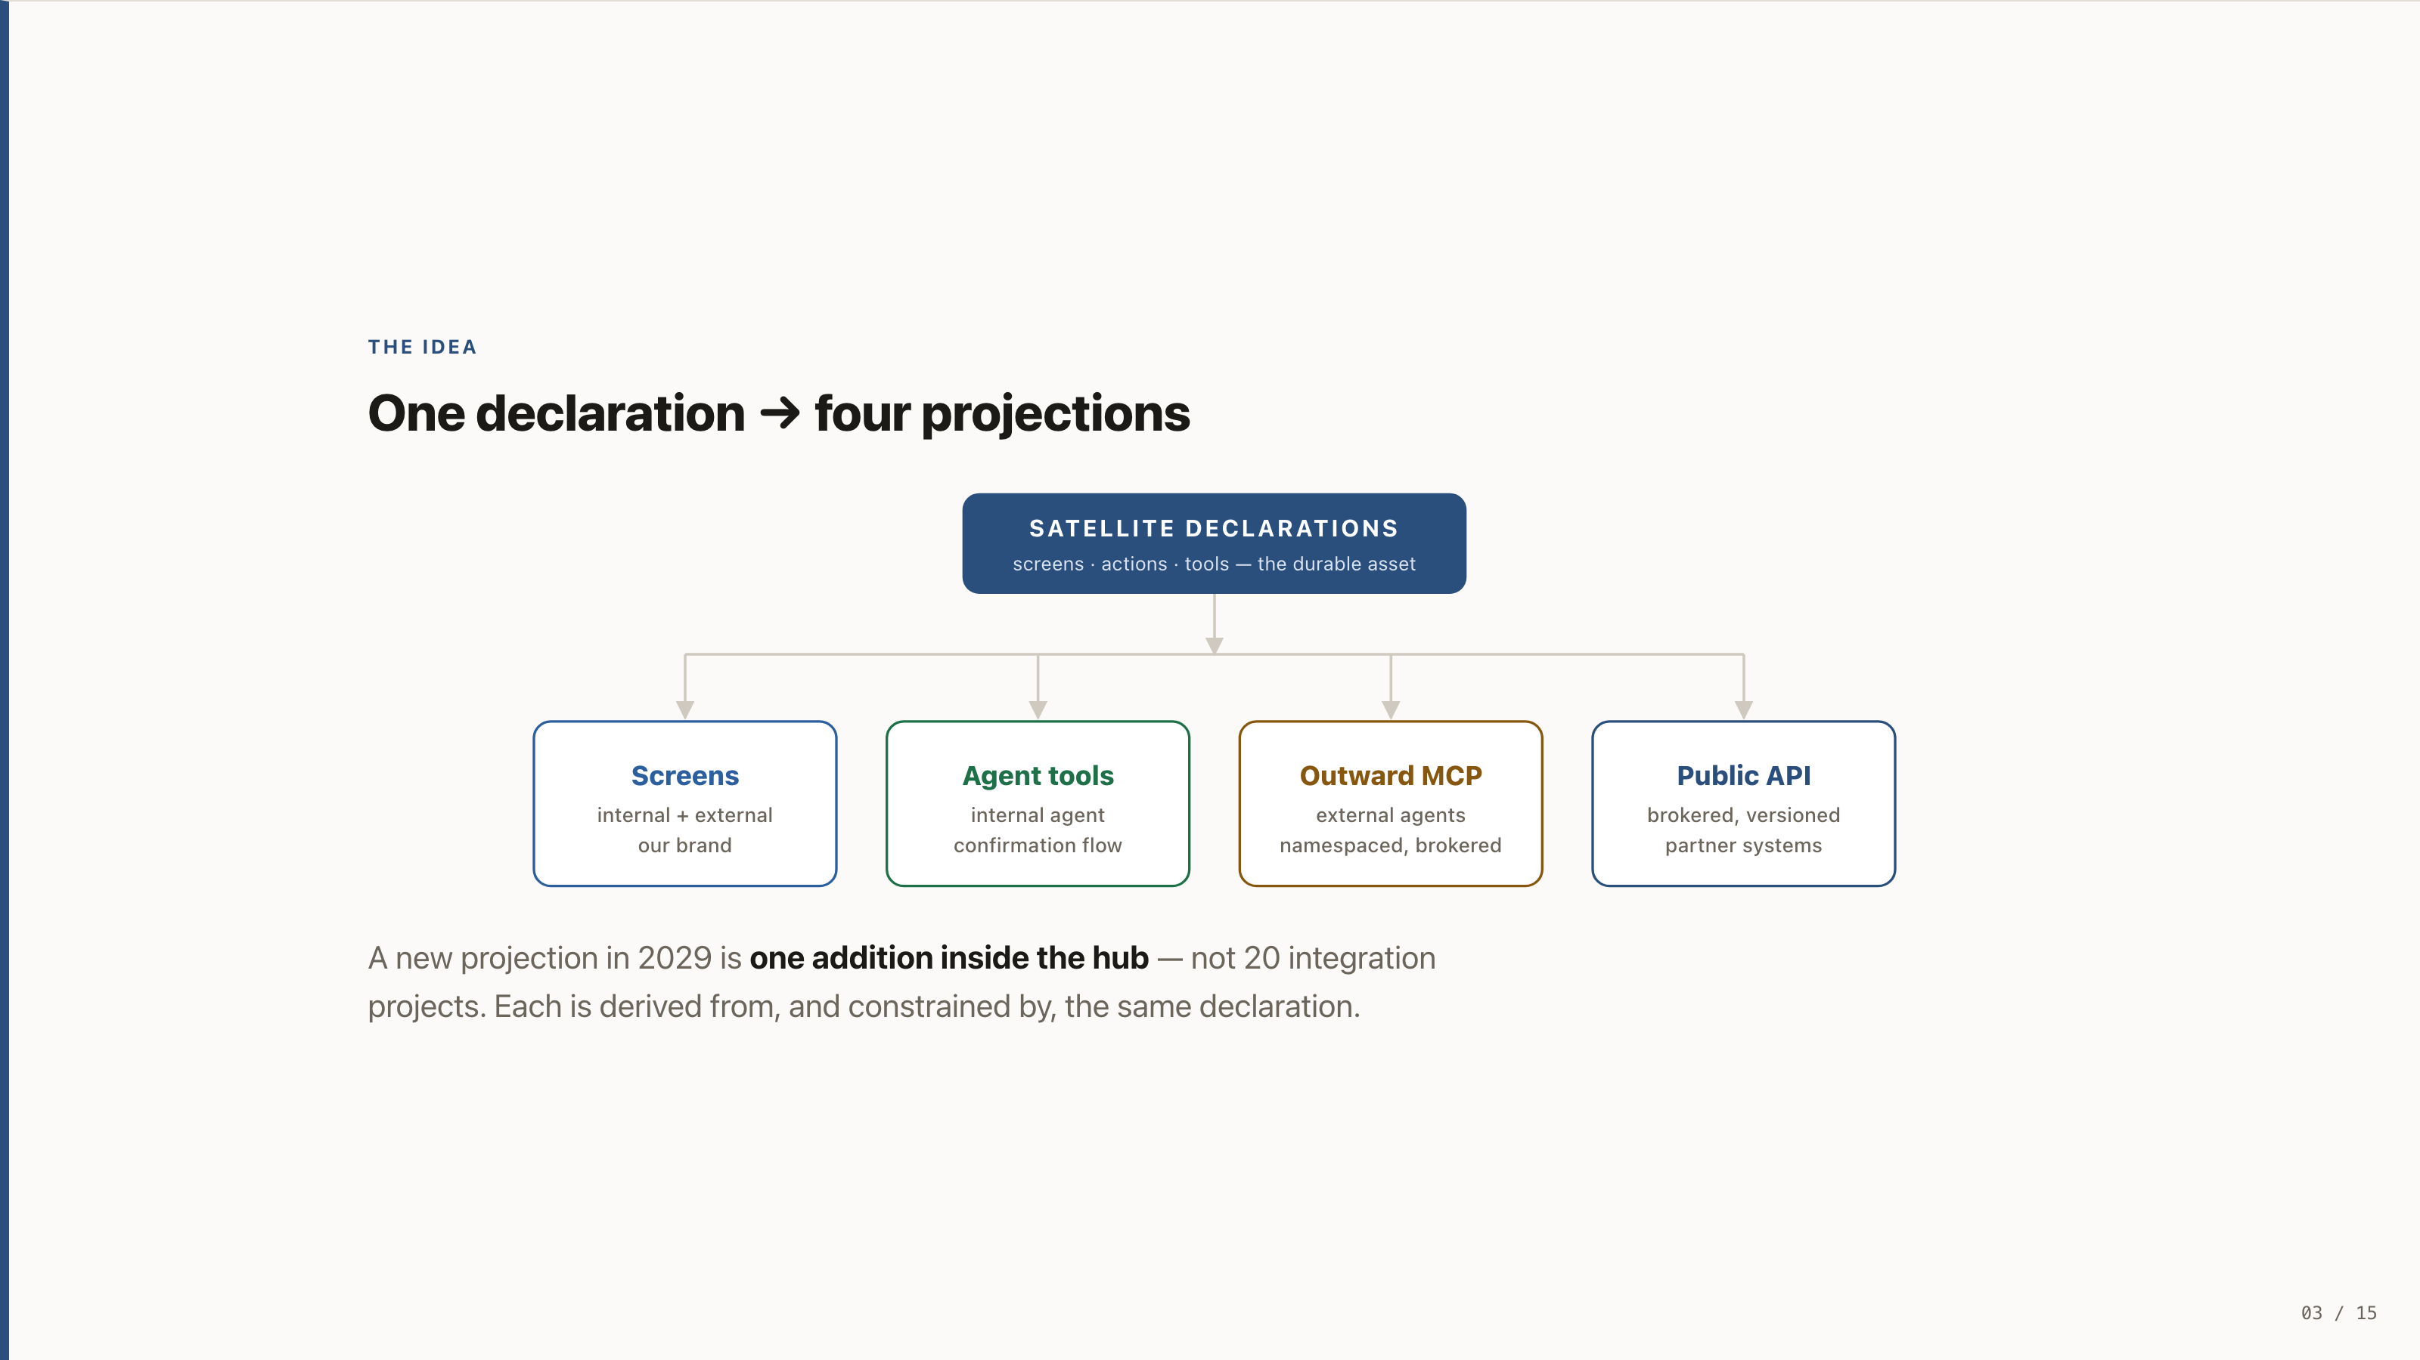
Notes:
THE IDEA
One declaration → four projections
A new projection in 2029 is one addition inside the hub — not 20 integration projects. Each is derived from, and constrained by, the same declaration.

Slide 4
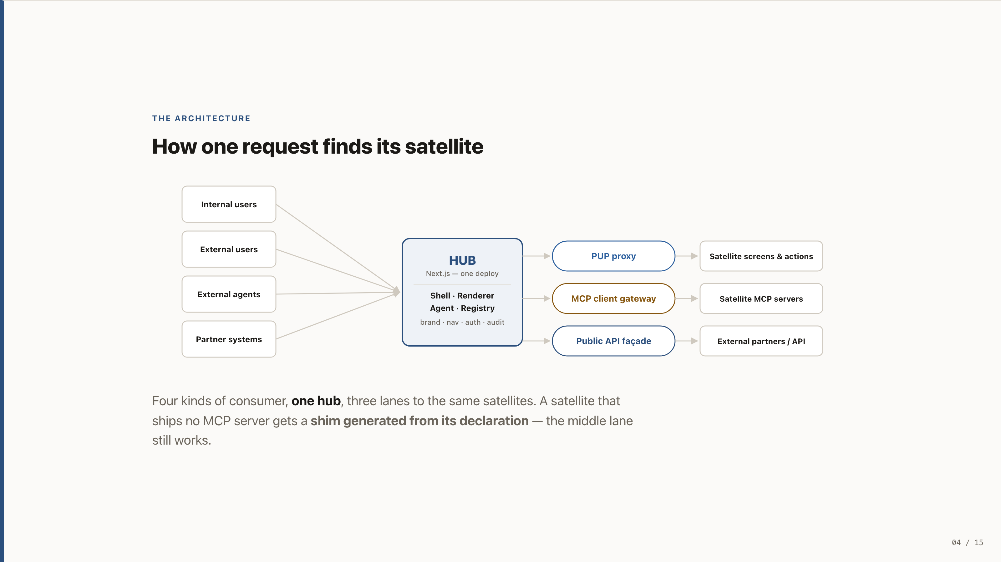
Notes:
THE ARCHITECTURE
How one request finds its satellite
Four kinds of consumer, one hub, three lanes to the same satellites. A satellite that ships no MCP server gets a shim generated from its declaration — the middle lane still works.

Slide 5
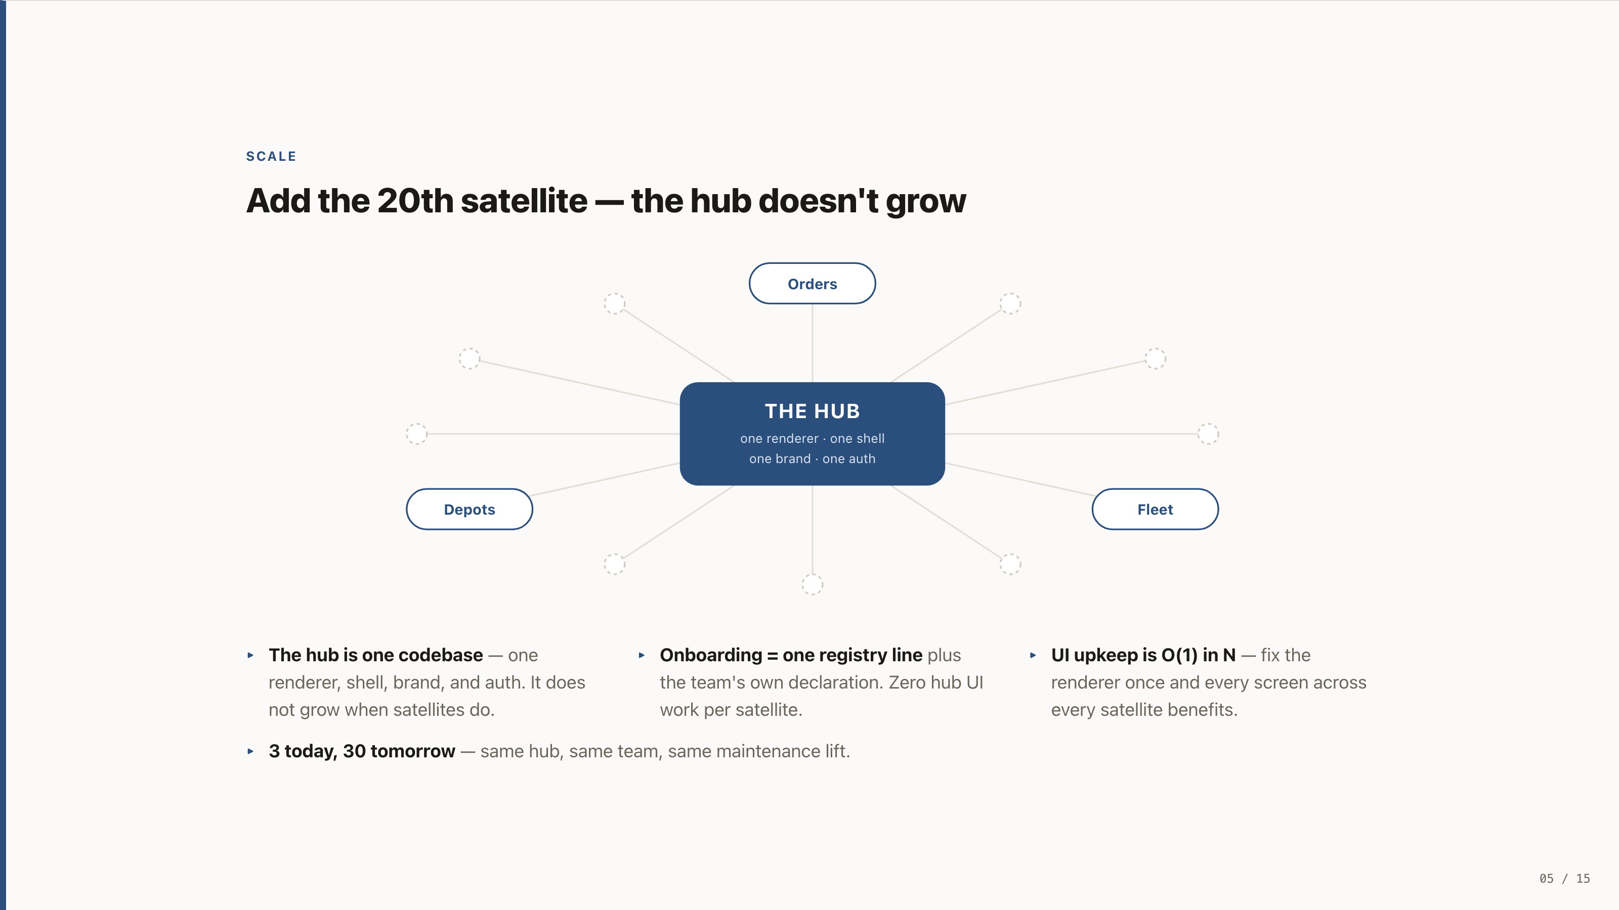
Notes:
SCALE
Add the 20th satellite — the hub doesn't grow
The hub is one codebase — one renderer, shell, brand, and auth. It does not grow when satellites do.
Onboarding = one registry line plus the team's own declaration. Zero hub UI work per satellite.
UI upkeep is O(1) in N — fix the renderer once and every screen across every satellite benefits.
3 today, 30 tomorrow — same hub, same team, same maintenance lift.

Slide 6
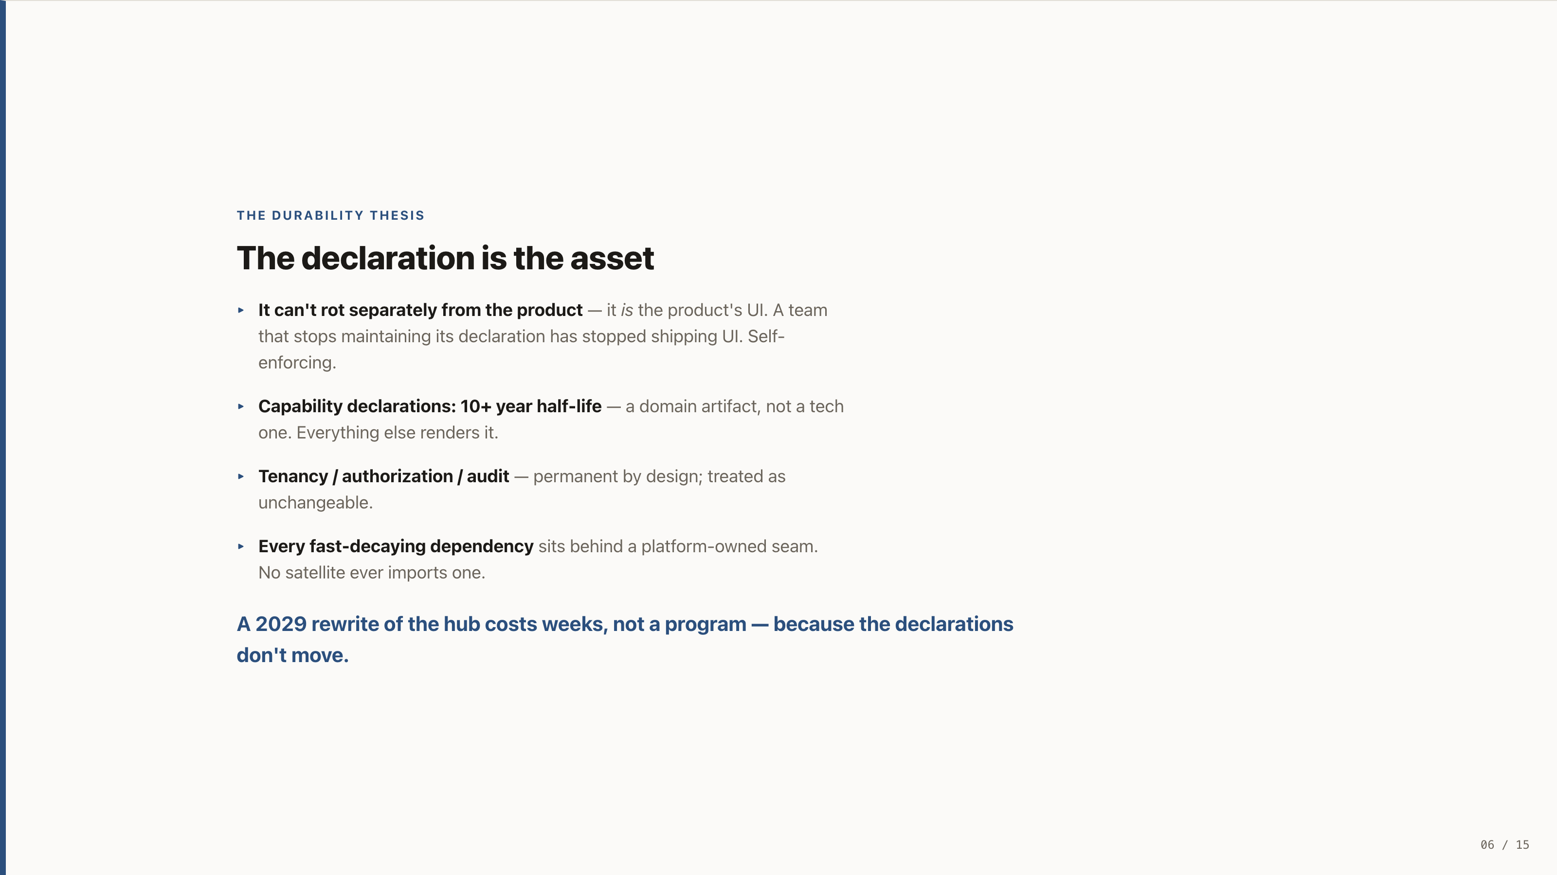
Notes:
THE DURABILITY THESIS
The declaration is the asset
It can't rot separately from the product — it is the product's UI. A team that stops maintaining its declaration has stopped shipping UI. Self-enforcing.
Capability declarations: 10+ year half-life — a domain artifact, not a tech one. Everything else renders it.
Tenancy / authorization / audit — permanent by design; treated as unchangeable.
Every fast-decaying dependency sits behind a platform-owned seam. No satellite ever imports one.
A 2029 rewrite of the hub costs weeks, not a program — because the declarations don't move.

Slide 7
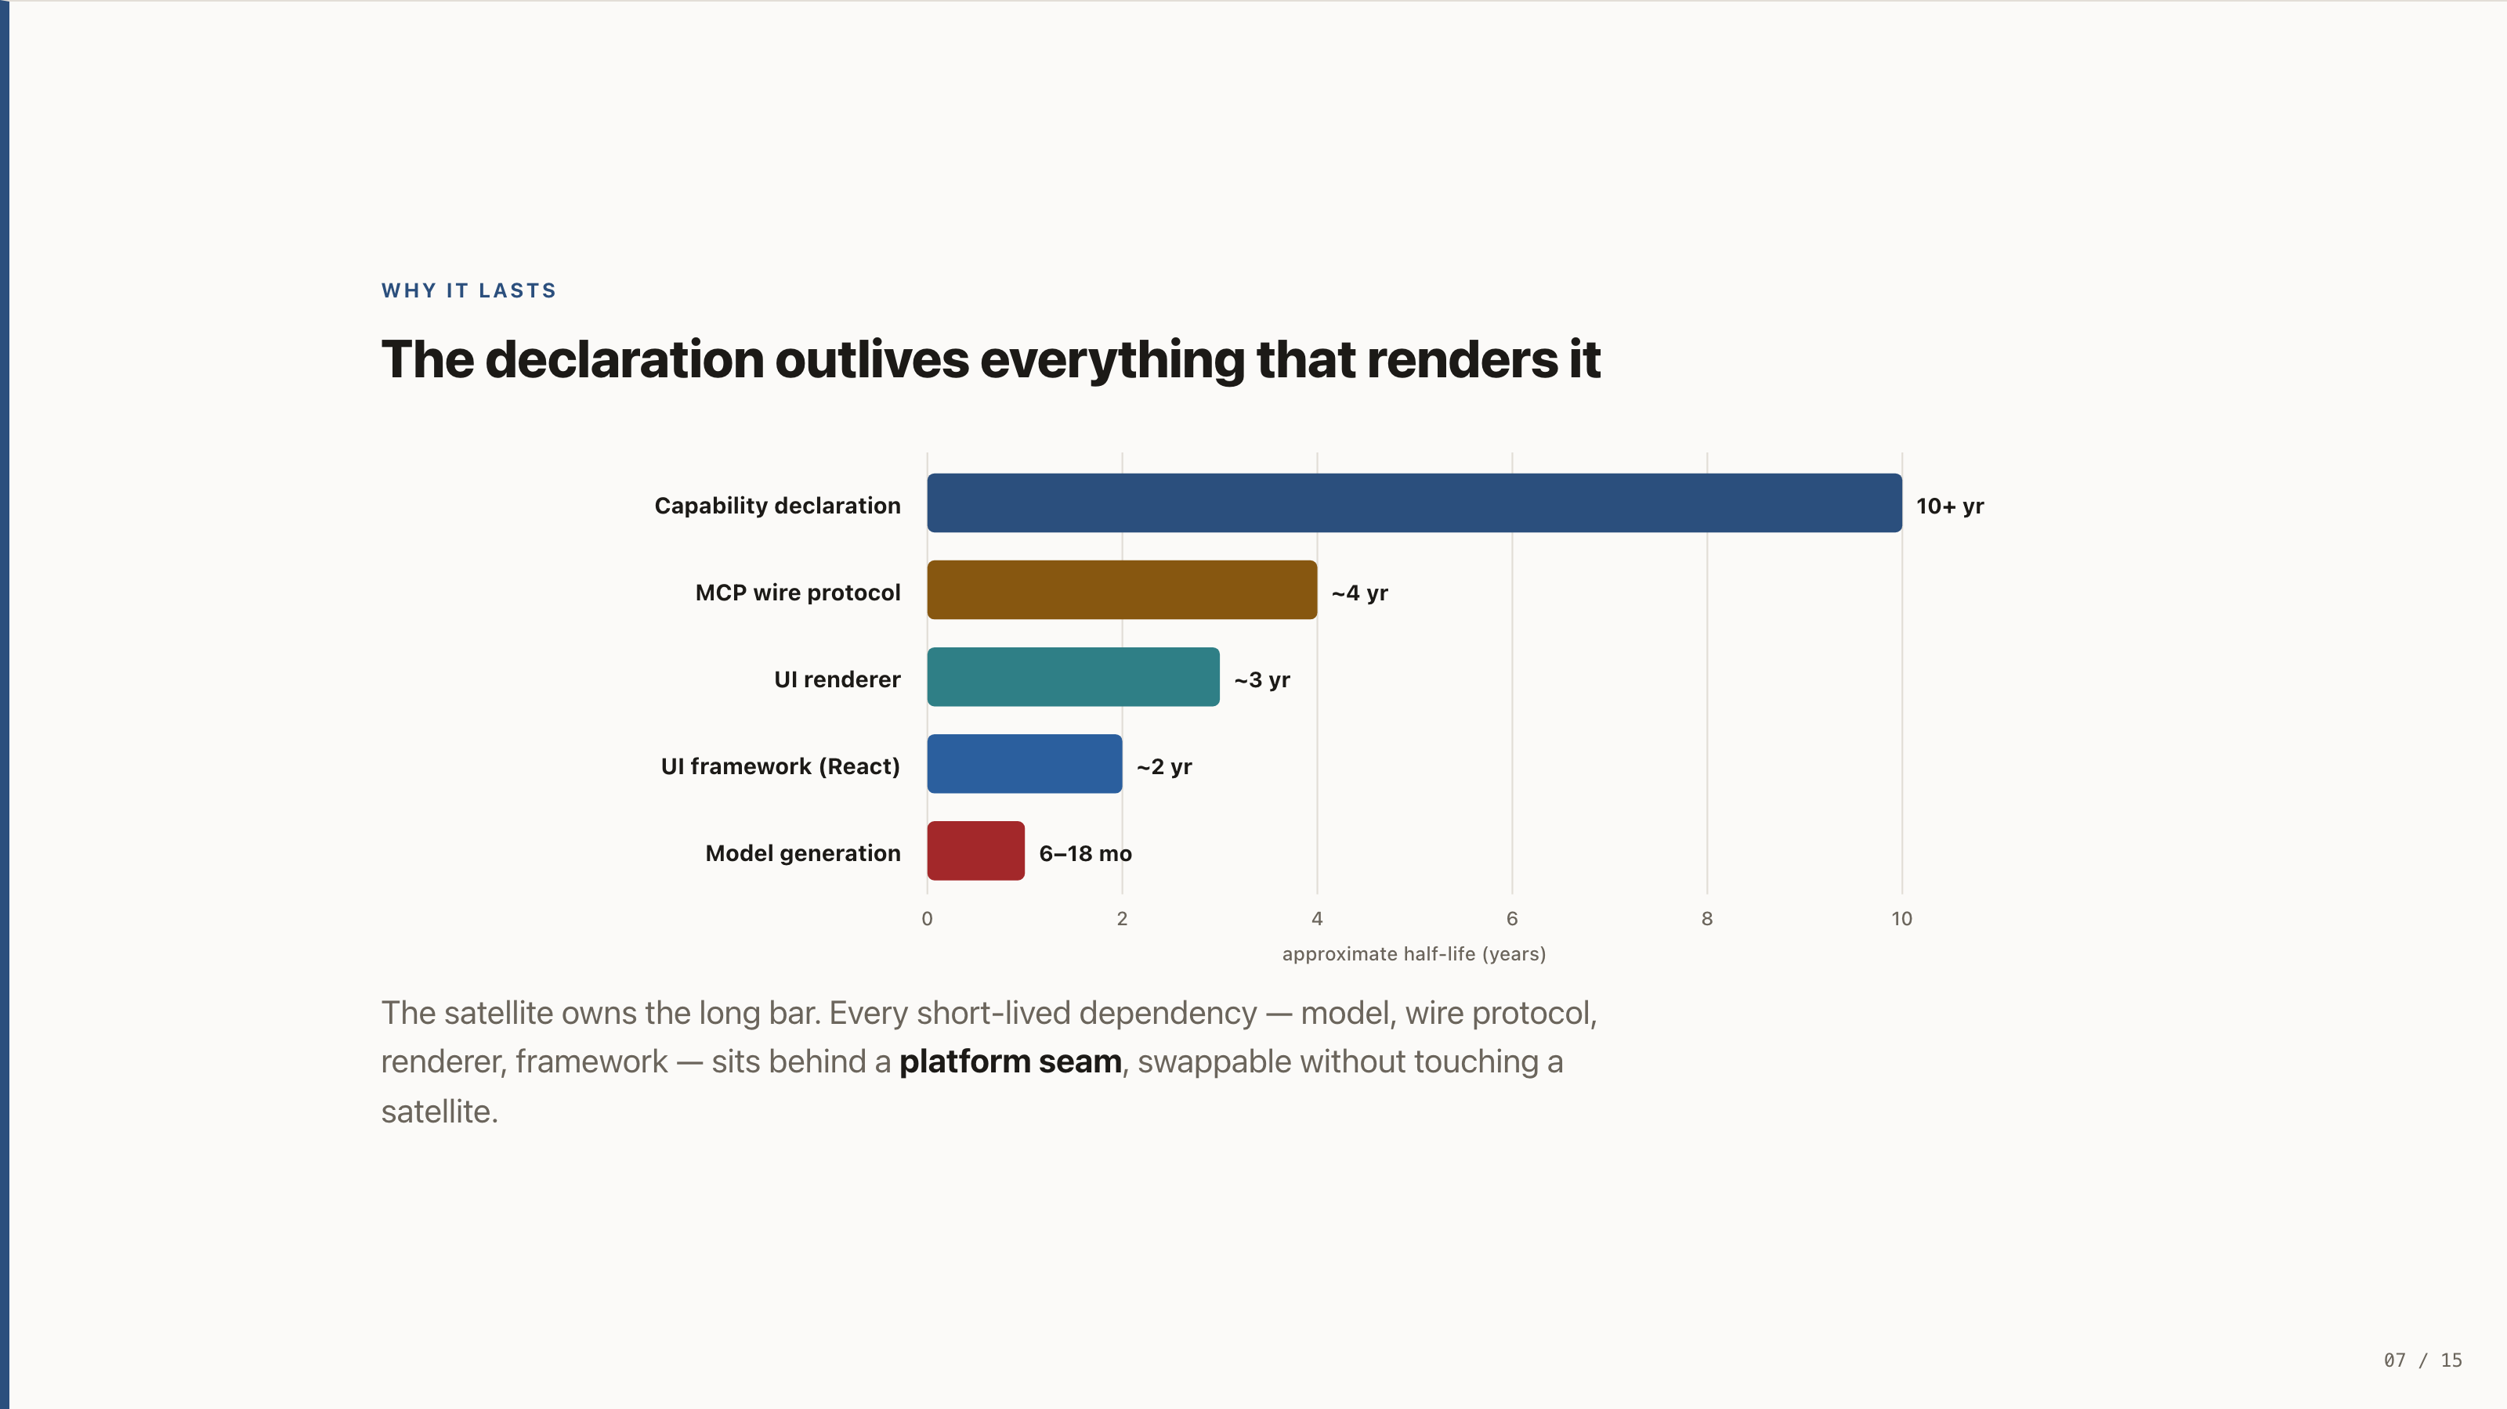
Notes:
WHY IT LASTS
The declaration outlives everything that renders it
The satellite owns the long bar. Every short-lived dependency — model, wire protocol, renderer, framework — sits behind a platform seam, swappable without touching a satellite.

Slide 8
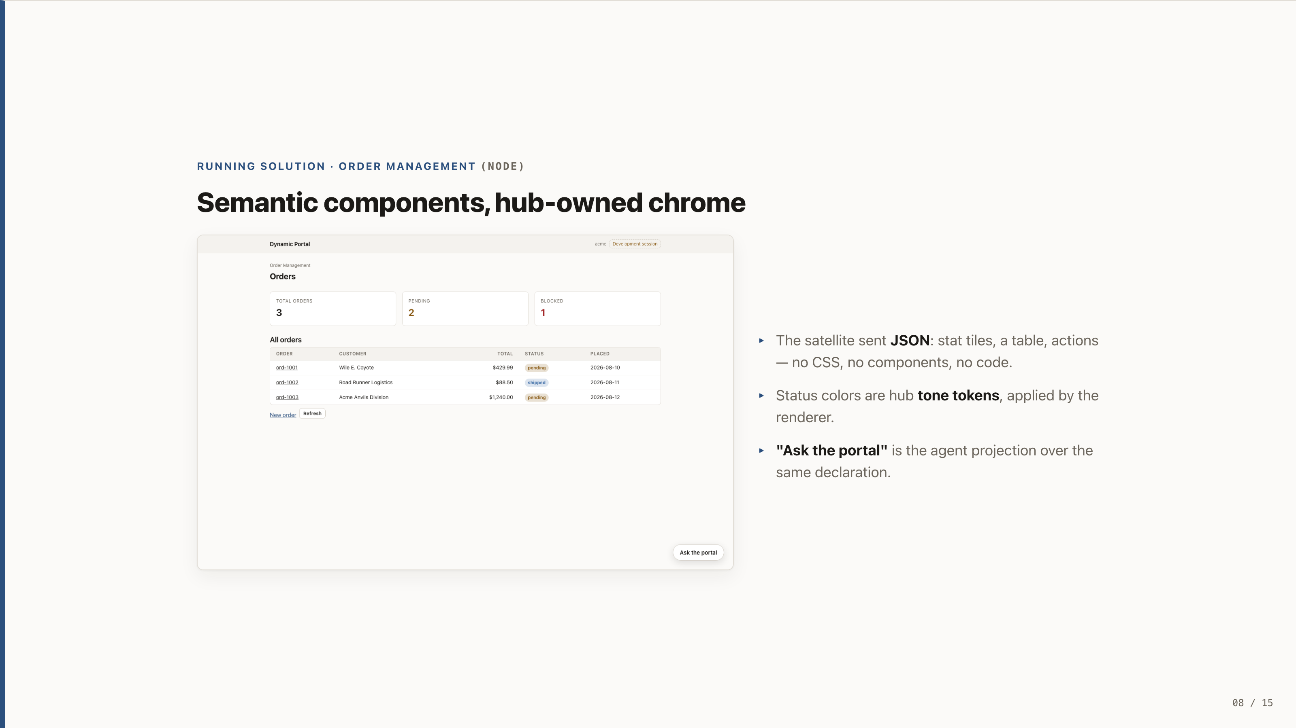
Notes:
RUNNING SOLUTION · ORDER MANAGEMENT (NODE)
Semantic components, hub-owned chrome
The satellite sent JSON: stat tiles, a table, actions — no CSS, no components, no code.
Status colors are hub tone tokens, applied by the renderer.
"Ask the portal" is the agent projection over the same declaration.

Slide 9
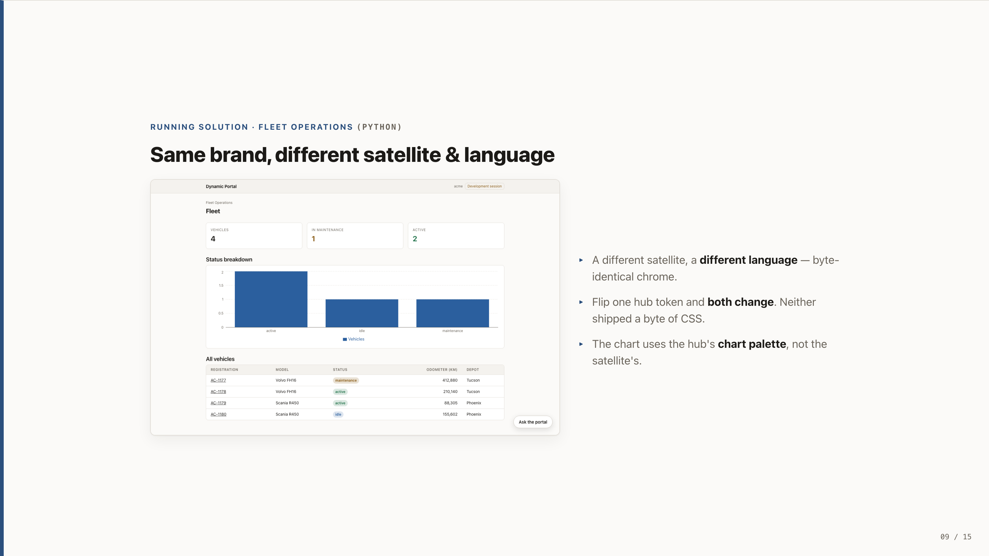
Notes:
RUNNING SOLUTION · FLEET OPERATIONS (PYTHON)
Same brand, different satellite & language
A different satellite, a different language — byte-identical chrome.
Flip one hub token and both change. Neither shipped a byte of CSS.
The chart uses the hub's chart palette, not the satellite's.

Slide 10
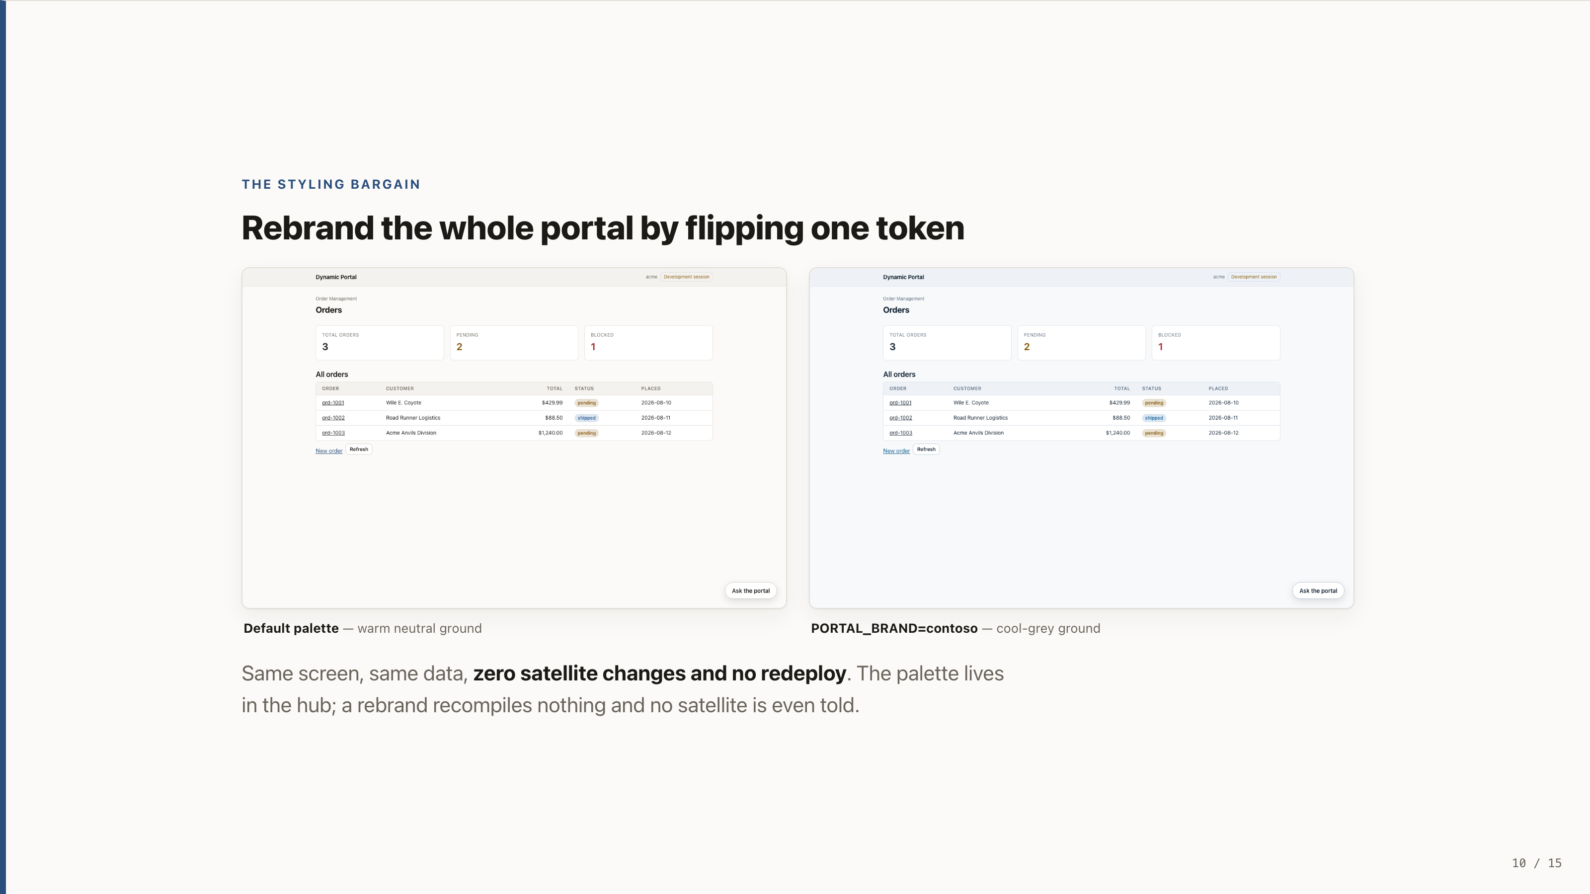
Notes:
THE STYLING BARGAIN
Rebrand the whole portal by flipping one token
Default palette — warm neutral ground
PORTAL_BRAND=contoso — cool-grey ground
Same screen, same data, zero satellite changes and no redeploy. The palette lives in the hub; a rebrand recompiles nothing and no satellite is even told.

Slide 11
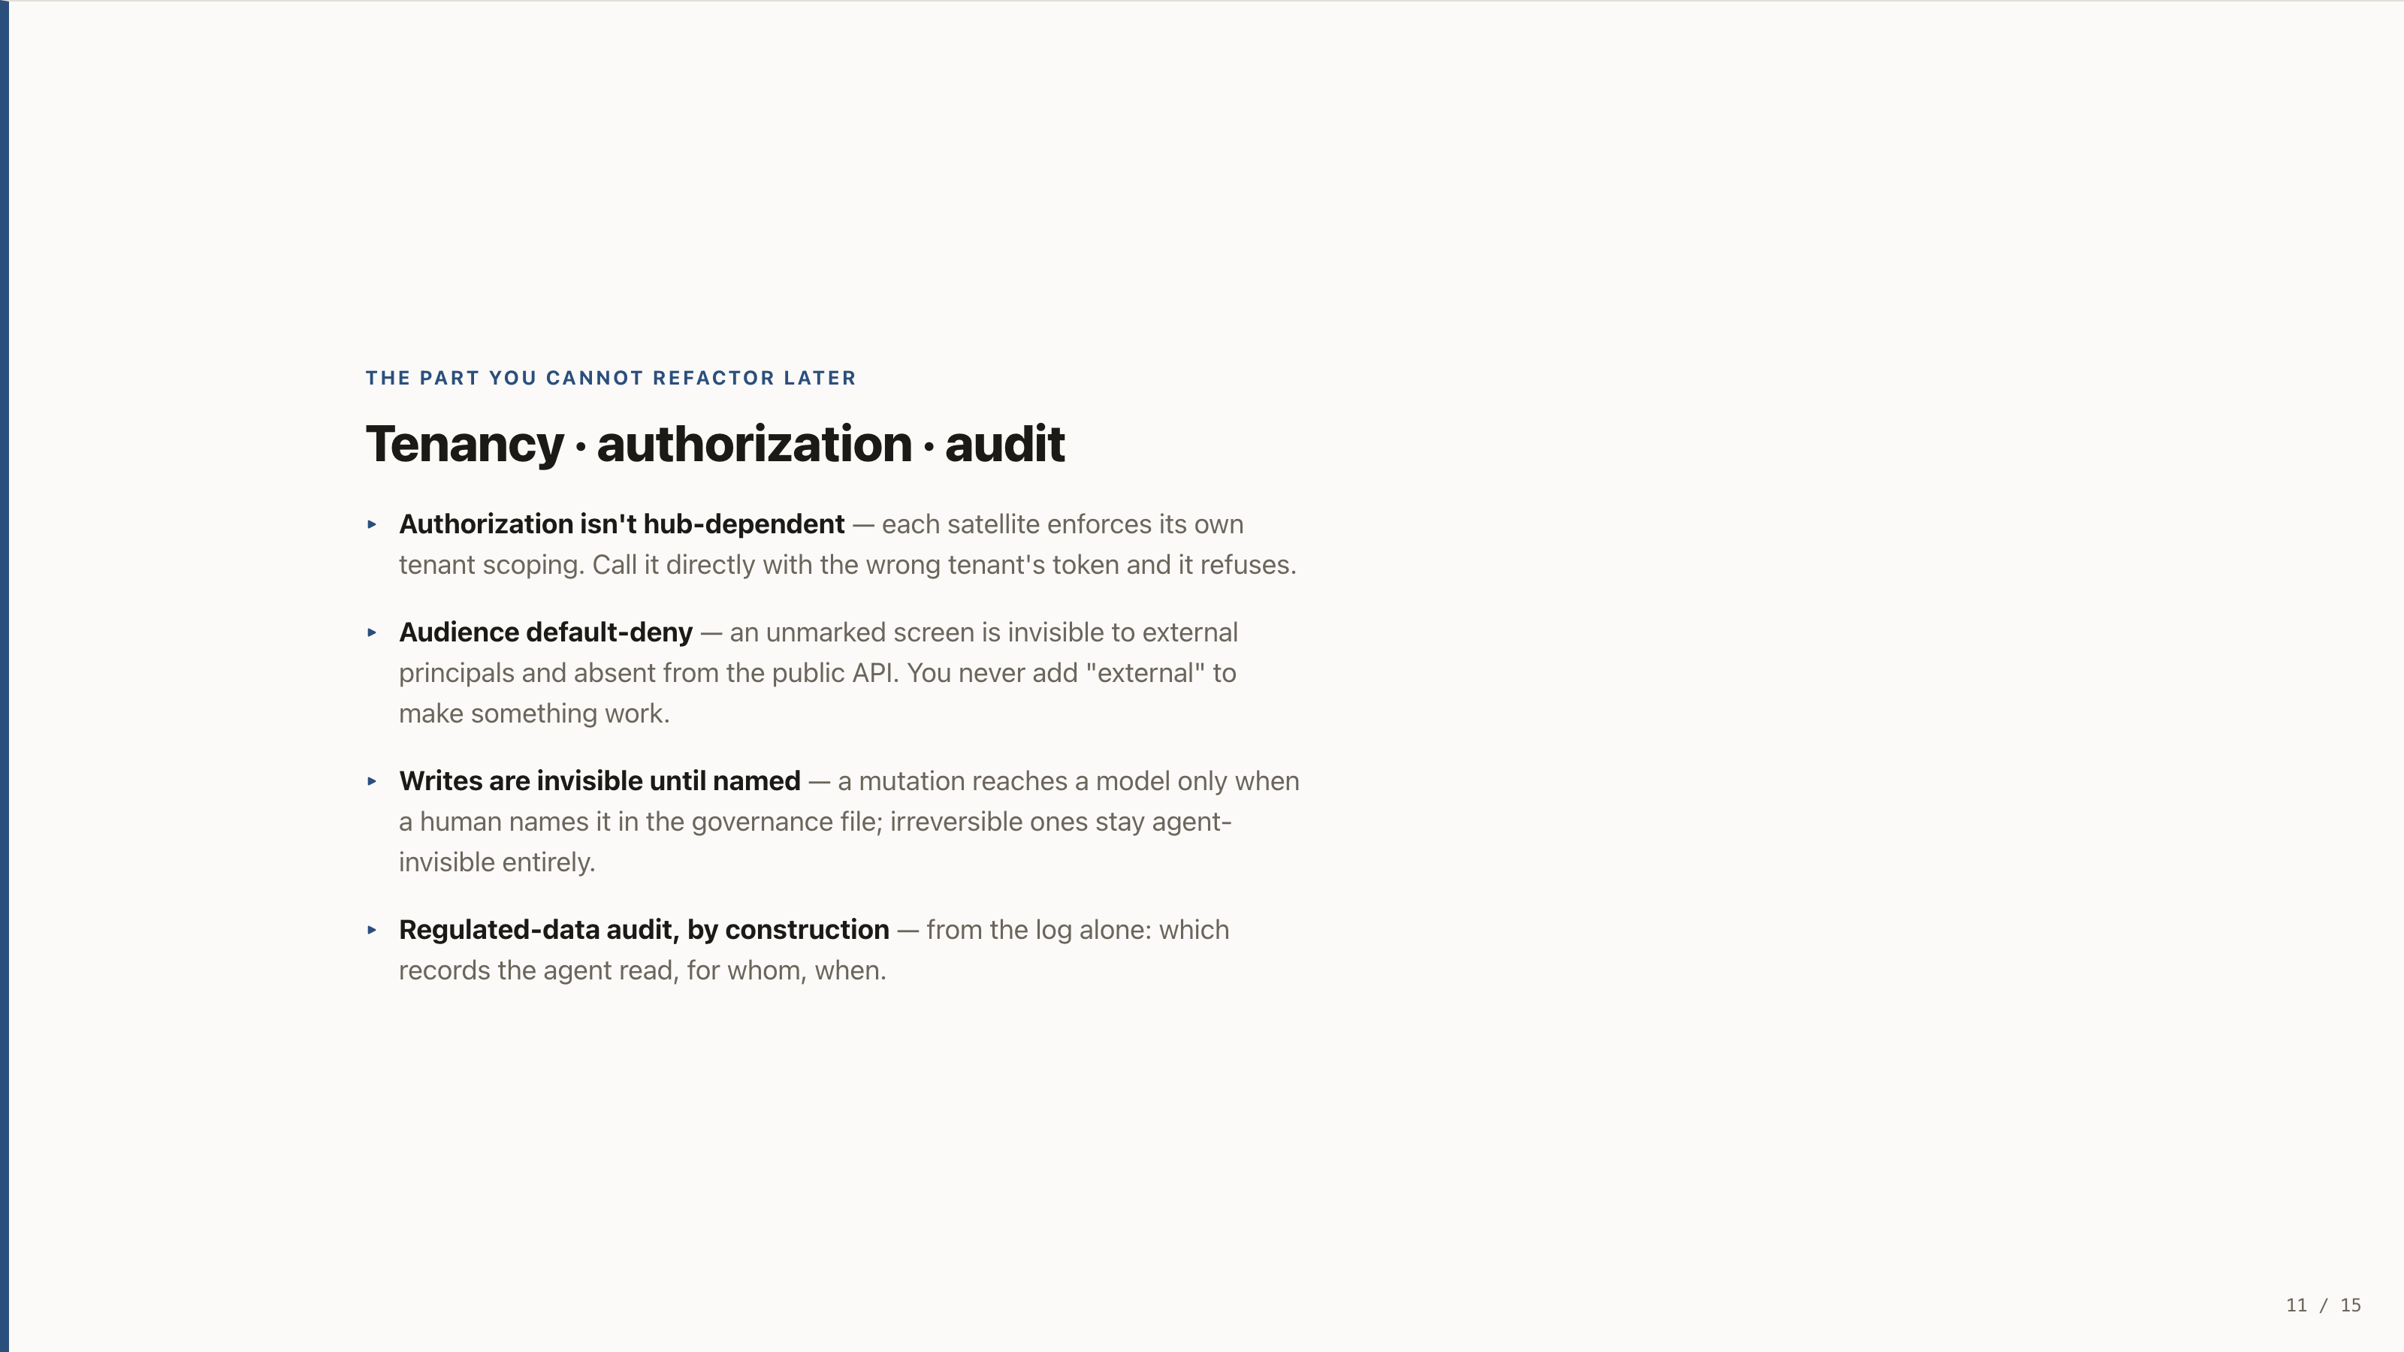
Notes:
THE PART YOU CANNOT REFACTOR LATER
Tenancy · authorization · audit
Authorization isn't hub-dependent — each satellite enforces its own tenant scoping. Call it directly with the wrong tenant's token and it refuses.
Audience default-deny — an unmarked screen is invisible to external principals and absent from the public API. You never add "external" to make something work.
Writes are invisible until named — a mutation reaches a model only when a human names it in the governance file; irreversible ones stay agent-invisible entirely.
Regulated-data audit, by construction — from the log alone: which records the agent read, for whom, when.

Slide 12
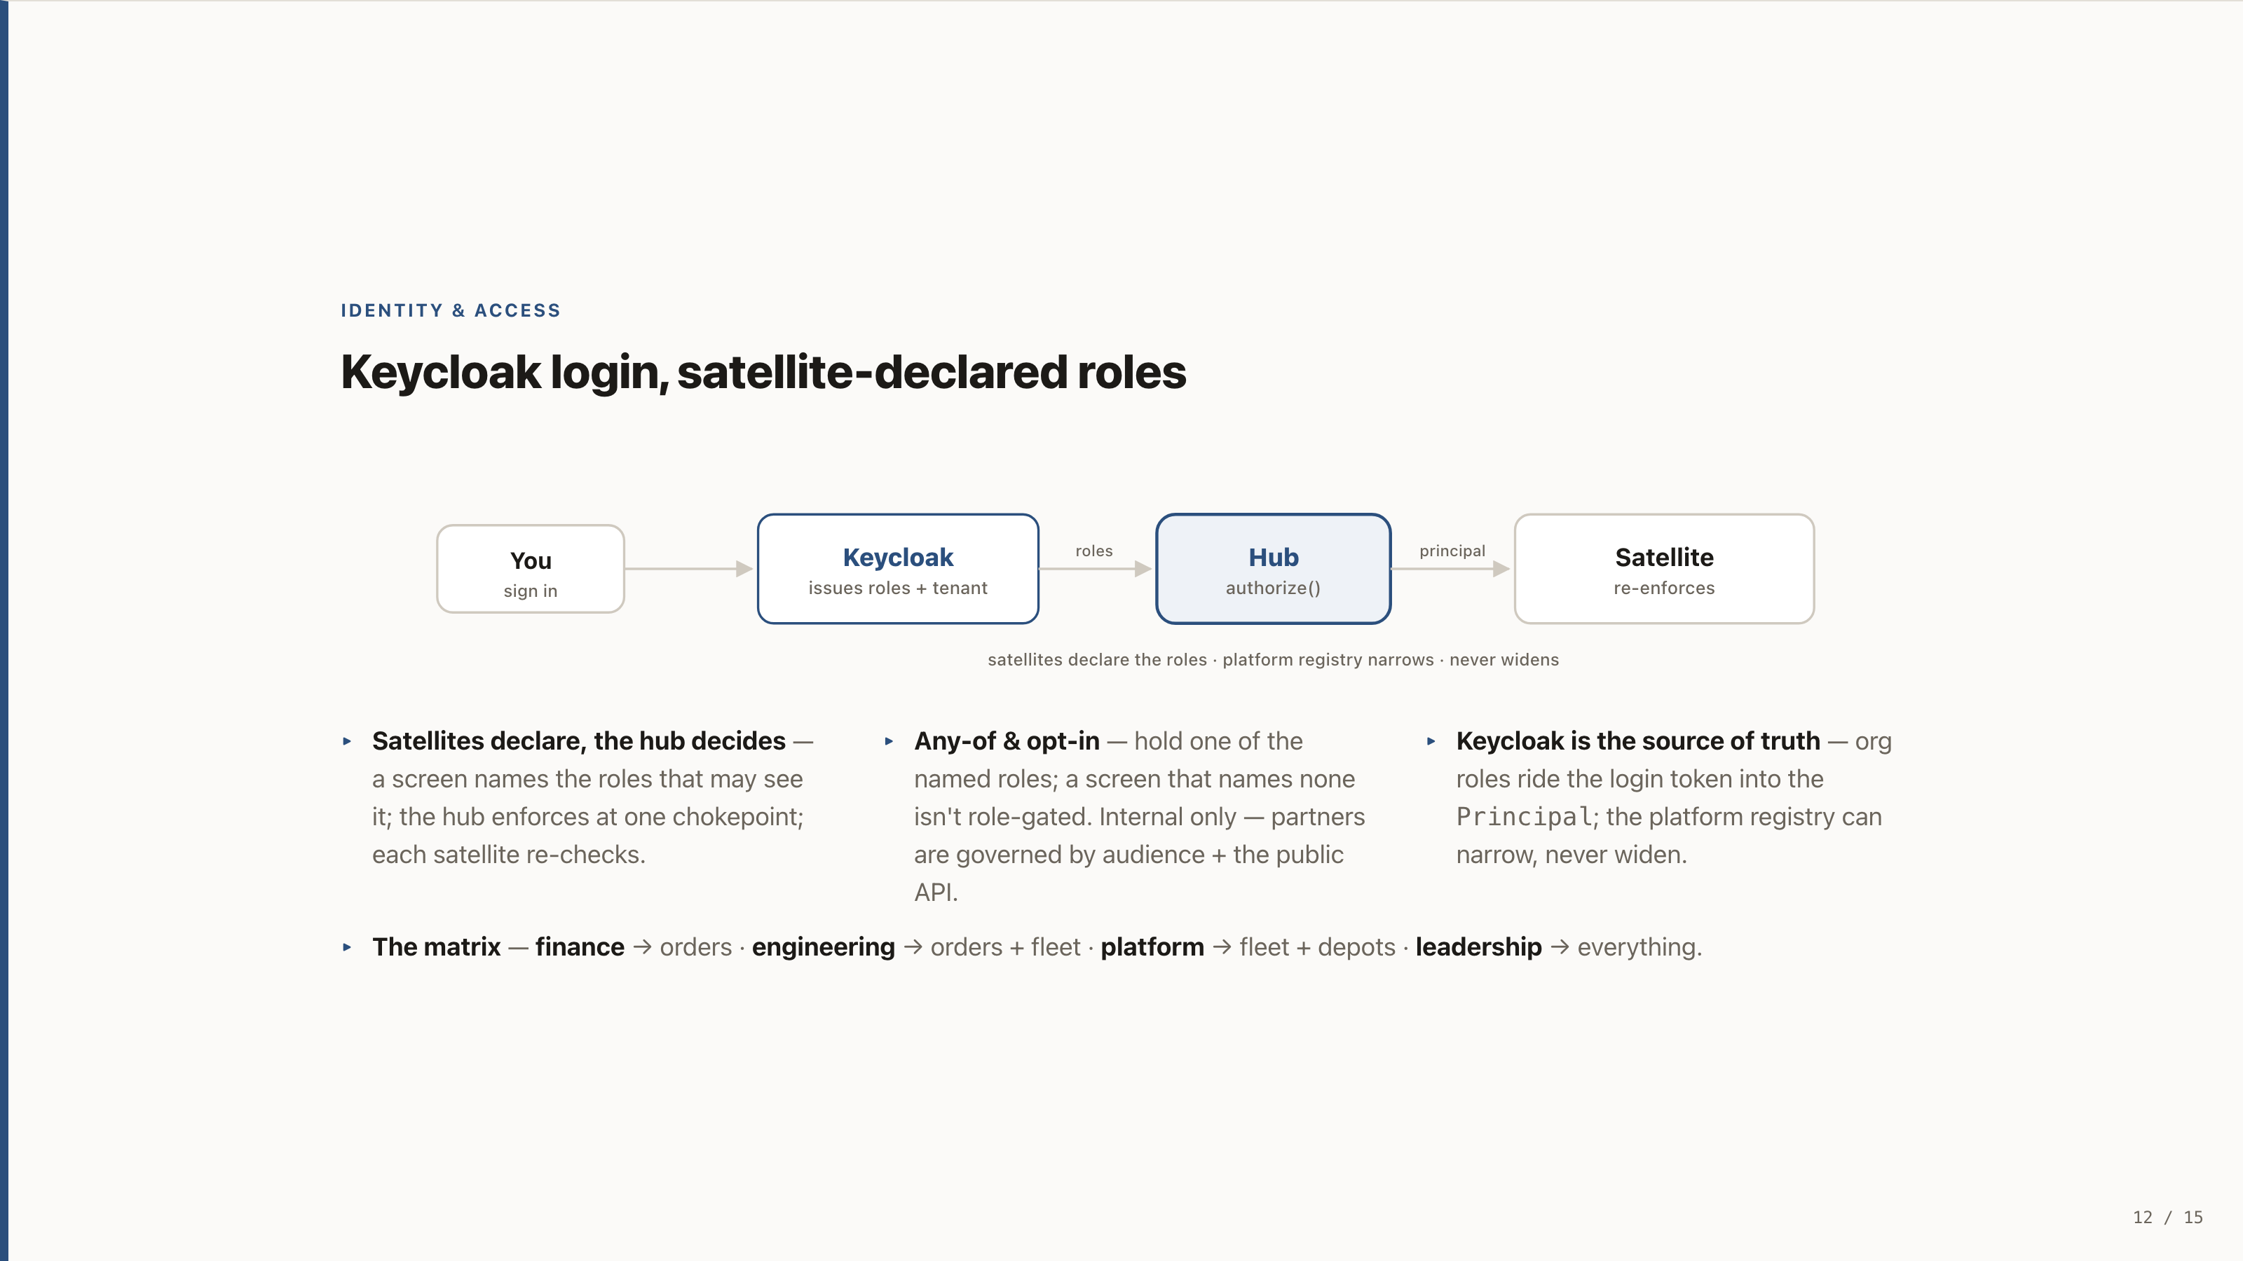
Notes:
IDENTITY & ACCESS
Keycloak login, satellite-declared roles
Satellites declare, the hub decides — a screen names the roles that may see it; the hub enforces at one chokepoint; each satellite re-checks.
Any-of & opt-in — hold one of the named roles; a screen that names none isn't role-gated. Internal only — partners are governed by audience + the public API.
Keycloak is the source of truth — org roles ride the login token into the Principal; the platform registry can narrow, never widen.
The matrix — finance → orders · engineering → orders + fleet · platform → fleet + depots · leadership → everything.

Slide 13
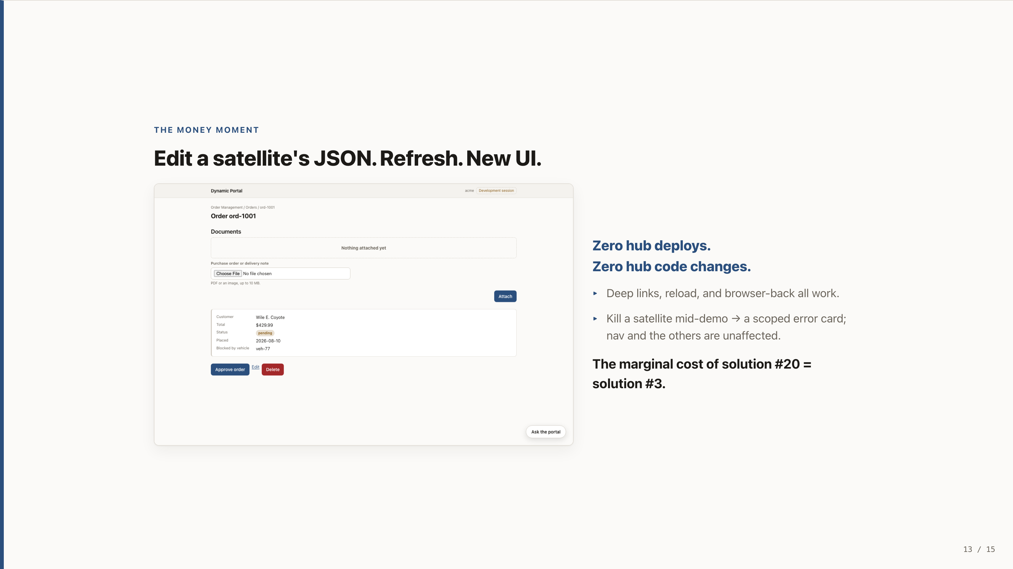
Notes:
THE MONEY MOMENT
Edit a satellite's JSON. Refresh. New UI.
Zero hub deploys. Zero hub code changes.
Deep links, reload, and browser-back all work.
Kill a satellite mid-demo → a scoped error card; nav and the others are unaffected.
The marginal cost of solution #20 = solution #3.

Slide 14
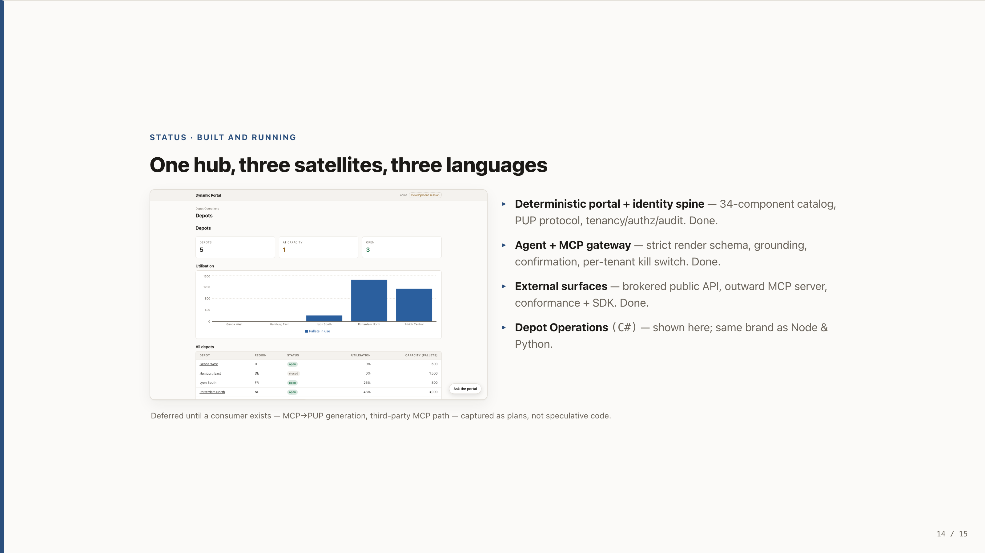
Notes:
STATUS · BUILT AND RUNNING
One hub, three satellites, three languages
Deterministic portal + identity spine — 34-component catalog, PUP protocol, tenancy/authz/audit. Done.
Agent + MCP gateway — strict render schema, grounding, confirmation, per-tenant kill switch. Done.
External surfaces — brokered public API, outward MCP server, conformance + SDK. Done.
Depot Operations (C#) — shown here; same brand as Node & Python.
Deferred until a consumer exists — MCP→PUP generation, third-party MCP path — captured as plans, not speculative code.

Slide 15
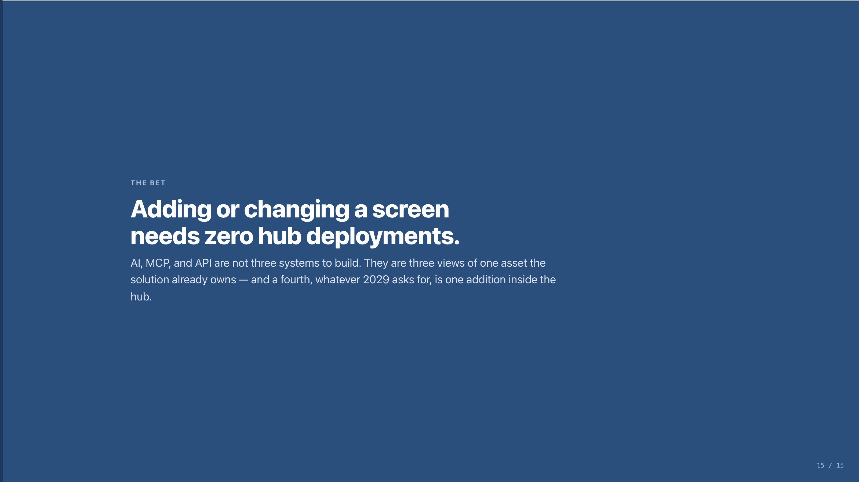
Notes:
THE BET
Adding or changing a screen needs zero hub deployments.
AI, MCP, and API are not three systems to build. They are three views of one asset the solution already owns — and a fourth, whatever 2029 asks for, is one addition inside the hub.

