Slide 1

Investigation of opening new restaurant in Manhattan and Berczy Park by K-means clustering
9 Nov 2020

Slide 2
Manhattan or Berczy Park?

Slide 3
Background
Capture opportunities in two of my favourite neighbourhoods
Open the restaurants in both places?
Keeping a simple menu and selling food to specify targeted customers are the key to success

Slide 4
Business Problem
People living in the similar Neighbourhood would share similar interest and taste on food due to cultural and background similarities. Open the restaurants in both places?
Determine whether neighborhoods near my two opinions are highly concentrated in one segment

Slide 5
Data source and cleaning
Foursquare API
Scraping data from various website
Data cleaning by python libraries
Pandas
Numpy
Json

Slide 6
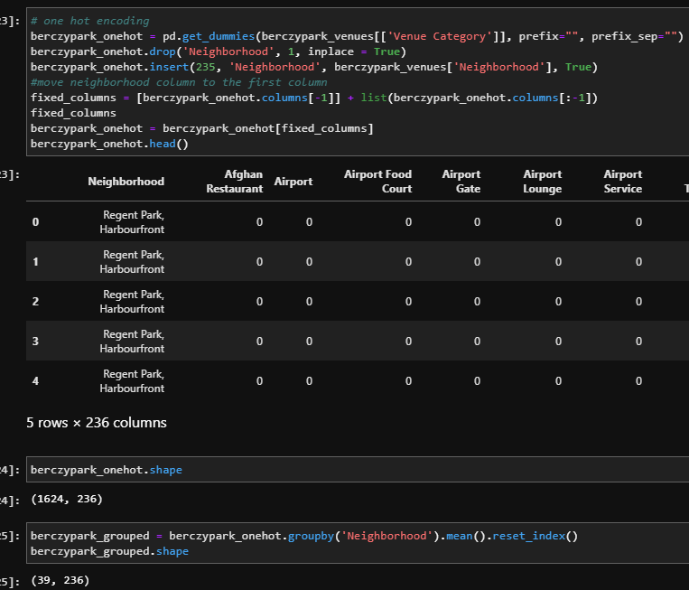
Methodology
K-mean model
Transform data shape by Pandas

Slide 7
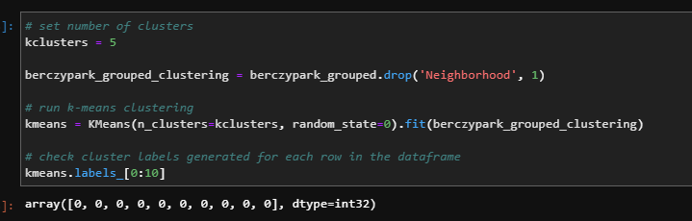
Methodology
Input the data frame to K-mean

Slide 8
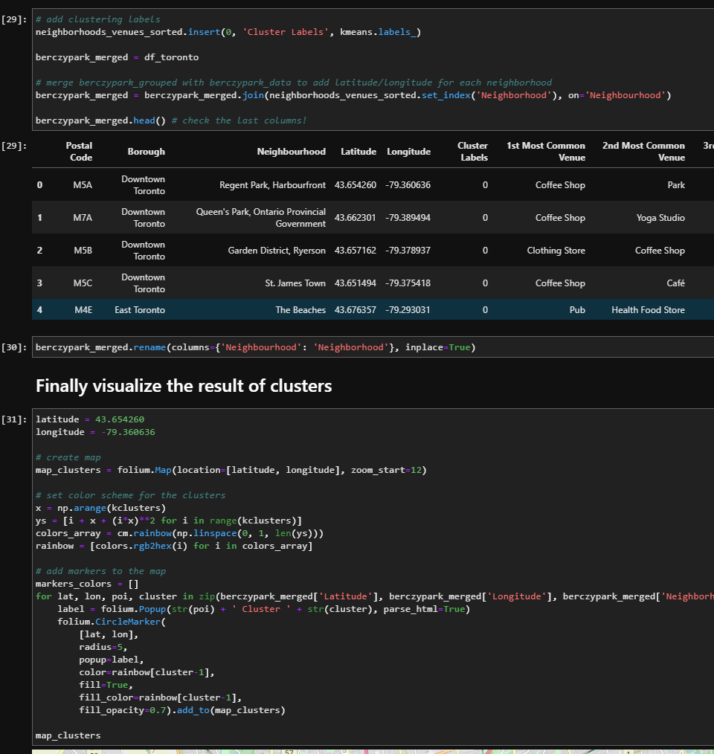
Methodology
Combine clustering result

Slide 9
Methodology
Combine clustering result

Slide 10
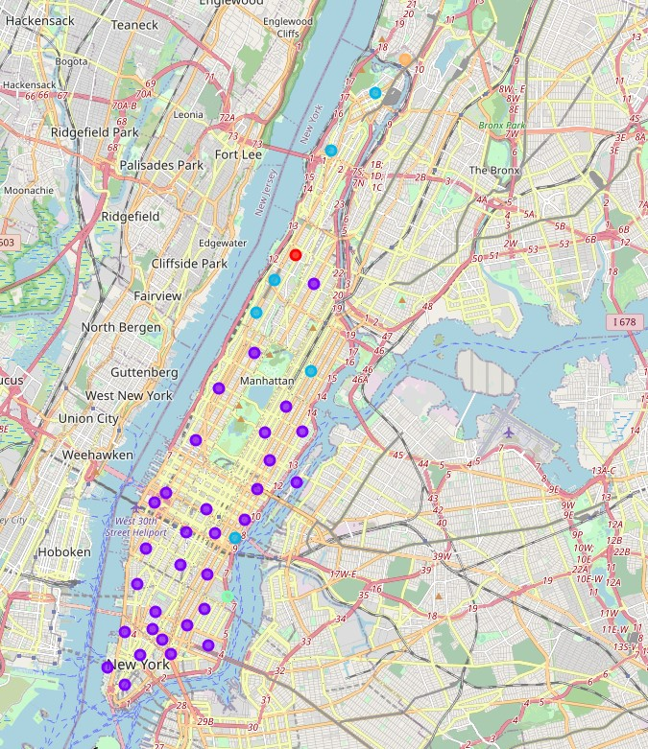
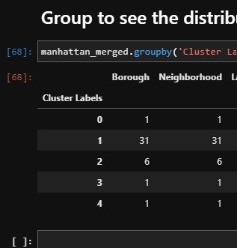
Result
Manhattan

Slide 11
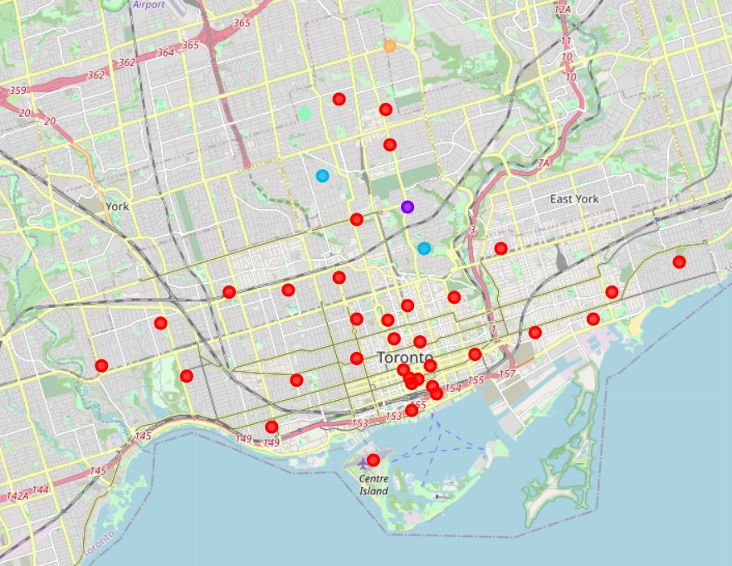
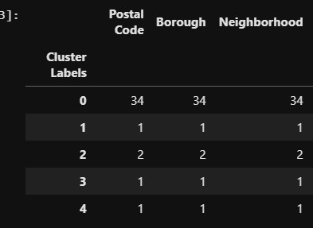
Result
Berczy Park

Slide 12
Discussion
Manhattan, 31 out of 40 (77.5%) neighborhoods are classified as cluster 1
Berczy Park, 34 out of 39 (87.18%) neighborhoods are classified as cluster
Only these two indicators is not good enough to conclude our decision
The location of each neighbourhoods have to be highly concentrated with each other

Slide 13
Conclusion
Opening the restaurant in Manhattan first
As our restaurant in Manhattan become famous
One more restaurant can be opened in Berczy Park

