Slide 1
Armstrong Boot Sequence
2015. 7. 24
Minyoung Eom

Slide 2
CONTENTS
Initialization
SWA
SIC
Event Handle
SWA
SIC
SvcPlatform
Armstrong Boot Sequence

Slide 3
1 Project Based boot Sequence
Project Flow in Boot Time
( Initialization )
Armstrong.exe
SWA
Armstrong
ComponentManager2
SCI
ComponentManager
ES2D
ScanView
ImageController
DSPController
PPC
AlgorithmHandller
HardwareController

Slide 4
1 Project Based boot Sequence
Project Flow in Boot Time
( Event )
SWA
SCI
ComponentManager
ES2D
ScanView
ImageController
AlgorithmHandller
onOptionLicenseReadyEvent
SystemReadyEvent
HardwareController
SvcPlatform
SvcParasite

Slide 5
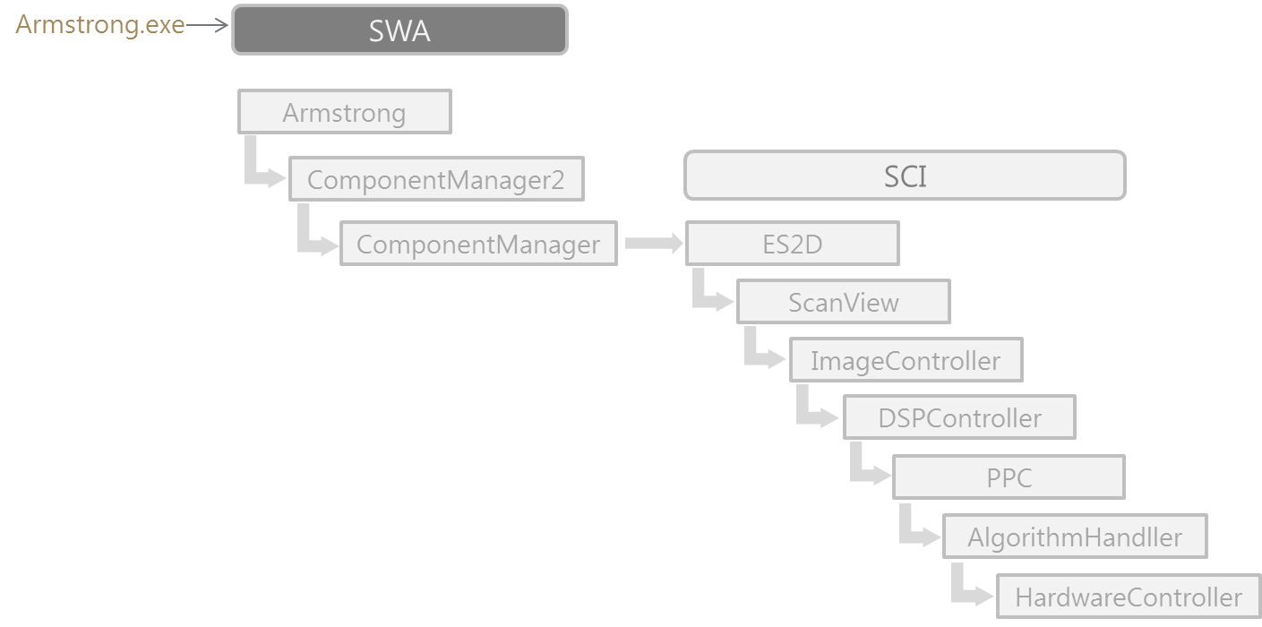
2 Initialization- SWA
Armstrong
ComponentManager2
ComponentManager
Armstrong.cpp
ICM2.cpp
ComponentManager.cpp
InitInstance( )
createComInterface_( )
myCM->create_Mgr( )
Vi1000GIComponent.xml
create_Mgr( )
myCM->initialize( )
initialize( )
myImpl->initialize( )
ComponentManagerImpl.cpp
Component List 저장
initialize( )
myCbc.createComponents( )
myCbc.initializeComponents( )
ComponentBusController.cpp
createComponents( )
initializeComponents( )

Slide 6
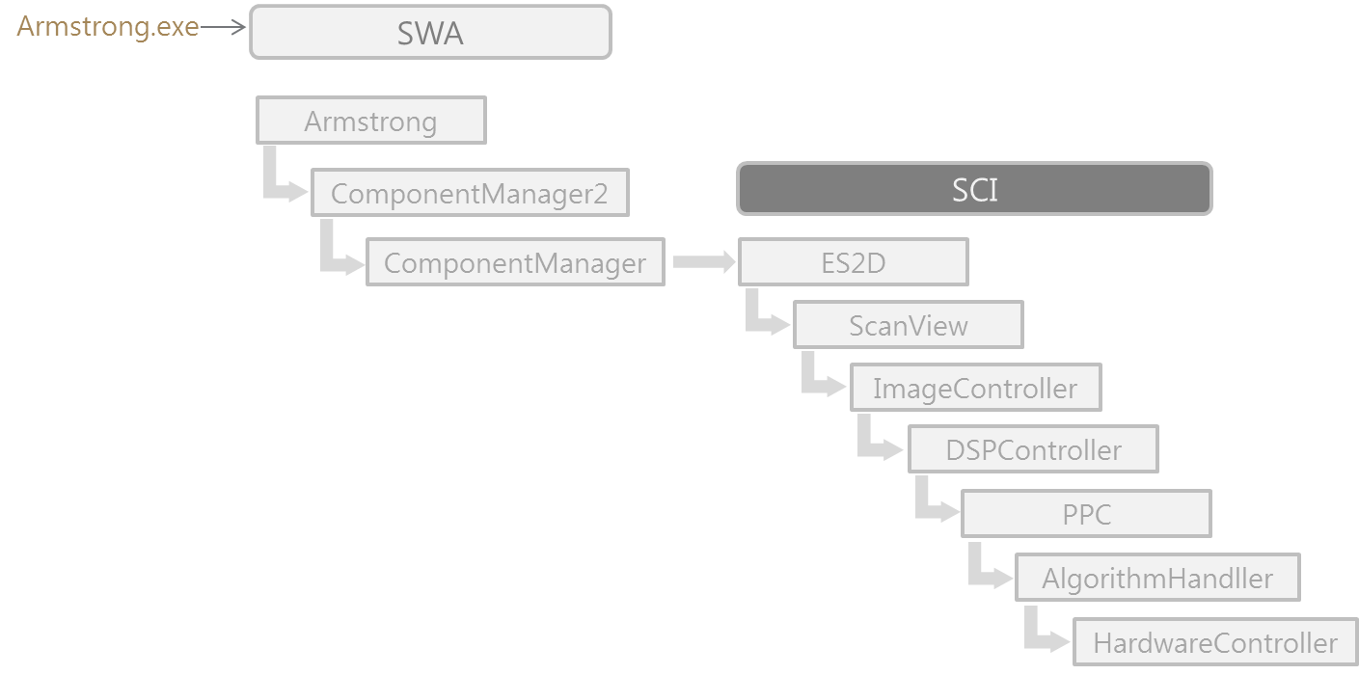
3 Initialization - SIC
ES2D
ScanView
ScanView
ES2D.cpp
ViewerManager.cpp
StudyLayer.cpp
create( )
initialize( )
myViewerManager->initialize( )
initializse( )
initializeUSImageModel_( )
layloutViews( )
RTC.xml
LayerInfo.xml
ScannerStatus.xml
VRModel.xml
prepareStudyLayers_( )
studyLayer->initialize( )
ImageController::initialize( )

Slide 7
3 Initialization - SIC
ImageController
DSPController
DSP
ImageController.cpp
HardwareInit.cpp
initialize( )
HWSetValue.xml
Vi1000GI_IP_Var.xml
Vi1000GI_FpgaAddr.xml
ImageControllerConfig.xml
dsp_Init( )
initHw_byStep( )
DSP RTC download
BF FPGA download
BE FPGA download
TI FPGA download
CW FPGA download
FE FPGA download
Run Start
initializeHwController_( )
Run Stop
myHwInit->dsp_Init( )
Probe->initProbeManager( )
initializeOpState( )
initializeAlgorithmHandler_( )
FPGAInitConfirm_( )
initializeHwHandler_( )
CMD_FREEZE (stop)

Slide 8
4 SystemReadyEvent
ComponentManager
ES2D
ScanView
ComponentManagerImpl.cpp
ES2D.cpp
ViewerManager.cpp
initialize( )
systemReady( )
myCbc.createComponents( )
myScanStudyLayers->
systemReady( )
myCbc.initializeComponents( )
myCbc.sendMessage( )
onSystemReadyEvent_( )
myViewerManager->
systemReady( )
StudyLayer.cpp
SystemReadyEvent
systemReady( )
ImageController->notifyinitialize( )
sendEvent(systemReady Event)
ImageController::run thread 생성
Event Queue 에 event 가 있을 시에 호출됨.
loadProbeExam_( )
sendEvent(ExamChangedEvent )
sendEvent(SVideoFormatEvent )
SendEvent() :
Event Queue 에 event name 저장

Slide 9
4 SystemReadyEvent
ImageController
AlgorithmHandler
HardwareController
ImageController.cpp
AlgorithmHandler.cpp
HardwareController.cpp
run_( )
execCmdSync( )
myAlgHandler->Execute( )
Execute( )
Sync Command write( ) 수행
변한 Parameter 있을 경우 무조건
seqStop_process( ) 호출됨.
List 에 있는 Algorithm 들의
Proc( ) 수행
myHwHandler->ExecCmdSync( )
execCmdASync( )
myHwHandler->ExecCmdSync( )
myHwHandler->ExecCmdASync( )

Slide 10
4 SystemReadyEvent
ComponentManager
SvcPlatform
ScanView
ComponentManagerImpl.cpp
SvcParasite.cpp
initialize( )
myCbc.createComponents( )
myCbc.initializeComponents( )
myCbc.sendMessage( )
handleMessage( )
onSystemReady_( )
StudyLayer.cpp
SystemReadyEvent
onLicenseReady_( )
onOptionLicenseReadyEvent_( )
ImageController->
sendEvent(LicenseEvent )
Board License Check !!

